Slide 1
Communications & Customer Service
COMMITTEE MEETING
April 16, 2024

Slide 2
Agenda
Approval of Minutes
General Manager Comments
Committee Member Comments

Slide 3
Strategic
Communications Plan

Slide 4
Strategic Communications Plan Development Steps
Discovery
Completed
Stakeholder feedback
(survey, committee, workshops)
Content review
SWOT Analysis
Demographic research
Channel assessment
Development
Current Stage
Where do we want to be, and how will we get there
SMART Goal setting
Tactical planning
Resource allocation
(staff, budget)
Documentation
Formalize plan details and commitment to success
Draft plan document
Review, get feedback, edit
Approve plan

Slide 5
Discovery Recap: SWOT Analysis STRENGTHS
Communication Strengths
Customer Service Strengths
Newsletter
Education campaigns
Grant for field trips
Outreach events
In-house graphic designer
Positive response to detachment
Auto-dialer for emergency shutdown notices
Village news earned media
Frequent project updates
Phone service: We take time to explain programs and rates and answer questions
Low average hold times and max hold times
Friendliness of CSR team
Strong conflict de-escalation skills
Field staff is great with customers
Diversified communication channels (digital & paper)
FAST response to service requests compared to other utilities
Flume program
Call metrics are reported to committee
Customer service survey in place
Reverse 911 system in place
Notes:
– FAQ one pager for detachment distributed

Slide 6
Discovery Recap: SWOT Analysis WEAKNESSES
Communications Weaknesses
Customer Service Weaknesses
Slowly shifting to new branding
Inconsistent tone and voice
Website hard to navigate, and updates are slow
Social media is dormant
Limited resources (staff & budget)
Competing priorities
Limited crisis communications preparation
Consistency. Ensuring ALL staff understand messages
Translation resources - website
Real-time updates on social media
Flume utilization is low – program in progress, registration increased by 50%
Employees feel ill-equipped to answer some questions
Notes:
– FAQ one pager for detachment distributed

Slide 7
Discovery Recap: SWOT Analysis OPPORTUNITIES
Communications Opportunities
Customer Service Opportunities
Consistent brand guidelines
Online photo catalogue, train staff on photography
Internal campaign to highlight components of agency
Become a trusted resource on social media with positive stories
Photo contest with middle/high school students for stock images
Reduce frequency of newsletter
More sign boards
Leverage personal connections in community
Build relationships with students
Crisis communications training
More data analysis tools
Update website regularly
Have FAQ page on website that is easy to find
Add how-to videos to website
Using multi-channel tools (web, newsletter, media, invoice messages, text, auto-dialer)
Community surveys
Standardize outreach with a checklist

Slide 8
Discovery Recap: SWOT Analysis THREATS
Communications Threats
Customer Service Threats
Social media in election year – competition for attention
Public outbursts at meetings and community
Online trolls
Wholesale rate increases
Online chatter/misinformation
Small community: word spreads fast
Unplanned shutdowns/reputation
Extreme weather events
Resources to stay engaged
Competing news sources and channels
Unrealistic expectations for lower bills
Comparing us to larger agencies
Wholesale rate increases
Detachment expectations vs. reality
Legacy community perception isn’t positive
Complex regulations that are changing frequently

Slide 9
Target Audiences
Primary
Secondary
Tertiary
Residents
Agricultural ratepayers
Board
Staff
Media
Neighboring agencies
HOAs
Community groups
Elected officials
Schools
Job applicants
Industry groups
Contractors
Developers
Sub metered residents
Real estate agents

Slide 10
Audience Concerns and Key Messages
Key messages:
Rainbow Water provides a good value for the price. We do this by:
  Delivering water to your door from hundreds of miles away
  Ensuring water meets or exceeds all water quality regulations
  Investing in infrastructure improvements to ensure reliability
Rainbow Water cares about its customers. We show this by:
  Being transparent about our budget and operations
  Helping customers save money through programs like Flume and CropSWAP
  Providing bill payment plans
  Responding promptly to calls, service requests, and emergency shutdowns
  Offering helpful information about their service
Primary audience: Residents
Interests:
Rates: why they are what they are
Water quality & safety
Water efficiency/saving money
System reliability/leak prevention
Transparency and trustworthiness
How we get water to their house
Needs:
How-to information (pay bills, find meter, shut off water, save money, repair backflow, contact us)
Emergency alerts

Slide 11
Audience Concerns and Key Messages
Key messages:
Rainbow Water supports agriculture. We do this by:
  Seeking innovative ways to keep rates sustainable, like detachment
  Advocating for agriculture regionally
  Offering efficiency programs like CropSWAP and Flume
  Investing in distribution system improvements to ensure reliability
  Encouraging agricultural ratepayers to participate on advisory committees
  Researching alternative water resource options
  Sharing helpful and timely information about planned shutdowns, water quality, and pressure
  We have the infrastructure to support agriculture – our system was designed for it
Primary audience: Agricultural ratepayers
Interests:
Fixed/variable rate structure
Efficiency programs/CropSWAP
Reliability
Being represented
Water resources
Needs:
Sustainable rates to stay in business
Location of meters
Information about water quality & impact on trees
Information about water pressure

Slide 12
Audience Concerns and Key Messages
Key messages:
Rainbow Water makes responsible decisions. We do this by:
  Providing timely and transparent updates to the Board on operations
  Providing the Board with reliable and accurate data
  Offering multiple options and the impacts of each option for the Board’s consideration
Primary audience: Board of Directors
Interests:
How their decisions affect ratepayers
How staff is executing the mission, strategic plan, goals and objectives
Needs:
Accurate and timely information to make informed decisions
Alternative options and impacts of each option
Understanding of legal obligations

Slide 13
Audience Concerns and Key Messages
Key messages:
Rainbow Water values and supports its team members. We do this by:
  Offering training, education, and advancement opportunities
  Ensuring staff has tools and resources to do jobs effectively and safely
  Providing timely updates through multiple channels, including All-Hands, message boards, and 1:1s.
  Soliciting feedback at All-Hands, through surveys, stay interviews and 1:1s.
  Facilitating team connections through employee events and workshops
Primary audience: Staff
Interests:
Being informed of plans
Ways to provide feedback
Why changes are made
Team connections
Career growth opportunities
Needs:
Resources to do jobs effectively
Information to share with customers
Consistency with messages
Timely information & training

Slide 14
Audience Concerns and Key Messages
Key messages:
Rainbow Water is an important partner in the local community. We do this by:
  Collaborating with North County Fire on training, education, and fire suppression efforts (heli-hydrant)
  Supporting schools by educating students about water efficiency and STEM careers in the water industry
  Participating in civic groups like Rotary
Primary audience: Local media
Interests:
Breaking news
Emergency response
Low effort/done for them content
Feel good stories
Needs:
Newsworthy content
Timely information
Current & evergreen information

Slide 15
Customer
Service Survey
2024 Update

Slide 16



2024 Survey Update
New survey to launch at the Avocado Festival
  Customer Service Team researched questions best suited to measure performance
  Alternate survey with questions from previous meeting
Survey Goals
Review experience, explain info, & resolve issue.
Follow up email or phone to contact for further assistance.
Establish a consistent metric,
rate on a scale from 1 – 5.

Slide 17
2024 Survey Update
Option 1 Survey
Please rate the QUALITY of water (taste, color, smell) delivered by RMWD
scale of 1-5.
Please rate the courtesy/professionalism of RMWD employees (1-5)
How knowledgeable is the RMWD employee you spoke to? (1-5)
Do you feel like RMWD cares about your concerns? (Y/N)
Please rate the speed of service/ease of doing business at RMWD (1-5)
Please rate the speed of any maintenance/repair work done by RMWD (1-5)
Notes:
Survey questions aimed at overall experience with Rainbow Water Team.
Committee recommends the survey to select for the festival.
We highly recommend the CS survey as it will address concerns highlighted from the past year and reviews the most common questions from neighboring water agencies.

Slide 18
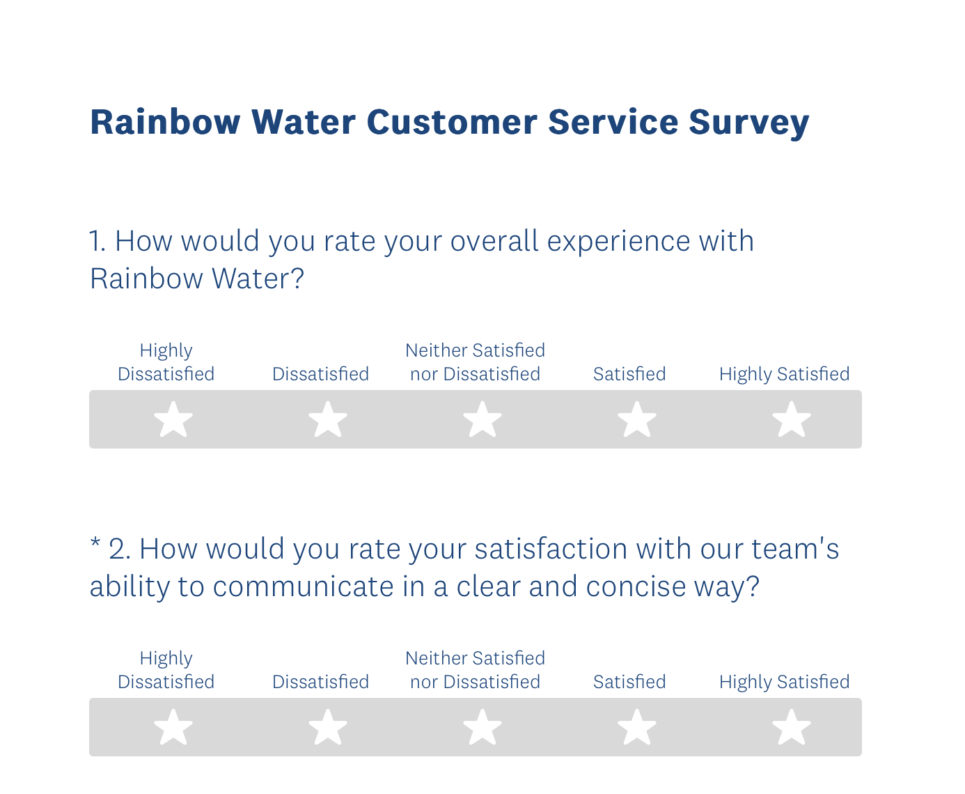
2024 Survey Update
Option 2 Survey
    How would you rate your overall experience with Rainbow Water? (scale 1-5)
    Did our team explain information clearly and concisely? (scale 1-5)
    Was your issue resolved? Yes or No
    Would you like to be contacted for further assistance? Yes or No, enter name, phone or email
    Do you feel the District cares about your concerns? (scale 1-5)
    As a customer, what Rainbow Water topics are you most concerned about? (list of 20 topics, select up to 6 topics)
    How do you prefer to receive information?
      Billing message, newsletter, newspaper,
      social media, website
Notes:
Survey questions aimed at overall experience with Rainbow Water Team.
Committee recommends the survey to select for the festival.
We highly recommend the CS survey as it will address concerns highlighted from the past year and reviews the most common questions from neighboring water agencies.

Slide 19
Community
Events Update
Outreach Planning

Slide 20
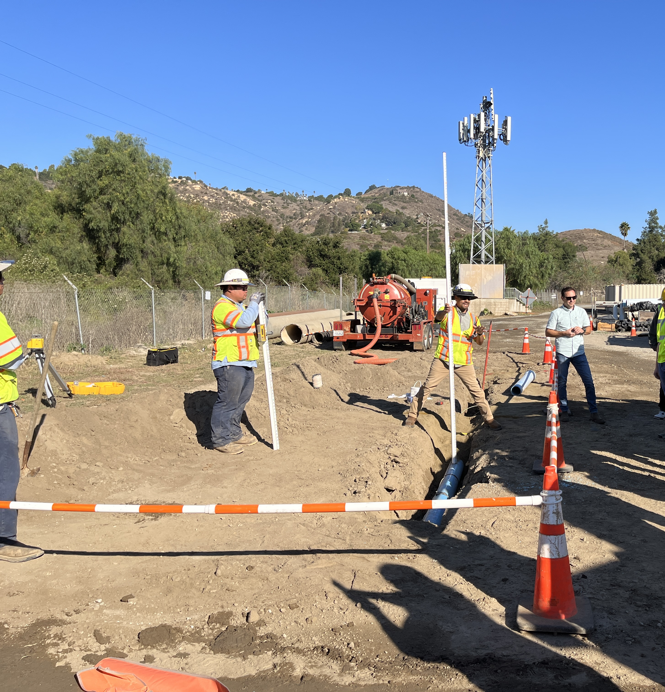
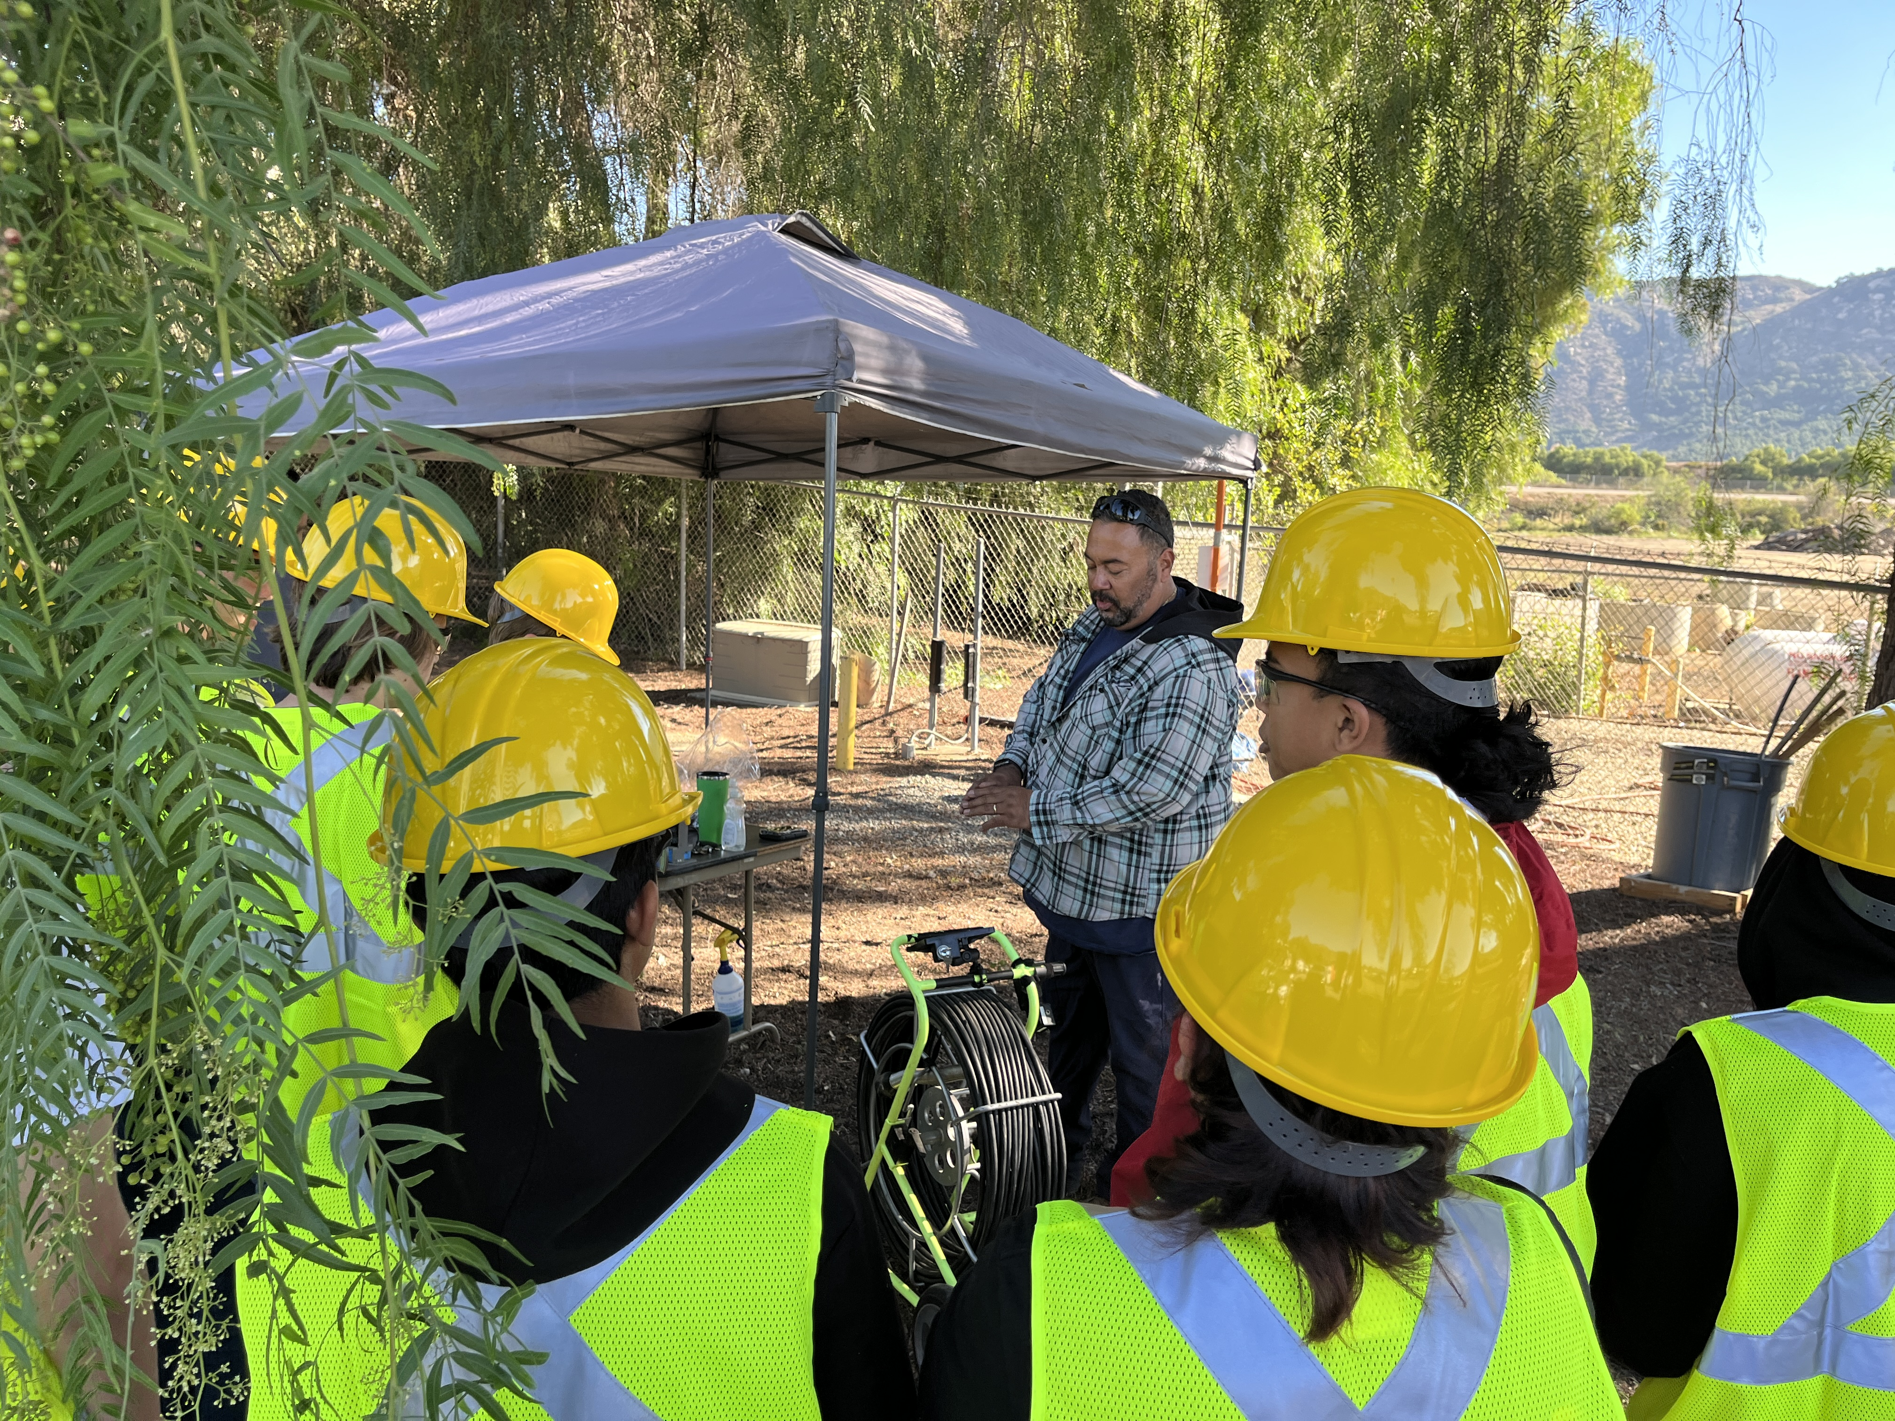
School Outreach
Bonsall High School Field Trip
Thursday, April 25
    Volunteers in place
    to lead 30 students
    through headquarters
    Community Partner
    Grant to fund field
    trip expenses for
    STEM Kit, engineering
    plans, and PPE
    supplies
Notes:
Field trip scheduled for next week with expected attendance of 30 students.
Will be handing out swag from the Avocado Festival

Slide 21

School Outreach
Inaugural Rainbow Run
  Vallecitos School District
  Saturday, June 15
    Event sponsor with opportunity to register for the event as runners
Notes:
Event is open to the public, will have flyers in the office and registration code to pre-register for the June event. Serves as a community fundraiser.

Slide 22




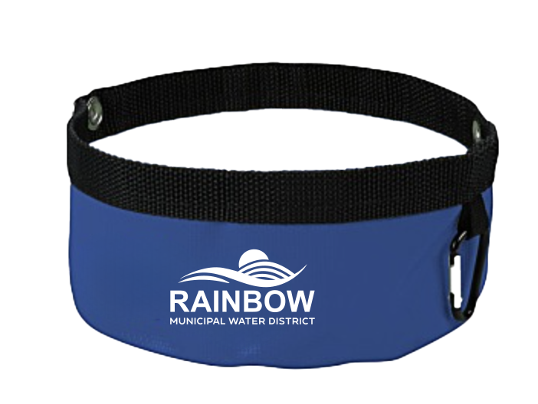
Avocado Festival
Sunday, April 21, 2024
  Planning in Progress
  Staff and board members to work booth from 9 am – 5 pm
    Promotional items organized and ready for the event
    Schedule open in the afternoon for board and committee members to join the team
    Rack cards
    FAQ sheet with tips for answering questions on detachment, rates, projects
Notes:
Information sent out to all volunteers who will work the event.
Booth space 705 + 704 near college and main

Slide 23
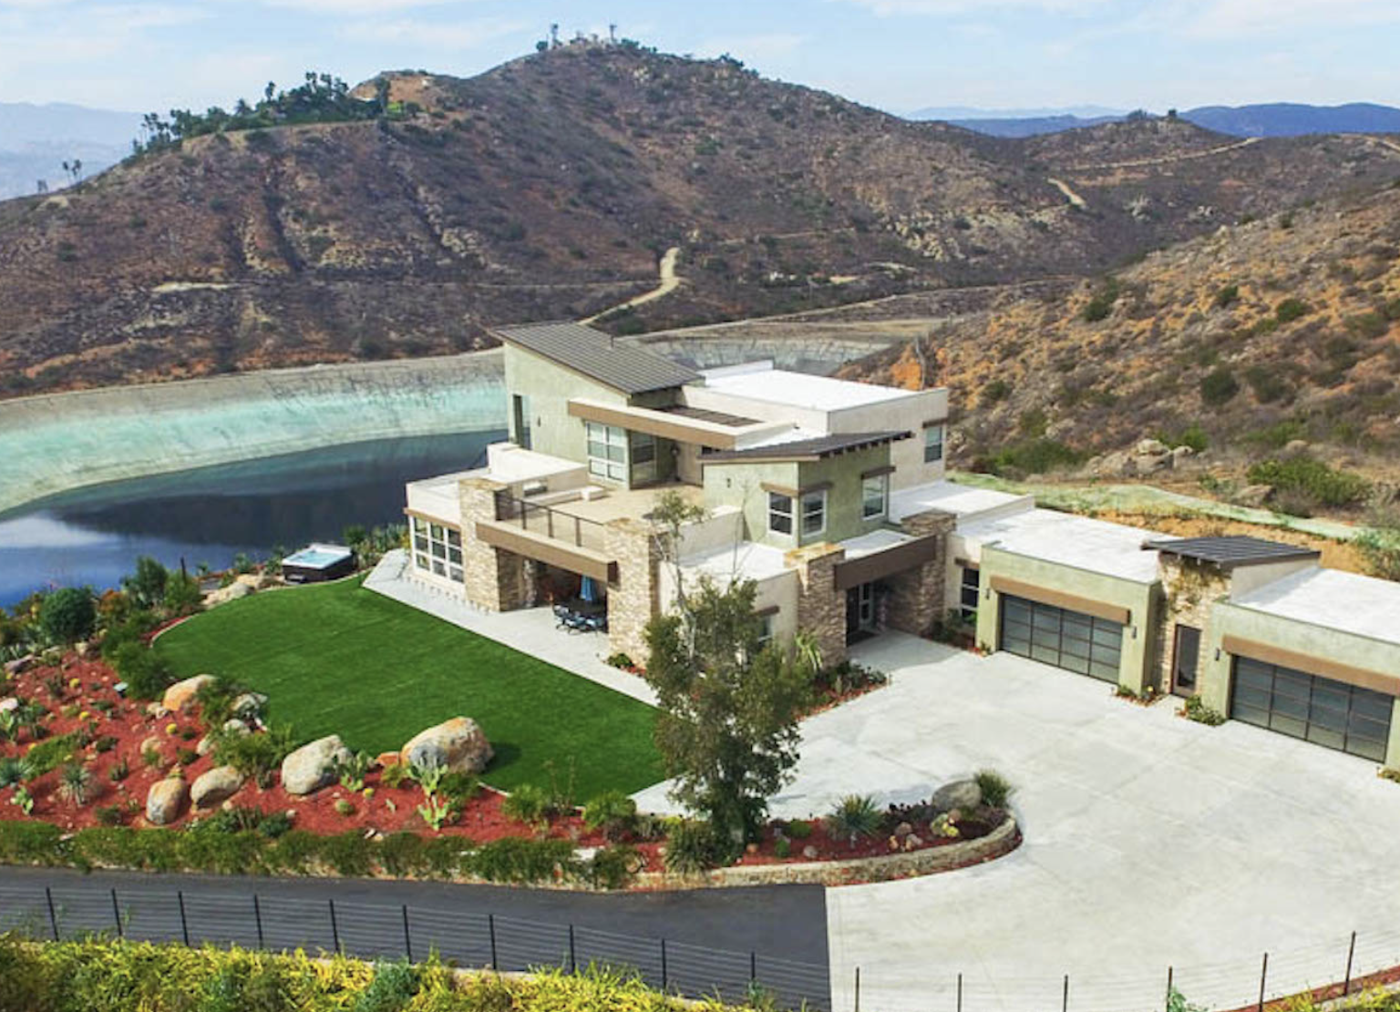
Detachment Event
Joint event with FPUD & Chamber of Commerce
  Thurs, Sept 27
    Event venue and beverages donated by FPUD board members
    Venue tour scheduled for
    mid May with planning in progress

Slide 24
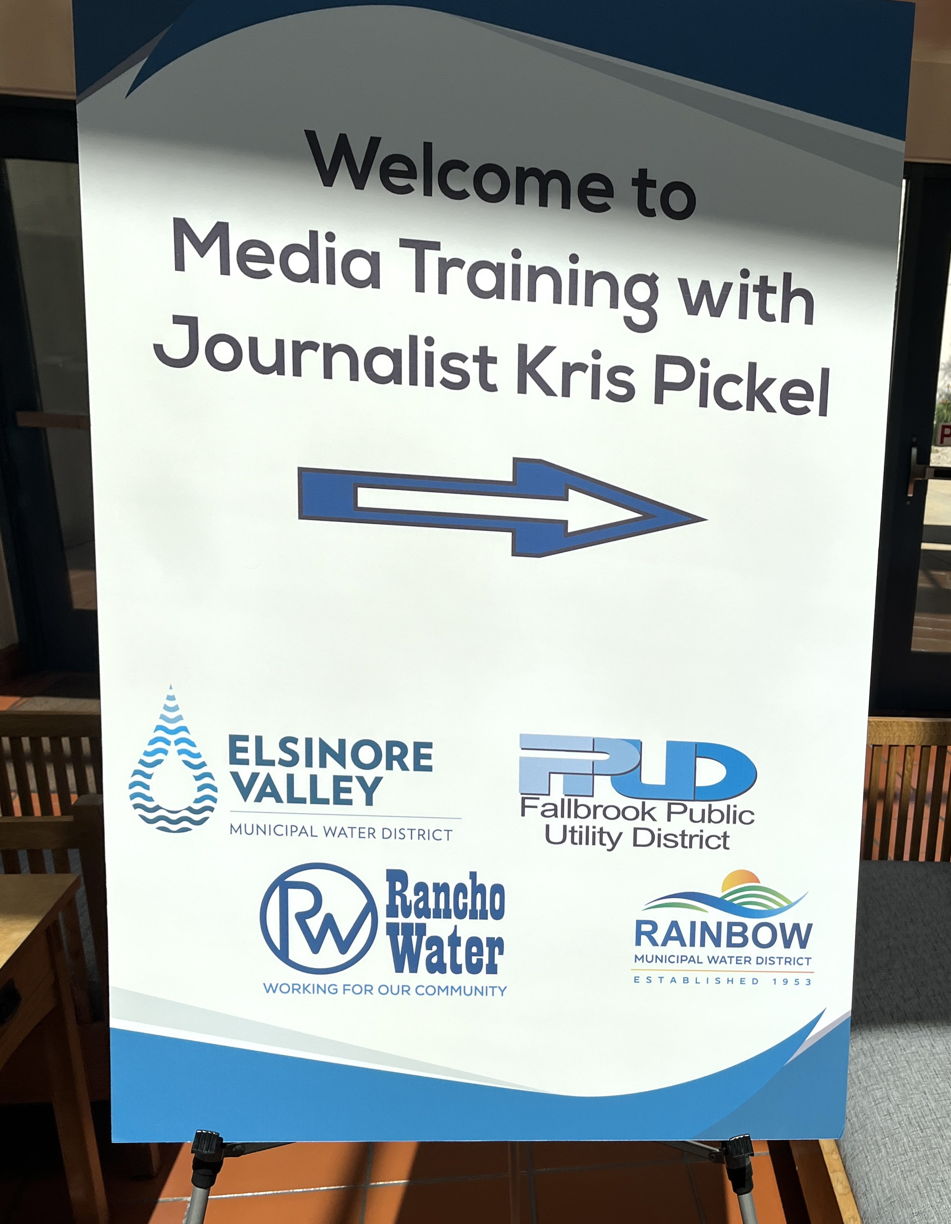
Media Training
April 2, 2024
  Hosted by Rancho Water
  3 members of staff and 1 board member attended
  Reviewed best practices
    Following the 3 C’s: Clear, Concise and Consistent
    Camera ready in person & zoom
    Tips for engaging with media
    Build your message
    Interview preparation
    Handling difficult Q’s & topics
Notes:
Event brough together agencies from Southwest Riverside County, FPUD + Rainbow Water.
Guest speaker: Kris Pickel, award-winning journalist who has worked for major news stations markets across the U.S. She reviewed ways to anticipate and prepare for reporters’ questions. Understand how to engage with media, handling difficult or sensitive topics.

Slide 25
Newsletter
Content Planning

Slide 26
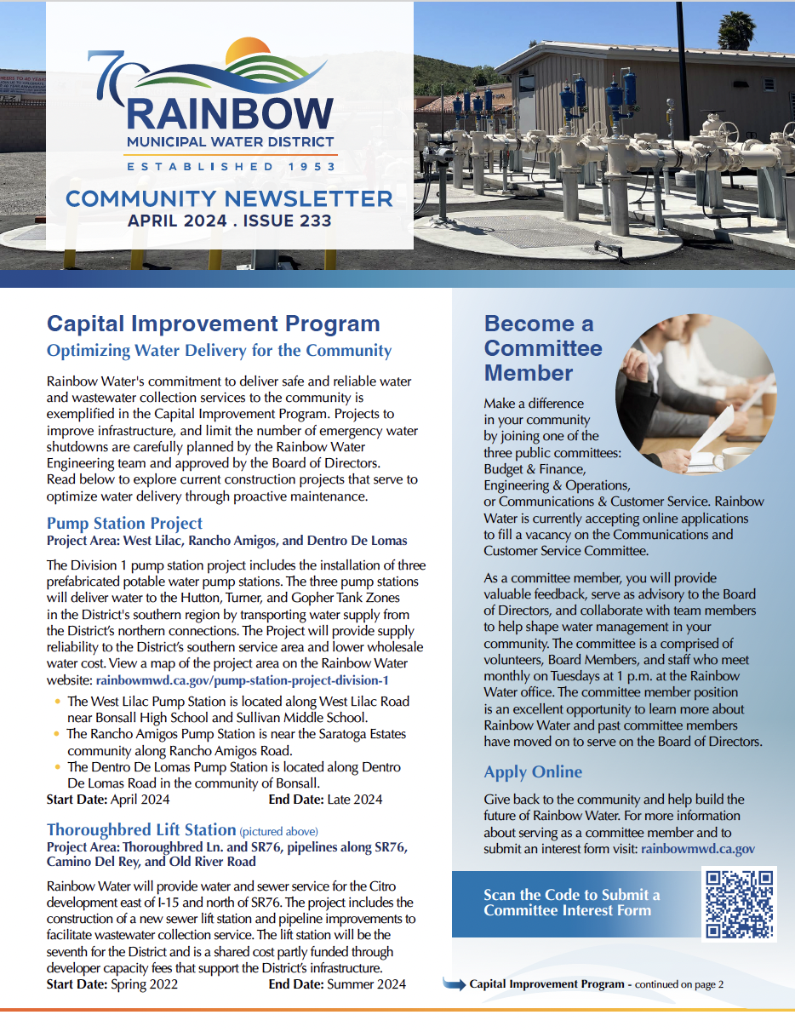

Newsletter Review
April
  Capital Improvement Program
    CIP Projects overview
  Invest in Your Landscape
    Rebates from MWD for turf removal, link to top 50 water friendly native plants
  Committee Member Volunteers
    Get involved and be an important part of the Rainbow Team as a volunteer committee member
  Avocado Festival
  Career Opportunities
Notes:
CIP website updated with new projects and photographs, committee member interest form launched on the website, landscape tips from Met with links to rebate information and come by the Avocado Festival Booth to receive your free 50 CA Friendly plant guide and poppy seeds, Career opp available on the website
Spring newsletter was sent out to non-ratepayers with information on CIP, Committee opportunity, Be Water Wise spring plant guide, career opportunities, detachment update and avocado festival invite to stop by the booth.

Slide 27
Newsletter Planning
May
  National Water Awareness Month with FAQ
  What’s Backflow?
    Meters team review, device tips, when to call for support, website update with new info
  Register for the Rainbow Run
    Rainbow Water is sponsoring the water booth at the event
  Recap of Events
    Photos, recap of Avo Festival
    BHS field trip 2024
June
  CCR Report + Rate Increase
      CCR report stats, cost of water and water rates messaging
  Adjust water for summer
    Tips for watering, expected dry conditions for La Nina season
  Virtual Workshops
    Metropolitan Water workshops for irrigation and G3 Landscape zooms
  Water Efficiency Survey
    Make the most of water use and take the survey to review high usage on BeWaterWise.com

Slide 28
Public
Communications
& Related Media Stories

Slide 29
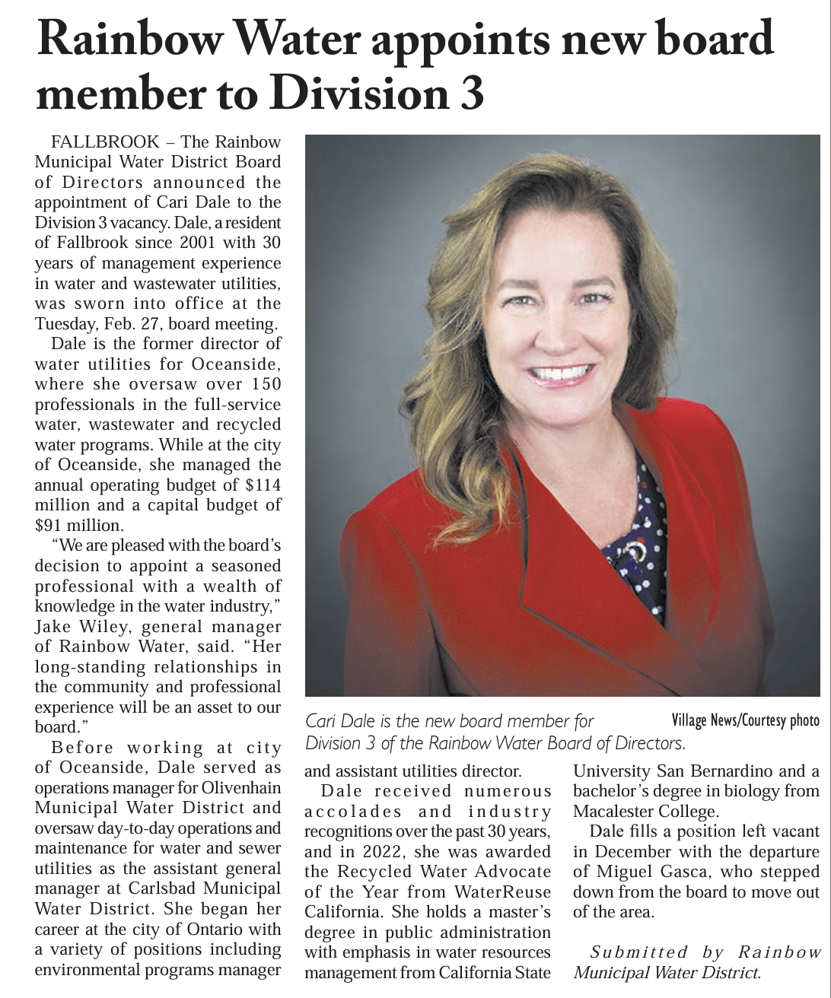
Village News
March 15
New Board Member Appointed to Division 3
Notes:
One story published about the appointment of Cary Dale to the Board of Directors which ran on March 15.

Slide 30
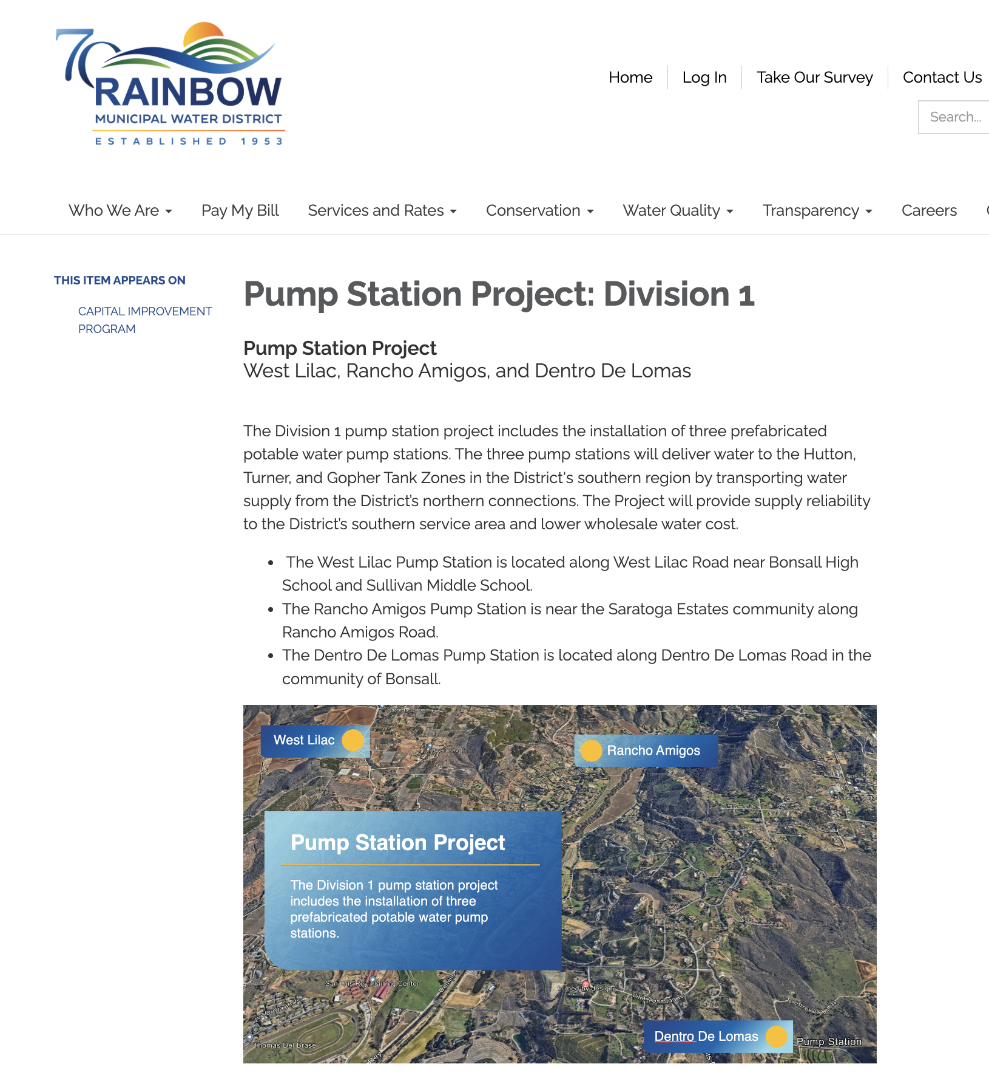

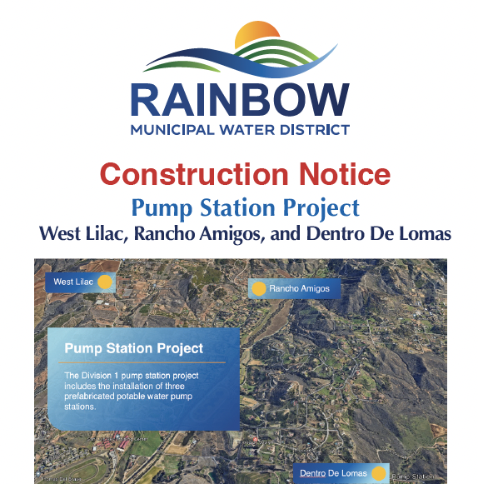
Signage
Pump Station Project
Construction signs for Pump Stations
New CIP webpage with QR code link on signs
Door hanger for construction notification
Notes:
Collaborated with Engineering to develop a new project launch campaign to inform residents of the pump station projects. A new webpage, onsite signage and door hanger were created and printed. The project was featured in the April newsletter and the webpage will be updated as new information is released and new photography posted.

Slide 31
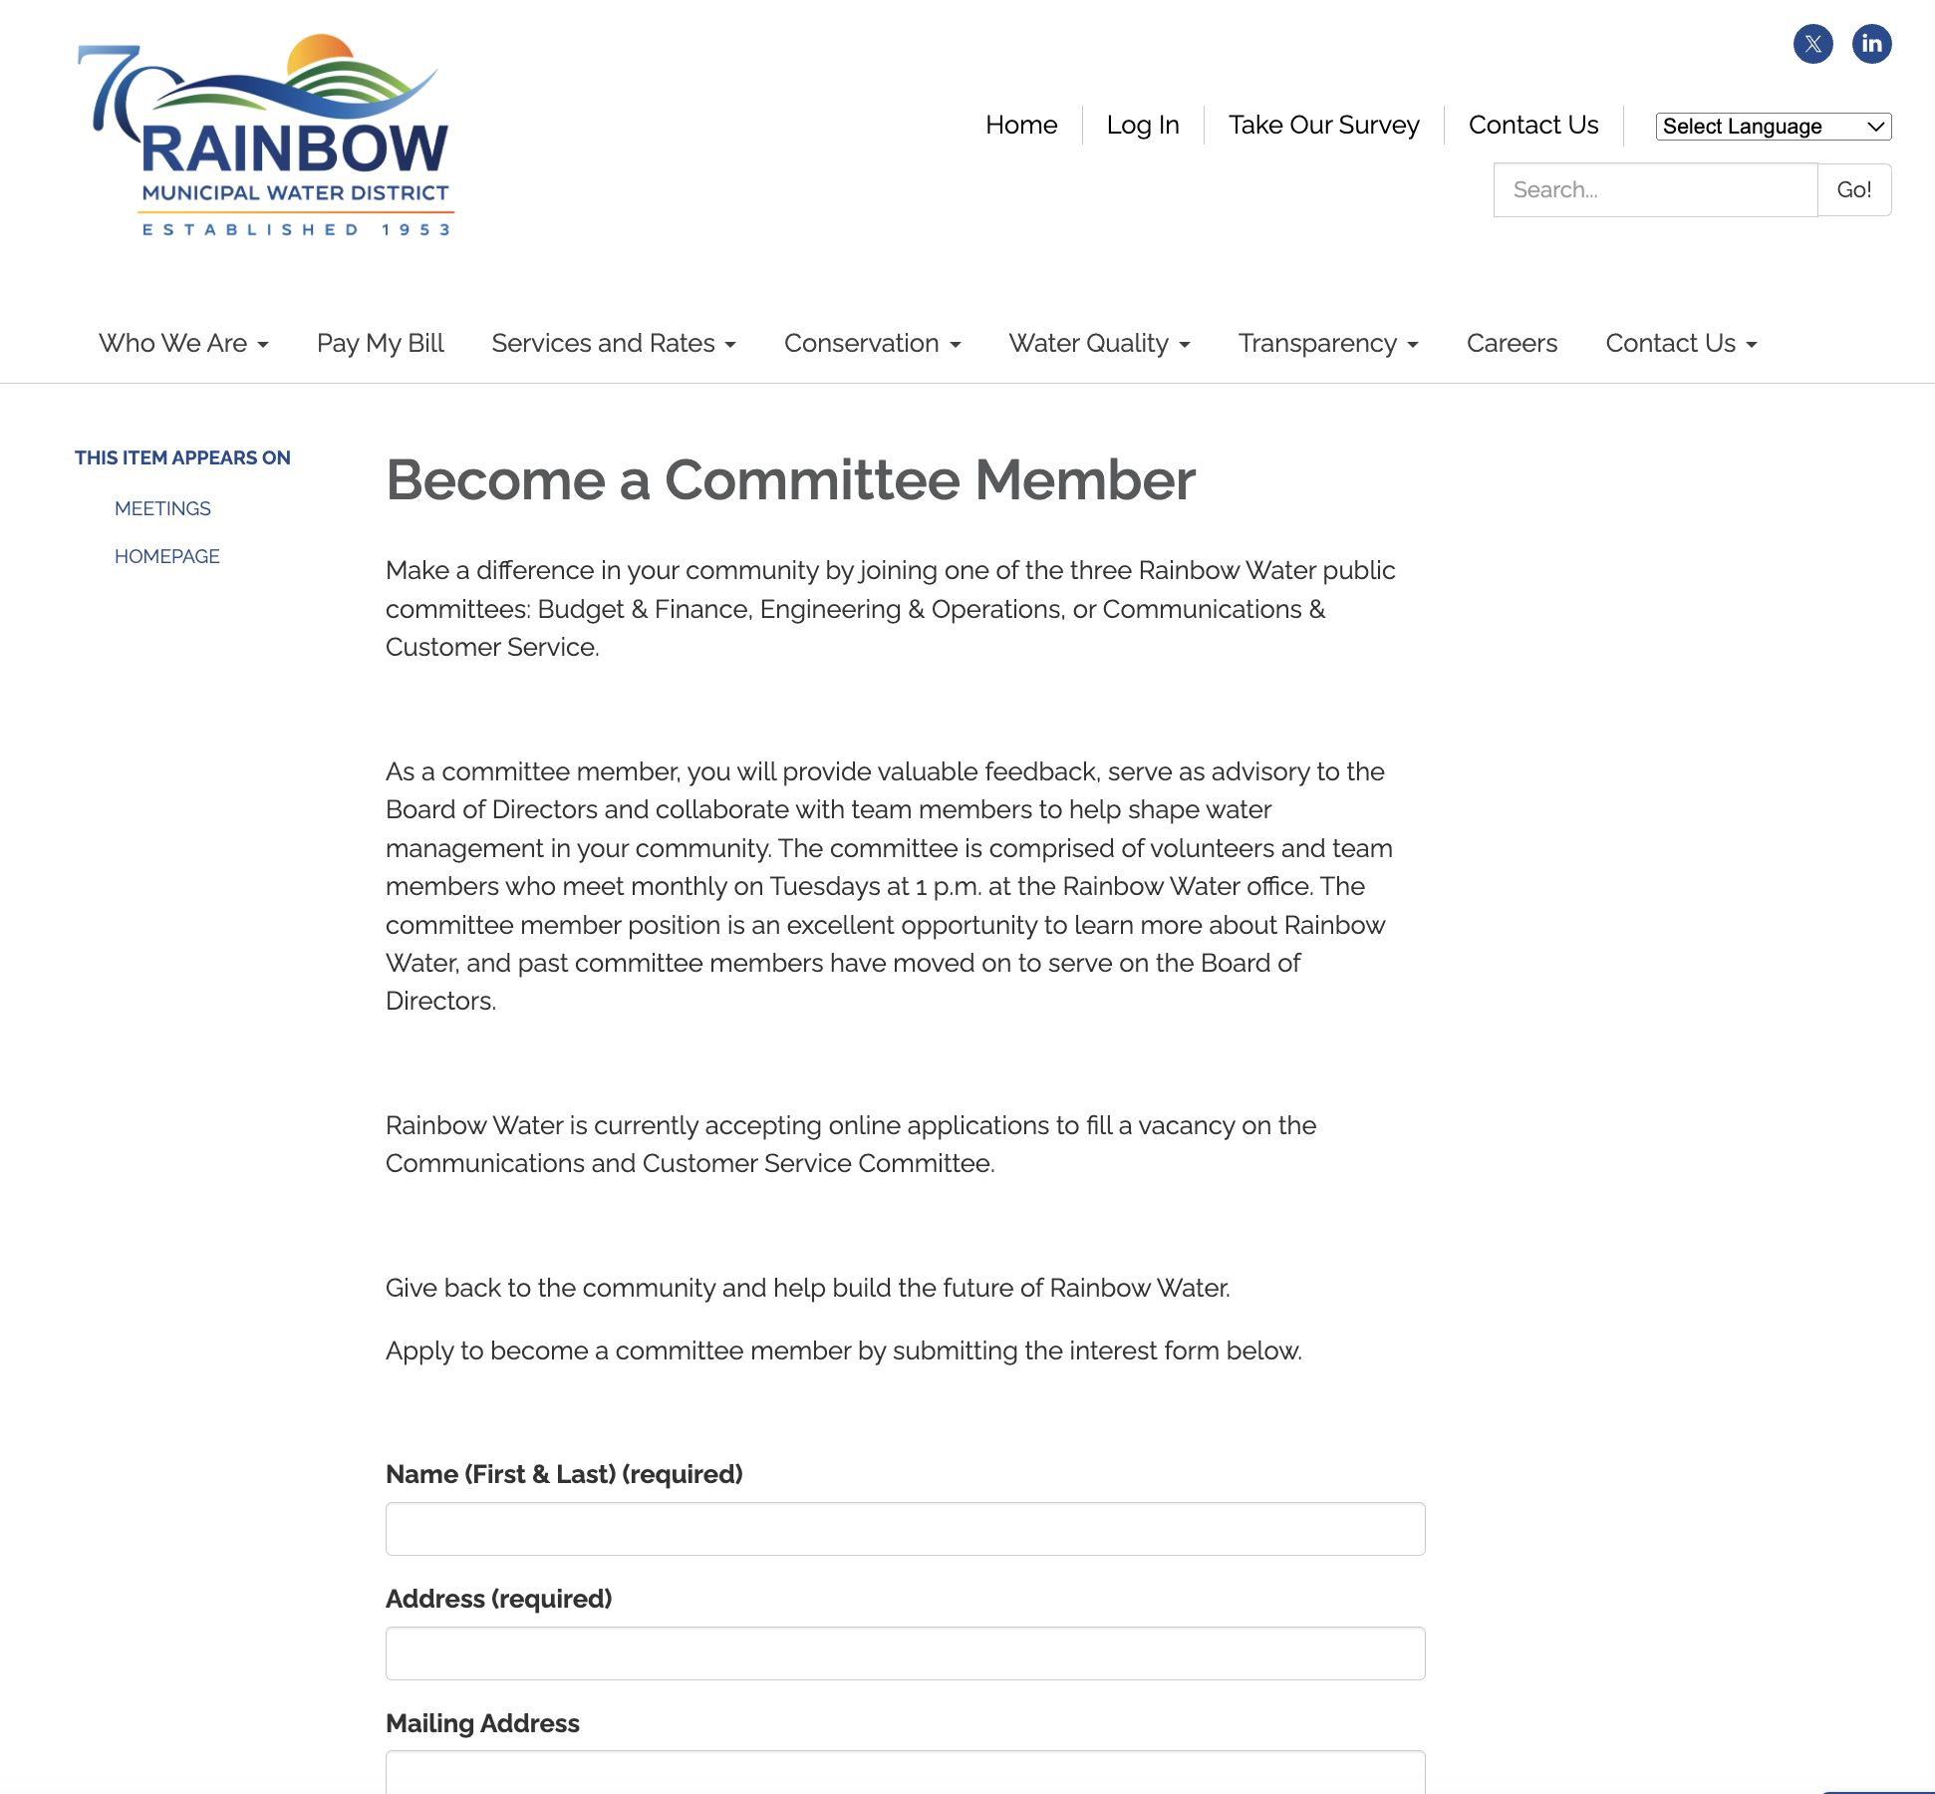
Website Updates
Become a Committee Member
Public Committee information, interest form
Notes:
Committee member campaign in the progress with article to be published in the Village News, rack card available at the Avocado Festival and form on the website to capture information for interested parties.

Slide 32
Agenda Items for Next Meeting
May 21, 2024

