Slide 1
Communications & Customer Service
Committee Update
Notes:
Good afternoon members of the board and rainbow water staff, I am here to give an update on the communications and customer service committee. While we did not meet this month, we have an update on our community events and newsletter.

Slide 2
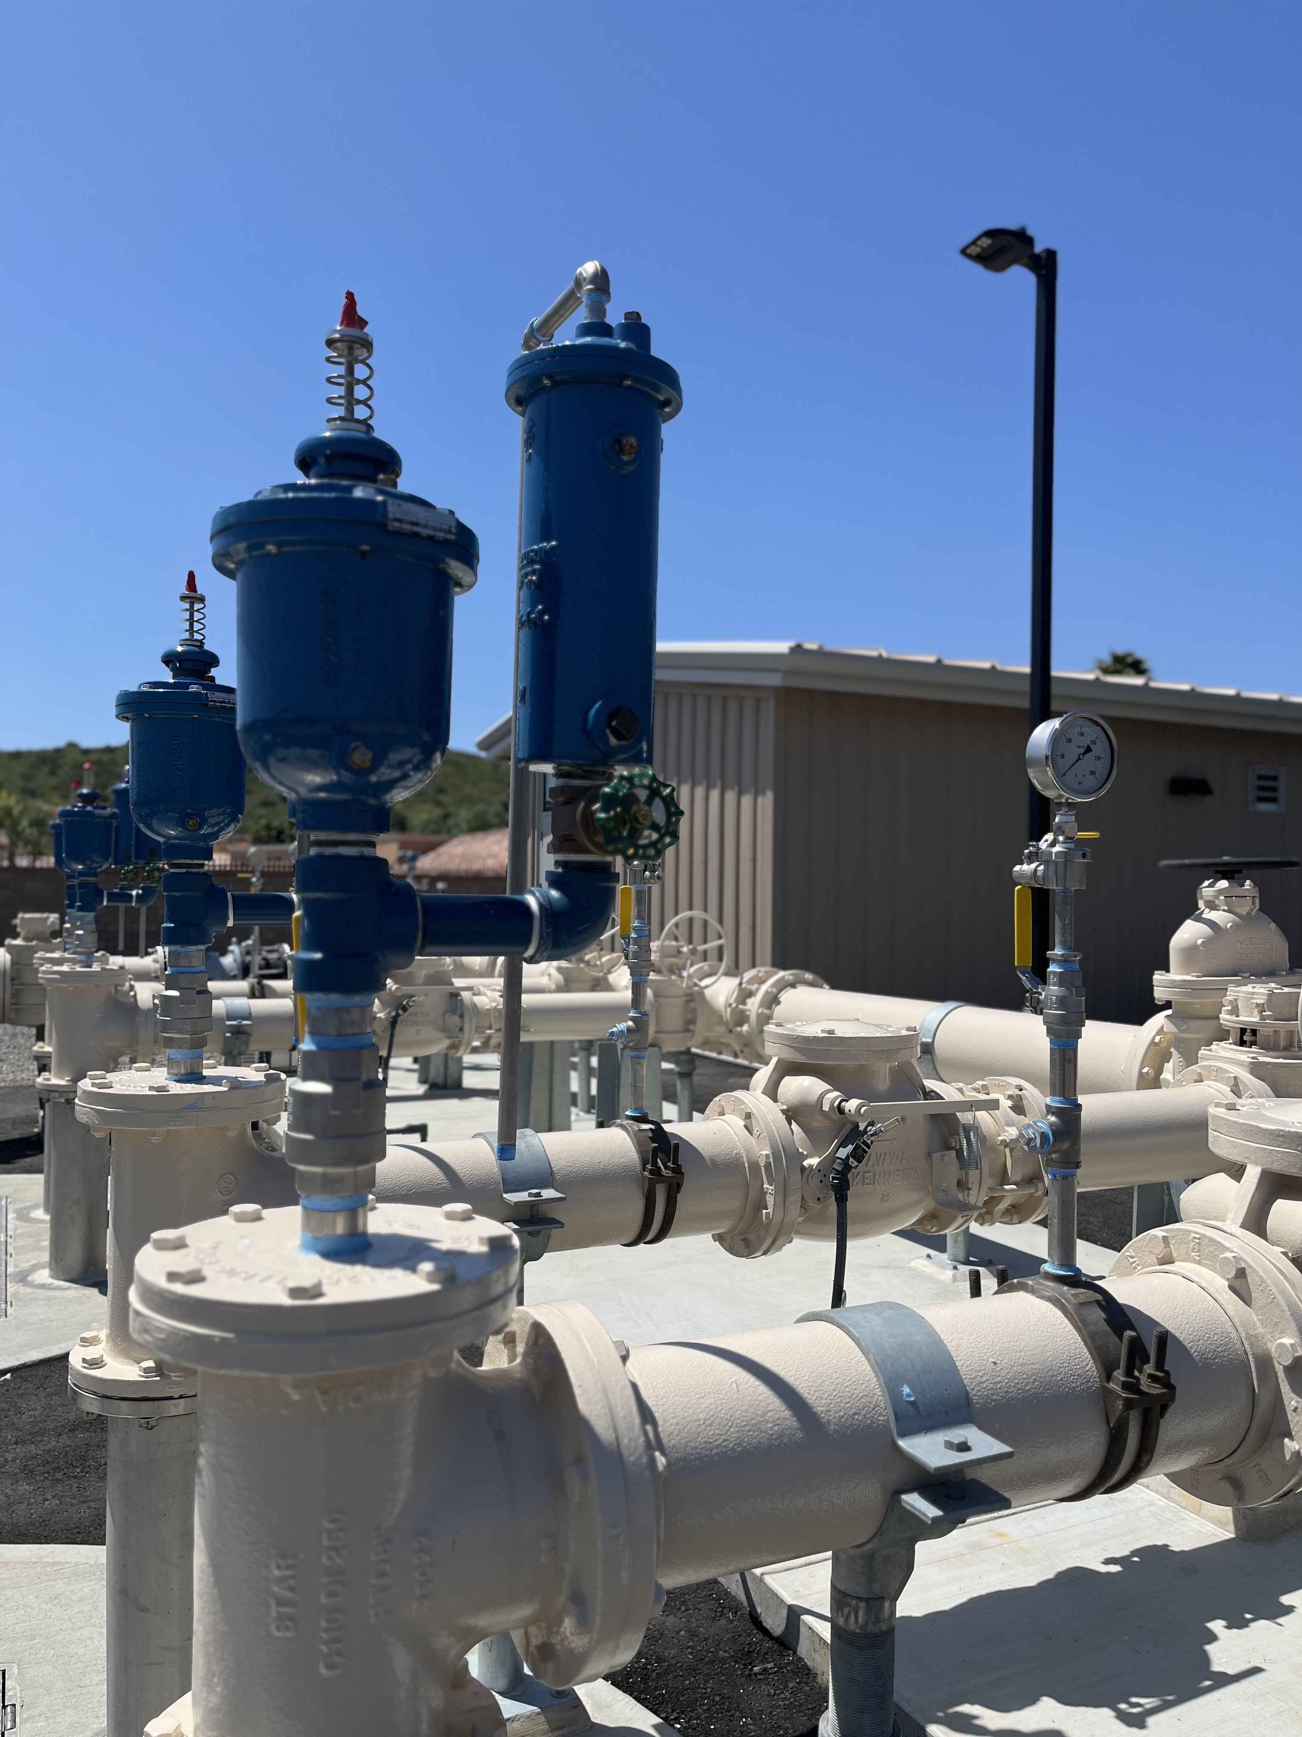
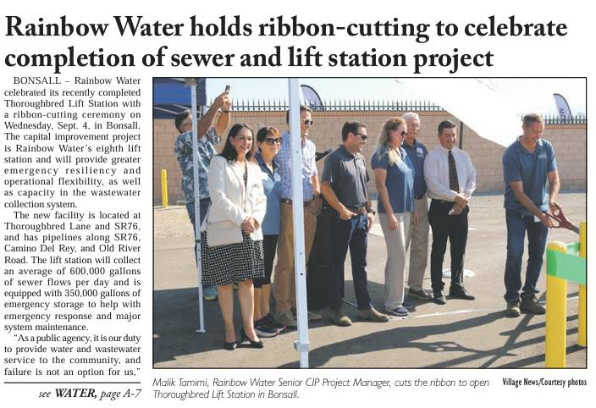
Thoroughbred Lift Station
Ribbon Cutting Event
Wednesday, September 4
  Ribbon cutting celebrated the District’s eighth Lift Station
  Those in attendance included project partners, school district, local representatives, Board and Committee members
  Front page feature in Village News
Notes:
Representatives from Supervisor Desmond’s office, Superintendent of Bonsall School District, Project Partners and staff, board, committee members joined us for the celebration of our 8th lift station. The multi year capital improvement project will provide greater emergency resiliency and operational flexibility to our wastewater collection system.

Slide 3
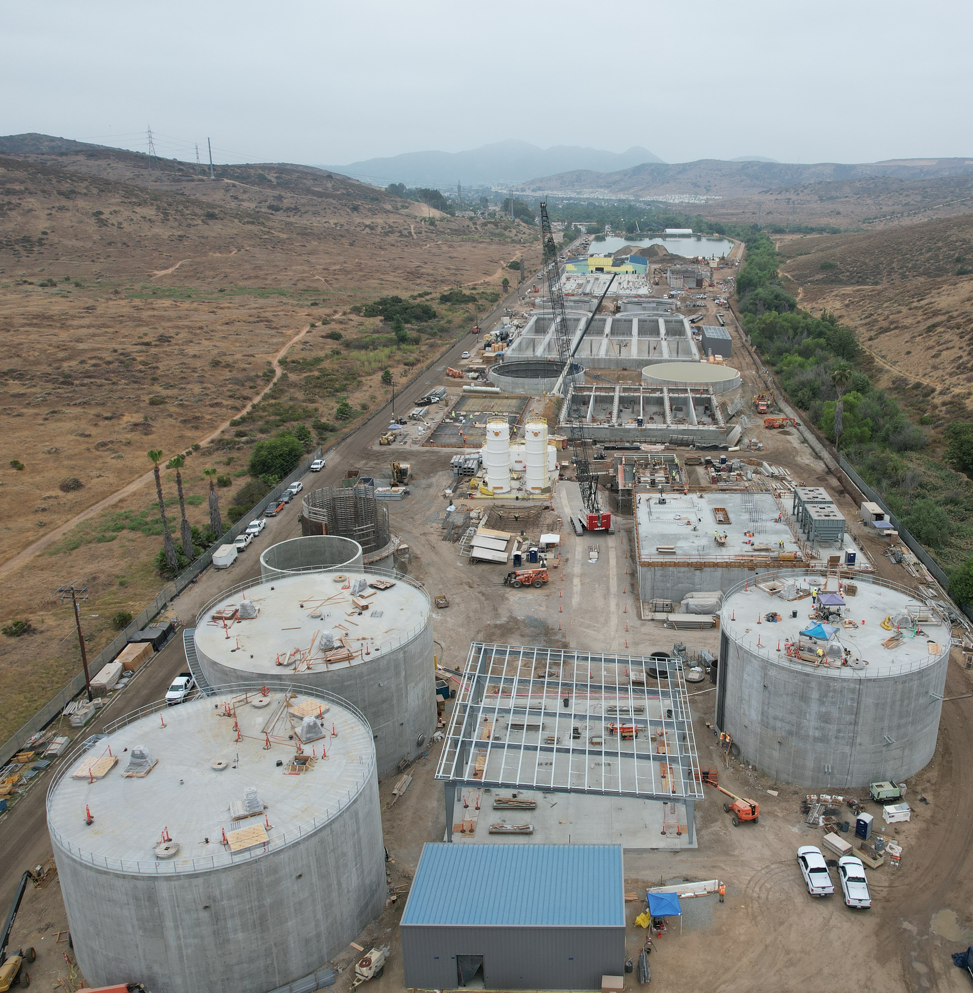
Padre Dam Field Trip
Thursday, September 5
  Staff visited the East County Advanced Water Purification Program
  Tour the facility north of Santee Lakes
  The water recycling facility is in construction phase and will treat 16 million gallons of water per day
Notes:
Water recycling facility treating16 million gallons of water per day (MGD).
Advanced water purification facility treating 11.5 MGD.
Supplies 30 percent of a local water source that is reliable and uninterruptable during periods of drought.
As of late July 2024, roughly 42,000 cubic yards of concrete has allowed portions of the advanced water purification, water recycling and solids handling facilities to take shape.

Slide 4
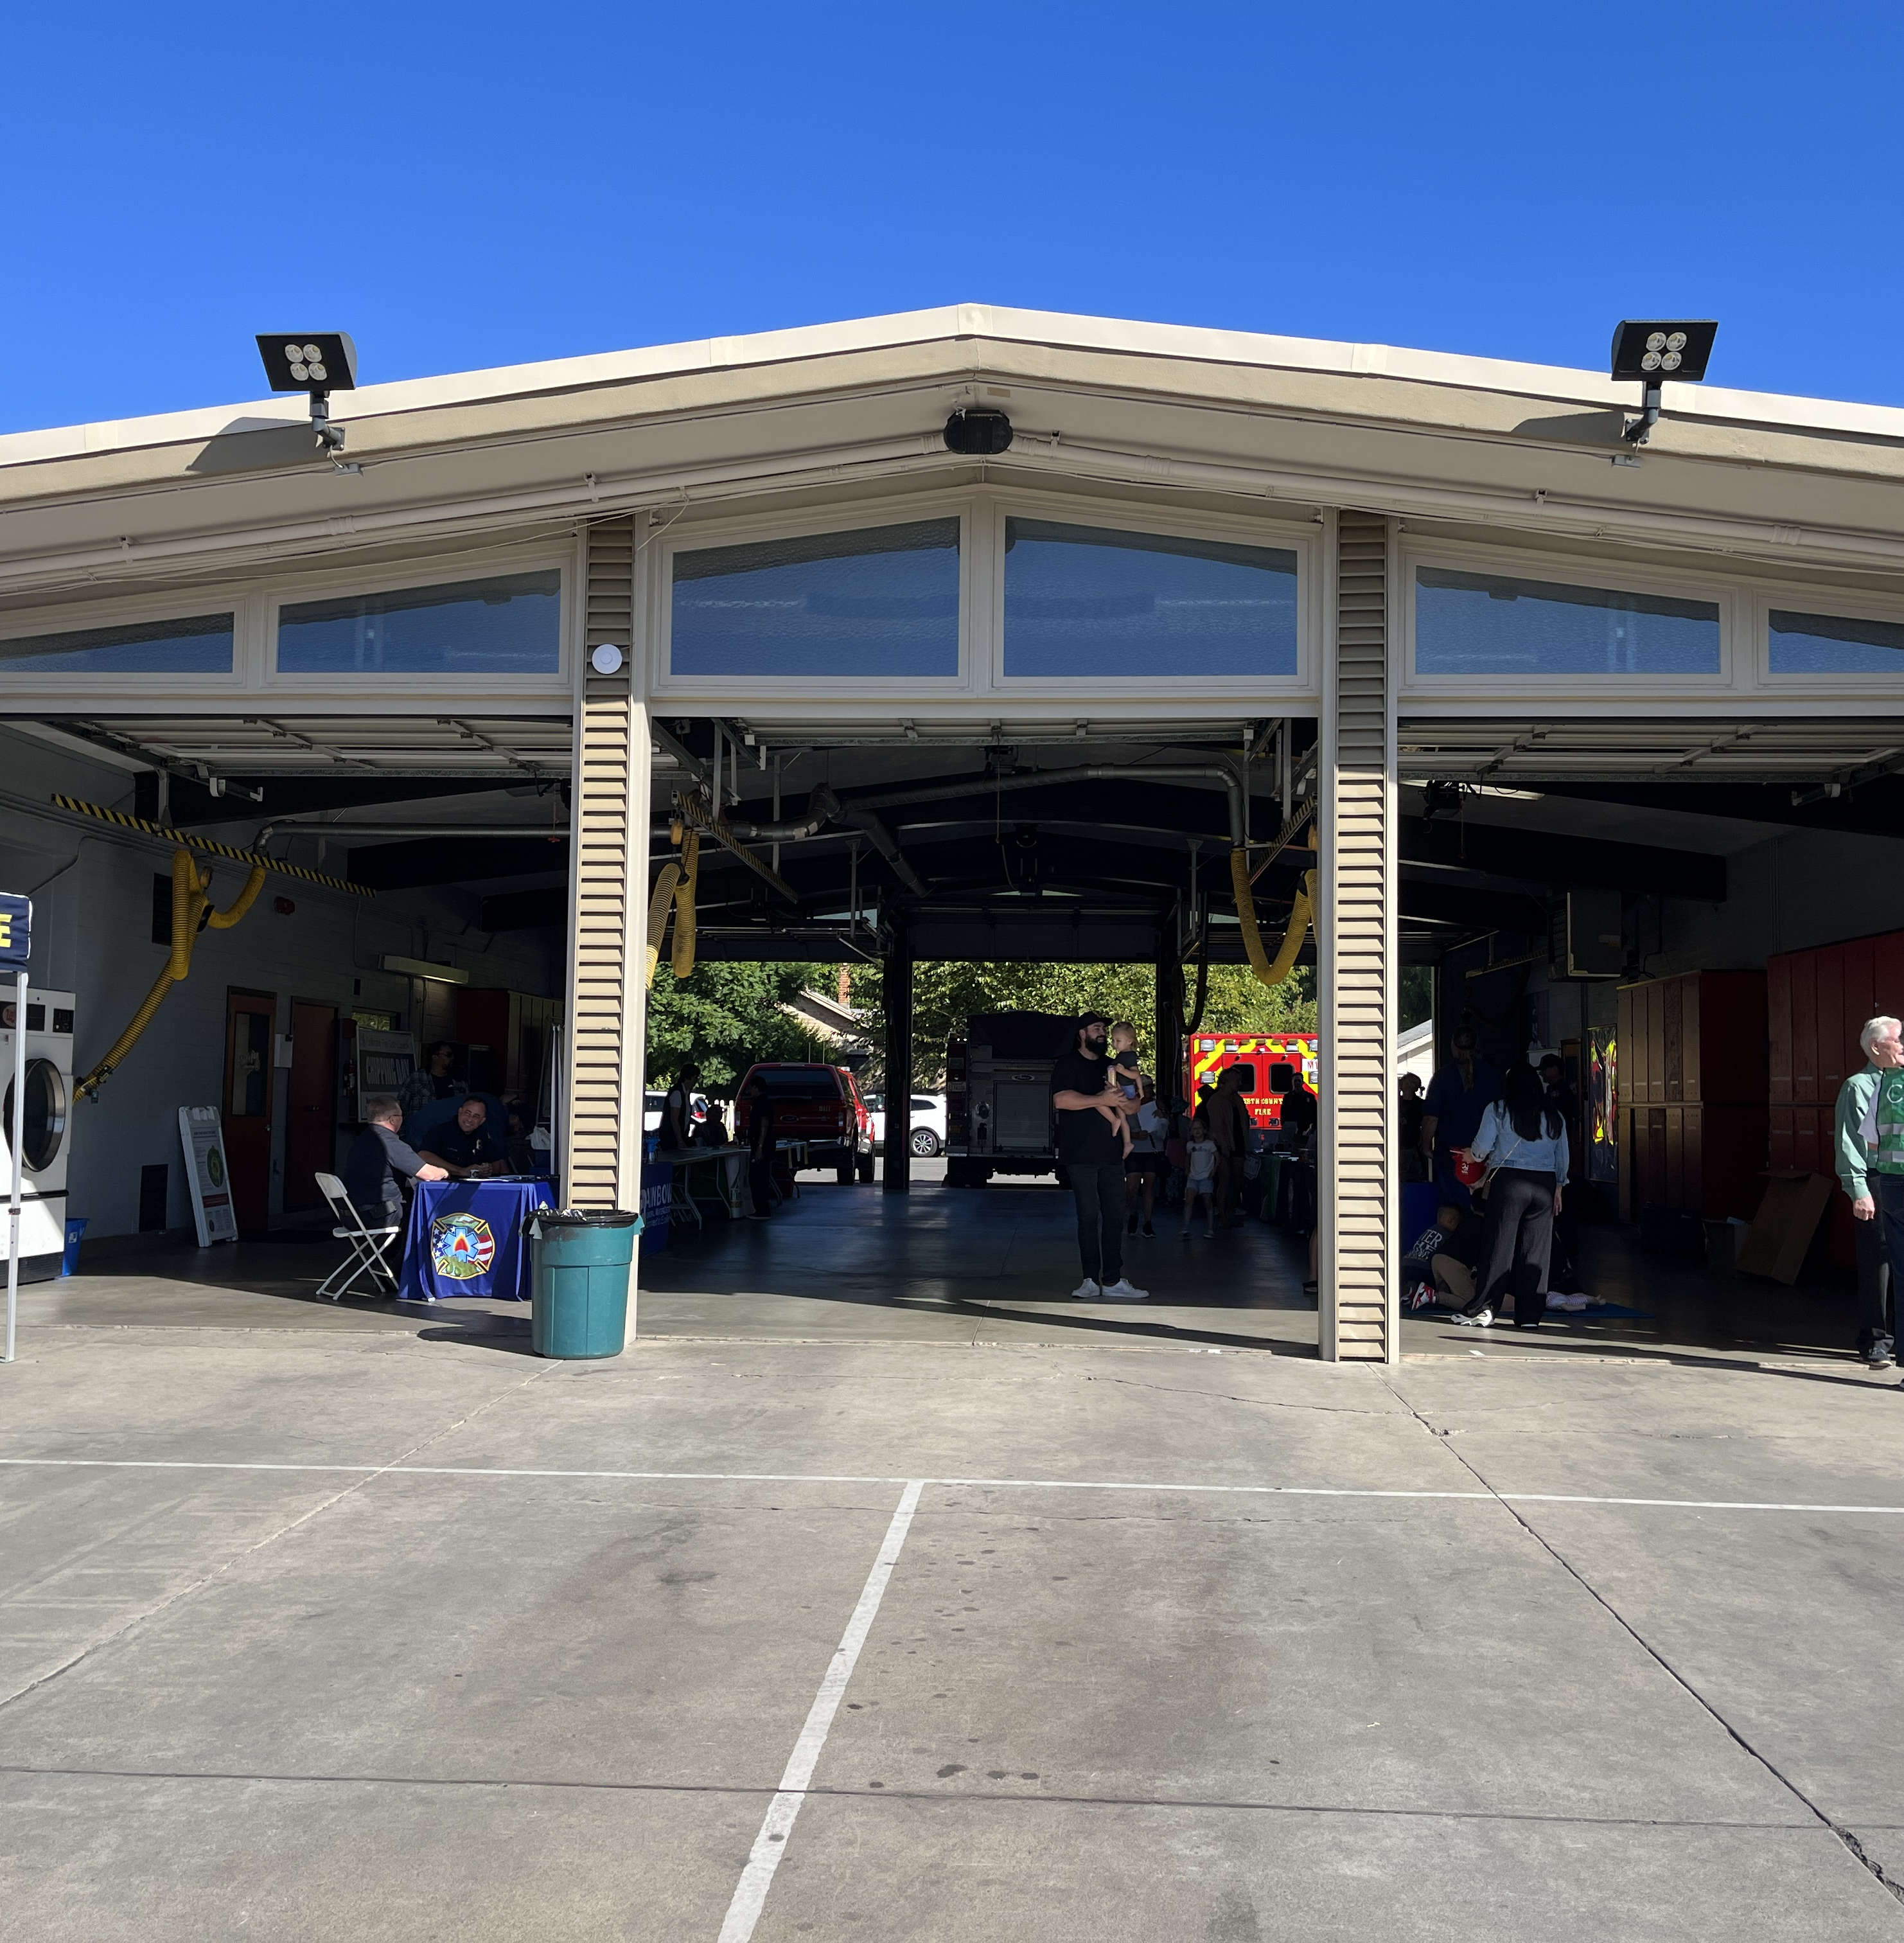

North County Fire Open House
Saturday, October 12
  Event from 9 am - 1 pm
  Free community event at Fire Station 1 in Fallbrook
  Volunteers to work the booth at the event
Notes:
Agencies and community groups in attendance: Fallbrook Land and Conservancy, Bonsall Chamber, Mission Resource Conservation District, Fallbrook Health, Burn Institute, SDGE, Pala Tribe, FPUD

Slide 5
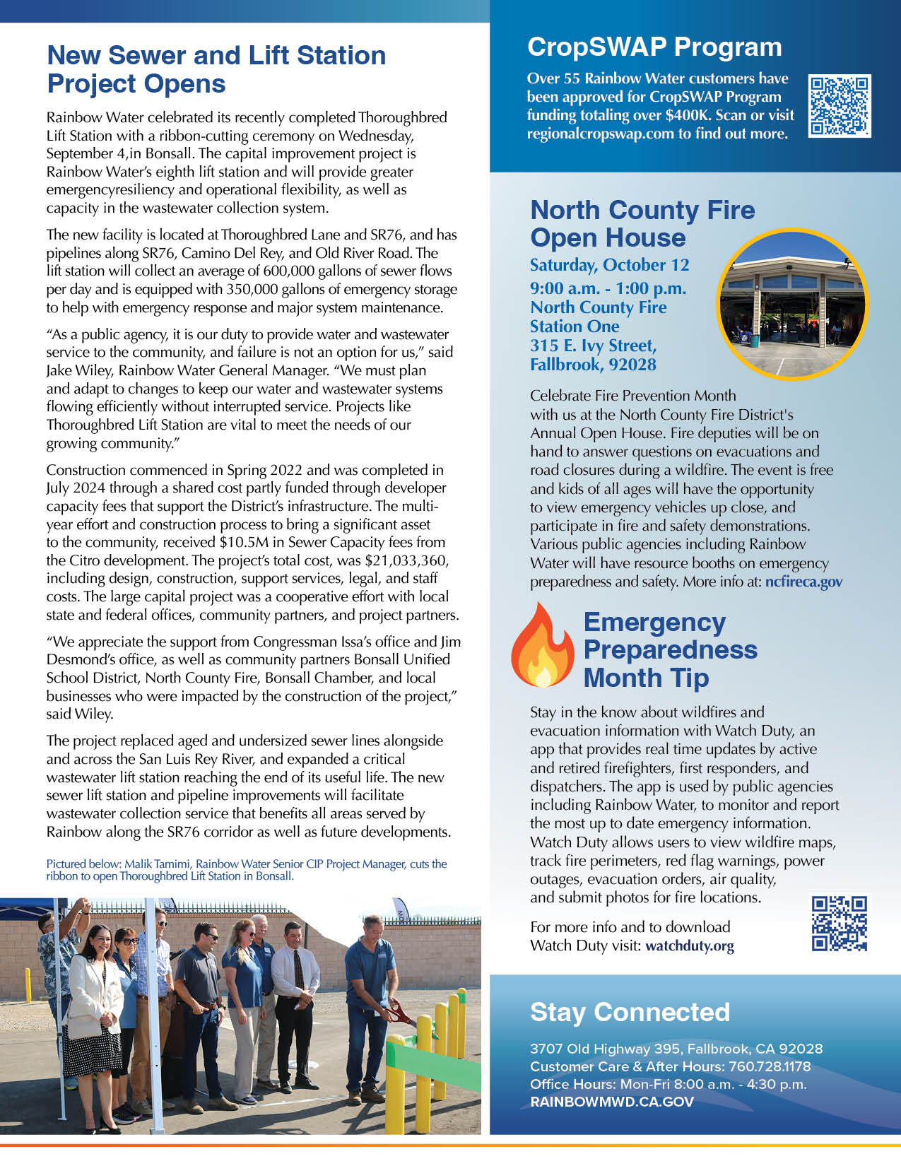
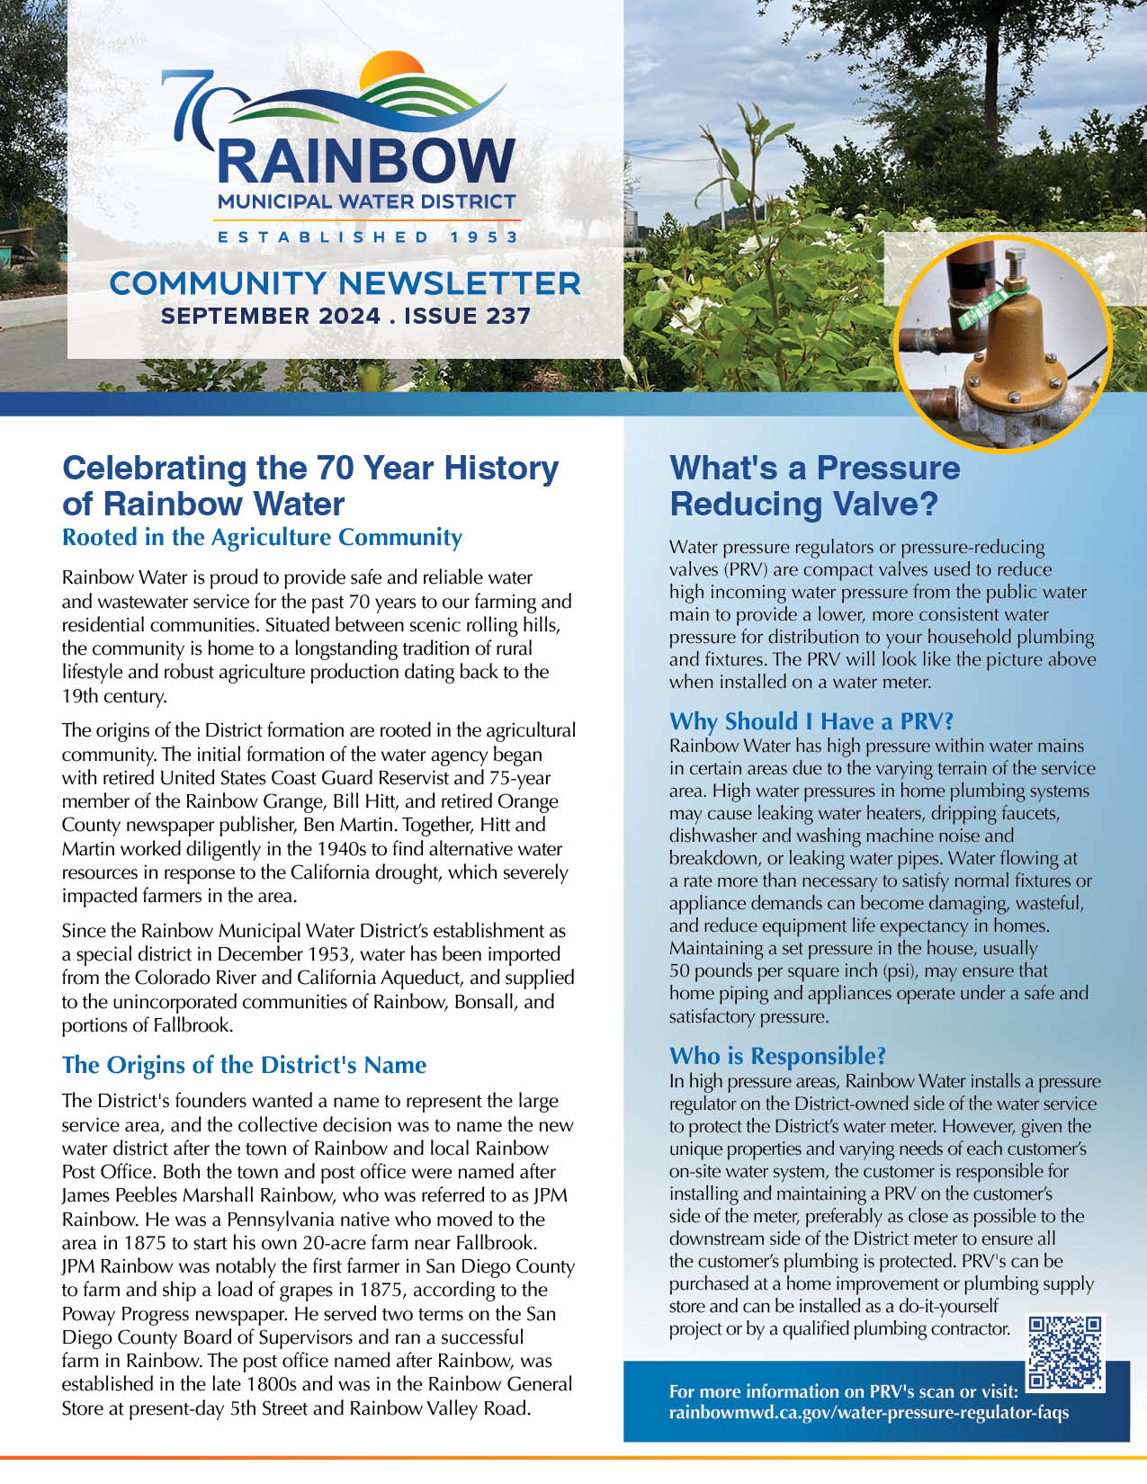
September Newsletter
Articles
Celebrating 70 years of History
  Origins of the District name and
  the grower community
What’s a Pressure Reducing Valve?
  Explain the reason to have a PRV and who is responsible for the PRV
New Sewer Lift Station Project Opens
  Thoroughbred ribbon-cutting event
North County Fire Open House
Emergency Preparedness Month Tip:
  Overview of Watch Duty app
Notes:
Committee with reconvene on Tuesday, October 15

