Slide 1
Potential CIP Project Acceleration w/Savings from Early Detachment
E&O Committee
November 5, 2024

Slide 2

Savings of $768,800 from Early Detachment
Overage Offset - PS’s Overage of $1.1M
  Reduction in Debt Service
Pipeline Replacement - Accelerate La Canada Pipeline Replacement
Water Quality – Advance RCS systems at Southern Tanks
Reliability – Advance Emergency Generator Installation at Lilac PS

Slide 3
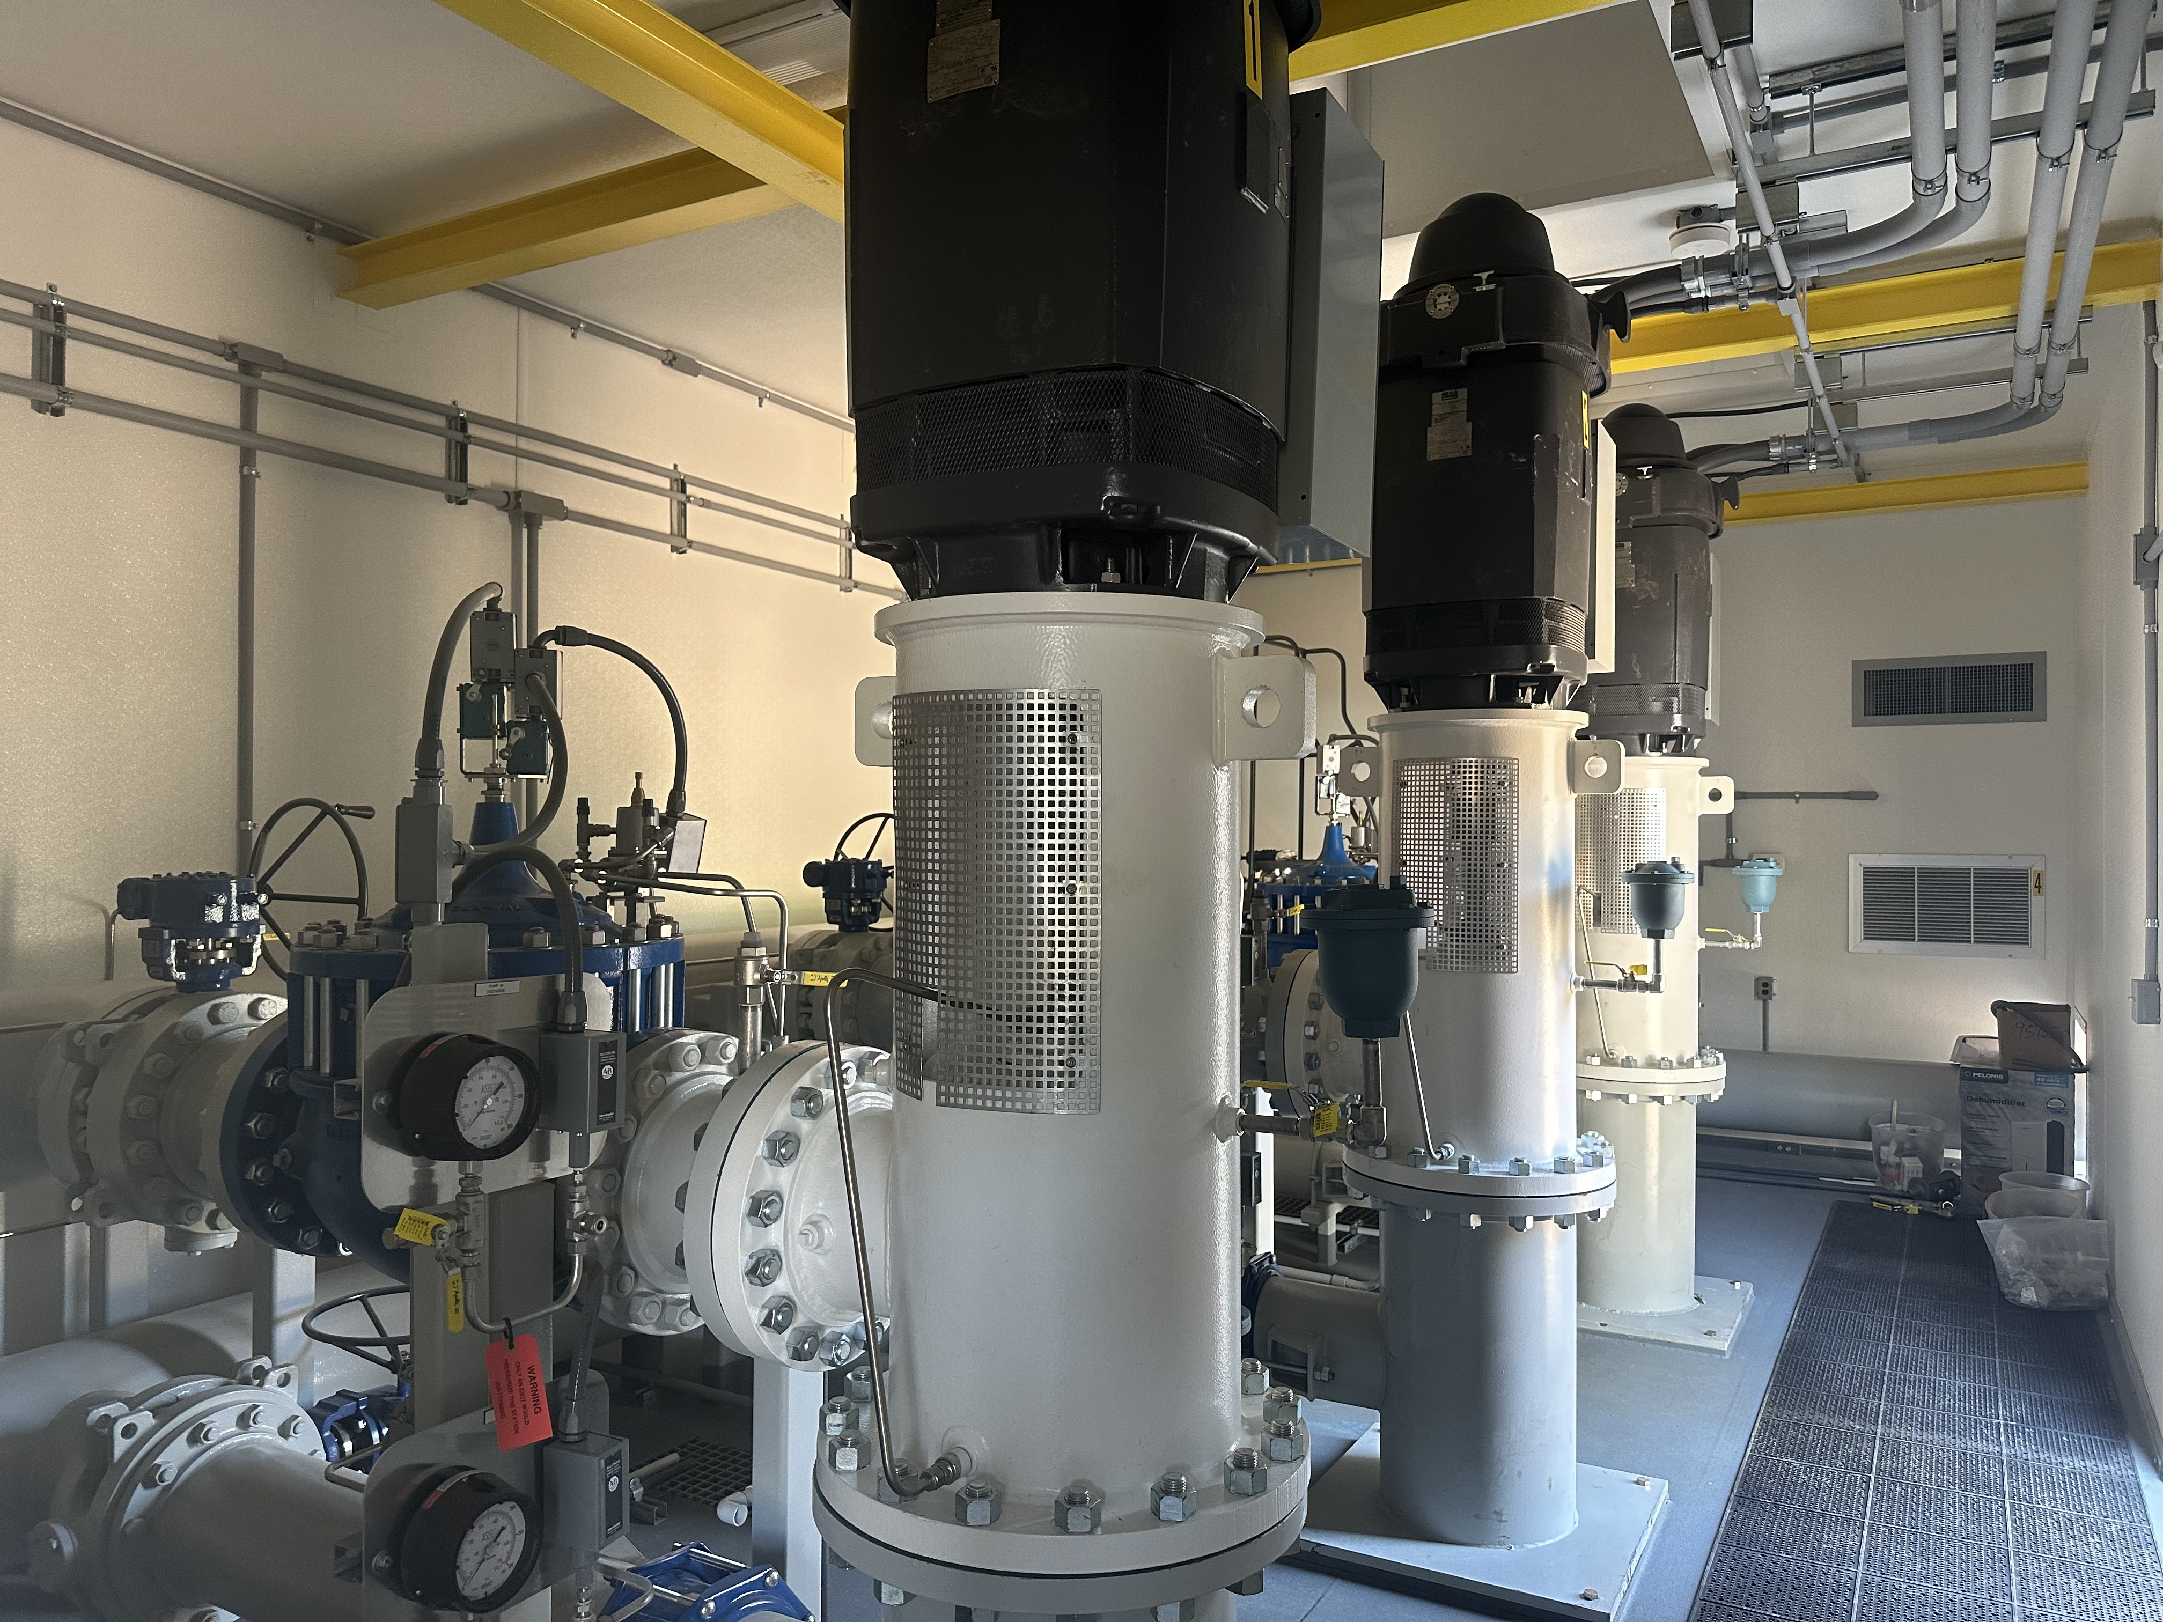
Reduction in Proposed Debt Service
Offsets $1.15M Pump Station additional funding need
Saves ~$209,000 in interest costs over 10-years

Slide 4
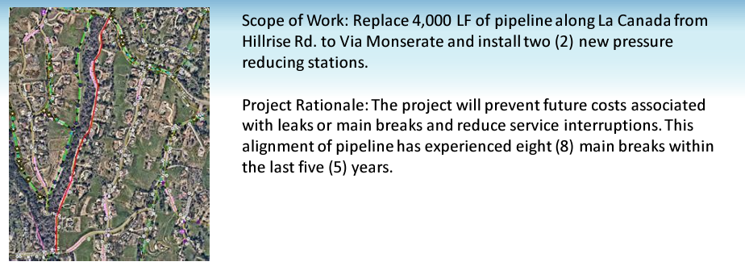
Rehabilitation/Replacement Project
  La Canada Pipeline Replacement
    $150k for PRS System Install in 24/25
    $700k for pipeline replacement in 25/26

Slide 5
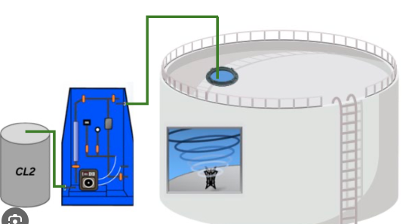
Water Quality
RCS systems for chloramine residual maintenance at Hutton, Turner, and Gopher Canyon Tanks
  Tank Mixer + Chem Storage and Feed System
  ~$250k per system
  Allows for maintenance of adequate disinfection residuals during low-demand periods, fire weather response, or other operational needs
  Potential for reduced chemical demands at Morro Reservoir

Slide 6
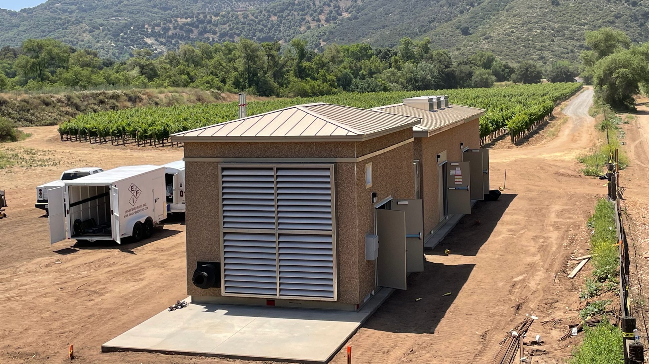
Reliability
Diesel Gen Set for Lilac
  Backup Power for outages in the southern zone
  Largest Pump Station in the Zone
  $750k-$1.0M
  Potential Grant Funded Project

