Slide 1
Communications & Customer Service
COMMITTEE MEETING
July 16, 2024

Slide 2
2024 Poster
Contest Winners
Awards Recognition

Slide 3

NCWA Water Poster Contest
Congratulations 2024 Poster Contest Winners from Bonsall Elementary
  Selma H.
  Lillian N.
  Ivy S.
  Jones T.
  Selma
  Lillian
  Ivy
  Jones
Notes:
The committee to recognize three fourth-grade students from Bonsall Elementary School for their award-winning poster submissions from the North County Water Agencies annual poster contest. Art sent to NCWA for regional contest and finalists to be published in the 2025 calendar
Students will be presented with awards certificate, art supplies, and Rainbow Water promotional bags.
Students in attendance with families: Selma Have, Ivy Shadzi, and Jones Titera. (Lillian is celebrating her 10th birthday today and is unable to join us)

Slide 4
Pipeline 5 Relining
San Diego County Water Authority
San Luis Rey Canyon Project

Slide 5
Agenda
Approval of Minutes
General Manager Comments
Committee Member Comments

Slide 6
CropSWAP
Program
Regional Program Update

Slide 7
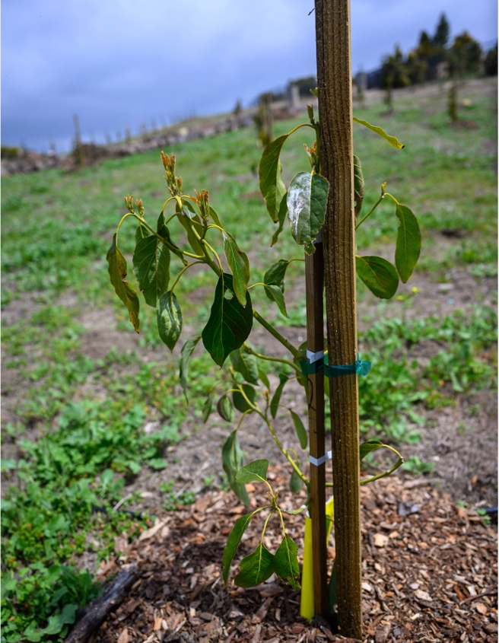
Crop SWAP Program
  The Regional CropSWAP continues to gain traction among our customers
  15 Applications submitted in June
    Marketing efforts to promote the Regional Program continue in the community newsletter
      July feature on irrigation efficiency and August will include info on automation rebates for National Farmer’s Week
Notes:
Regional CropSWAP Program continues to bring online applications from Rainbow Water customers.
Rainbow Water has reported 15 submissions for the month of June, for a total of 51
National Farmer’s Week: Rancho recommends promoting the scheduling automation rebate to customers as this is one of the least applied for rebates.
A campaign to inform customers continued in the July issue of the community newsletter with information on rebate upgrade types for irrigation efficiency improvements, enhancements, pressure regulators and drip systems.

Slide 8





51 Total Program Submissions
15
Project Submissions in June
20
Projects Approved
14
Pre-Inspection
15
Submissions Received
$319,300
In Reserved Grant Funding for Approved Projects
Notes:
Regional CropSWAP Program continues to bring online applications from Rainbow Water customers.
Rainbow Water has reported 15 submissions for the month of June, for a total of
51 submissions to date.
Status on the 51 projects to date: 20 approved, 14 in pre-inspection and 15 submitted for review with Rancho Water’s project administrators.

Slide 9
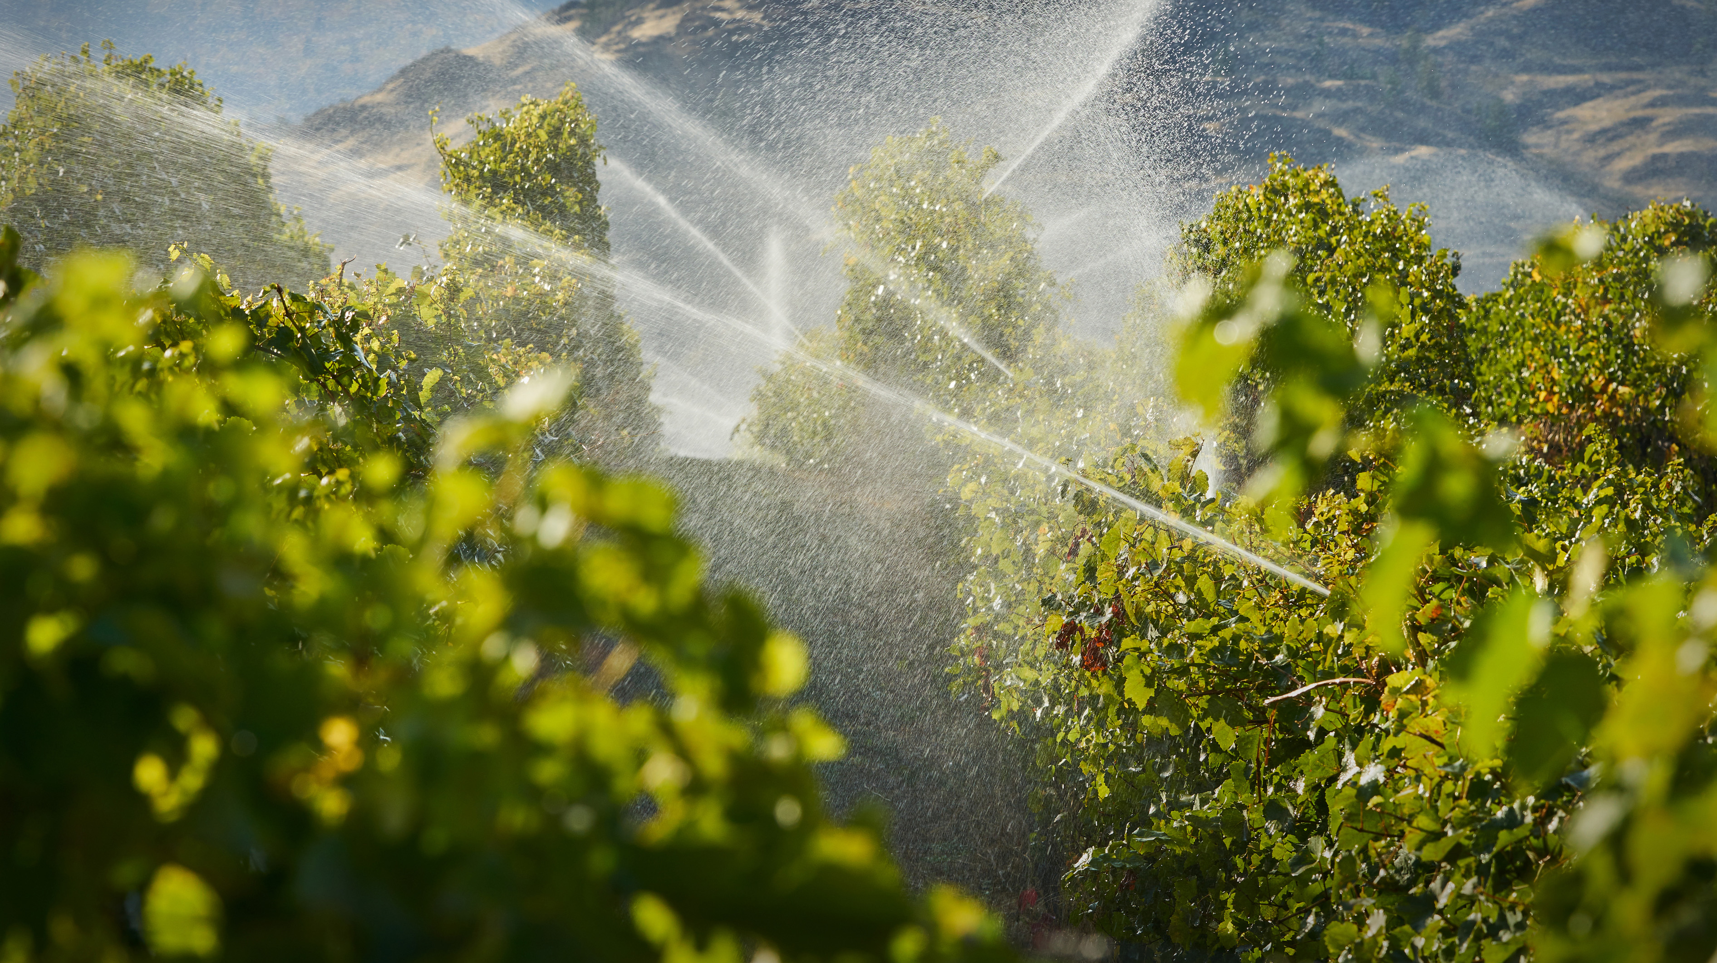

Total Applications by Project Type
11
Crop Conversion
5
Avocado Rejuvenation
4
Mulching
3
Uniformity Improvements
2
Soil Moisture Sensors
2
Scheduling Automation
1
Nutrient Management
1
Cover Crops
16
Avocado Rootstock
Notes:
The top two rebate types: 11 crop conversion and 16 avocado rootstock.
Crop Conversions reported: 5 avocado to winegrapes; 1 citrus to winegrapes; 1 citrus to passion fruit; 1 avocado to cherimoya; and 2 unknown conversions.
Average property size is 1-5 acres

Slide 10

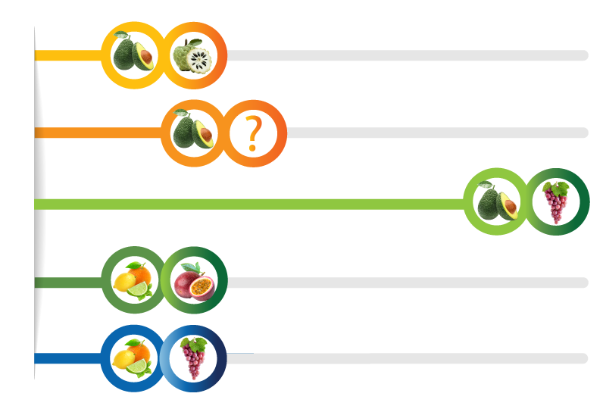
Applications by Project Type
1
Avocado to Cherimoya
2
Avocado to Unknown
5
Avocado to Winegrapes
1
Citrus to Passion Fruit
1
Citrus to Winegrapes
Notes:
The top two rebate types: 11 crop conversion and 16 avocado rootstock.
Crop Conversions reported: 5 avocado to winegrapes; 1 citrus to winegrapes; 1 citrus to passion fruit; 1 avocado to cherimoya; and 2 unknown conversions.
Average property size is 1-5 acres

Slide 11
Strategic Communications Plan
Development Recap

Slide 12
Strategic Communications Plan Development Steps
Discovery
Completed
Stakeholder feedback
(survey, committee, workshops)
Content review
SWOT Analysis
Demographic research
Channel assessment
Development
Current Stage
Where do we want to be, and how will we get there
SMART Goal setting
Tactical planning
(content calendar, etc)
Resource allocation
(staff, budget)
Documentation
Formalize plan details and commitment to success
Draft plan document
Review, get feedback, edit
Approve plan

Slide 13
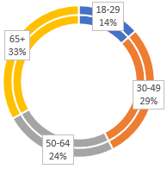
WHO: Resident Demographic Research
Voter Data: Age
    14% - 18-29
    29% - 30-49
    24% - 50-64
    33% - 65+
Housing:
  Owner-occupied homeowners: 59.1%
    61-71% have mortgages (Bonsall/ Fallbrook)

Slide 14
WHO: Customer Service Research

Slide 15
WHO: Target Audiences
Primary
Secondary
Tertiary
Residents
Agricultural ratepayers
Board
Staff
Media
Neighboring agencies
HOAs
Community groups
Elected officials
Schools
Job applicants
Industry groups
Contractors
Developers
Sub metered residents
Real estate agents

Slide 16
WHAT & HOW
Key Messages: “Rainbow Water…
Tone & Voice
Provides good value for the price
Cares about its customers
Supports agriculture
Makes responsible decisions
Values & supports its team
Is an important community partner
Professional & informative
Supportive & collaborative
Empathetic & reassuring
Clear & accessible
Engaging & inspiring

Slide 17
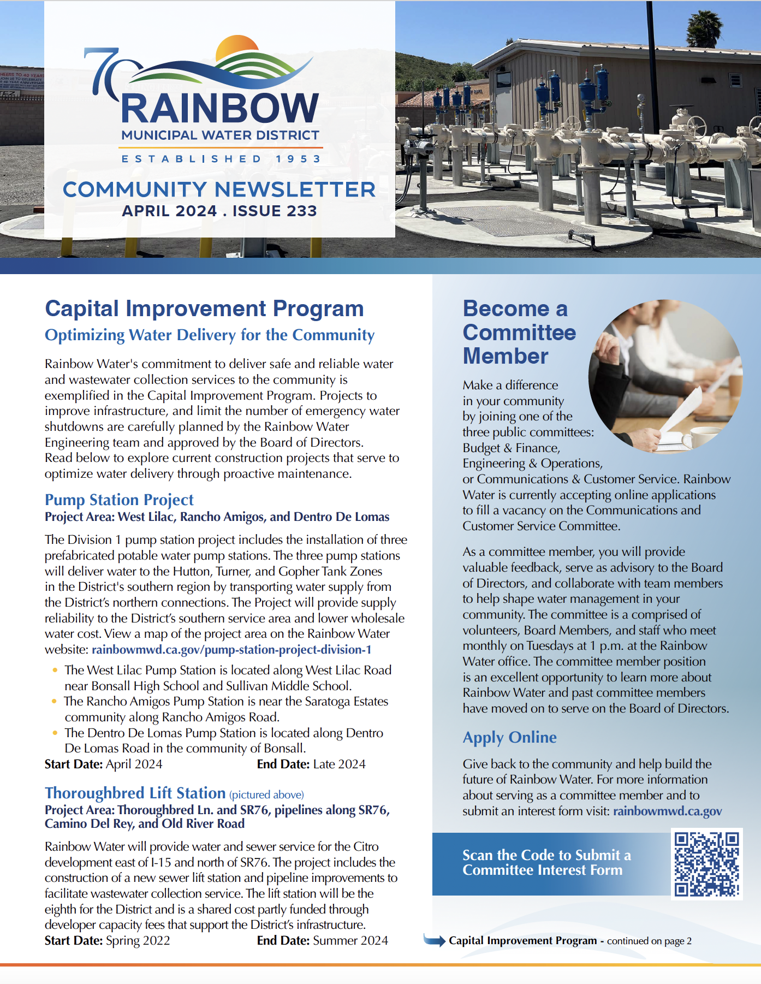
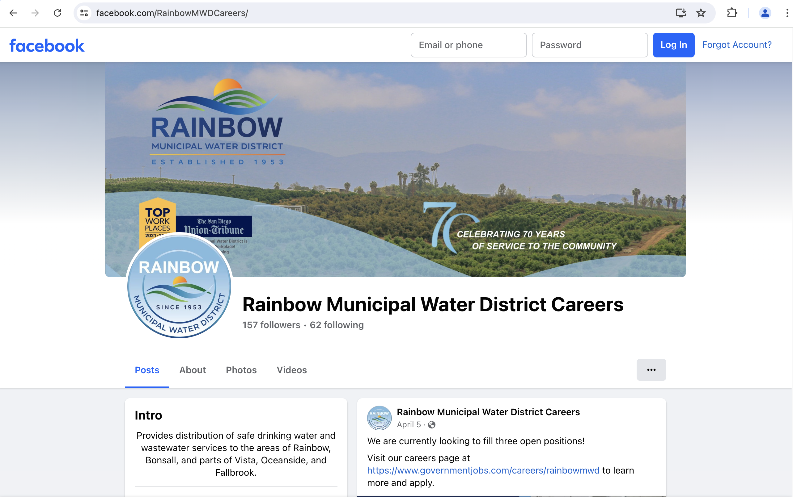
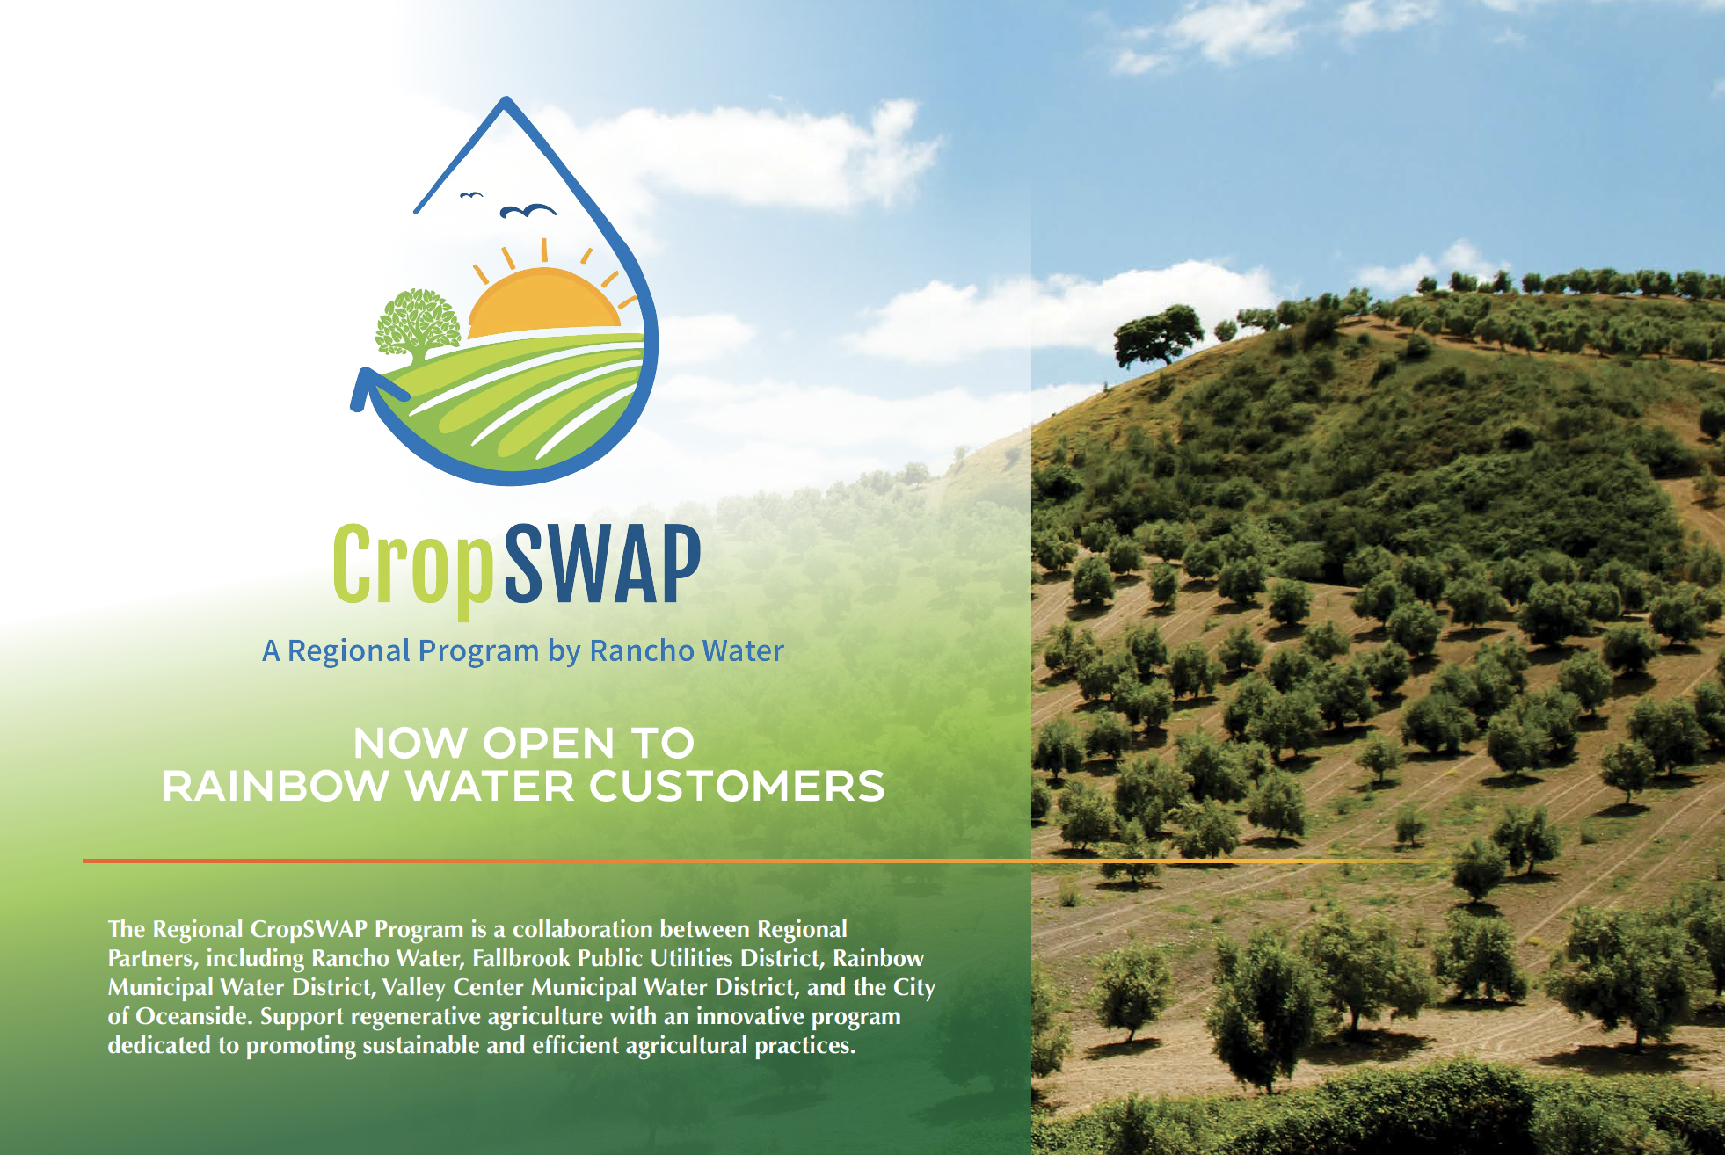
WHERE: Existing Channels in Use
Customer Newsletter (monthly w/bill)
Community Newsletter (quarterly mailed)
Press releases: Village News
Community events (Avo Festival)
Social media (for careers only)
Industry conferences
Award applications
Thought leadership articles (some)
Direct mailers
YouTube (for meetings only)

Slide 18
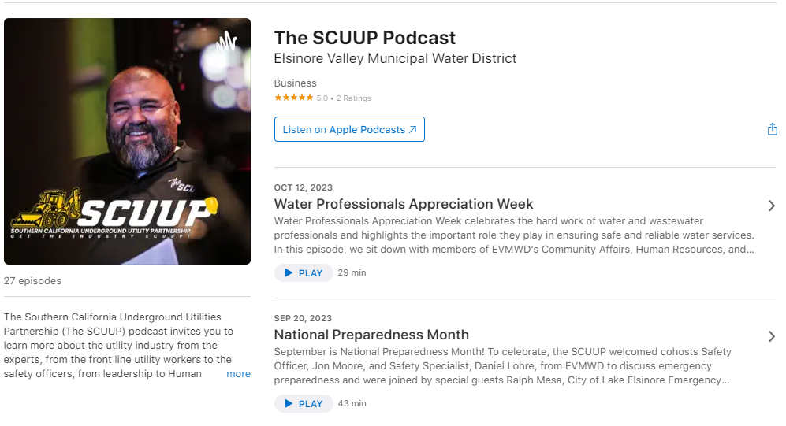

WHERE: Channels not currently in use (much)
Social media (coming soon)
Videos (coming soon)
Educational webinars
Blog posts
Email marketing
Podcasts (12-34 year-old audience)

Slide 19
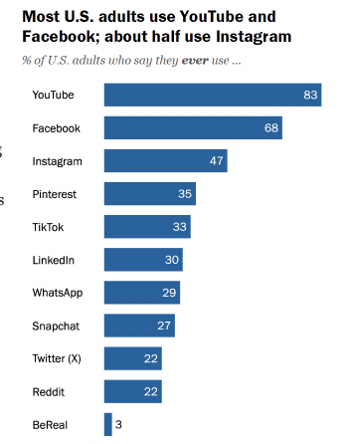
WHERE: Social Media Channel Research
Demographics
  Social channels
    YouTube and Facebook are the only two platforms that majorities of all age groups use. Still a wide margin between ages.
    27% to 35% of U.S. adults use Pinterest, TikTok, LinkedIn, WhatsApp, and Snapchat.
    About one-in-five say they use Twitter (recently renamed “X”) and Reddit.
    YouTube use
      83% Adults 18-65+
      15% 65+
    Facebook use
      68% Most Americans
      Dominant player in online landscape
    Source: Pew Research Study 2023

Slide 20
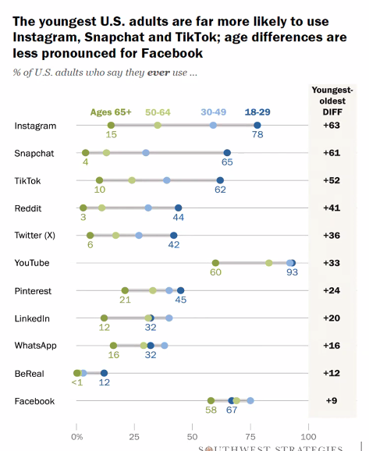
WHERE: Social Media Research
Social Media Channels most likely in use within the District
YouTube 78%
Facebook 67%
Instagram 40%
Pinterest 33%
TikTok 29%
LinkedIn 27%
Snapchat 20%
District Voter
Age Distribution
    Source: Pew Research Study 2023

Slide 21
NEXT STEPS
Why
Desired outcomes
(high-level goals from District strategic plan)
Who
Target audiences
(who cares)
What
Key messages (what do they care about)
How
Guiding principles
(tone and voice)
Tactical recommendations
(action items)
Resource allocation
(staff, technology tools, budget)
Metrics to measure outcomes
(how will we know we did it)
When
Content calendar
Metrics & measurement frequency
Where Communication channels
(where they get info, based on research of target audiences)

Slide 22
Community
Events Update

Slide 23
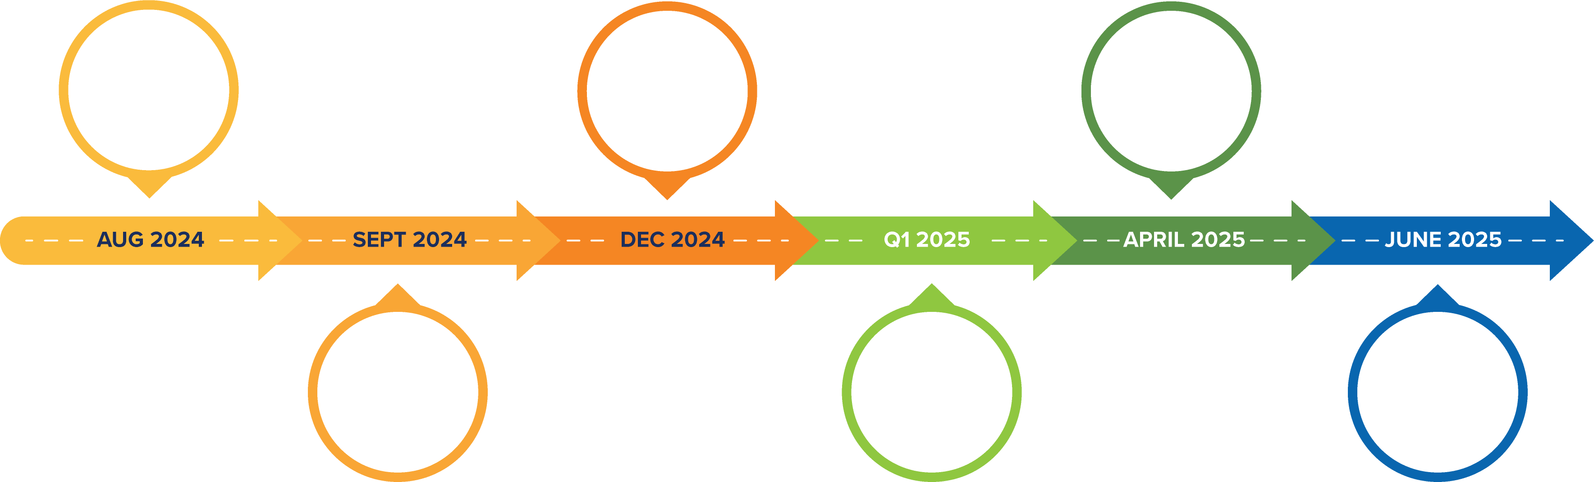







2024-2025 Events
FPUD+ RMWD Joint Community Leaders’ Appreciation Event
Vallecitos School Rainbow Run
Detachment Ceremony
with EMWD
Thoroughbred Lift Station Opening
Fallbrook Christmas Parade
Bonsall High School Field Trip
& Fallbrook Avocado Festival
Notes:
Thoroughbred Lift Station Opening: End August 2024 (date TBD)
Community Appreciation Event w/FPUD: Thurs, September 26
Fallbrook Christmas Parade: Sat, December 7
Detachment Celebration with EMWD: Q1 2025 (date TBD)
Bonsall High School Field Trip: April 2025 (date TBD)
Avocado Festival 2025 : Sun, April 27 (tentative date)
Vallecitos Rainbow Run sponsorship: June 2025 (dat TBD)

Slide 24
Newsletter
Content Planning

Slide 25
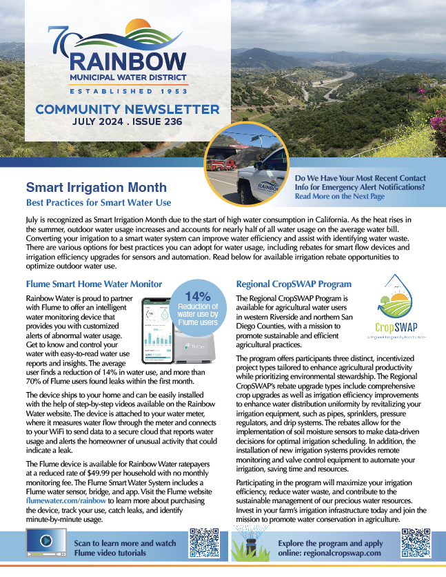
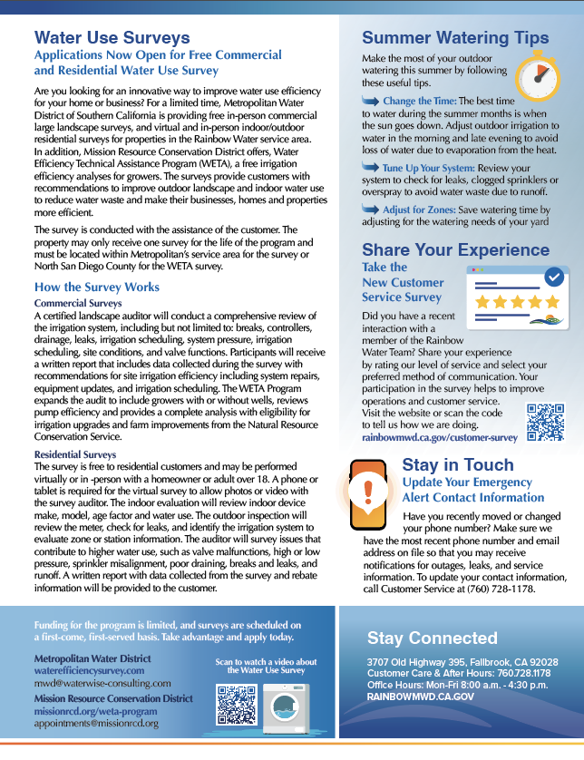
Newsletter Review
July
Smart Irrigation Month
  Smart water use programs available with review of Flume and Regional CropSWAP Program
Water Use Surveys
  Free surveys from Metropolitan and Mission Resource Conservation District for residential, commercial and agricultural customers
Summer Watering Tips
Reminder to Update Emergency Contact Info
Notes:
For a limited time Met is offering free in person commercial large landscape surveys, and virtual and in-person indoor and outdoor residential surveys for properties in our service area. Mission Resource Conservation District is offering a free irrigation efficiency analysis for growers with or without wells. Funding for the program is limited and a link to both programs is featured in the article.

Slide 26
Newsletter Planning
August
  National Farmers Week Aug 1-7
    Highlight programs available for growers: CropSWAP program types, scheduling automation, & Met rebates
  Convert to a Sustainable Landscape with Rebates
    Guide to removing turf & sheet mulching with video links
  Calendar Contest Winners
    Photo feature with artwork
  Share Your Experience
    Take the customer service survey
September
  Value of Water
    Explain how price of water pays for components of infrastructure, maintenance, and more to deliver safe reliable water
    Infographic with length water travels across CA
  Construction update
    Progress on lift stations, pump stations with photo feature
  Water Footprint Calculator,
    Free online tool to get an inside look at the amount of water used for residential and “virtual water”
  Share Your Experience
    Take the customer service survey
Notes:
CropSWAP Enhance water efficiency on one or more irrigated acres through equipment upgrades such as soil moisture sensors, best management practices with mulching and cover crops.
Option for Aug: Summer Heat Wave Tips for staying cool, cooling center info, update your emergency contact info

Slide 27
Public
Communications
& Related Media Stories

Slide 28
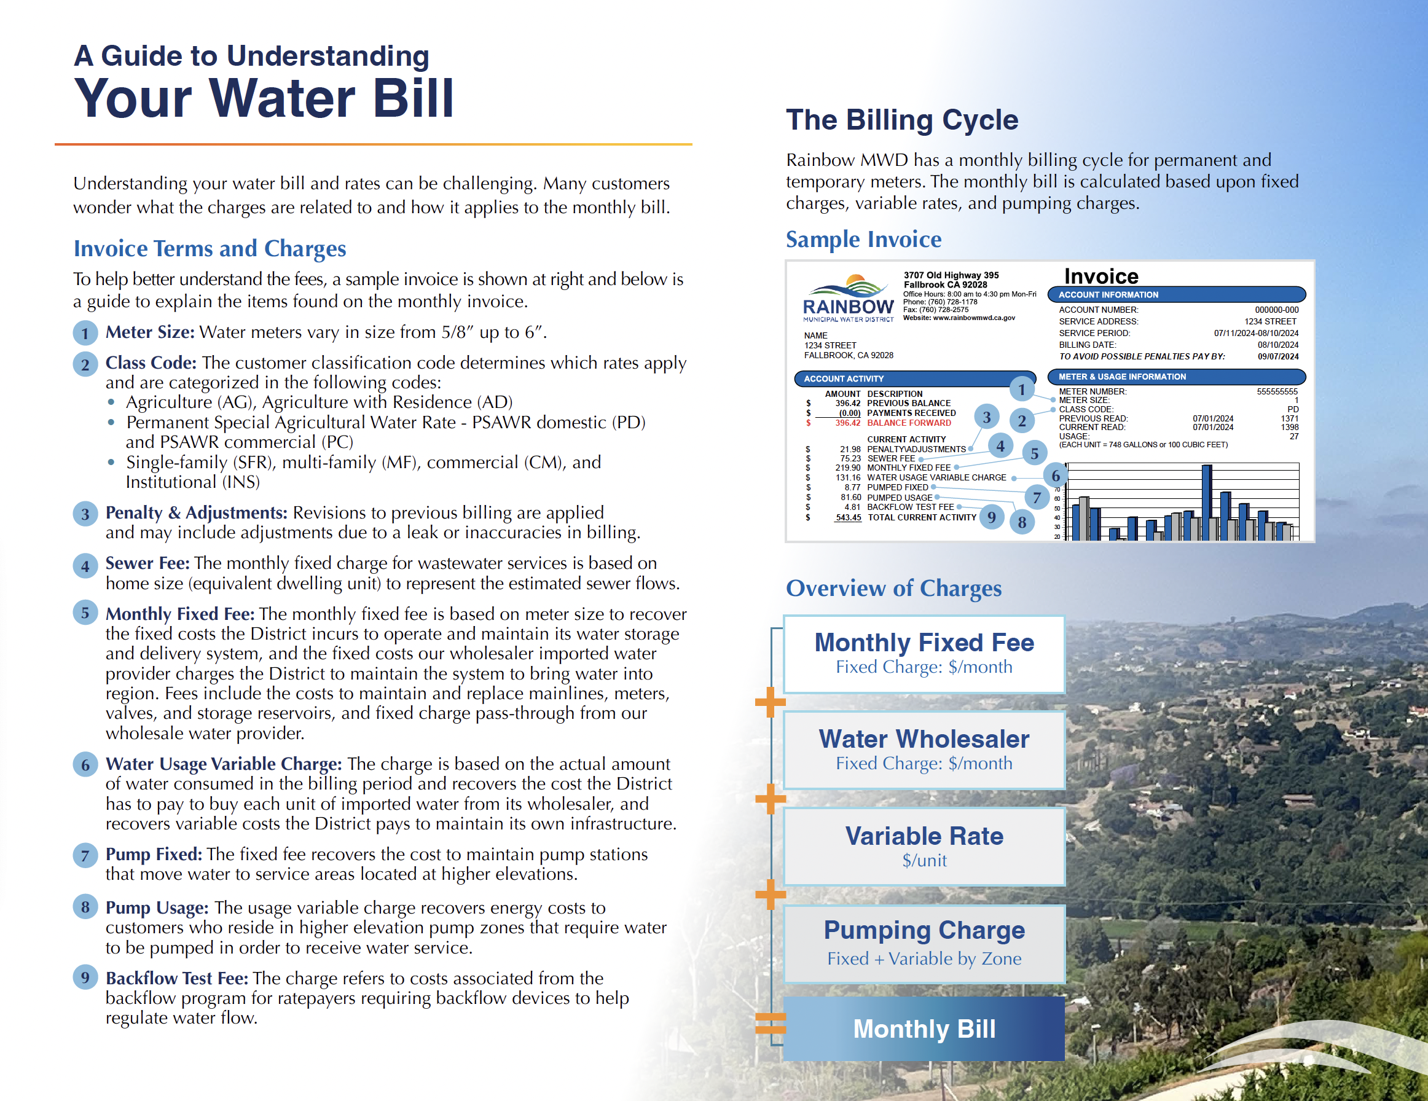

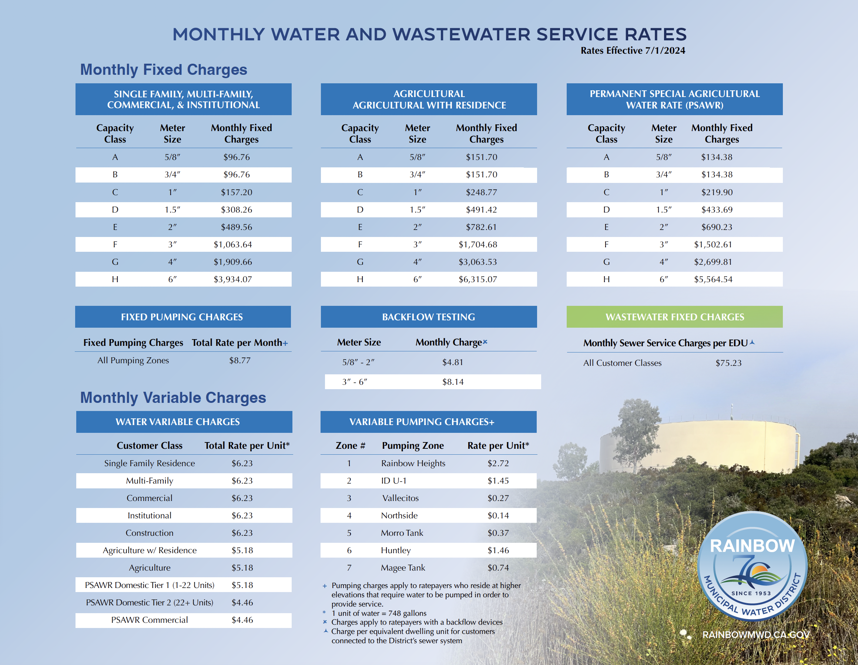
Website & Collateral
Welcome Brochure
Intro to Your Water Agency with infographics, terms and billing info
Rate Sheet
July 1 Rate information

Slide 29
Agenda Items for the Next Meeting

