Slide 1
FY 2025-26 Budget Adoption
May 27, 2025

Slide 2
Water Fund - 01
Budget FY 2025-26

Slide 3
Key Budget FY26 Assumptions and Highlights
11,000 AF water sales in FY26, up from 10,000 AF in FY25
Imported treated water rate increase of 9.5% on January 1, 2026
Debt service $6.3M ($15.8M SDCWA exit fee financing), up from $3.9M in FY25
Electricity cost increase 9%
Labor cost increase 5.6% driven by health insurance 7%, avg merit 4.4% and avg COLA 2.5%
Water Rate Impact: 4% increase on January 1, 2026

Slide 4
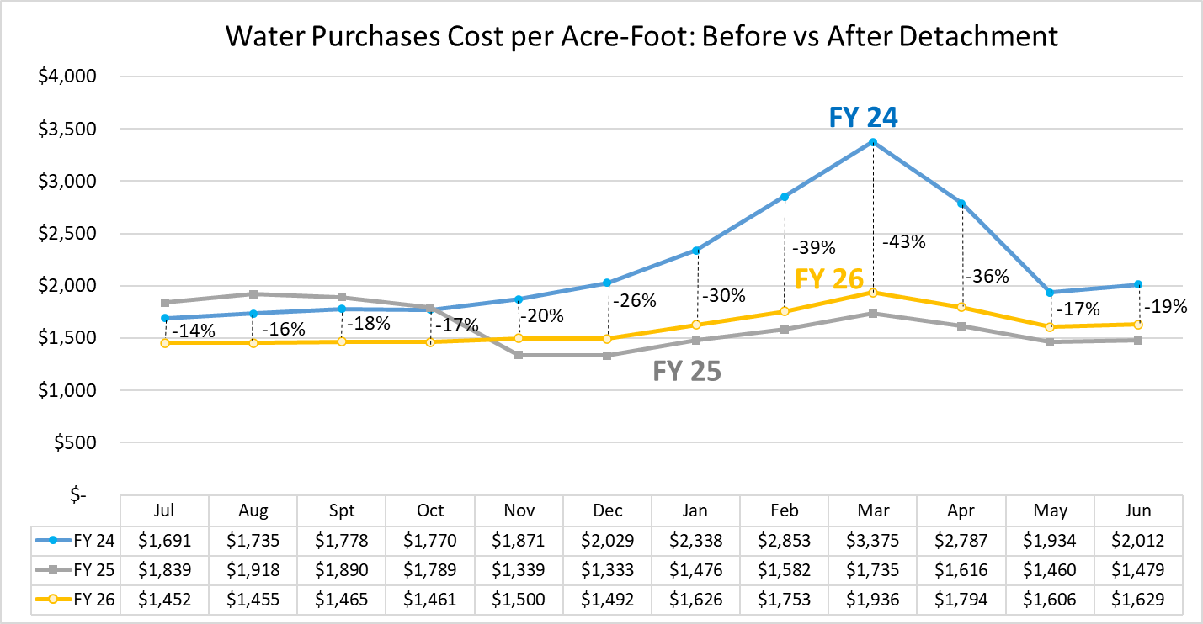

Slide 5
Total Net Revenue Budget FY26 Water Fund (01)
REVENUE | Dollars
Variable | 26,320,446
Fixed | 23,119,771
Other Revenue | 1,096,286
Total Revenue | 50,536,503
EXPENSES
Water Purchases EMWD | 18,273,278
Debt Service | 6,340,630
Labor | 9,208,193
CalPERS UAL | 962,869
O&M | 7,706,801
CIP - 5 year plan avg | 7,894,732
Cropswap | 150,000
Total Expenses | 50,536,503
Net Revenue | $0
Notes:
Labor and O&M expenses include 81% Fund 03 – General allocation to Fund 01

Slide 6
Wastewater Fund - 02
Budget FY 2025-26

Slide 7
Key Budget FY26 Assumptions and Highlights
City of Oceanside wastewater treatment cost $1.7M, minor change from FY25 cost
Reserve fund recovery from City of Oceanside “catch-up” billings for FY22,23,24 in the amount of $4.1M paid in FY25
Debt service payment $663k for Thoroughbred Lift Station
Environmental Compliance: $200k odor control for Horse Creek
Wastewater Rate Impact: 13% increase on July 1, 2025

Slide 8
Total Net Revenue Budget FY 26 Wastewater Fund (02)
Revenue | Dollars
EDU Fixed Charge | 6,017,688
CIP Grant Revenue | 1,075,000
Total Revenue | 7,092,688
Expenses
City of Oceanside O&M Cost | 1,718,782
Debt Service | 663,021
Labor | 1,496,103
O&M | 1,432,298
CIP | 1,125,000
“Catch-up” Billing Recovery | 657,484
Total Expenses | 7,092,688
Net Revenue | $0
Notes:
Labor and O&M expenses include 19% allocation of Fund 03 to Fund 02

Slide 9
Board Action Requested
Recommendation:
The Board to adopt the Resolution Adopting the Fiscal Year 2025-26 Budget
Rate Impacts:
Water Rates increase 4% on January 1, 2026
Wastewater Rates increase 13% on July 1, 2025

