Slide 1
Gopher Canyon Water Line and Paving Repairs
Robert Gutierrez, COO

Slide 2
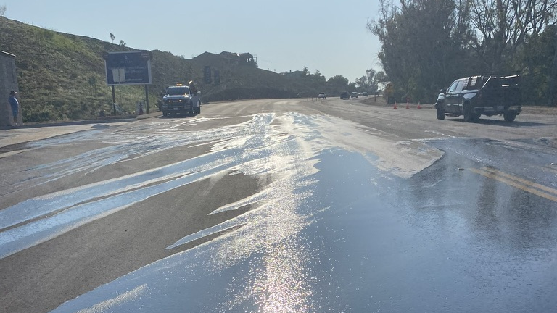

Slide 3
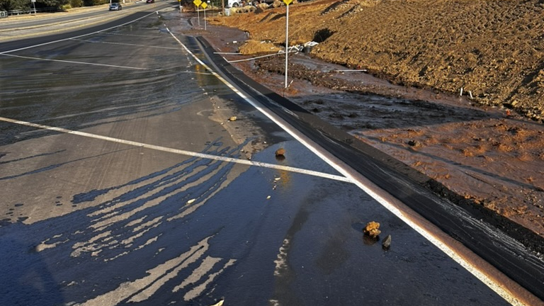

Slide 4
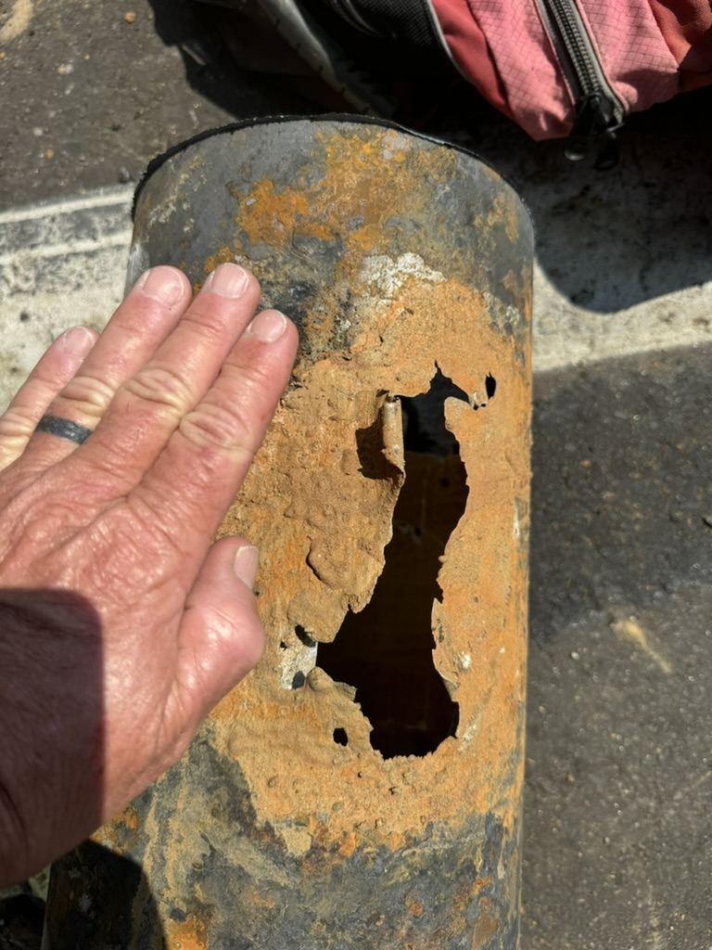
July 26, 2024
8” CMLC broke due to corrosion
4’ of pipe replaced
No one out of water
Significant damage to subgrade and paving.

Slide 5
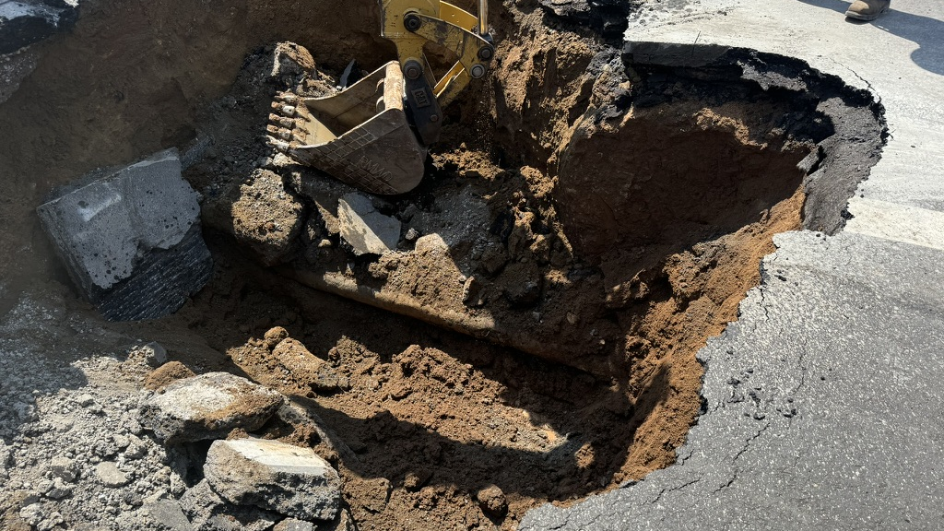

Slide 6
STAFFS RECOMMENDATIONS
Replace 300 feet of 8” CMLC with 12” CMLC
Add sacrificial anodes
12” CMLC will aid in the flow of water from Dentro Pump Station to the Gopher zone
Repave affected area

Slide 7
COST BREAKDOWN
Cost | Detail
$465,000 | Paving
$8,000 | Heavy Equipment Rental
$50,000 | Materials
$31,000 | Labor & Benefits
$554,000 | Total Hard Costs
$46,000 | Contingency
$600,000 | Total Project Cost

Slide 8
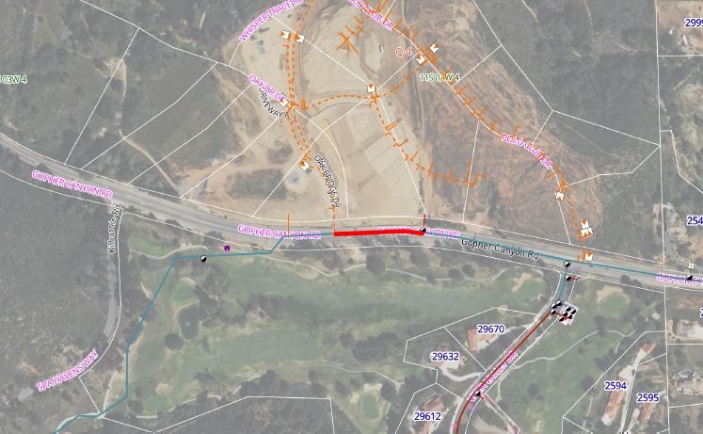

Slide 9
Questions?

