Slide 1
CIP Program
Year 1 Projects FY 24/25
August 2024

Slide 2
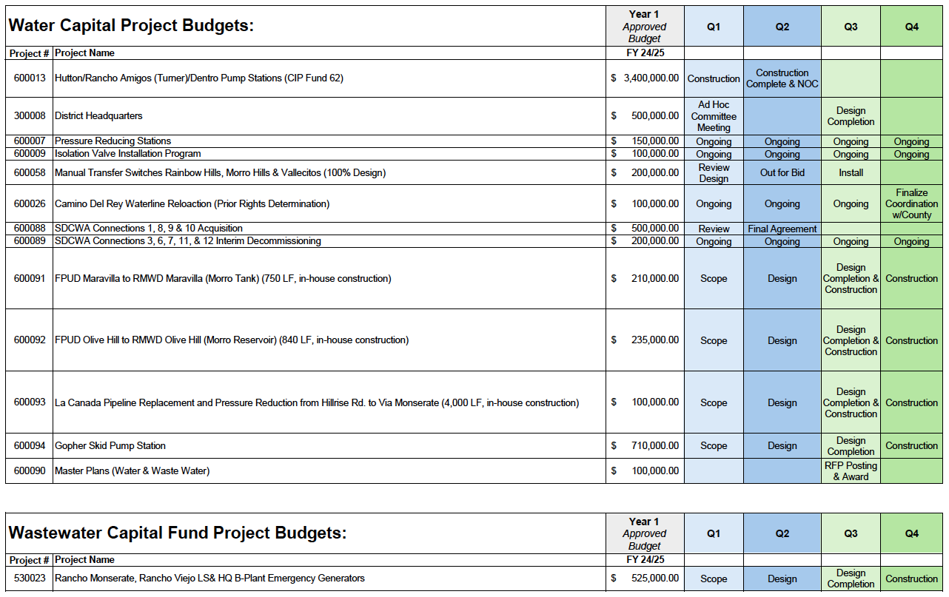

Slide 3
Water Projects
FY 24/25

Slide 4
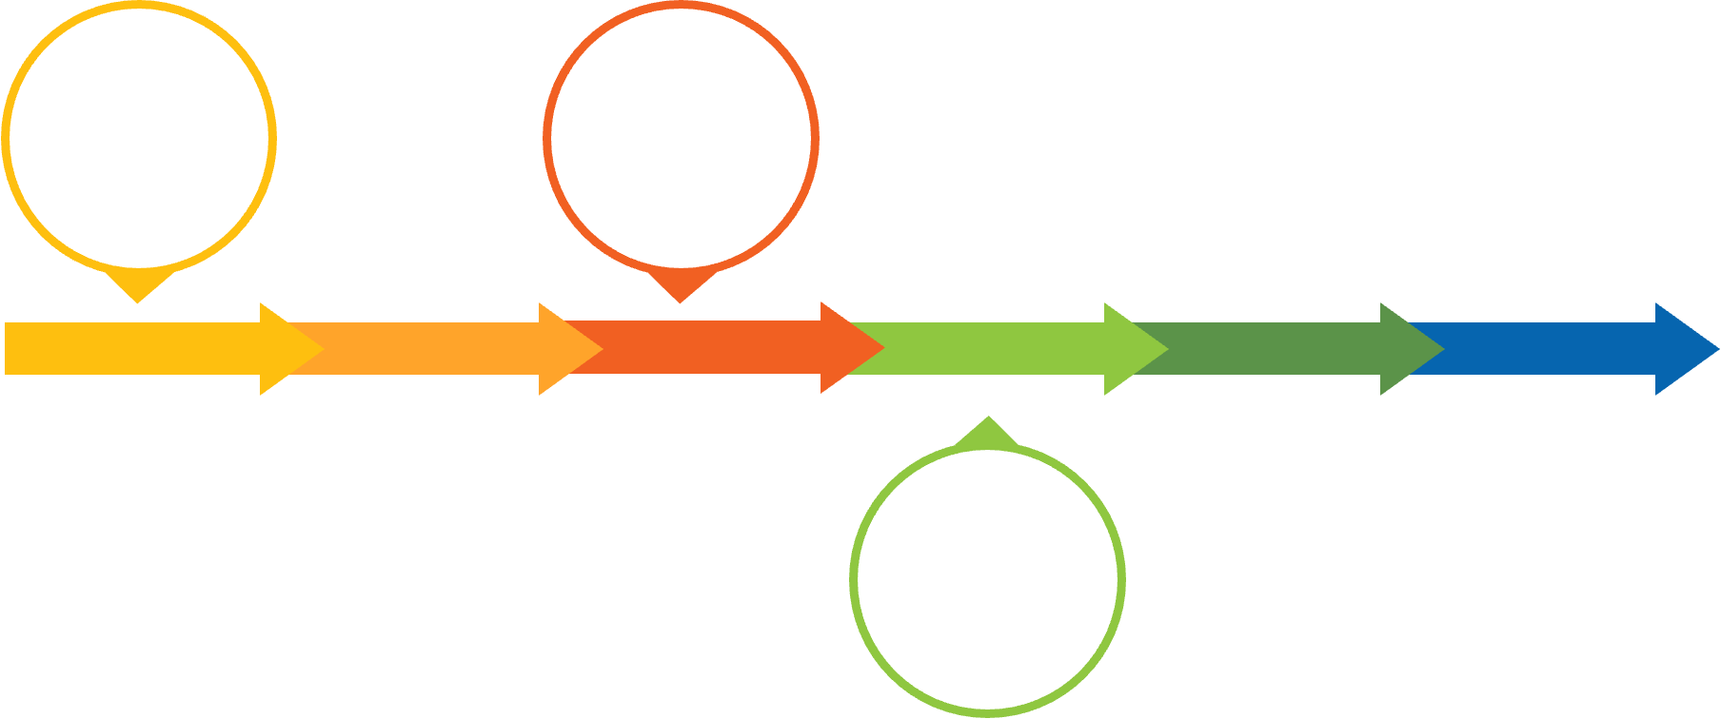
West Lilac, Rancho Amigos and Dentro De Lomas Pump Stations (600013)
Scope of Work: Install three (3) pump stations to provide water to the Hutton-Turner-Gopher Tank zones.
Project Rationale: Required operational project to deliver water to the District's southern pressure zones absent SDCWA supply.
Construction
Construction Complete
JULY 2024
OCT 2024
DEC 2024
JUNE 2025
Notice of Completion
 | Planned Expenditures
Project | Year 1 (FY 24/25) | Year 2 (FY 25/26) | Year 3 (FY 26/27) | Year 4 (FY 27/28) | Year 5 (FY 28/29) | Total
600013 | $3,400,000 |  |  |  |  | $3,400,000

Slide 5
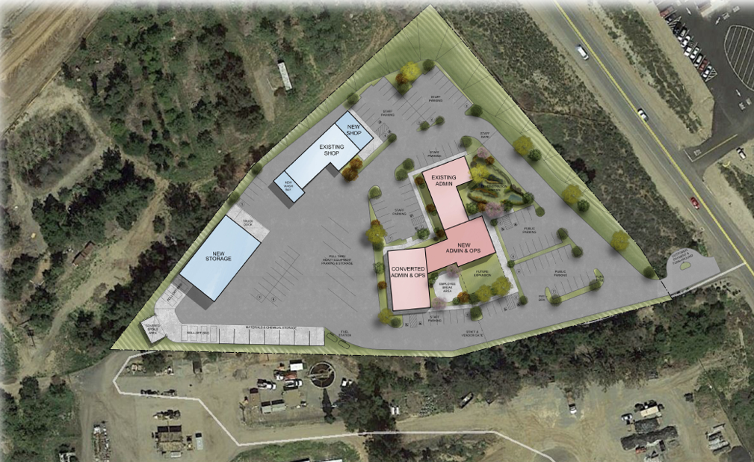
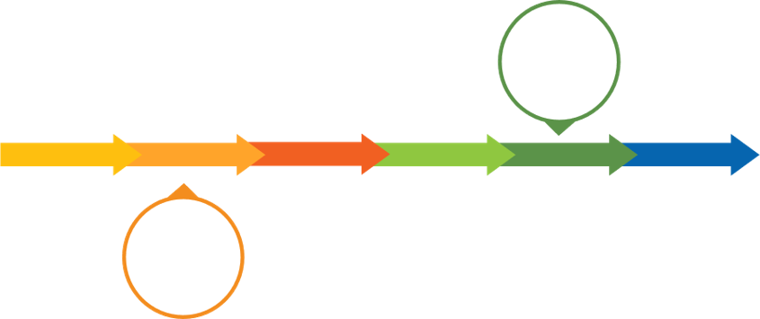
District Headquarters (300008)
Scope of Work: Repair and replace necessary facilities for on-going operations and explore options for long-term District facilities plan with the recently re-established Ad-Hoc committee.
Project Rationale: The project will fund roof and HVAC upgrades in the Admin Building in FY24/25 to maintain adequate facilities in the near-term and explore feasibility of a long-term facilities solution of either re-development of the existing site and relocation of District facilities or extending the useful life of existing facilities through significant upgrades. Facilities support day-to-day administration and operations of the District.
Design Completion
JULY 2024
FEB 2025
JUNE 2025
Ad Hoc Committee Meeting
 | Planned Expenditures
Project | Year 1 (FY 24/25) | Year 2 (FY 25/26) | Year 3 (FY 26/27) | Year 4 (FY 27/28) | Year 5 (FY 28/29) | Total
300008 | $500,000 | $500,000 | $1,000,000 | $4,000,000 |  | $ 6,000,000

Slide 6
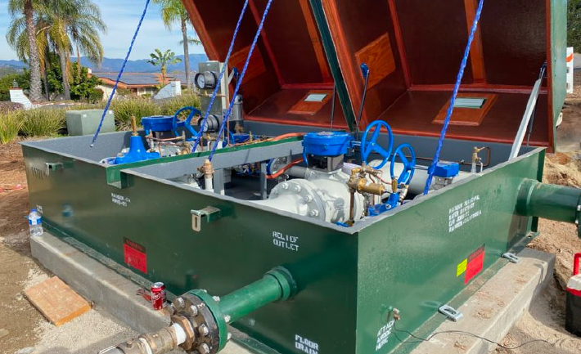
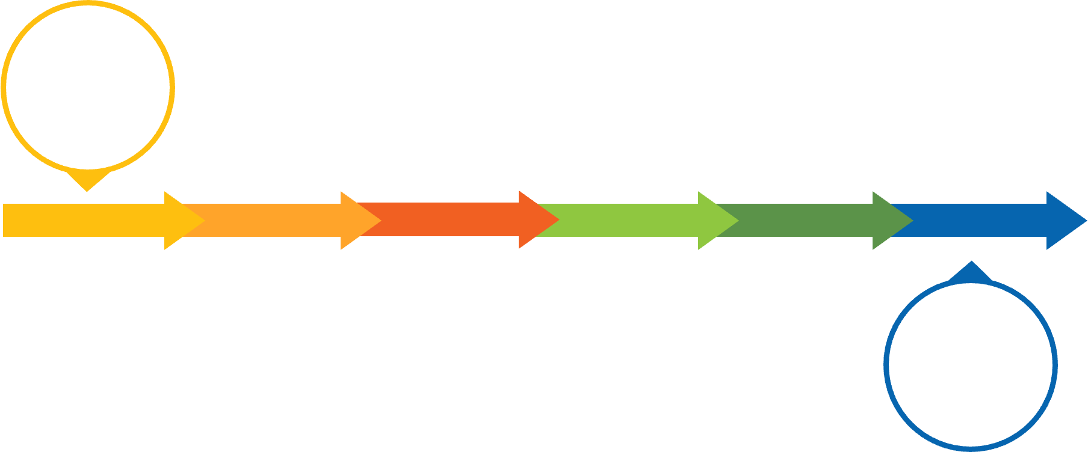
Pressure Reducing Stations (600007)
Scope of Work: Install previously purchased pressure reducing stations district-wide in areas of high pressure.
Project Rationale: The project will reduce high-pressure zones to extend the useful life of water infrastructure and reduce damage associated with main line breaks.
Ongoing
JULY 2024
JUNE 2025
Ongoing
 | Planned Expenditures
Project | Year 1 (FY 24/25) | Year 2 (FY 25/26) | Year 3 (FY 26/27) | Year 4 (FY 27/28) | Year 5 (FY 28/29) | Total
600007 | $150,000 | $150,000 | $150,000 |  |  | $450,000

Slide 7
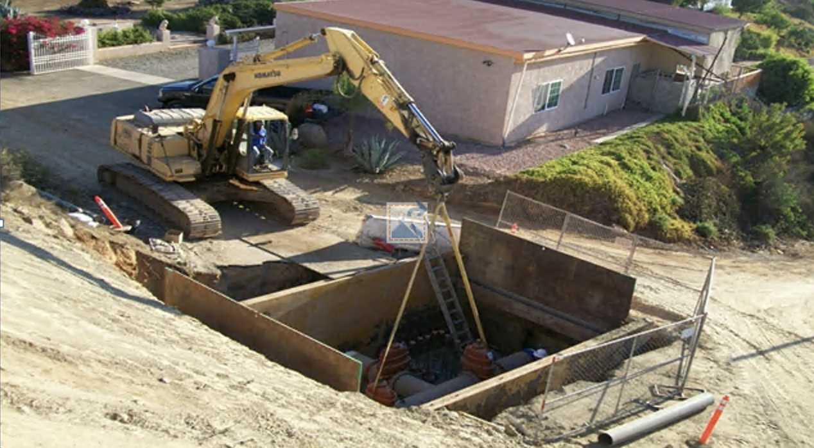
Isolation Valve Installation Program (600009)
Scope of Work: Replace isolation valves district-wide that have exceeded their useful life.
Project Rationale: The project will reduce the number of customers impacted by service interruptions due to leaks and main breaks and reduce repair time due to valves that don't fully seal. The Project will also replace valves in the broken or open positions.
Ongoing
JULY 2024
JUNE 2025
 | Planned Expenditures
Project | Year 1 (FY 24/25) | Year 2 (FY 25/26) | Year 3 (FY 26/27) | Year 4 (FY 27/28) | Year 5 (FY 28/29) | Total
600009 | $100,000 | $500,000 | $180,000 | $500,000 | $180,000 | $1,460,000
Ongoing

Slide 8
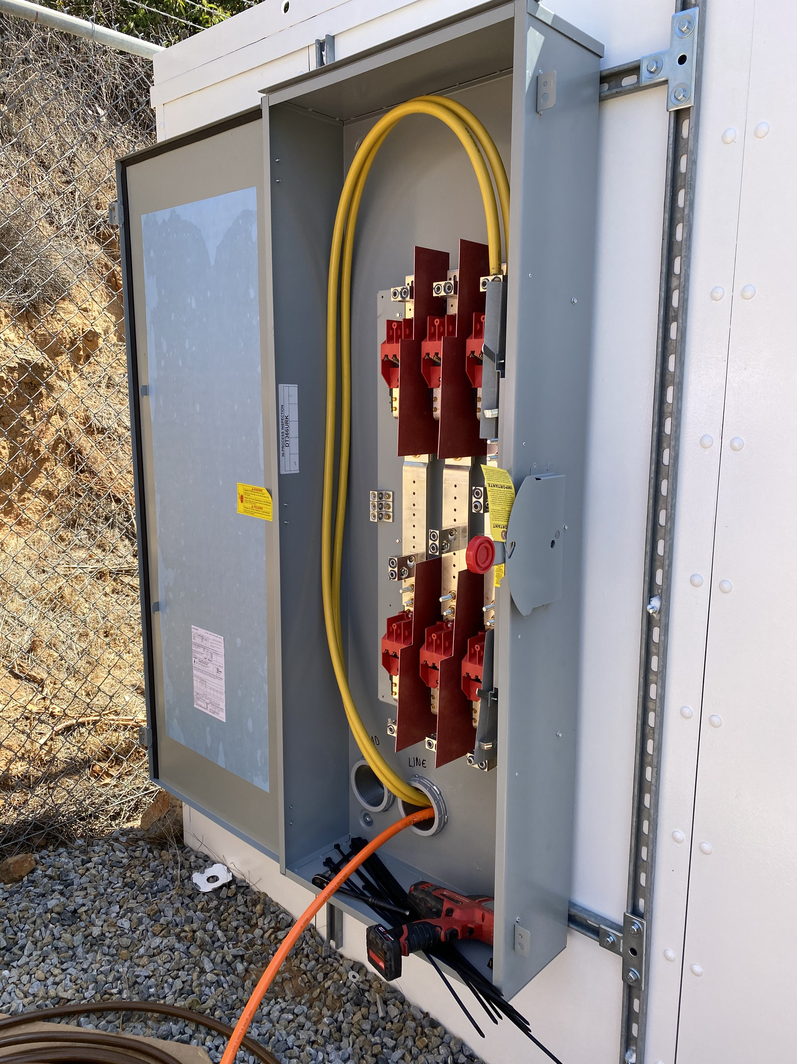
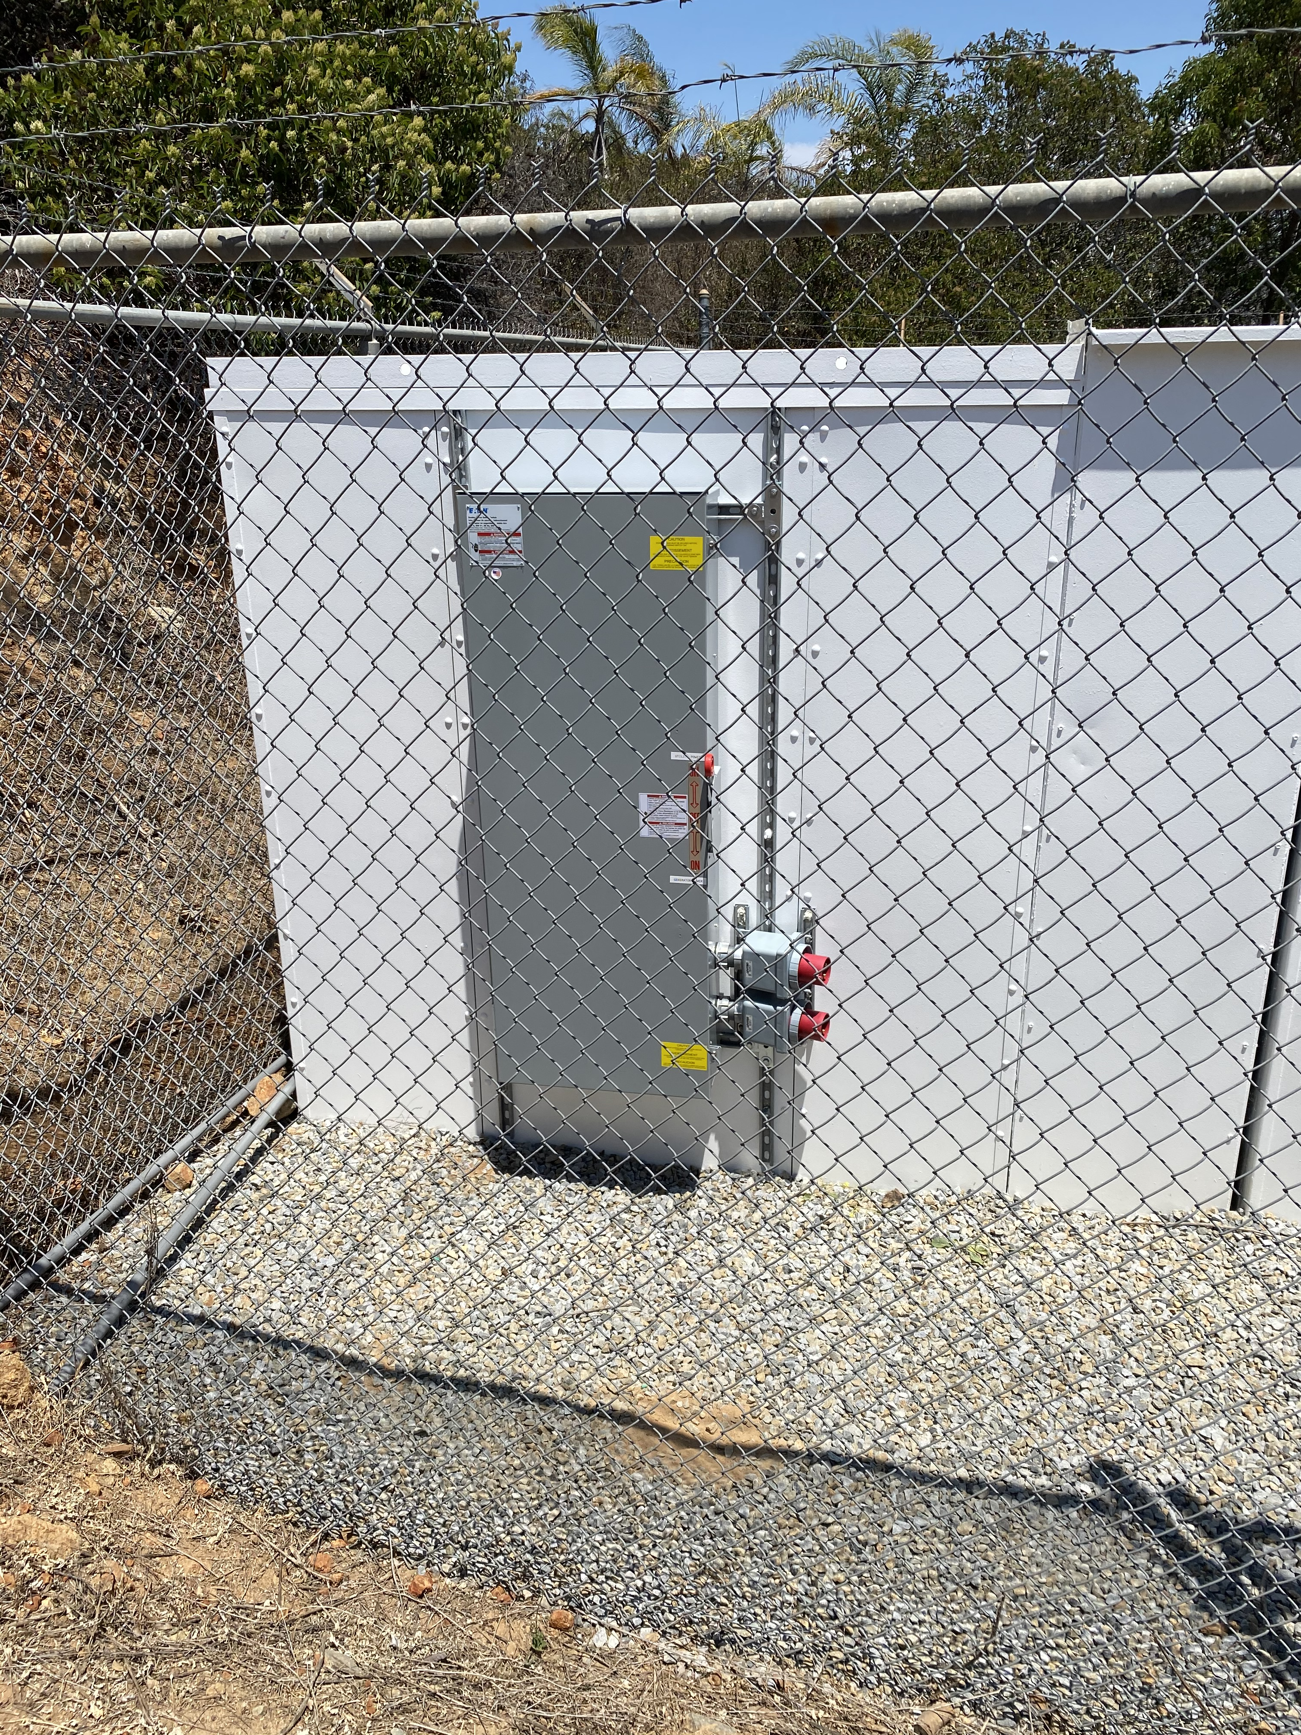
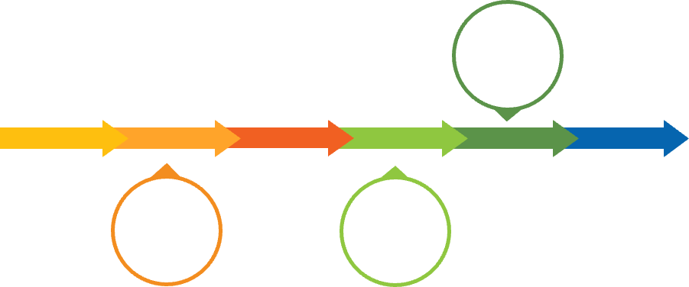
Manual Transfer Switches (600058)
Scope of Work: Install manual transfer switches at Morro Hills Pump Station, Rainbow Hills Pump Station, and Vallecitos Pump Station.
Project Rationale: The project will ensure the safety of District staff when switching to backup power during emergencies.
Install
JULY 2024
AUG 2024
NOV 2024
JAN 2025
JUNE 2025
Review Design
Out
for Bid
 | Planned Expenditures
Project | Year 1 (FY 24/25) | Year 2 (FY 25/26) | Year 3 (FY 26/27) | Year 4 (FY 27/28) | Year 5 (FY 28/29) | Total
600058 | $200,000 |  |  |  |  | $200,000

Slide 9
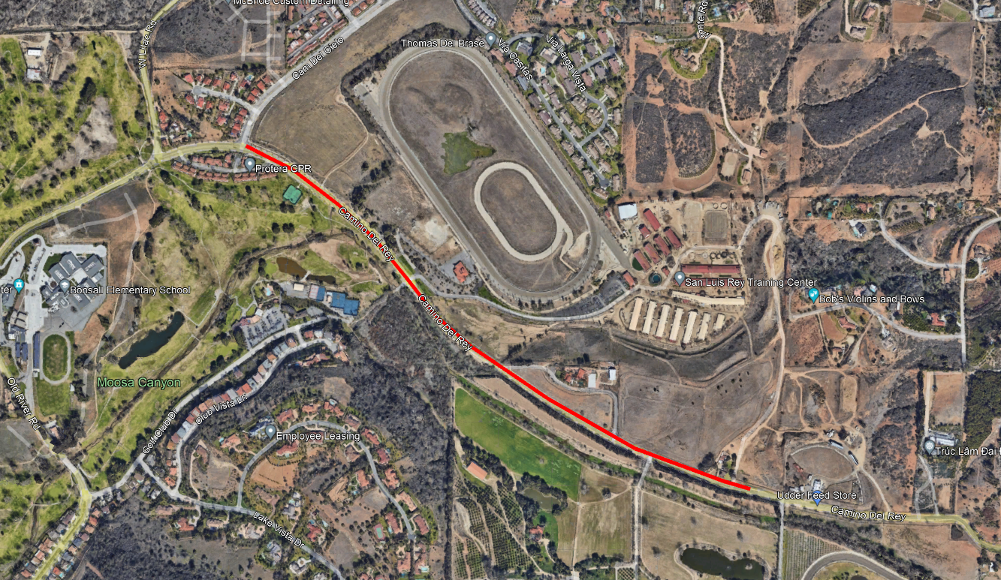
Camino Del Rey Waterline Relocation (600026)
Scope of Work: Relocate existing water and sewer infrastructure due to the County of San Diego's Road Improvement Project.
Project Rationale: The project will ensure continuity of service during the County-initiated construction project and upgrade water facilities.
Ongoing
Analysis
JULY 2024
JUNE 2025
Finalize
coordination w/County
 | Planned Expenditures
Project | Year 1 (FY 24/25) | Year 2 (FY 25/26) | Year 3 (FY 26/27) | Year 4 (FY 27/28) | Year 5 (FY 28/29) | Total
600026 | $100,000 | $25,000 |  |  |  | $125,000

Slide 10
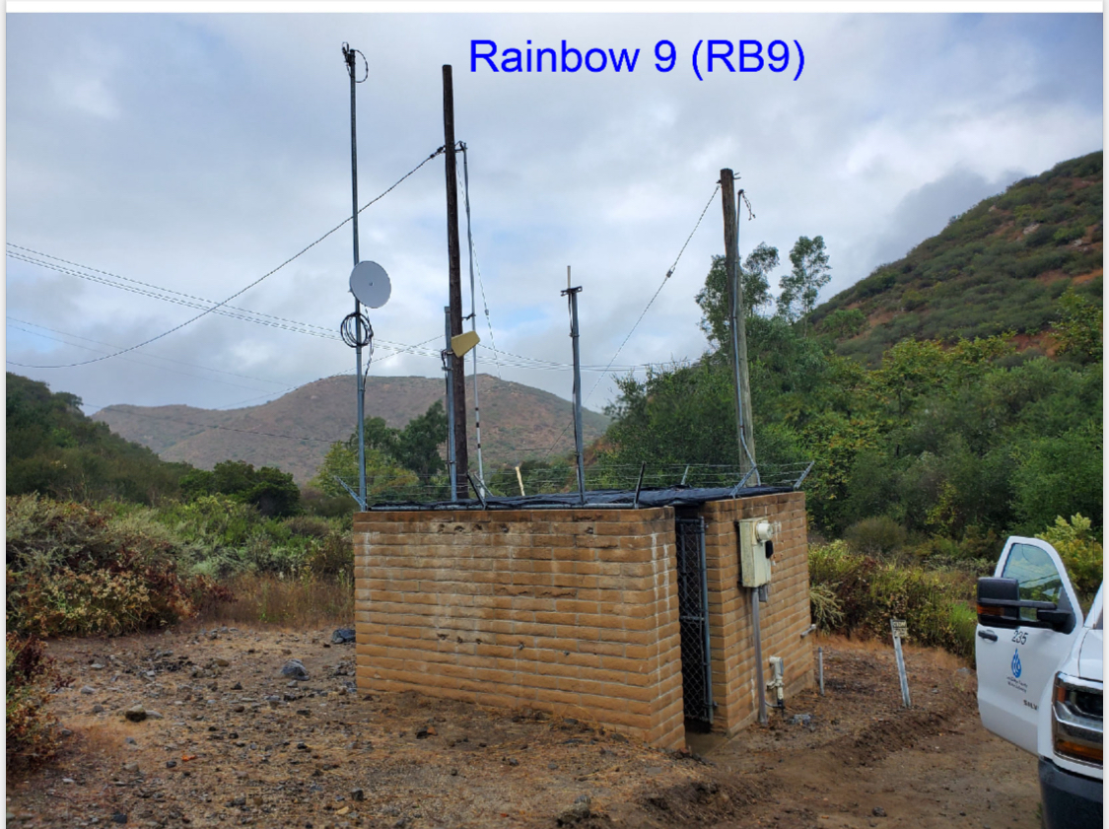
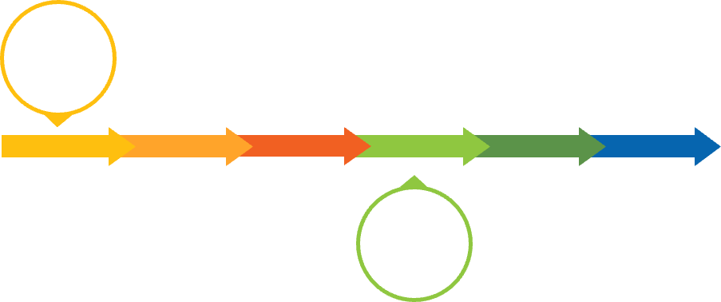
SDCWA Connections 1, 8, 9, and 10 Acquisition (600088)
Scope of Work: Purchase/acquire facilities and property associated with existing SDCWA connections 1, 8, 9, and 10.
Project Rationale: This is a condition of detachment.
REVIEW
JULY 2024
DEC 2024
JUNE 2025
Final
Agreement
 | Planned Expenditures
Project | Year 1 (FY 24/25) | Year 2 (FY 25/26) | Year 3 (FY 26/27) | Year 4 (FY 27/28) | Year 5 (FY 28/29) | Total
600088 | $500,000 |  |  |  |  | $500,000

Slide 11
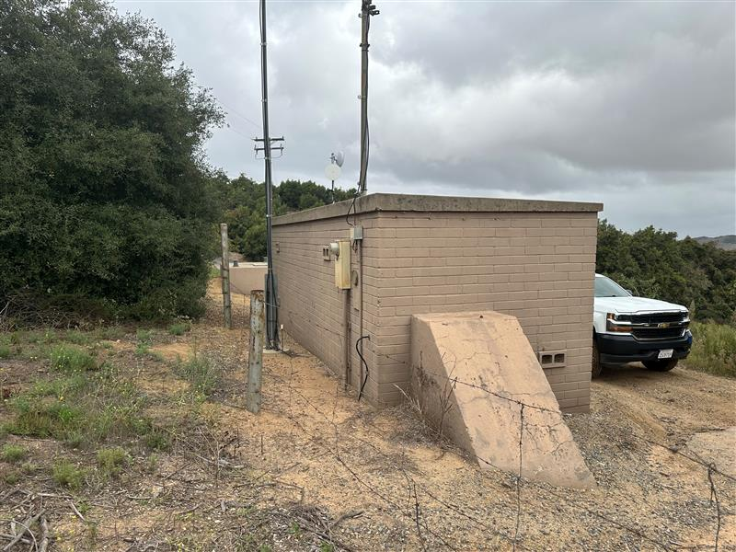
SDCWA Connections 3, 6, 7, and 11 Interim Decommissioning
Scope of Work: Interim decommissioning at SDCWA connections 3, 6, 7, and 11.
Project Rationale: Requirement of detachment from SDCWA.
Ongoing
JULY 2024
JUNE 2025
Ongoing
 | Planned Expenditures
Project | Year 1 (FY 24/25) | Year 2 (FY 25/26) | Year 3 (FY 26/27) | Year 4 (FY 27/28) | Year 5 (FY 28/29) | Total
600089 | $200,000 |  |  |  |  | $200,000

Slide 12
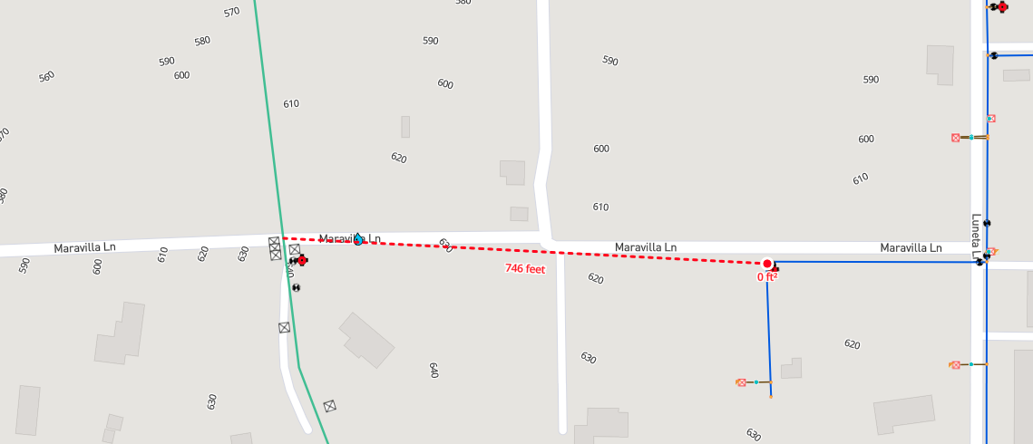
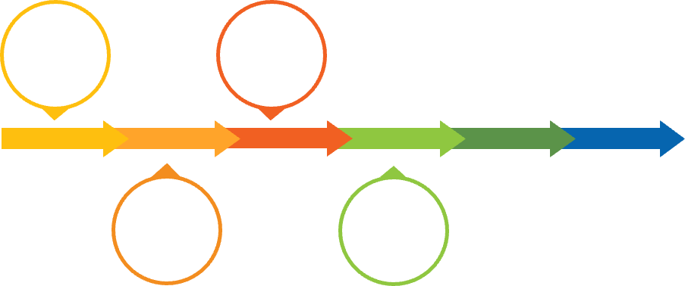
FPUD Maravilla to RMWD Maravilla (Morro Tank) (600091)
Scope of Work: Install 750 LF of C900 PVC pipeline to connect FPUD and RMWD potable water systems.
Project Rationale: Operational flexibility to source water into the Morro Tank zone providing additional capacity from Morro Reservoir to the District's southern pressure zones.
Design
Complete
Scope
JULY 2024
FEB 2025
MAR 2025
JUNE 2025
Design
Construction
 | Planned Expenditures
Project | Year 1 (FY 24/25) | Year 2 (FY 25/26) | Year 3 (FY 26/27) | Year 4 (FY 27/28) | Year 5 (FY 28/29) | Total
600091 | $210,000 |  |  |  |  | $210,000

Slide 13
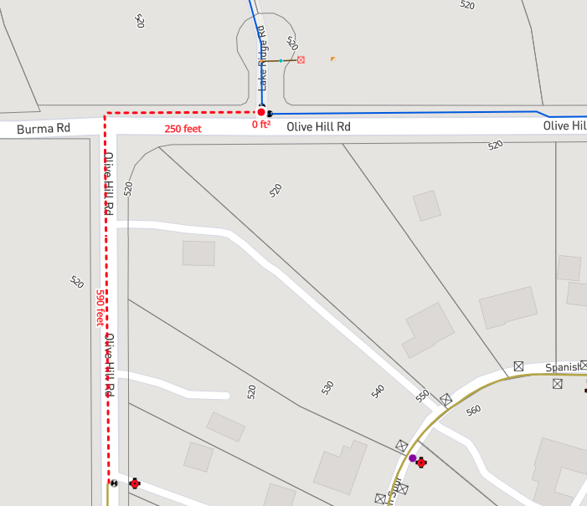
FPUD Olive Hill to RMWD Olive Hill (Morro Reservoir) (600092)
Scope of Work: Install 840 LF of C900 PVC Pipeline to connect FPUD and RMWD potable water systems.
Project Rationale: Operational flexibility to source water into the Morro Reservoir providing additional capacity to the District's southern pressure zones.
Scope
Design
Complete
JULY 2024
FEB 2025
MAR 2025
JUNE 2025
Design
Construction
 | Planned Expenditures
Project | Year 1 (FY 24/25) | Year 2 (FY 25/26) | Year 3 (FY 26/27) | Year 4 (FY 27/28) | Year 5 (FY 28/29) | Total
600092 | $235,000 |  |  |  |  | $235,000

Slide 14
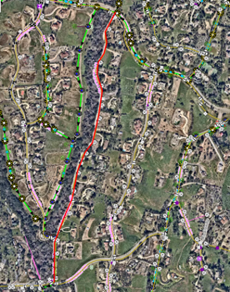
La Canada Pipeline Replacement and Pressure Reduction (600093)
Scope of Work: Replace 4,000 LF of pipeline along La Canada from Hillrise Rd. to Via Monserate and install two (2) new pressure reducing stations.
Project Rationale: The project will prevent future costs associated with leaks or main breaks and reduce service interruptions. This alignment of pipeline has experienced eight (8) main breaks within the last five (5) years.
Scope
Design Complete
JULY 2024
FEB 2025
MAR 2025
JUNE 2025
Design
Construction
 | Planned Expenditures
Project | Year 1 (FY 24/25) | Year 2 (FY 25/26) | Year 3 (FY 26/27) | Year 4 (FY 27/28) | Year 5 (FY 28/29) | Total
600093 | $100,000 | $700,000 |  |  |  | $800,000

Slide 15
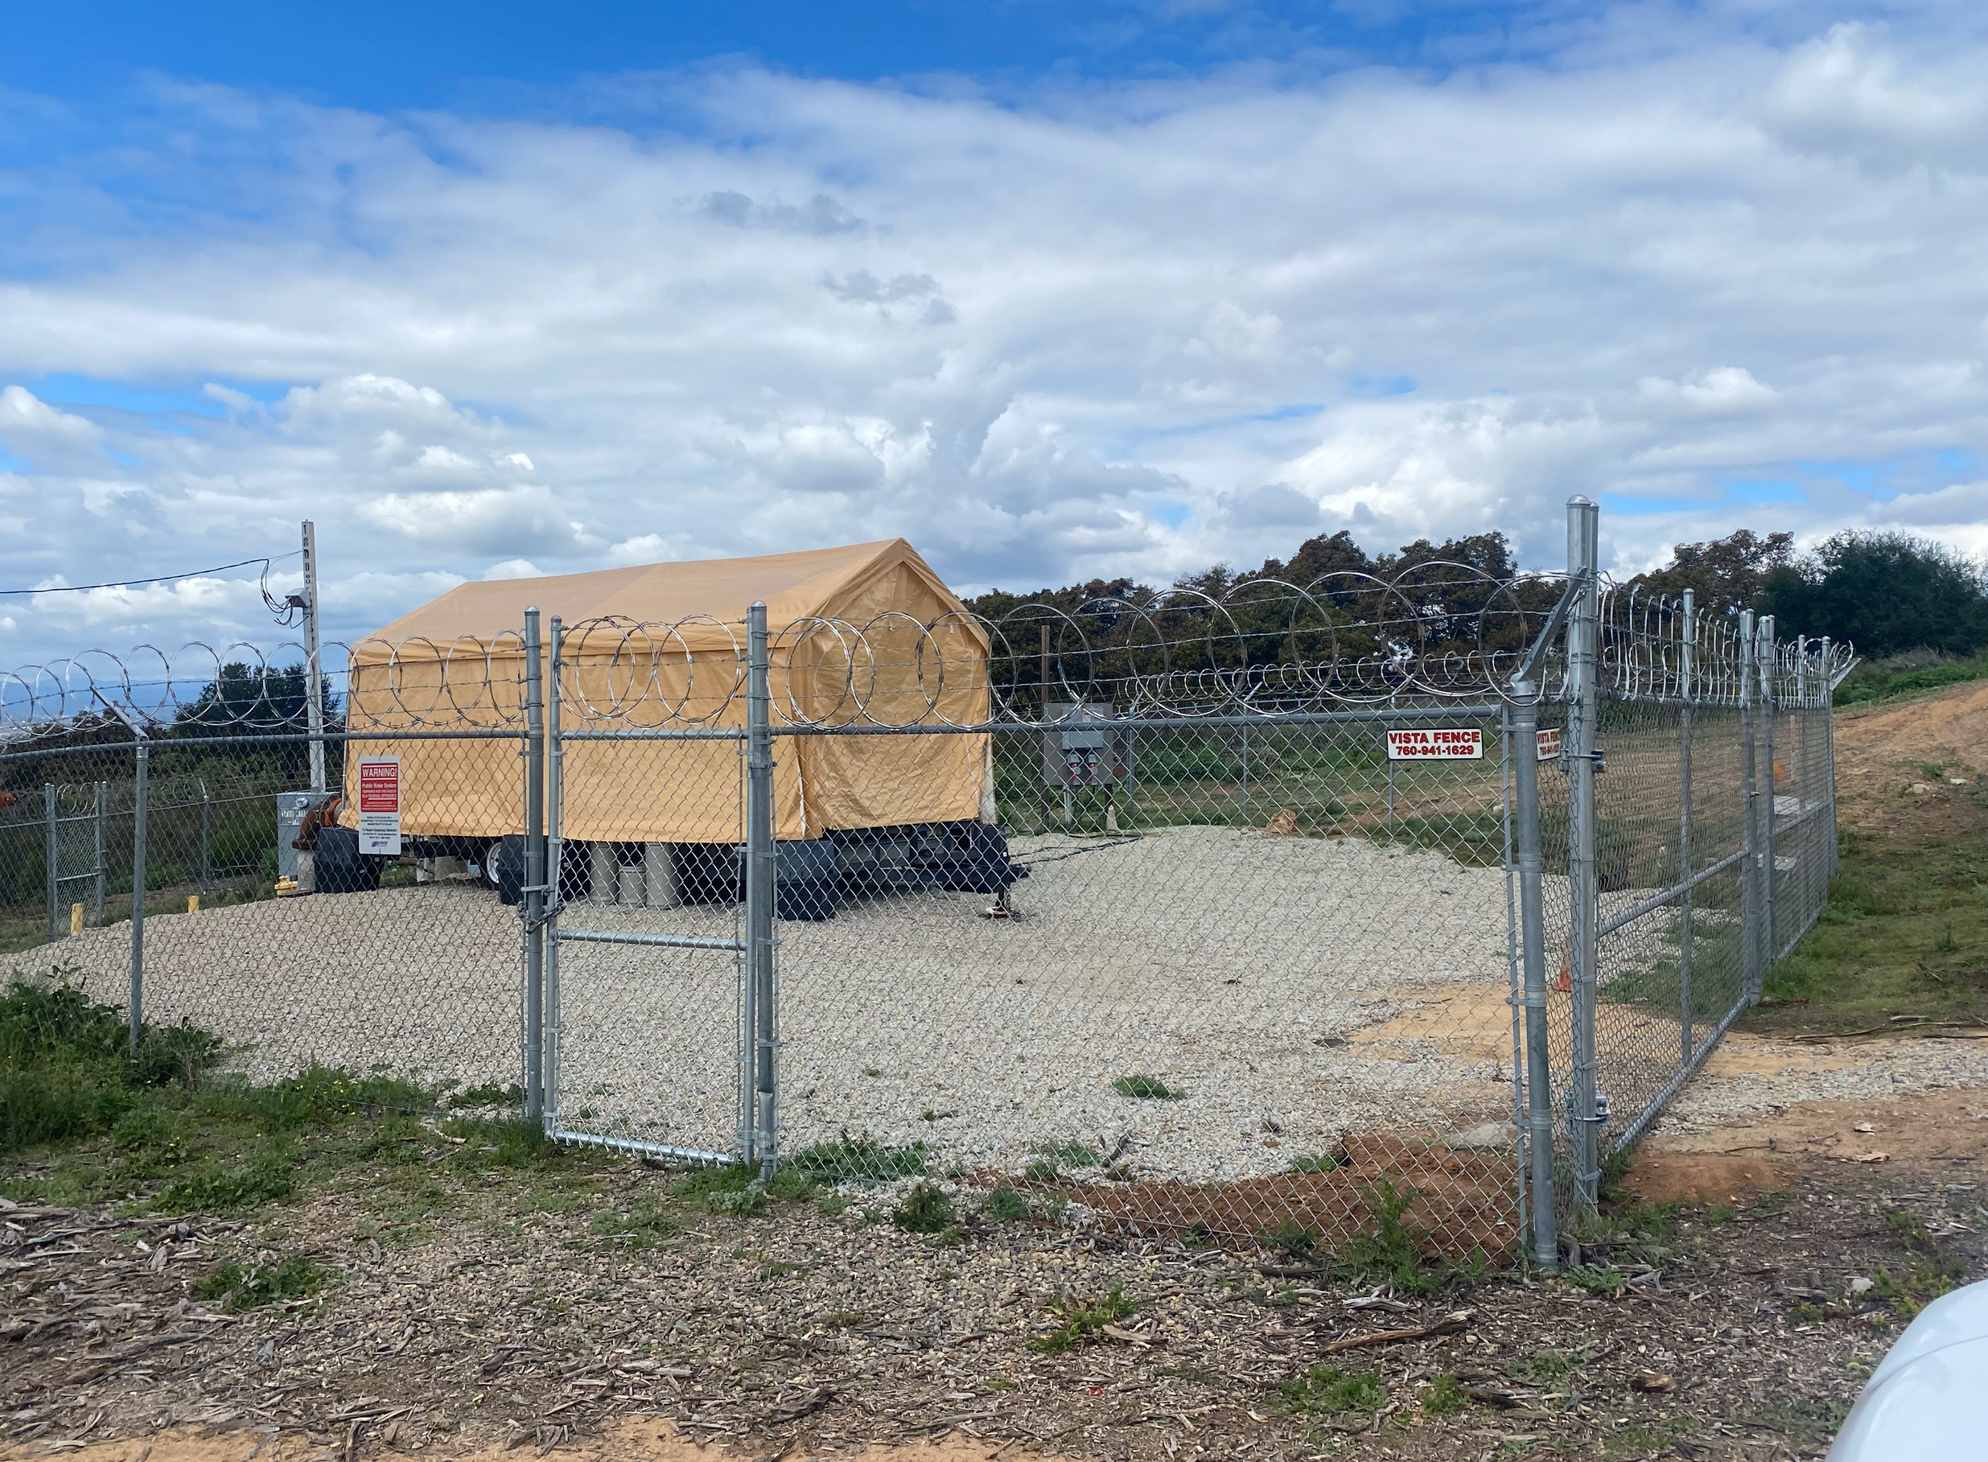
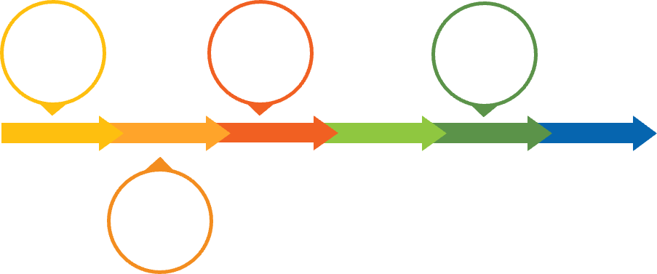
Gopher Skid Pump Station (600094)
Scope of Work: Replace the temporary pump skid with a permanent solution.
Project Rationale: Required operational flexibility to move water within the southern zone absent SDCWA connections.
Scope
Design
Completion
Construction
JULY 2024
MAR 2025
JUNE 2025
Design
 | Planned Expenditures
Project | Year 1 (FY 24/25) | Year 2 (FY 25/26) | Year 3 (FY 26/27) | Year 4 (FY 27/28) | Year 5 (FY 28/29) | Total
600094 | $710,000 |  |  |  |  | $710,000

Slide 16

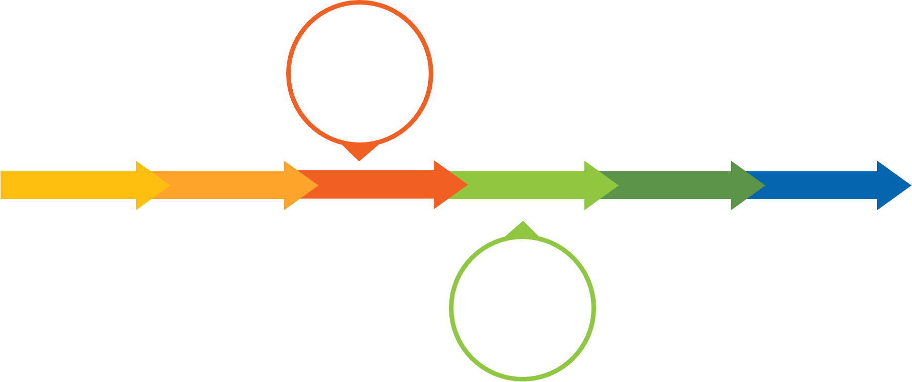
Water and Wastewater Master Plan (600090)
Scope of Work: Develop Long-range Water and Sewer System Master Plan. Includes Constructing system hydraulic model utilizing latest software technology to evaluate and identify system deficiencies and solutions based on updated demand projections and system operations.
Project Rationale: The project will provide the District with a master plan of project improvements for long-term planning, prioritization, and funding for water and wastewater infrastructure needs.
RFP
Posting
JULY 2024
JAN 2025
MAR 2025
JUNE 2025
Award
 | Planned Expenditures
Project | Year 1 (FY 24/25) | Year 2 (FY 25/26) | Year 3 (FY 26/27) | Year 4 (FY 27/28) | Year 5 (FY 28/29) | Total
600090 | $100,000 | $750,000 |  |  |  | $850,000

Slide 17
Sewer Projects
FY 24/25

Slide 18
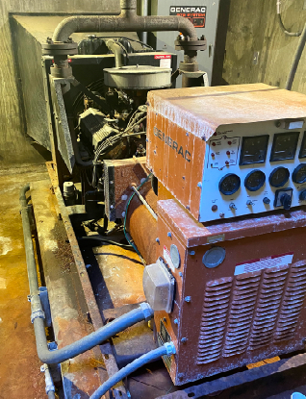
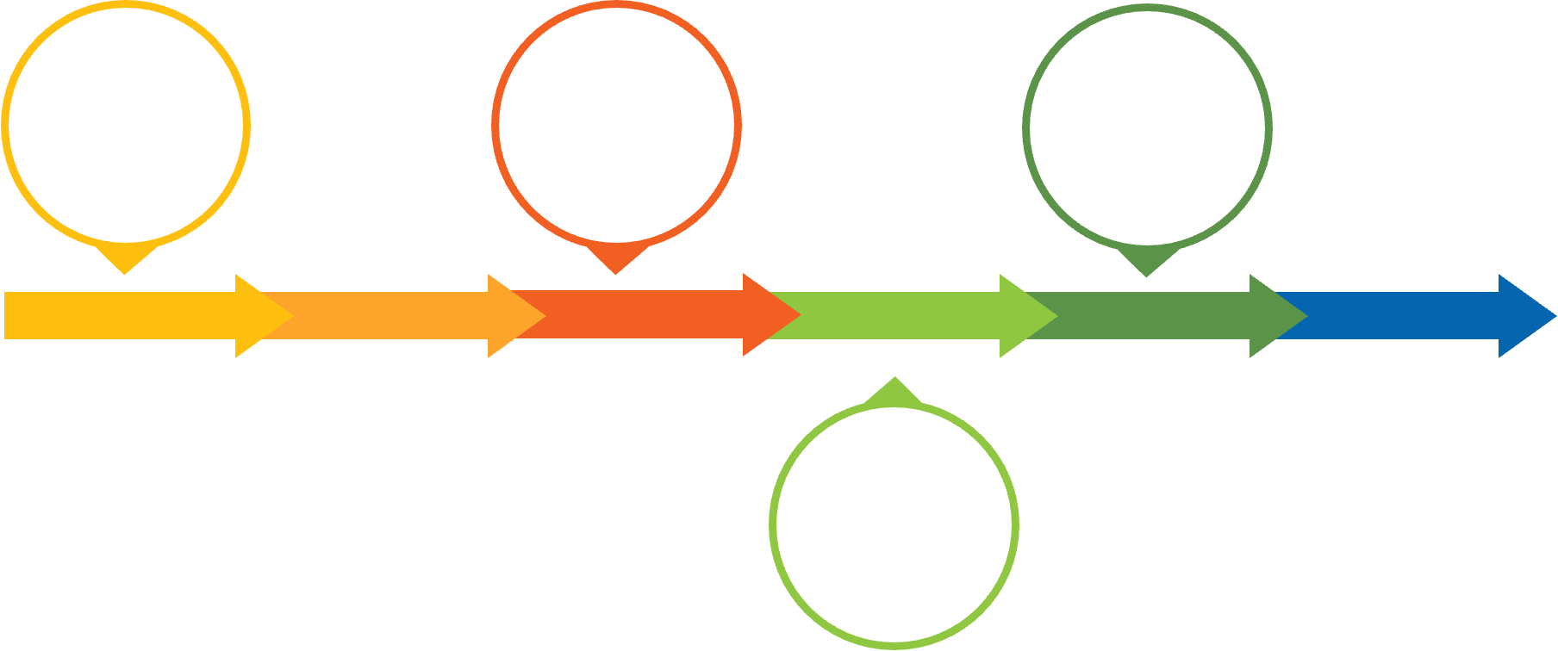
Rancho Monserate, Rancho Viejo, and HQ B-Plant Emergency Generators (530023)
Scope of Work: This project proposes to in-kind replacements of the obsolete emergency generators at Rancho Monserate, Rancho Viejos, and HQ B-Plant lift stations.
Project Rationale: The project will provide a backup power source for critical sewer infrastructure. Existing equipment has exceeded its useful life.
Scope
Design
Construction
JULY 2024
OCT 2024
FEB 2025
APR 2025
JUNE 2025
Design
Complete
 | Planned Expenditures
Project | Year 1 (FY 24/25) | Year 2 (FY 25/26) | Year 3 (FY 26/27) | Year 4 (FY 27/28) | Year 5 (FY 28/29) | Total
530023 | $525,000* |  |  |  |  | $525,000
*Grant funding dependent

Slide 19
Questions?

