Slide 1
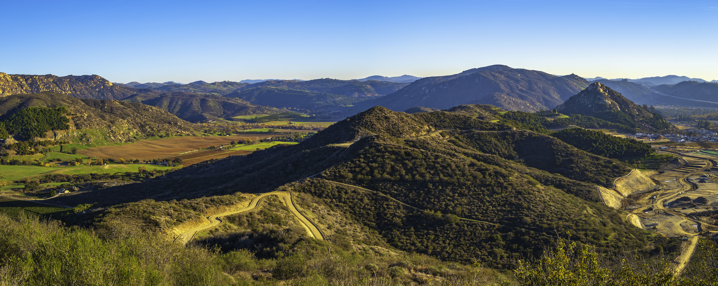
Communications & Customer Service
Committee Update

Slide 2




CropSWAP Program
_
67
Submissions to Date
_
55
Projects Approved
$765,700
In Reserved Grant
Funding for
Approved Projects
_
4
Pre-Inspection
Notes:
Rainbow Water leads with participation in Regional CropSWAP program
Strong uptick in application approval for the month of September
6 Submissions for Sept – mid Oct
Two projects rejected and resubmitted to meet requirements
Pre- inspection 2 are crop conversion, 1 avocado tree rejuvenation, 1 avocado rootstock
Used 565,700 in the communal fund

Slide 3
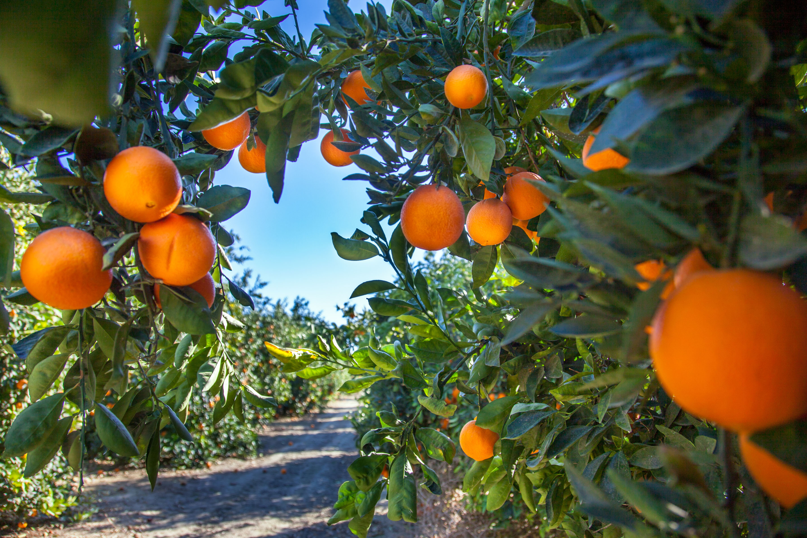
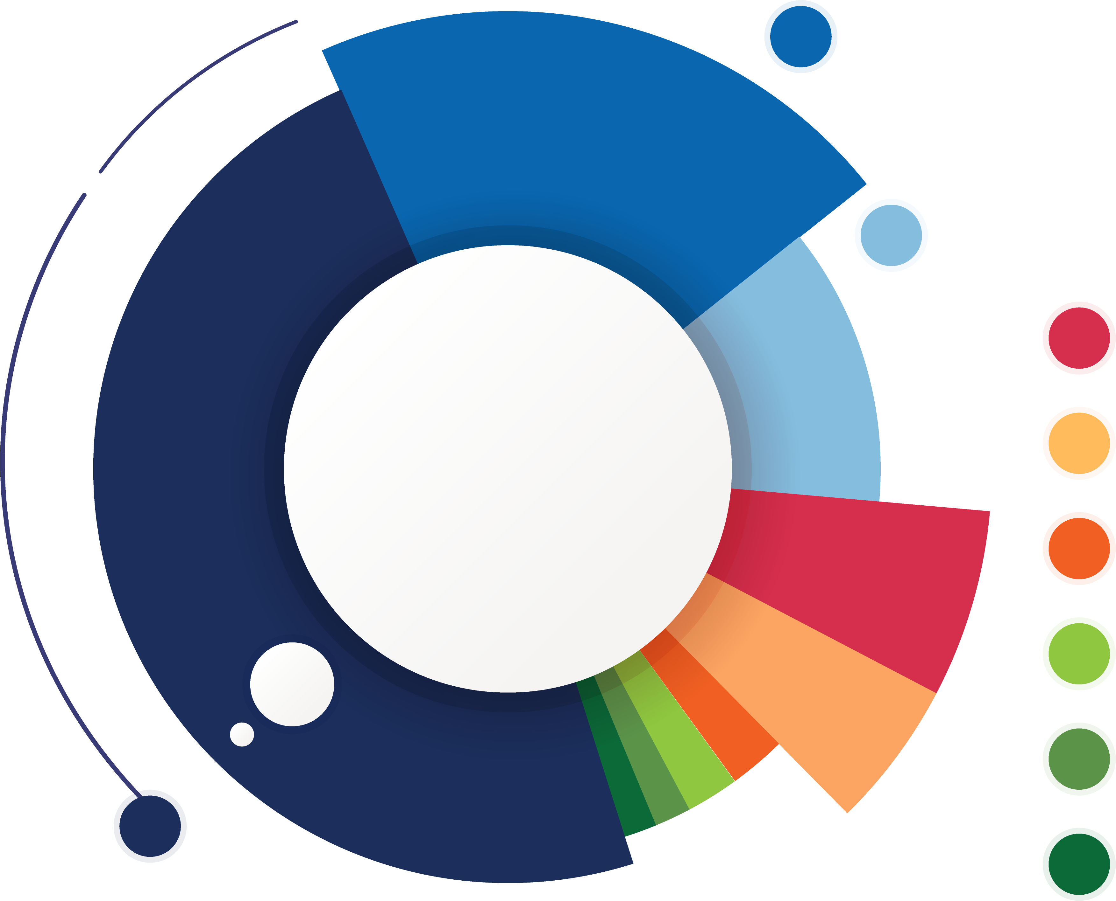
Total Applications by Project Type
13
Crop Conversion
8
Avocado Rejuvenation
6
Soil Moisture Sensors
5
Mulching
5
Scheduling Automation
3
Uniformity Improvements
2
Nutrient Management
1
Cover Crops
23
Avocado Rootstock
Notes:
One project was 80 acres for scheduling automation

Slide 4
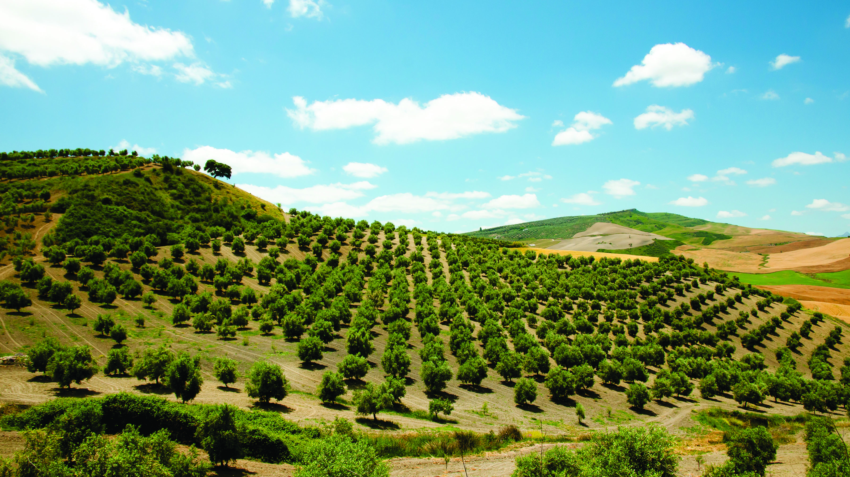

Average Project
Avocado Rootstock
Projects received the largest grant funds
Project Average 36-50K
Division 1
Area with largest amount of projects
Multiple Project Submissions
41% of Customers submitted more than
two projects for review

Slide 5
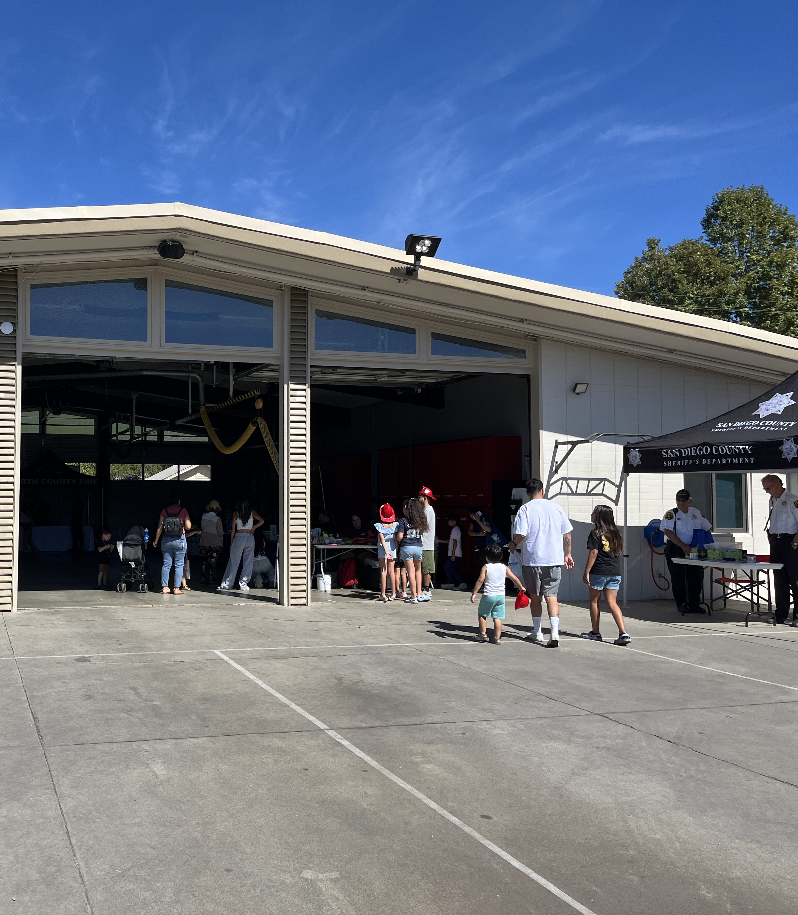
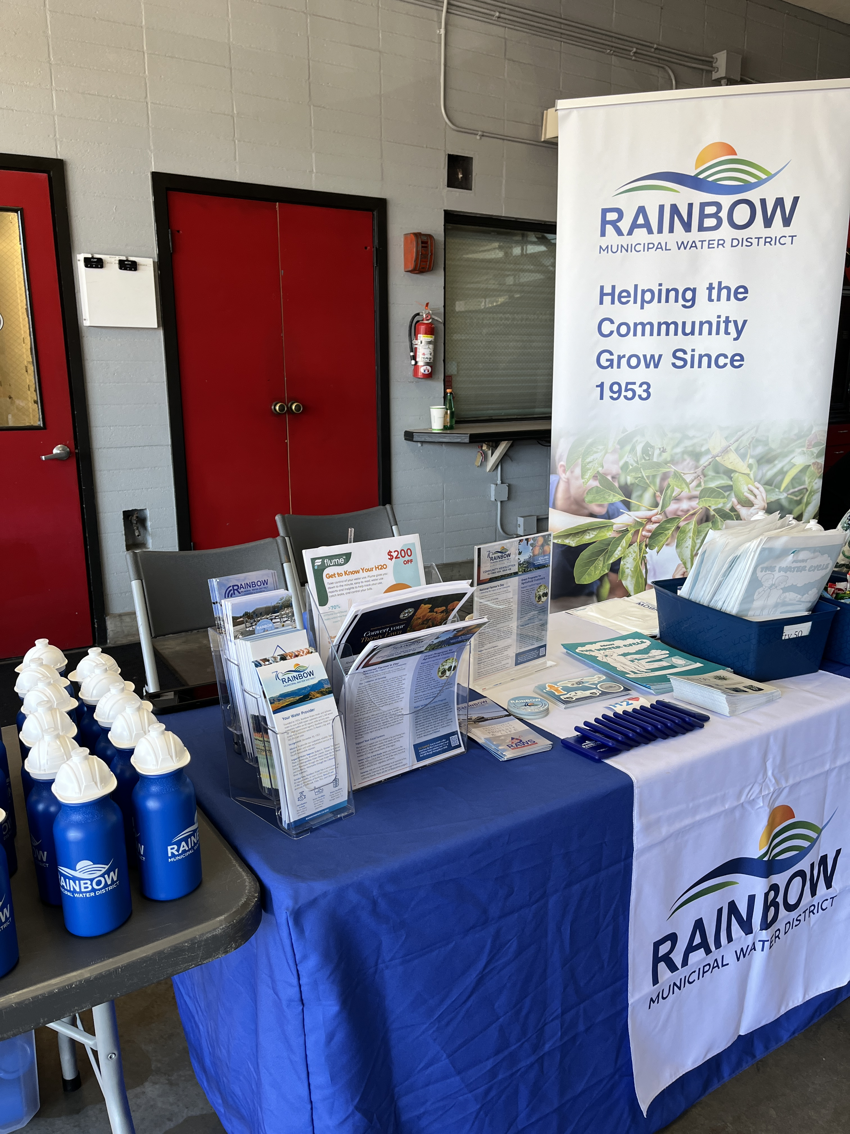
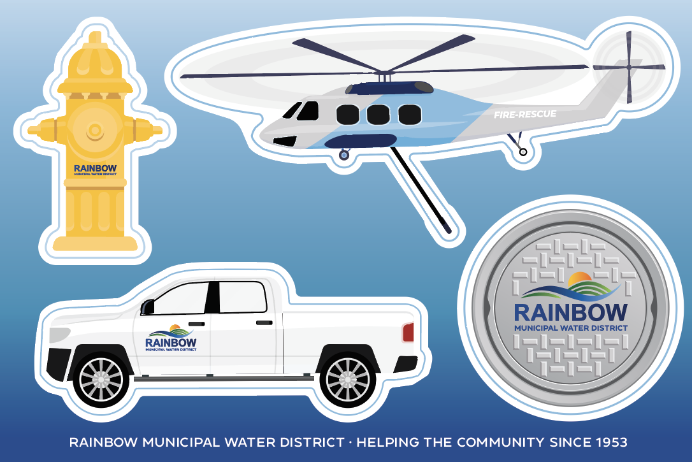
Community Events
North County Fire Open House
  Saturday, October 12
  Free community event at Fire Station 1 in Fallbrook
  Team members networked
  with agencies, handed out promotional items, and
  answered customer
  questions related to
  rates and detachment
Notes:
Most common questions were related to detachment and rates
Gave away 285 pieces of promotional gear, bags and candy. Hand sanitizers and gardening kits were a big hit as were stickers.
Many FPUD customers were not aware of detachment, RMWD customers asked about wells, detachment, how it will work, and lower rates

Slide 6
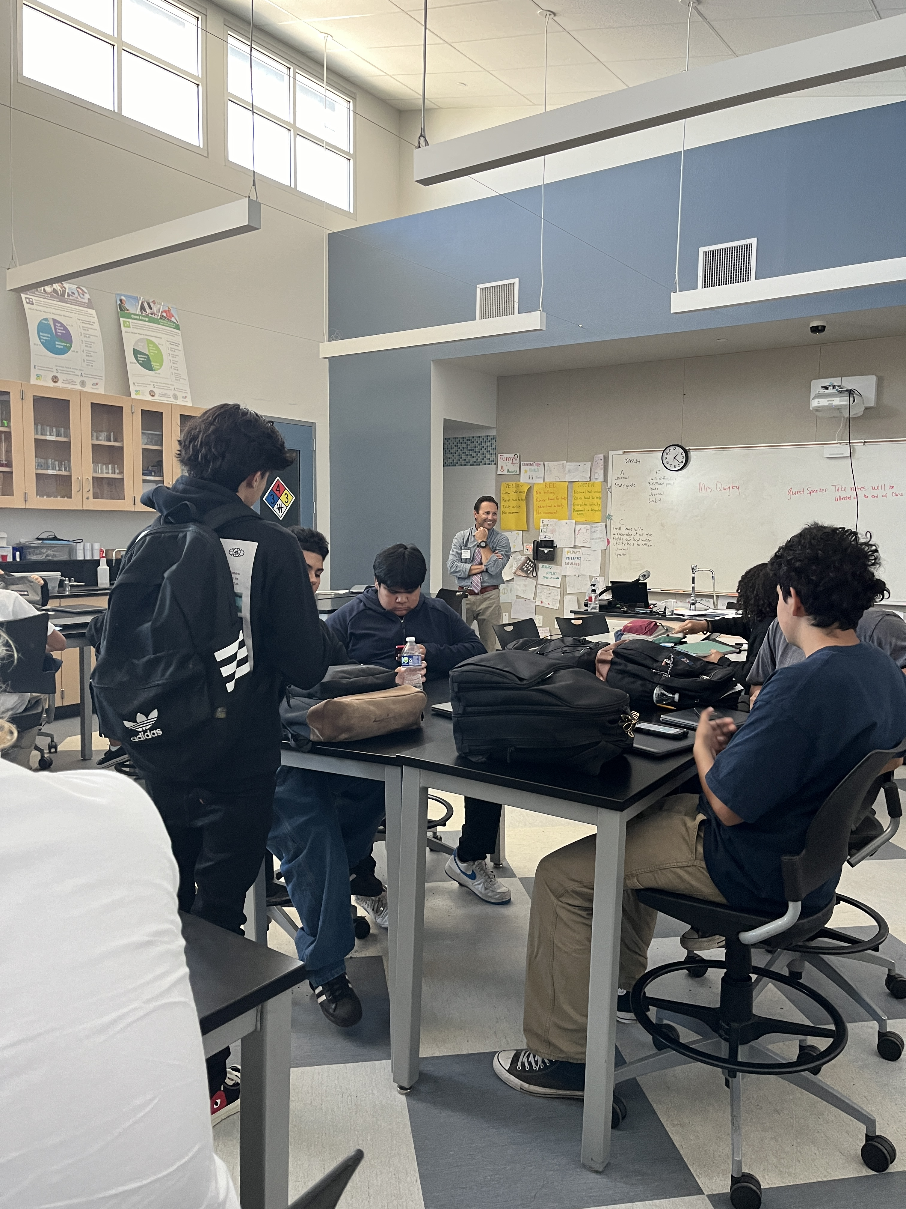
Community Events
Speakers Bureau at Bonsall High School
  Friday, October 25
  IT and Engineering presented to students in
  six computer science and chemistry classes
_
Students surveyed were interested in a Field Trip to the District
70%
_
The average survey rating for the overall presentation and knowledge gained
4.4
Notes:
Reviewed careers in the water industry, cybersecurity, and how chemistry is a key subject for helping clean and transport water
Exit survey to get students feedback on the speakers bureau program
Extended invitation to Palomar College to speak with students enrolled in water and wastewater technology courses.

Slide 7
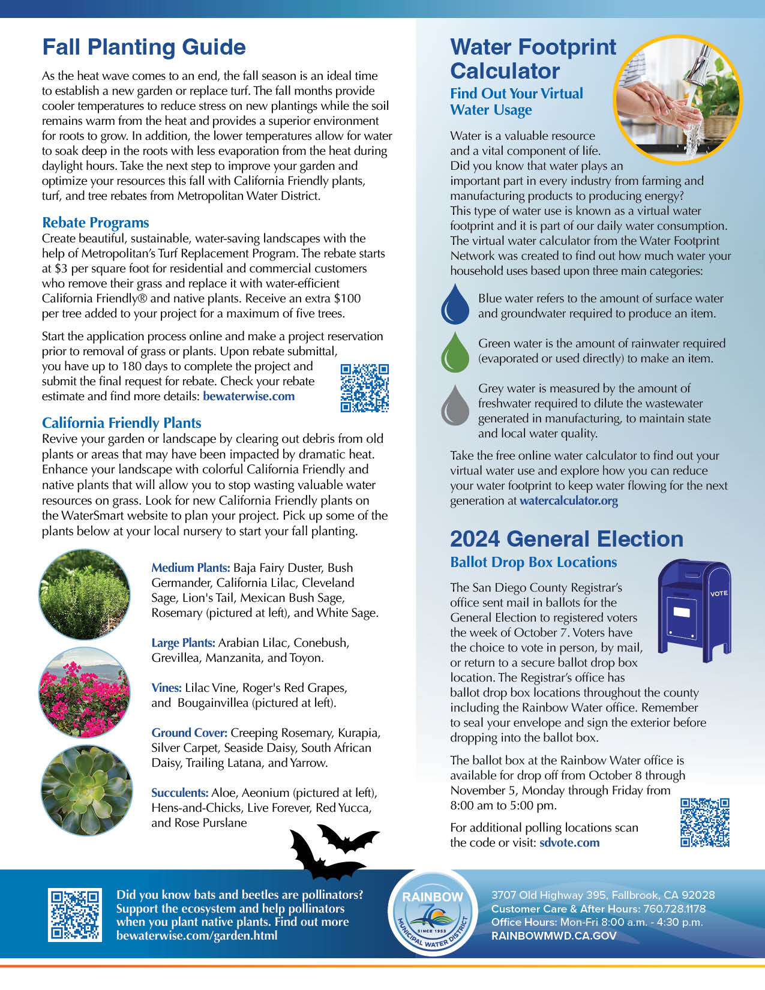

Newsletter Review
October
National Farmer’s Day
  History of farming in the community
  Tips to support local growers by
  buying local
Grant Programs for Ag Customer
  CropSWAP stats and program info
  Met’s WISP Program
  Link to Rice Canyon video
Fall Planting Guide
  Rebates for turf & tree replacement
  California Friendly Plants list
Water Footprint Calculator
General Election: Ballot Drop Box at the office
Notes:
Water Saving Incentive Program Metropolitan’s Water Savings Incentive Program (WISP) is exclusively available to non-residential customers in our service area to increase water-use efficiency through funding high-efficiency equipment upgrades, installation of irrigation systems, and water
management services.
Free tool to assess virtual water usage

Slide 8
Next meeting
Tuesday, November 19
Notes:
Abbreviated committee meeting before the scheduled board meeting at 2pm.

