Slide 1
CIP Program
Year 1 Projects FY 24/25
February 2025

Slide 2
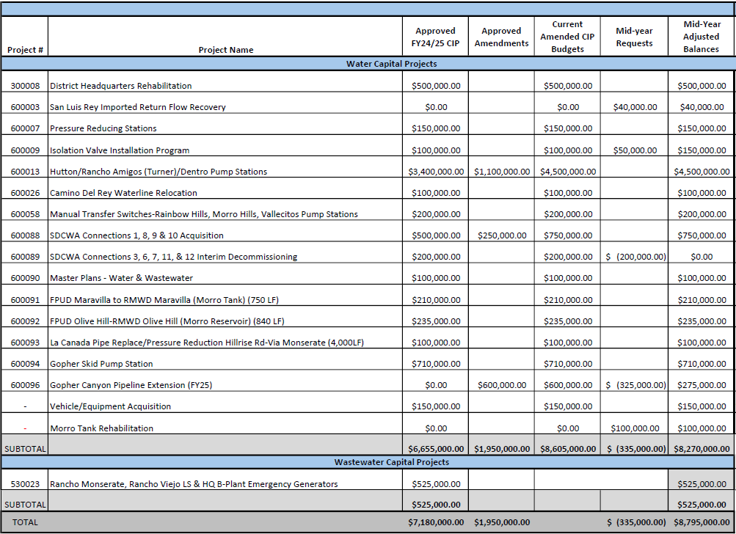

Slide 3
Water Projects
FY 24/25

Slide 4
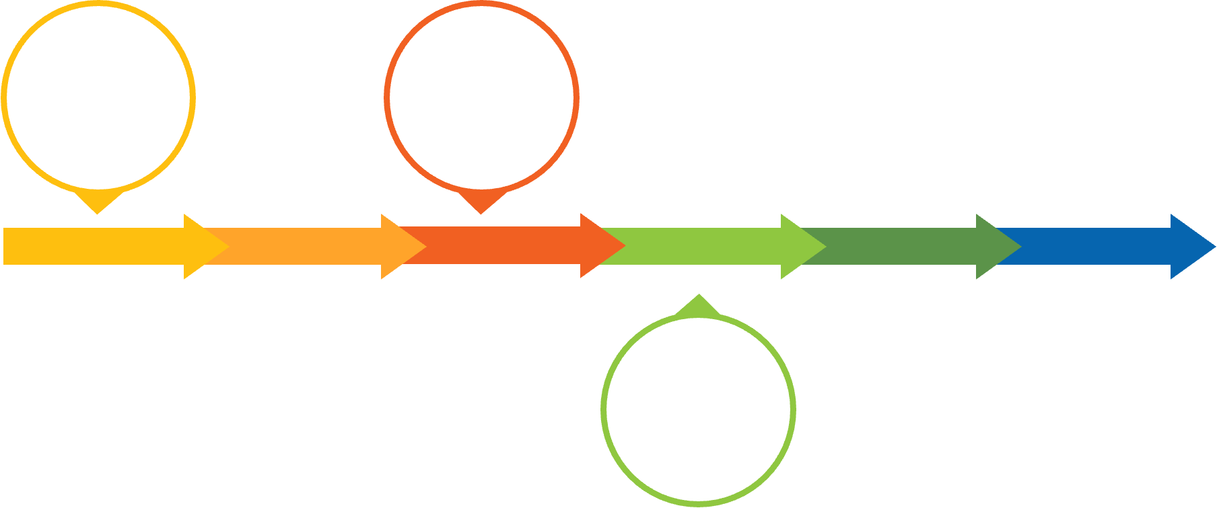
West Lilac, Rancho Amigos and Dentro De Lomas Pump Stations (600013)
Scope of Work: Install three (3) pump stations to provide water to the Hutton-Turner-Gopher Tank zones.
Project Rationale: Required operational project to deliver water to the District's southern pressure zones absent SDCWA supply.
Pump
Stations
On-line
Construction
JULY 2024
OCT 2024
MAR 2025
JUNE 2025
Notice of Completion
 | Planned Expenditures
Project | Year 1 (FY 24/25) | Year 2 (FY 25/26) | Year 3 (FY 26/27) | Year 4 (FY 27/28) | Year 5 (FY 28/29) | Total
600013 | $4,500,000 |  |  |  |  | $4,500,000

Slide 5
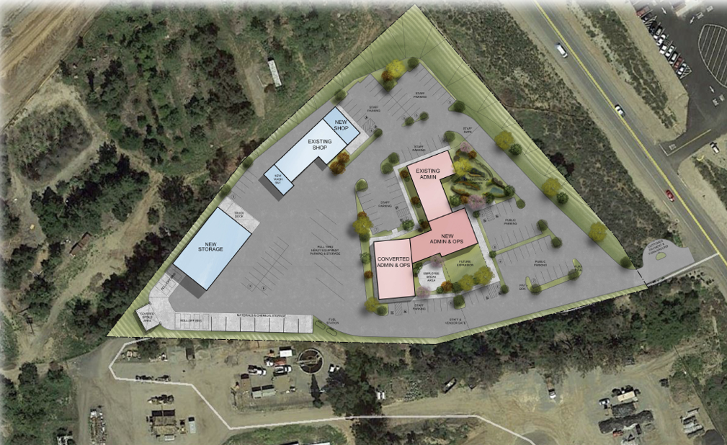
District Headquarters (300008)
Scope of Work: Repair and replace necessary facilities for on-going operations and explore options for long-term District facilities plan with the recently re-established Ad-Hoc committee.
Project Rationale: The project will fund roof and HVAC upgrades in the Admin Building in FY24/25 to maintain adequate facilities in the near-term and explore feasibility of a long-term facilities solution of either re-development of the existing site and relocation of District facilities or extending the useful life of existing facilities through significant upgrades. Facilities support day-to-day administration and operations of the District.
Award
JULY 2024
MAR 2025
APR 2025
JUNE 2025
Design
Out to
Bid
Construction
 | Planned Expenditures
Project | Year 1 (FY 24/25) | Year 2 (FY 25/26) | Year 3 (FY 26/27) | Year 4 (FY 27/28) | Year 5 (FY 28/29) | Total
300008 | $500,000 | $500,000 | $1,000,000 | $4,000,000 |  | $ 6,000,000

Slide 6
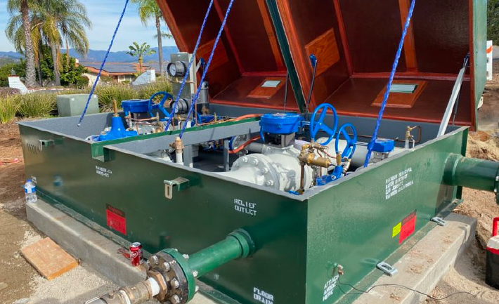
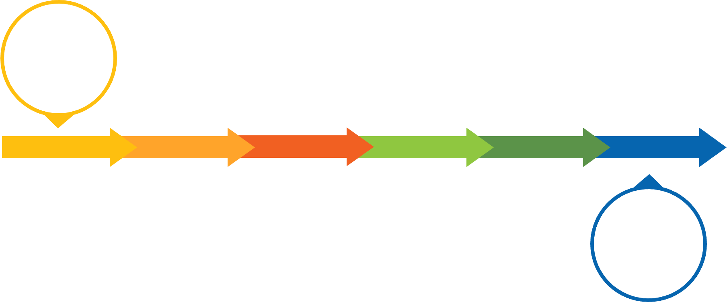
Pressure Reducing Stations (600007)
Scope of Work: Install previously purchased pressure reducing stations district-wide in areas of high pressure.
Project Rationale: The project will reduce high-pressure zones to extend the useful life of water infrastructure and reduce damage associated with main line breaks.
Ongoing
JULY 2024
JUNE 2025
Ongoing
 | Planned Expenditures
Project | Year 1 (FY 24/25) | Year 2 (FY 25/26) | Year 3 (FY 26/27) | Year 4 (FY 27/28) | Year 5 (FY 28/29) | Total
600007 | $150,000 | $150,000 | $150,000 |  |  | $450,000

Slide 7
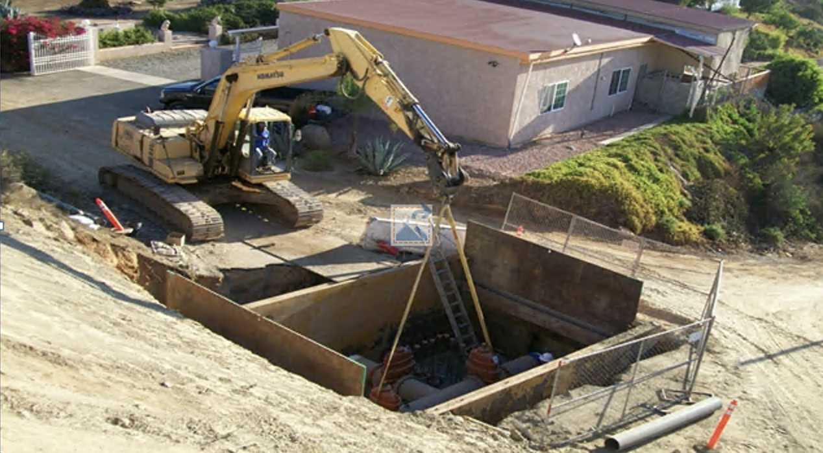
Isolation Valve Installation Program (600009)
Scope of Work: Replace isolation valves district-wide that have exceeded their useful life.
Project Rationale: The project will reduce the number of customers impacted by service interruptions due to leaks and main breaks and reduce repair time due to valves that don't fully seal. The Project will also replace valves in the broken or open positions.
Ongoing
JULY 2024
JUNE 2025
 | Planned Expenditures
Project | Year 1 (FY 24/25) | Year 2 (FY 25/26) | Year 3 (FY 26/27) | Year 4 (FY 27/28) | Year 5 (FY 28/29) | Total
600009 | $100,000 | $500,000 | $180,000 | $500,000 | $180,000 | $1,460,000
Ongoing

Slide 8
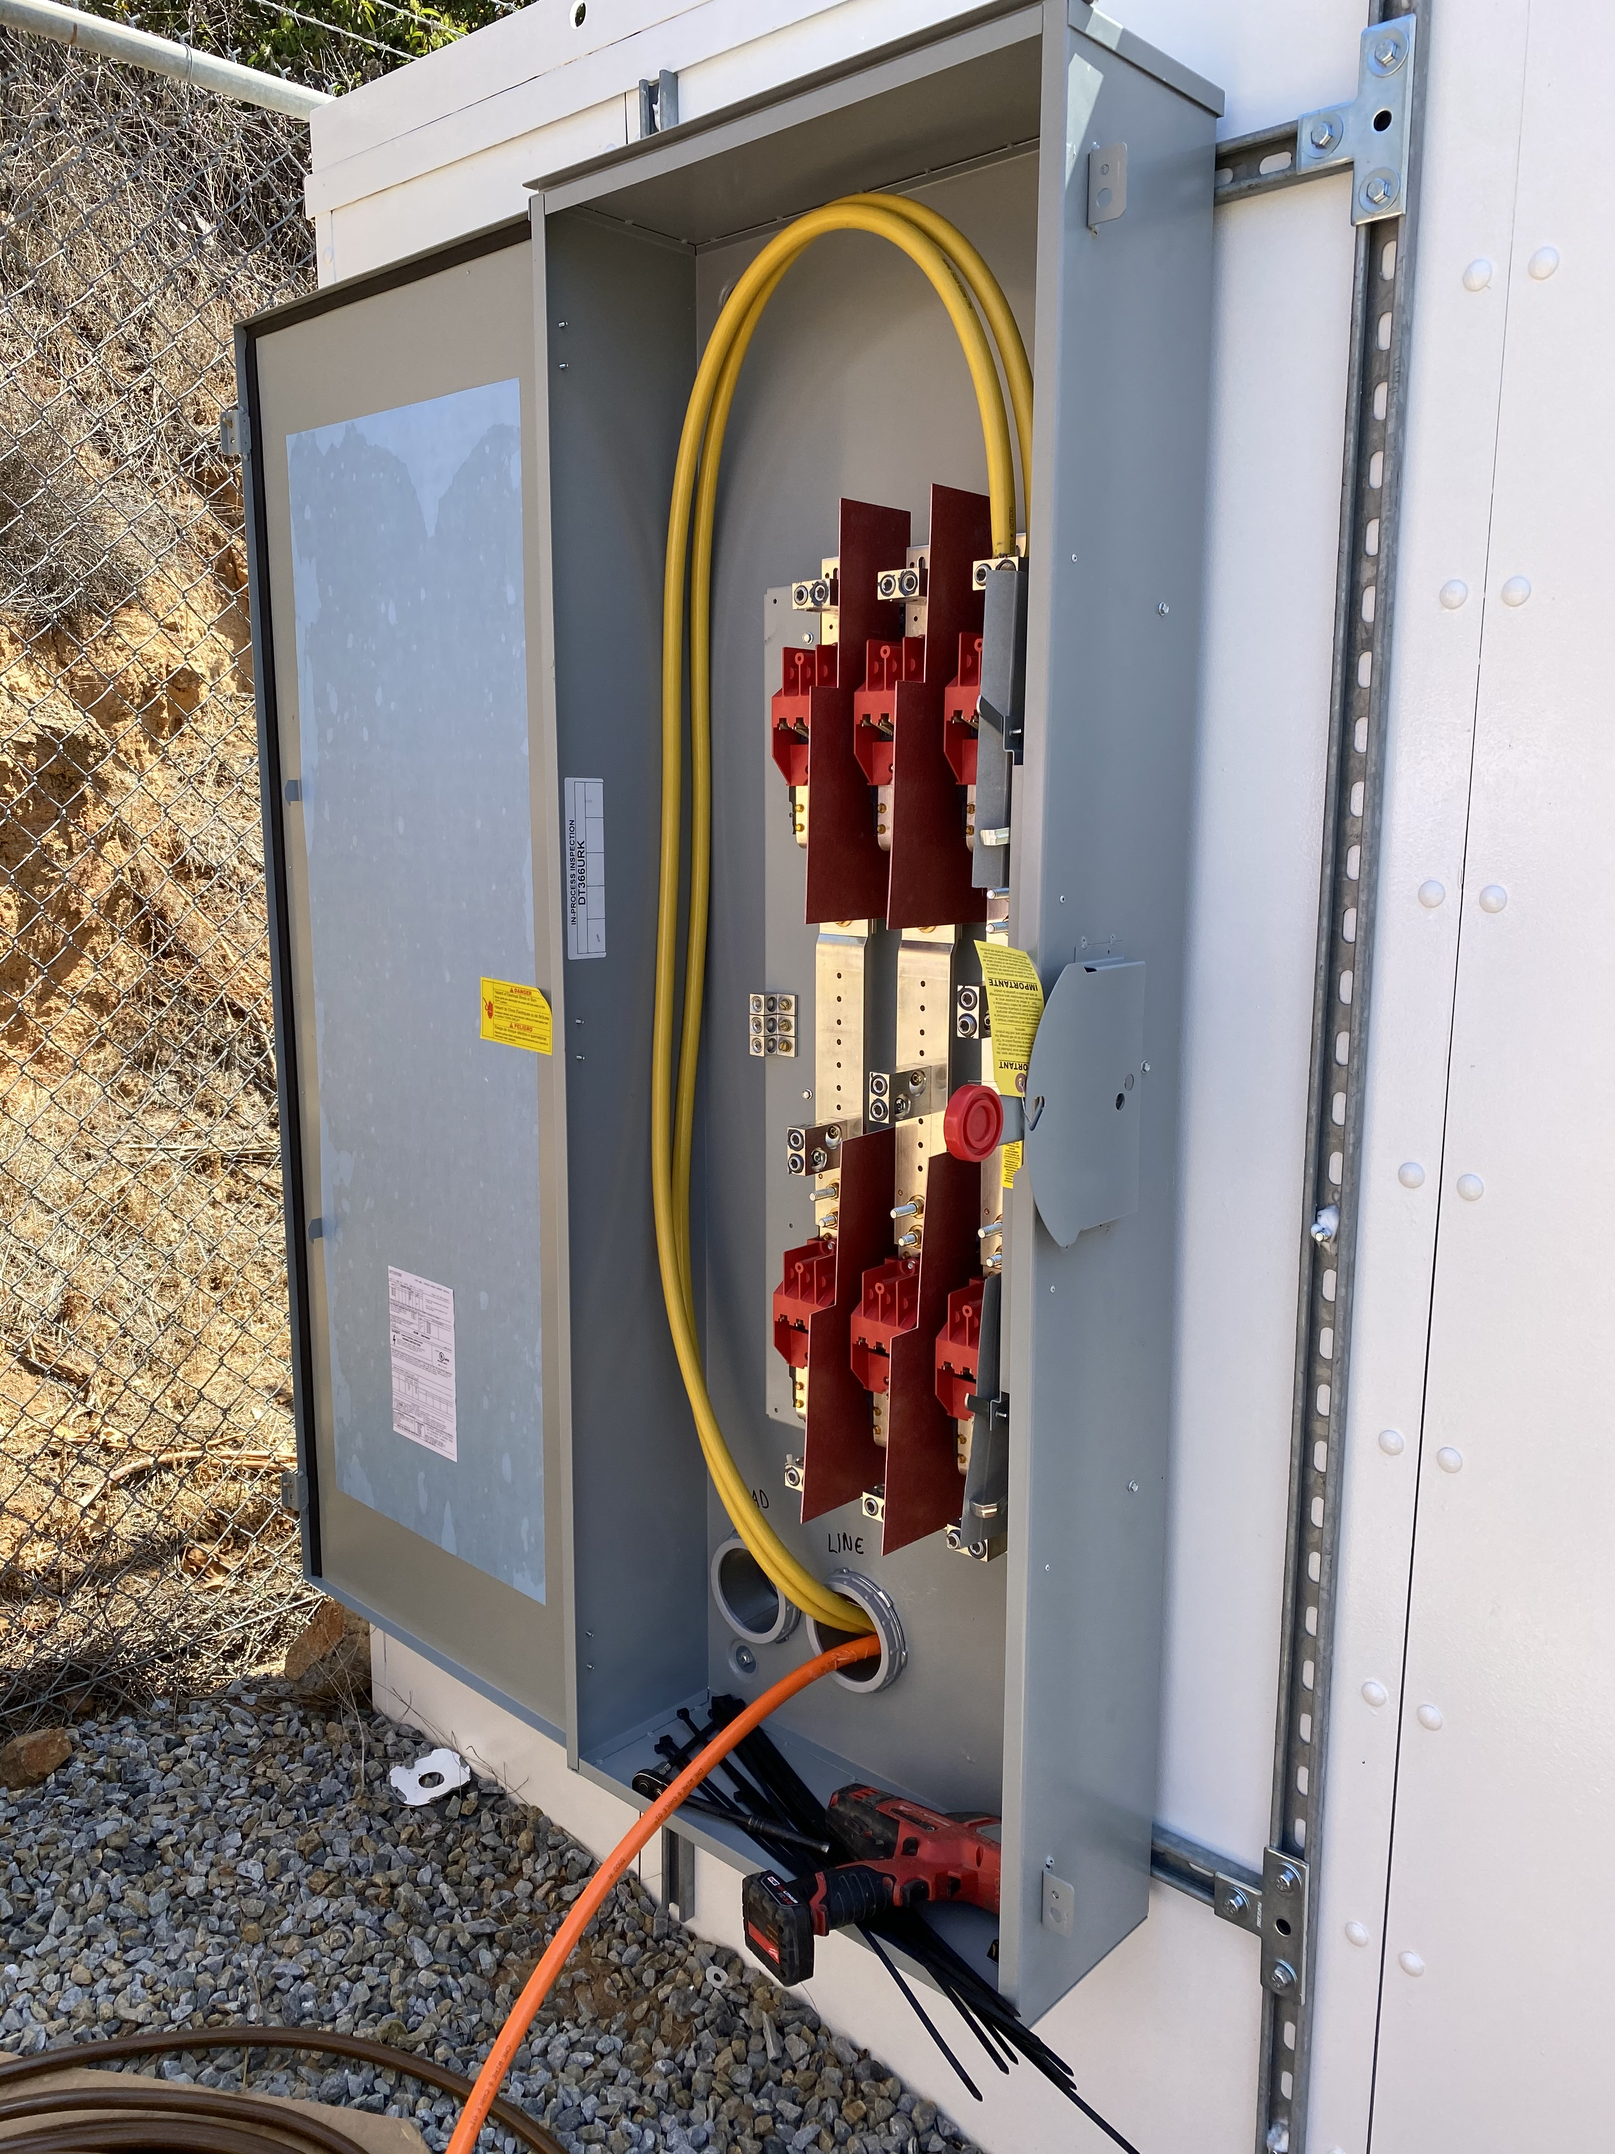
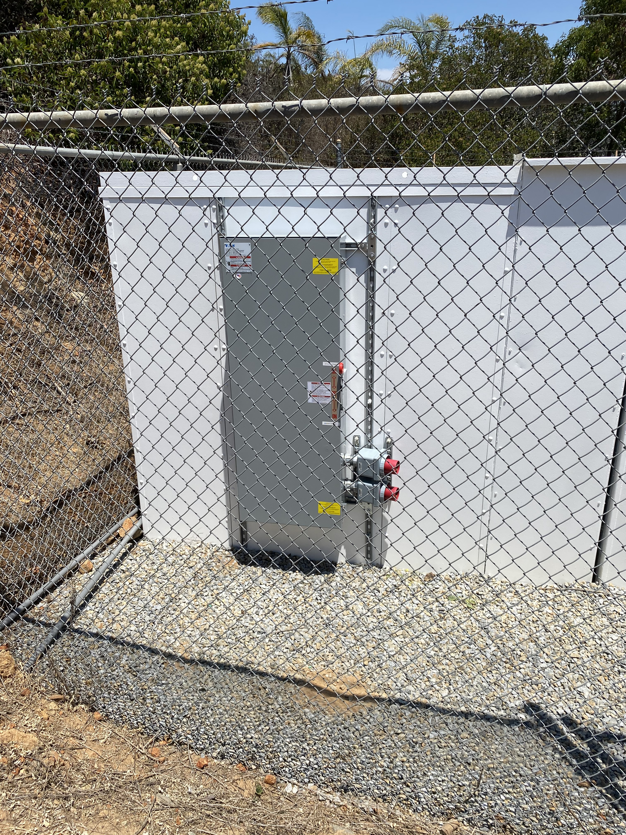
Manual Transfer Switches (600058)
Scope of Work: Install manual transfer switches at Morro Hills Pump Station, Rainbow Hills Pump Station, and Vallecitos Pump Station.
Project Rationale: The project will ensure the safety of District staff when switching to backup power during power outages.
Bidding &
Construction
JULY 2024
MAR 2025
MAY 2025
JUNE 2025
Out
for Bid
 | Planned Expenditures
Project | Year 1 (FY 24/25) | Year 2 (FY 25/26) | Year 3 (FY 26/27) | Year 4 (FY 27/28) | Year 5 (FY 28/29) | Total
600058 | $200,000 |  |  |  |  | $200,000

Slide 9
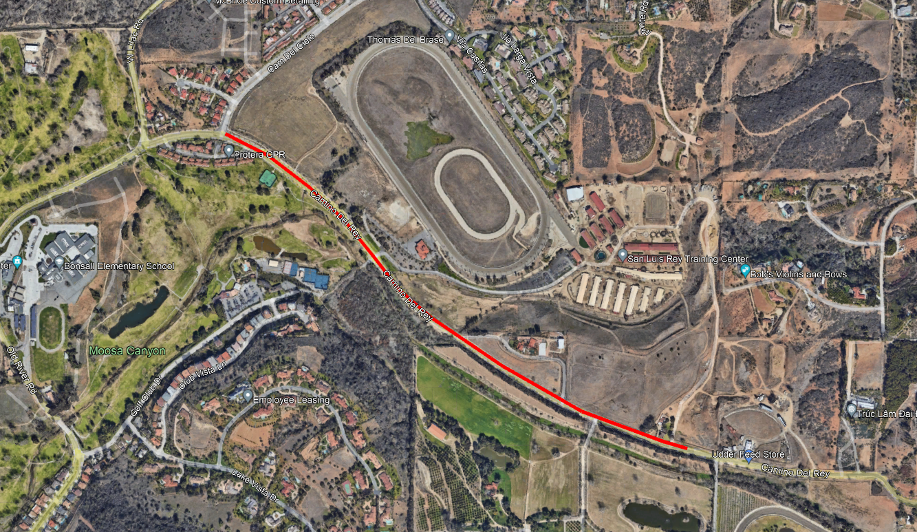
Camino Del Rey Waterline Relocation (600026)
Scope of Work: Relocate existing water and sewer infrastructure due to the County of San Diego's Road Improvement Project.
Project Rationale: The project will ensure continuity of service during the County-initiated construction project and upgrade water facilities.
Ongoing
Analysis
JULY 2024
JUNE 2025
Ongoing
 | Planned Expenditures
Project | Year 1 (FY 24/25) | Year 2 (FY 25/26) | Year 3 (FY 26/27) | Year 4 (FY 27/28) | Year 5 (FY 28/29) | Total
600026 | $100,000 | $25,000 |  |  |  | $125,000

Slide 10
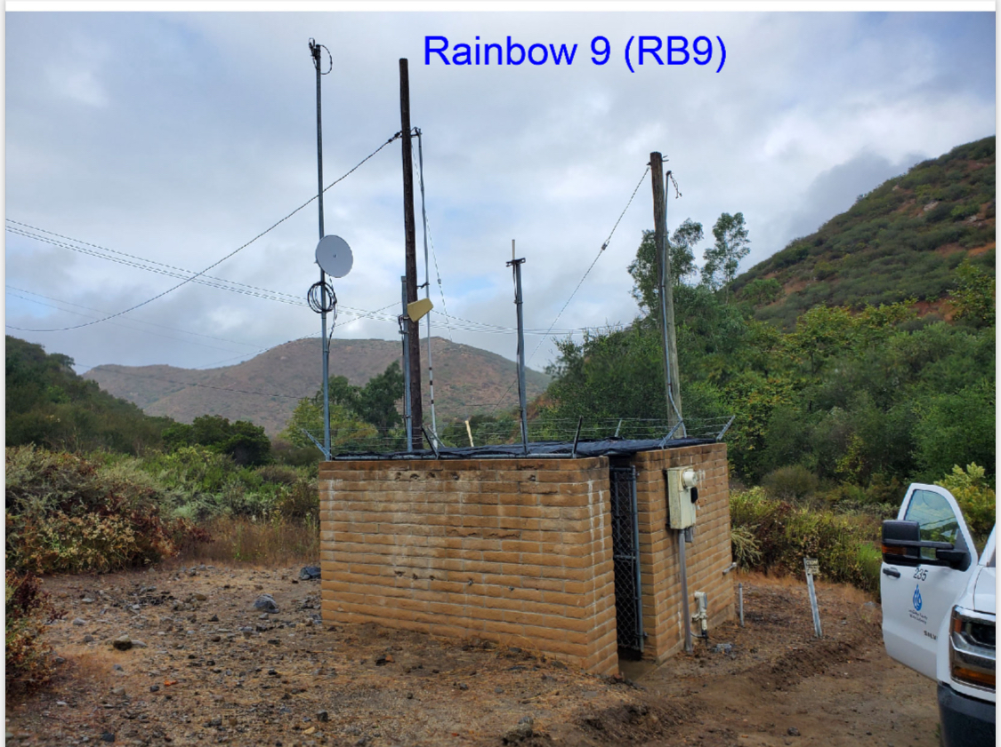
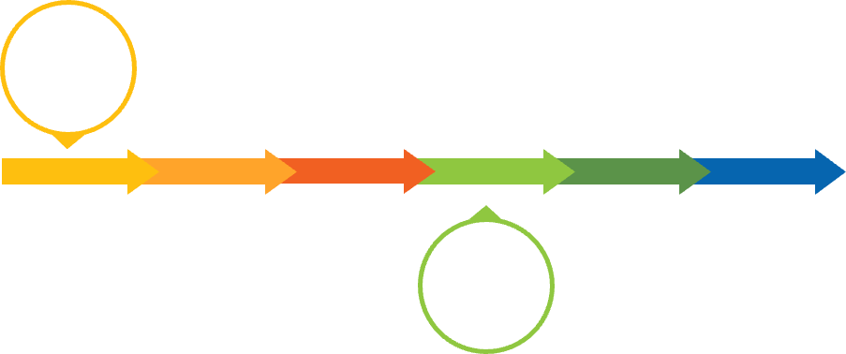
SDCWA Connections 1, 8, 9, and 10 Acquisition (600088)
Scope of Work: Purchase/acquire facilities and property associated with existing SDCWA connections 1, 8, 9, and 10.
Project Rationale: This is a condition of detachment.
Review
JULY 2024
DEC 2024
JUNE 2025
Final
Agreement
 | Planned Expenditures
Project | Year 1 (FY 24/25) | Year 2 (FY 25/26) | Year 3 (FY 26/27) | Year 4 (FY 27/28) | Year 5 (FY 28/29) | Total
600088 | $750,000 |  |  |  |  | $750,000
*$500,000 was approved in FY 24/25, $250,000 was approved off budget cycle

Slide 11
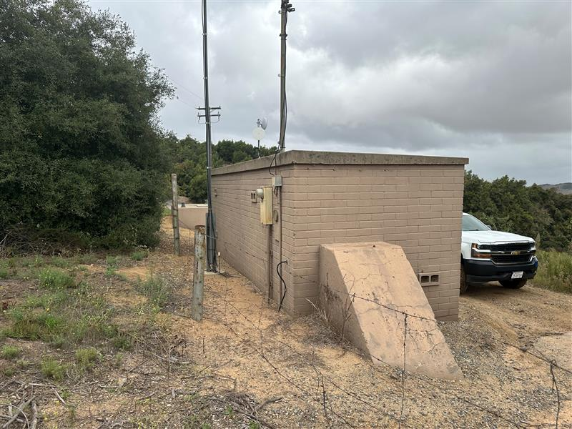

SDCWA Connections 3, 6, 7, and 11 Interim Decommissioning (600089)
Scope of Work: Interim decommissioning at SDCWA connections 3, 6, 7, and 11.
Project Rationale: Requirement of detachment from SDCWA.
CANCELLED
JUNE 2025
JAN 2025
JUNE 2025
 | Planned Expenditures
Project | Year 1 (FY 24/25) | Year 2 (FY 25/26) | Year 3 (FY 26/27) | Year 4 (FY 27/28) | Year 5 (FY 28/29) | Total
600089 | $200,000 |  |  |  |  | $200,000
*Due to modifications to SDCWA/RMWD Operating Plan eliminated the need for District expenditures, budgeted expenditures requested to be reduced -$200,000

Slide 12
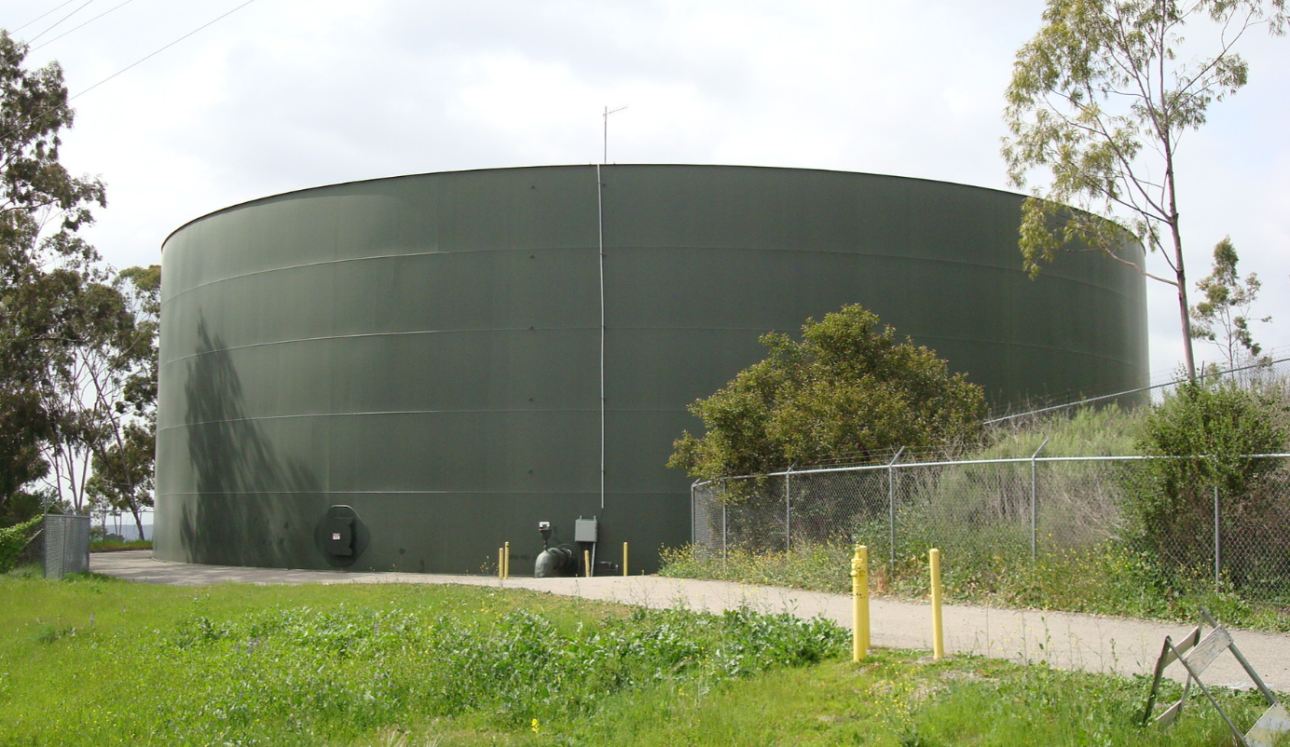
Morro Tank Rehabilitation
Scope of Work: Ongoing assessment of tank movement/settlement, and recommended rehab/repairs.
Project Rationale: Two (2) inclinometers were installed along the southern slope and registered ¼-inch movement. Additional survey benchmarks to be installed and structural engineer to evaluate.
 | Planned Expenditures
Project | Year 1 (FY 24/25) | Year 2 (FY 25/26) | Year 3 (FY 26/27) | Year 4 (FY 27/28) | Year 5 (FY 28/29) | Total
 |  |  |  |  |  | $100,000.00*

Slide 13
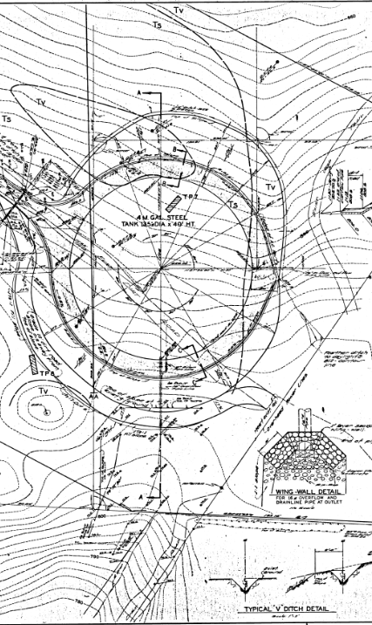
Site Development and Tank Construction
Initial plans developed in 1967 by Albert A. Webb Associates.
Grading performed in 1972
  Cutting on the northern side of the tank
  Filling on the southern side to create a building pad.
Over-excavation of the bedrock was completed to a depth of 10 feet below the “cut” side of the tank.
All slopes were inclined at 1.5:1 and the slopes were not “keyed in”.
The fill pad was constructed using onsite highly expansive clayey soils.
The tank was constructed upon a steel plate situated upon 2.5 inches of oiled sand over 12 inches of Class II Aggregate Base.

Slide 14
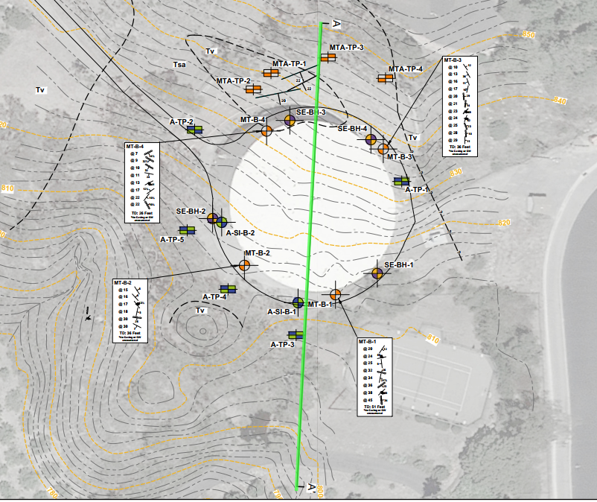
Geological Conditions

Slide 15
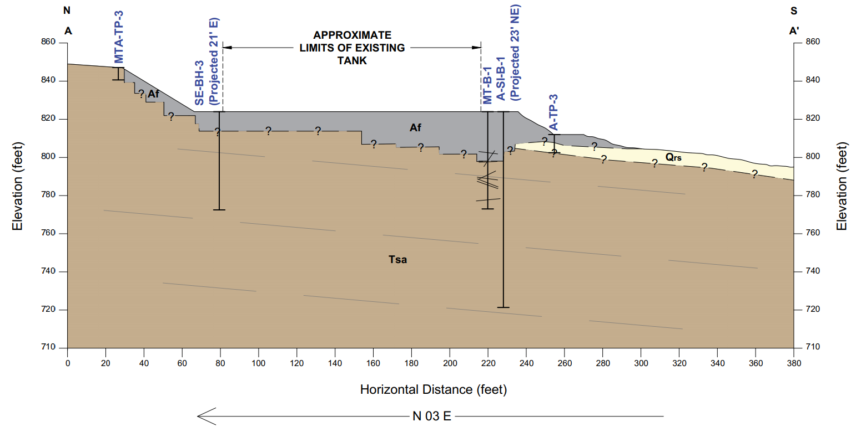
Geologic Conditions

Slide 16
Timeline
1967
Plans developed by Albert A. Webb
1972
Morro Tank is Constructed
1983
JayKim Engineers investigate movement and tilting of Morro Tank.
1985–1991
William Skarn Surveying, install benchmarks and monitors ongoing movement. They report up to 4.4 Inches of total settlement.
1991
Moore and Taber perform a geotechnical investigation into ongoing movement and settlement of Morro Tank
1993
Slope failures occur on the slope north of Morro Tank and the adjacent reservoir.
2013
Sladden Engineers investigate Morro Tank movement and uplift.
Atlas installs two slope inclinometers to monitor the slope south of Morro Tank.
2023–2025
2015
Kennedy/Jenks investigate ongoing distress to Morro Tank and provides retrofit/replacement recommendations.

Slide 17
1983, JayKim Investigation
By 1983, the tank was indicating signs of movement and tilting. The District contracted JayKim Engineers to investigate potential causations.
Recommended Mitigation Measures
Checking the tank for leaks.
Planting, chemically stabilizing, and lacing matting on the slopes.
Placing interceptor drains along the north and south sides of the tank.
Removing existing pavement, placing a plastic sheet under 12 inches of free draining material sloped away from the tank, and repaving the road.
Installing two, full depth lateral drainage ditches along the south side of the tank to remove perched water.

Slide 18
1985 to 1991, William Skarn Surveying
From 1985 to 1991, William Skarn Engineering was contracted by the District to establish survey points to monitor the ongoing movement.
A total of 8 monitoring points were established along the perimeter of the tank, and they were monitored in 1985, 1988, 1990, and twice in 1991.
Measured maximum vertical displacement of 0.37 feet (4.4 inches) and differential movement of 0.25 feet (3 inches).
Maximum settlement was observed in the areas of deepest fill placement.
The second reading performed in 1991 indicated upward movement of the tank which was attributed to rebound caused by a reduction of the water levels.

Slide 19
1991, Moore and Taber
In 1991, Moore and Taber performed a geotechnical investigation to evaluate the ongoing distress at the tank site.
Drilled 4 large diameter borings which were downhole logged by an engineering geologist.
Conclusions and Recommendations
The primary cause of the tank movement was compression of the underlying fill soils with the possibility that the fill mass is sliding translationally downslope.
Extensive foundation repairs were not deemed necessary.
Compaction grouting and re-grading of the site were viable repair options but were deemed unnecessary at the time.
Surface pavement and drainage improvements around the tank were recommended.
They recommended that intake/outlet be fitted with a flexible connections that could tolerate horizontal and vertical movements on the order of 0.4 feet.

Slide 20
1993, M&T, Agra
M&T, Agra was contracted by the District to investigate slope failures that occurred during winter storms on the northern side of Morro Tank and Morro Reservoir.
The failures were investigated utilizing several backhoe excavated test pits.
Conclusions and Recommendations
Adverse geologic structure and the steep inclination of cutslope north of the tank.
They recommended that the slope be repaired by placing a stability fill along failed portions of the slope and reducing the overall slope inclinations to a 2:1.

Slide 21
2013, Sladden Engineering
Sladden Engineering was contracted to perform a geotechnical investigation to evaluate the differential settlement/uplift of the tank.
Conclusions and Recommendations
The tank had experienced significant differential movement that had potentially damaged its long-term stability.
The movement was attributed to fill settlement beneath the tank, slope creep on the south side of the tank, and expansion of the highly expansive fill and bedrock materials beneath the site.
They recommended regrading of the fill slope south of the tank, underpinning the tank and installing an internal concrete slab system.

Slide 22
2015, Kennedy/Jenks Consultants
Kennedy/Jenks was contracted to conduct a study into the ongoing distress which included uplift of the tank floor first documented in the 1990’s as well as movement in the inlet/outlet pipes flexible joints.
Conclusions and Recommendations
The southern slope is subject to failure during a seismic event. Additionally, they indicate that the tank was past its 75 percent design life.
They provided several options to the District ranging from tank retrofits to tank replacement.

Slide 23
2022-2025, Atlas
Atlas field program included test pits, geotechnical borings, and installing two inclinometers along the southern slope. Atlas regularly monitored the inclinometers over the course of approximately 2 years.
Conclusions and Recommendations
The readings indicate that the slope south of the tank moved progressively downslope for the first 6 months of monitoring. After this period the inclinometers started to register movements interpreted as settlement.
Survey monitoring points are recommended to evaluate the tank settlement.
Lateral displacement varied over time and could be a function of water level and rainfall.
Movement was attributed to the presence of highly expansive fill, differential settlement, and slope creep. A structural engineer should be consulted to address structural repairs for the tank. Potential repairs may include underpinning and regrading the slope.

Slide 24
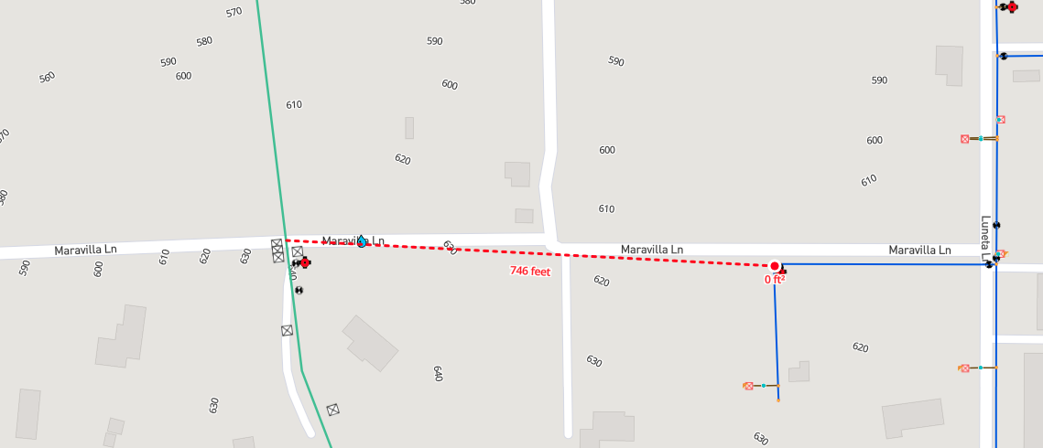
FPUD Maravilla to RMWD Maravilla (Morro Tank) (600091)
Scope of Work: Install 750 LF of C900 PVC pipeline to connect FPUD and RMWD potable water systems.
Project Rationale: Operational flexibility to source water into the Morro Tank zone providing additional capacity from Morro Reservoir to the District's southern pressure zones.
Scope
Design
Complete
JULY 2024
MAY 2025
JUNE 2025
Design
In House
Construction
 | Planned Expenditures
Project | Year 1 (FY 24/25) | Year 2 (FY 25/26) | Year 3 (FY 26/27) | Year 4 (FY 27/28) | Year 5 (FY 28/29) | Total
600091 | $210,000 |  |  |  |  | $210,000

Slide 25
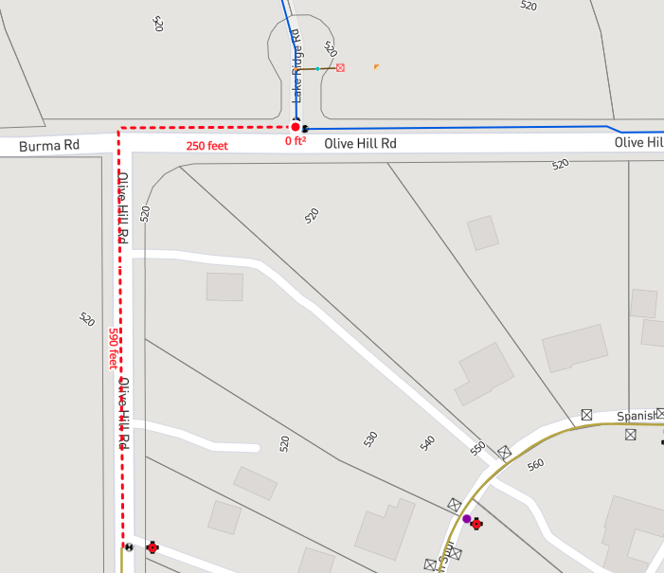
FPUD Olive Hill to RMWD Olive Hill (Morro Reservoir) (600092)
Scope of Work: Install 840 LF of C900 PVC Pipeline to connect FPUD and RMWD potable water systems.
Project Rationale: Operational flexibility to source water into the Morro Reservoir providing additional capacity to the District's southern pressure zones.
Scope
Design
Complete
JULY 2024
MAY 2025
JUNE 2025
Design
In House
Construction
 | Planned Expenditures
Project | Year 1 (FY 24/25) | Year 2 (FY 25/26) | Year 3 (FY 26/27) | Year 4 (FY 27/28) | Year 5 (FY 28/29) | Total
600092 | $235,000 |  |  |  |  | $235,000

Slide 26
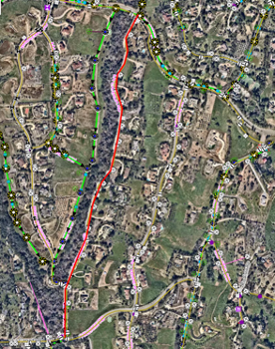
La Canada Pipeline Replacement and Pressure Reduction (600093)
Scope of Work: Replace 4,000 LF of pipeline along La Canada from Hillrise Rd. to Via Monserate and install two (2) new pressure reducing stations.
Project Rationale: The project will prevent future costs associated with leaks or main breaks and reduce service interruptions. This alignment of pipeline has experienced eight (8) main breaks within the last five (5) years.
Scope
Design Complete
JULY 2024
MAY 2025
JUNE 2025
Design
In House
Construction
 | Planned Expenditures
Project | Year 1 (FY 24/25) | Year 2 (FY 25/26) | Year 3 (FY 26/27) | Year 4 (FY 27/28) | Year 5 (FY 28/29) | Total
600093 | $100,000 | $700,000 |  |  |  | $800,000

Slide 27
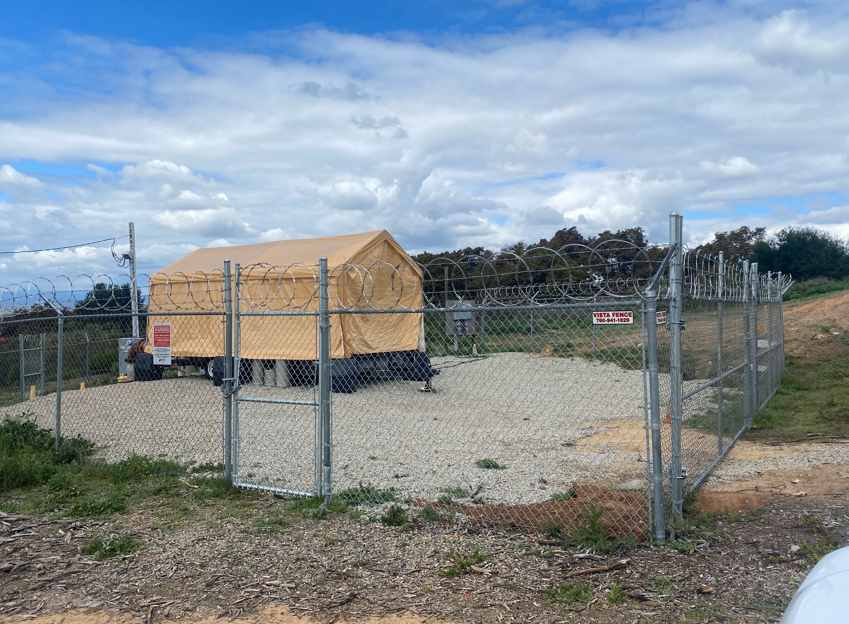
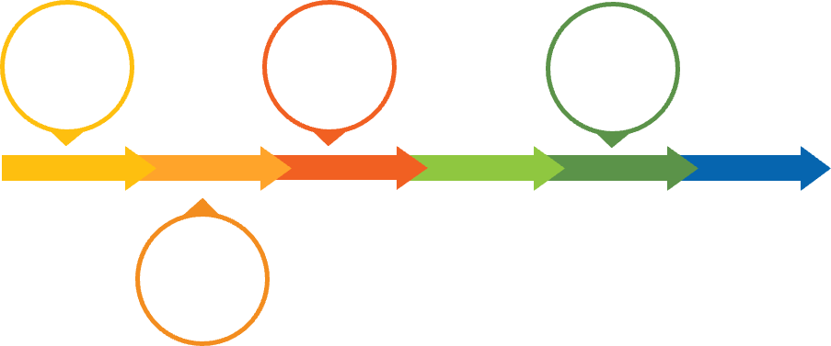
Gopher Skid Pump Station (600094)
Scope of Work: Replace the temporary pump skid with a permanent solution.
Project Rationale: Required operational flexibility to move water within the southern zone absent SDCWA connections.
Award
Design
Scope
Ongoing
JAN 2025
FEB 2025
MAY 2025
JUNE 2025
Design
 | Planned Expenditures
Project | Year 1 (FY 24/25) | Year 2 (FY 25/26) | Year 3 (FY 26/27) | Year 4 (FY 27/28) | Year 5 (FY 28/29) | Total
600094 | $710,000 |  |  |  |  | $710,000

Slide 28

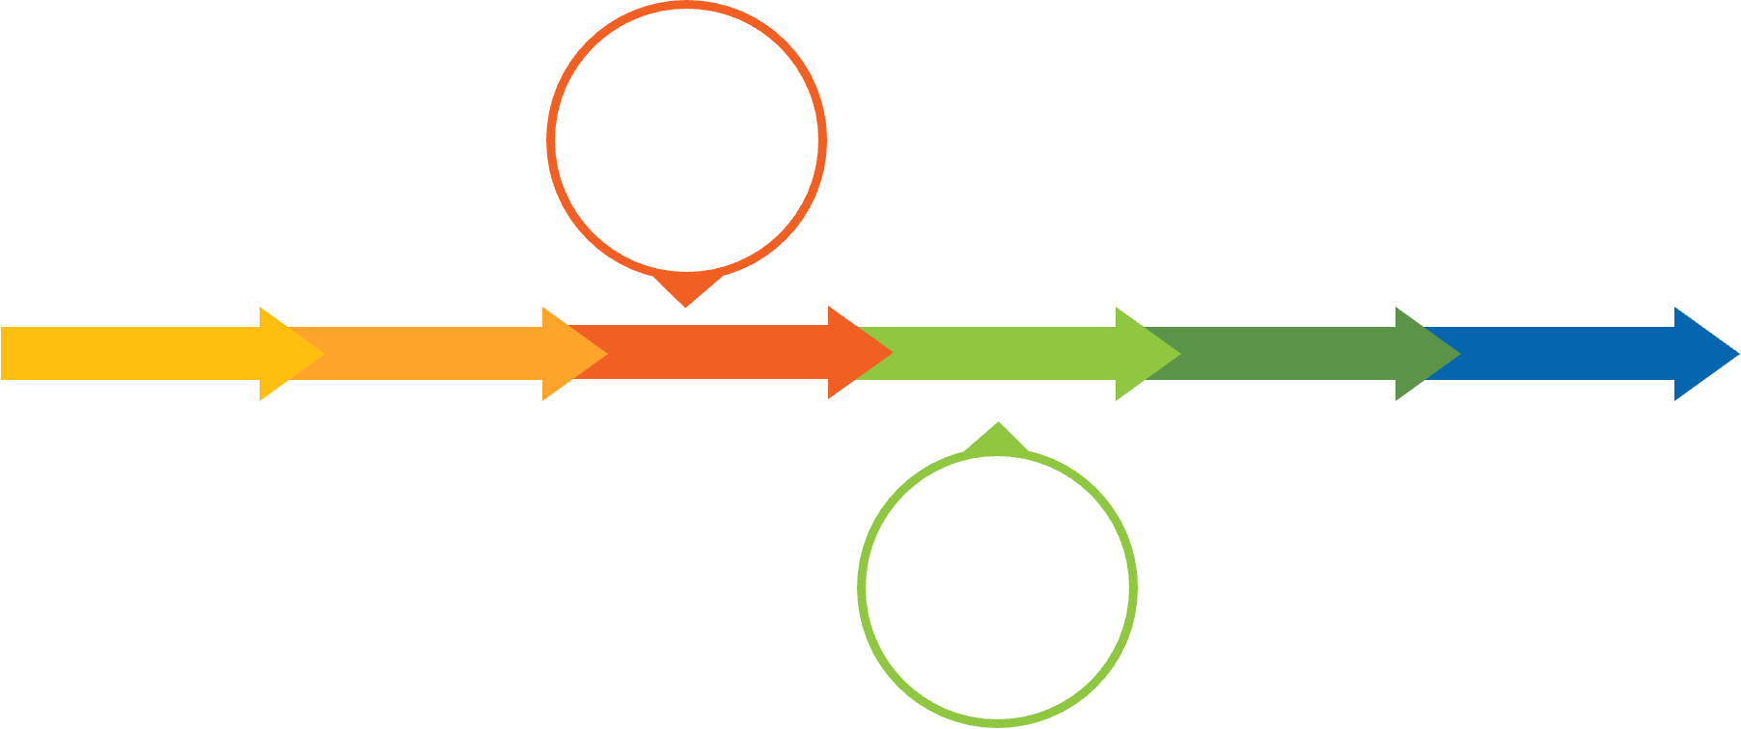
Water and Wastewater Master Plan (600090)
Scope of Work: Develop Long-range Water and Sewer System Master Plan. Includes Constructing system hydraulic model utilizing latest software technology to evaluate and identify system deficiencies and solutions based on updated demand projections and system operations.
Project Rationale: The project will provide the District with a master plan of project improvements for long-term planning, prioritization, and funding for water and wastewater infrastructure needs.
RFP
Posting
JULY 2024
FEB 2025
APRIL 2025
JUNE 2025
Award
 | Planned Expenditures
Project | Year 1 (FY 24/25) | Year 2 (FY 25/26) | Year 3 (FY 26/27) | Year 4 (FY 27/28) | Year 5 (FY 28/29) | Total
600090 | $100,000 | $750,000 |  |  |  | $850,000

Slide 29
Sewer Projects
FY 24/25

Slide 30
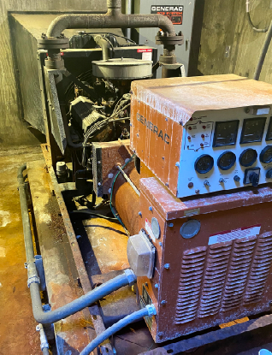
Rancho Monserate, Rancho Viejo, and HQ B-Plant Emergency Generators (530023)
Scope of Work: This project proposes to in-kind replacements of the obsolete emergency generators at Rancho Monserate, Rancho Viejos, and HQ B-Plant lift stations.
Project Rationale: The project will provide a backup power source for critical sewer infrastructure. Existing equipment has exceeded its useful life.
Coordination w/EPA
JAN 2025
JUNE 2025
Ongoing
 | Planned Expenditures
Project | Year 1 (FY 24/25) | Year 2 (FY 25/26) | Year 3 (FY 26/27) | Year 4 (FY 27/28) | Year 5 (FY 28/29) | Total
530023 | $525,000* |  |  |  |  | $525,000
*Grant funding dependent

Slide 31
Questions?

