Slide 1
Five Year CIP Program
FY 24/25 - FY 28/29
March 2024

Slide 2
Projected 5 Year CIP Overview
Total Water - $40.7M
Total Sewer - $22.8M
Total CIP - $63.5M

Slide 3
Water 5 Year CIP by Driver (in $ Millions)

Slide 4
Water 5 Year CIP by Asset Type ( in $ Millions)

Slide 5
Sewer 5 Year CIP by Asset Type (in $ Millions)

Slide 6
Sewer 5 Year CIP by Driver (in $ Millions)

Slide 7
Proposed Fiscal Year Project Summary
Water Fund 60 & 62
Wastewater Fund 52 & 53
FY 24/25: 12 Projects
FY 25/26: 9 Projects
FY 26/27: 14 Projects
FY 27/28: 11 Projects
FY 28/29: 6 Projects
FY 24/25: 1 Project
FY 25/26: 1 Project
FY 26/27: 1 Project
FY 27/28: 4 Projects
FY 28/29: 3 Projects

Slide 8
Projected 10 Year CIP Overview
Total Water - $69.4M
Total Sewer - $31.2M
Total CIP - $100.6M

Slide 9
Water Projects
FY 24/25

Slide 10

Water and Wastewater Master Plan
Scope of Work: Develop Long-range Water and Sewer System Master Plan. Includes Constructing system hydraulic model utilizing latest software technology to evaluate and identify system deficiencies and solutions based on updated demand projections and system operations.
Project Rationale: The project will provide the District with a master plan of project improvements for long-term planning, prioritization, and funding for water and wastewater infrastructure needs.
 | Planned Expenditures
Project | Year 1 (FY 24/25) | Year 2 (FY 25/26) | Year 3 (FY 26/27) | Year 4 (FY 27/28) | Year 5 (FY 28/29) | Total
TBD | $500,000 | $500,000 |  |  |  | $1,000,000

Slide 11
West Lilac, Rancho Amigos and Dentro De Lomas Pump Stations (600013)
Scope of Work: Install three (3) pump stations to provide water to the Hutton-Turner-Gopher Tank zones.
Project Rationale: Required operational project to deliver water to the District's southern pressure zones absent SDCWA supply.
 | Planned Expenditures
Project | Year 1 (FY 24/25) | Year 2 (FY 25/26) | Year 3 (FY 26/27) | Year 4 (FY 27/28) | Year 5 (FY 28/29) | Total
600013 | $3,400,000 |  |  |  |  | $3,400,000

Slide 12
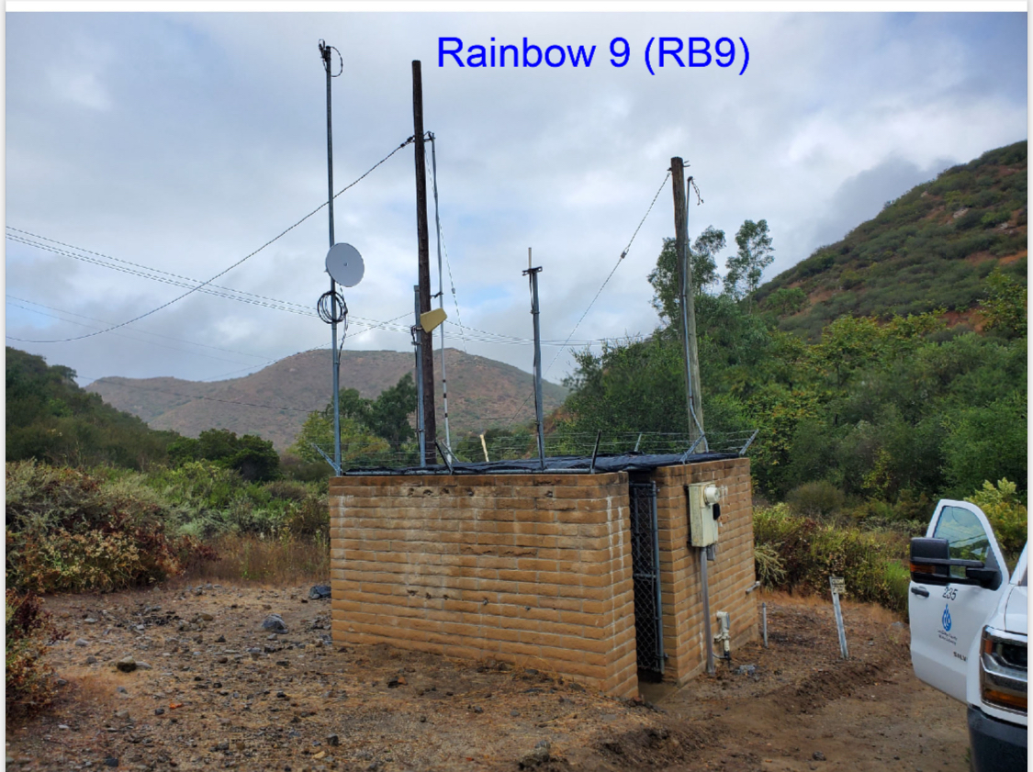
SDCWA Connections 1, 8, 9, and 10 Acquisition
Scope of Work: Purchase/acquire facilities and property associated with existing SDCWA connections 1, 8, 9, and 10.
Project Rationale: This is a condition of detachment.
 | Planned Expenditures
Project | Year 1 (FY 24/25) | Year 2 (FY 25/26) | Year 3 (FY 26/27) | Year 4 (FY 27/28) | Year 5 (FY 28/29) | Total
TBD | $500,000 |  |  |  |  | $500,000

Slide 13
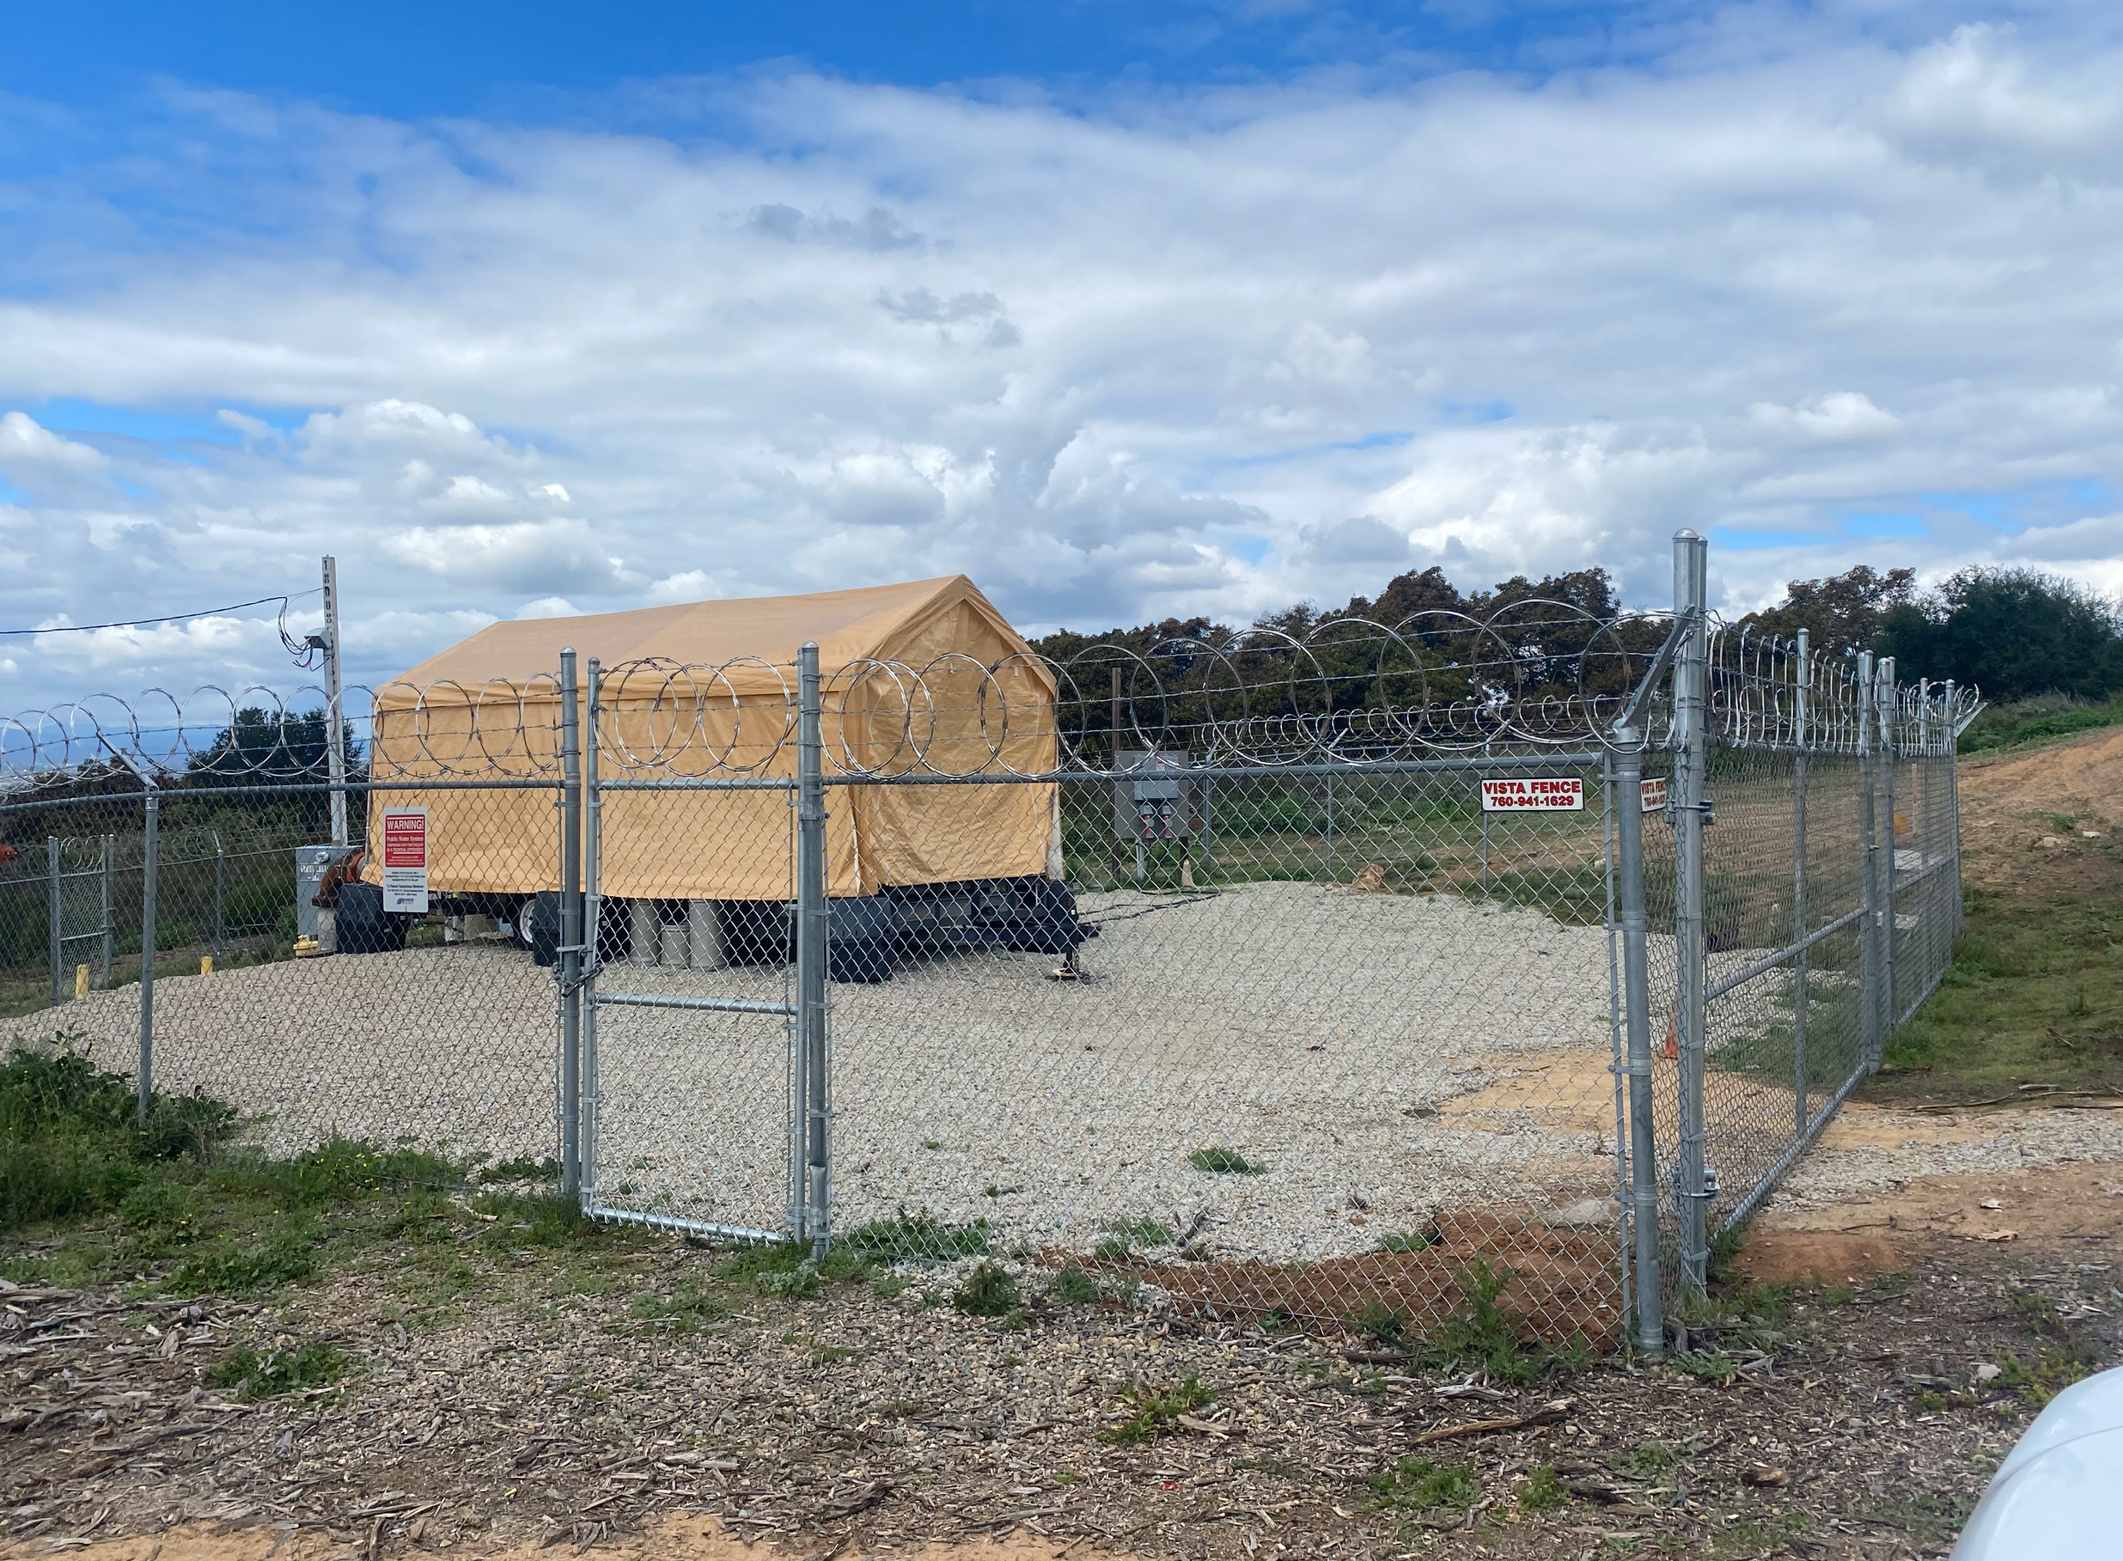
Gopher Skid Pump Station
Scope of Work: Replace the temporary pump skid with a permanent solution.
Project Rationale: Required operational flexibility to move water within the southern zone absent SDCWA connections.
 | Planned Expenditures
Project | Year 1 (FY 24/25) | Year 2 (FY 25/26) | Year 3 (FY 26/27) | Year 4 (FY 27/28) | Year 5 (FY 28/29) | Total
TBD | $710,000 |  |  |  |  | $710,000

Slide 14
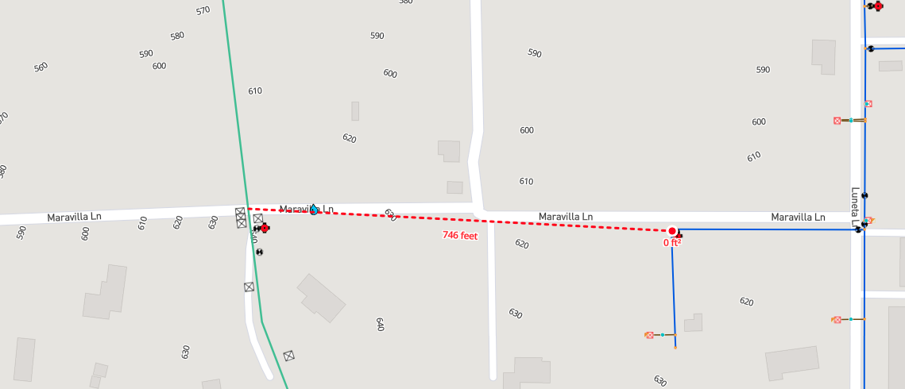
FPUD Maravilla to RMWD Maravilla (Morro Tank)
Scope of Work: Install 750 LF of C900 PVC pipeline to connect FPUD and RMWD potable water systems.
Project Rationale: Operational flexibility to source water into the Morro Tank zone providing additional capacity from Morro Reservoir to the District's southern pressure zones.
 | Planned Expenditures
Project | Year 1 (FY 24/25) | Year 2 (FY 25/26) | Year 3 (FY 26/27) | Year 4 (FY 27/28) | Year 5 (FY 28/29) | Total
TBD | $210,000 |  |  |  |  | $210,000

Slide 15
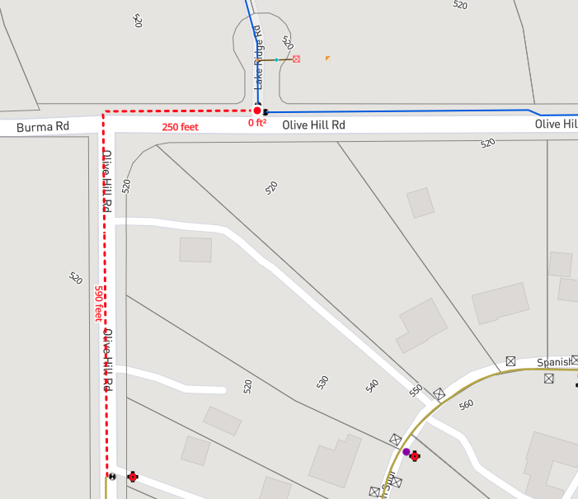
FPUD Olive Hill to RMWD Olive Hill (Morro Reservoir)
Scope of Work: Install 840 LF of C900 PVC Pipeline to connect FPUD and RMWD potable water systems.
Project Rationale: Operational flexibility to source water into the Morro Reservoir providing additional capacity to the District's southern pressure zones.
 | Planned Expenditures
Project | Year 1 (FY 24/25) | Year 2 (FY 25/26) | Year 3 (FY 26/27) | Year 4 (FY 27/28) | Year 5 (FY 28/29) | Total
TBD | $235,000 |  |  |  |  | $235,000

Slide 16
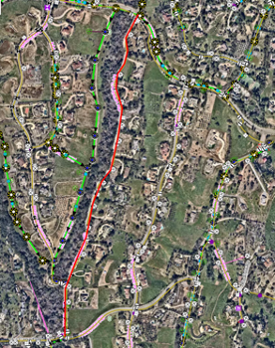
La Canada Pipeline Replacement and Pressure Reduction
Scope of Work: Replace 4,000 LF of pipeline along La Canada from Hillrise Rd. to Via Monserate and install two (2) new pressure reducing stations.
Project Rationale: The project will prevent future costs associated with leaks or main breaks and reduce service interruptions. This alignment of pipeline has experienced eight (8) main breaks within the last five (5) years.
 | Planned Expenditures
Project | Year 1 (FY 24/25) | Year 2 (FY 25/26) | Year 3 (FY 26/27) | Year 4 (FY 27/28) | Year 5 (FY 28/29) | Total
TBD | $100,000 | $700,000 |  |  |  | $800,000

Slide 17
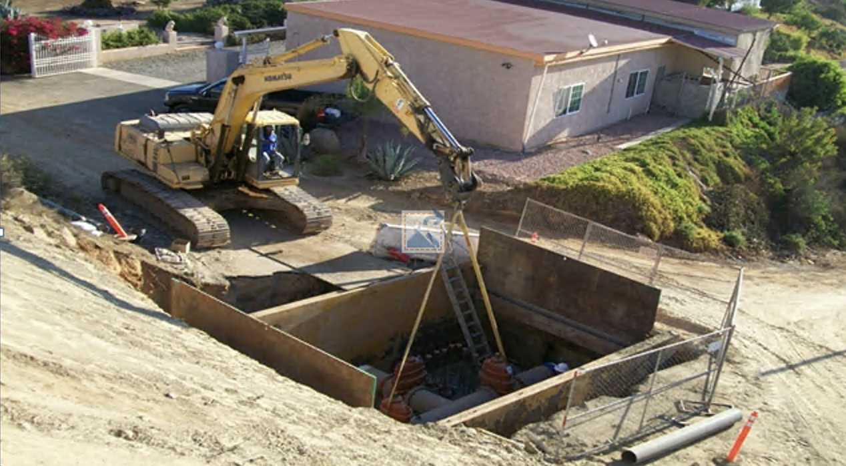
Isolation Valve Installation Program (600009)
Scope of Work: Replace isolation valves district-wide that have exceeded their useful life.
Project Rationale: The project will reduce the number of customers impacted by service interruptions due to leaks and main breaks and reduce repair time due to valves that don't fully seal. The Project will also replace valves in the broken or open positions.
 | Planned Expenditures
Project | Year 1 (FY 24/25) | Year 2 (FY 25/26) | Year 3 (FY 26/27) | Year 4 (FY 27/28) | Year 5 (FY 28/29) | Total
600009 | $100,000 | $500,000 | $180,000 | $500,000 | $180,000
 | Year 6 (FY 29/30) | Year 7 (FY 30/31) | Year 8 (FY 31/32) | Year 9 (FY 32/33) | Year 10 (FY 33/34)
 | $500,000 | $180,000 | $500,000 | $180,000 | $500,000 | $3,320,000

Slide 18
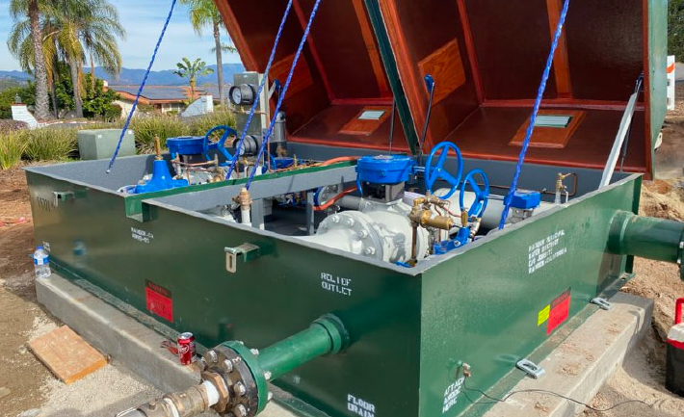
Pressure Reducing Stations (600007)
Scope of Work: Install previously purchased pressure reducing stations district-wide in areas of high pressure.
Project Rationale: The project will reduce high-pressure zones to extend the useful life of water infrastructure and reduce damage associated with main line breaks.
 | Planned Expenditures
Project | Year 1 (FY 24/25) | Year 2 (FY 25/26) | Year 3 (FY 26/27) | Year 4 (FY 27/28) | Year 5 (FY 28/29) | Total
600007 | $150,000 | $150,000 | $150,000 |  |  | $450,000

Slide 19
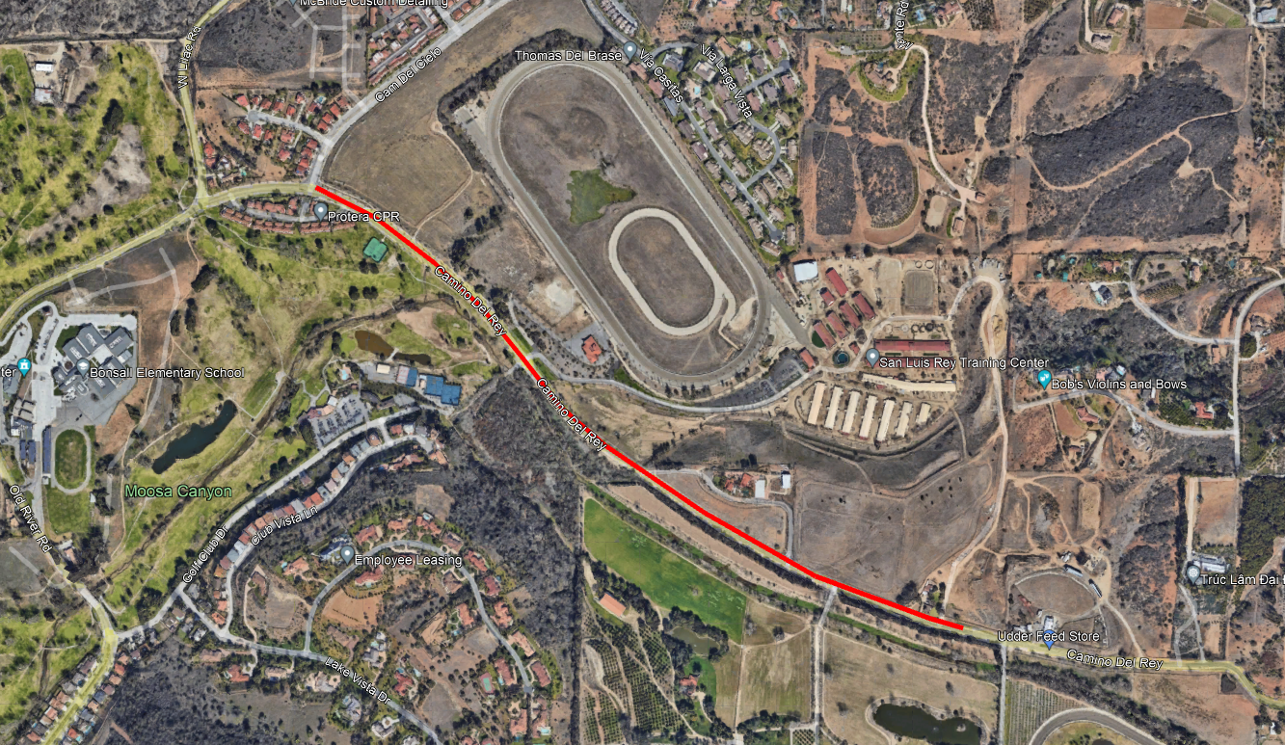
Camino Del Rey Waterline Relocation (600026)
Scope of Work: Relocate existing water and sewer infrastructure due to the County of San Diego's Road Improvement Project.
Project Rationale: The project will ensure continuity of service during the County-initiated construction project and upgrade water facilities.
 | Planned Expenditures
Project | Year 1 (FY 24/25) | Year 2 (FY 25/26) | Year 3 (FY 26/27) | Year 4 (FY 27/28) | Year 5 (FY 28/29) | Total
600026 | $100,000 | $25,000 |  |  |  | $125,000

Slide 20
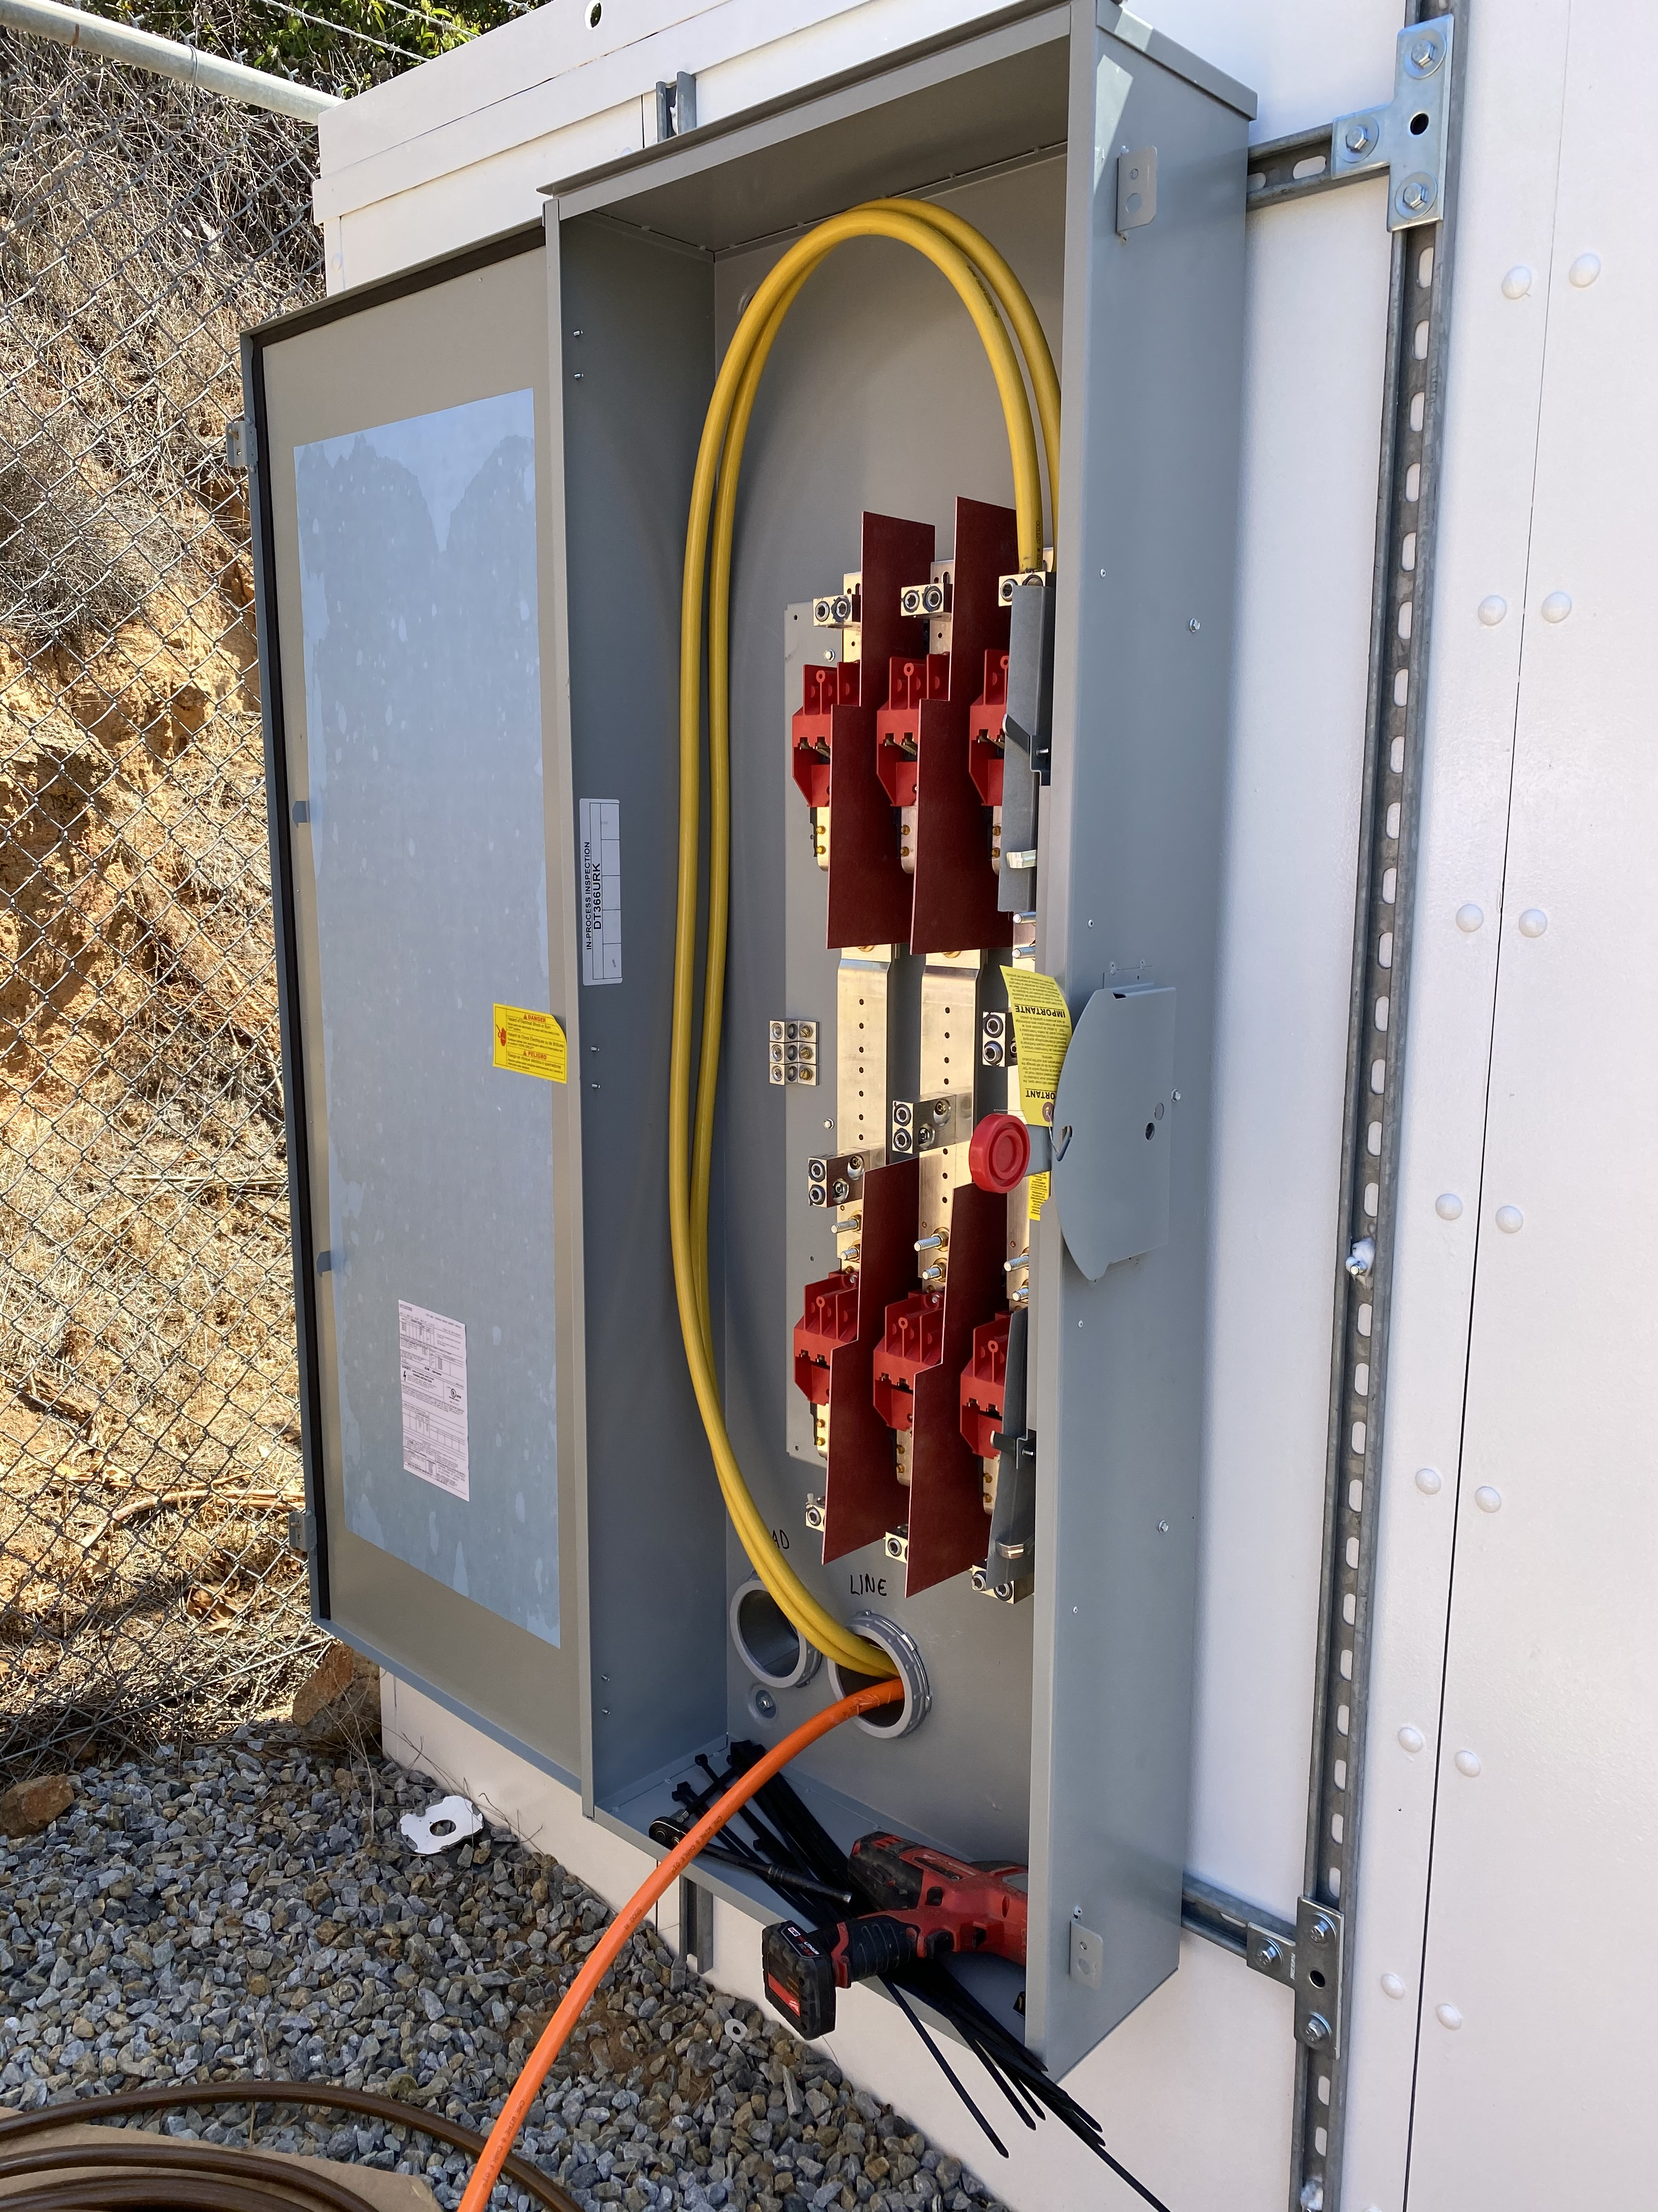
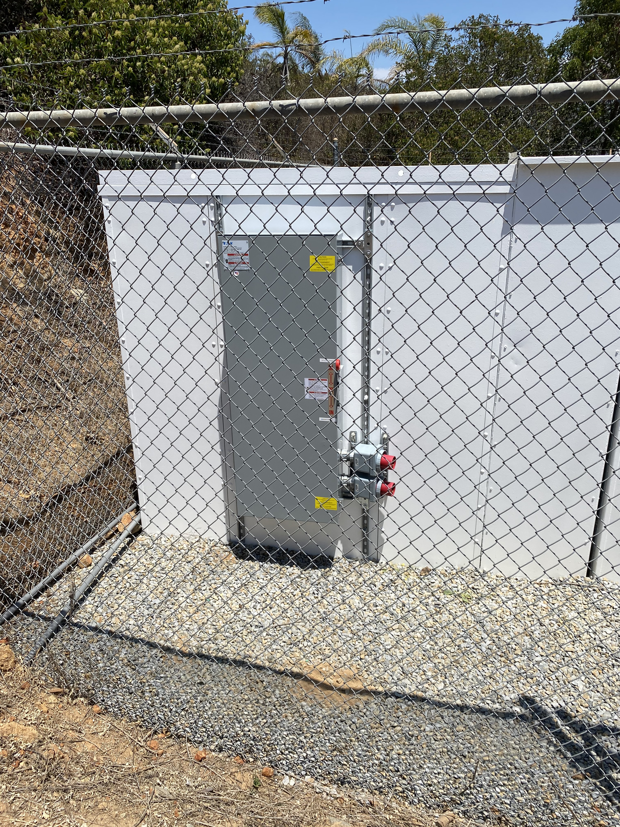
Manual Transfer Switches (600058)
Scope of Work: Install manual transfer switches at Morro Hills Pump Station, Rainbow Hills Pump Station, and Vallecitos Pump Station.
Project Rationale: The project will ensure the safety of District staff when switching to backup power during emergencies.
 | Planned Expenditures
Project | Year 1 (FY 24/25) | Year 2 (FY 25/26) | Year 3 (FY 26/27) | Year 4 (FY 27/28) | Year 5 (FY 28/29) | Total
600058 | $200,000 |  |  |  |  | $200,000

Slide 21
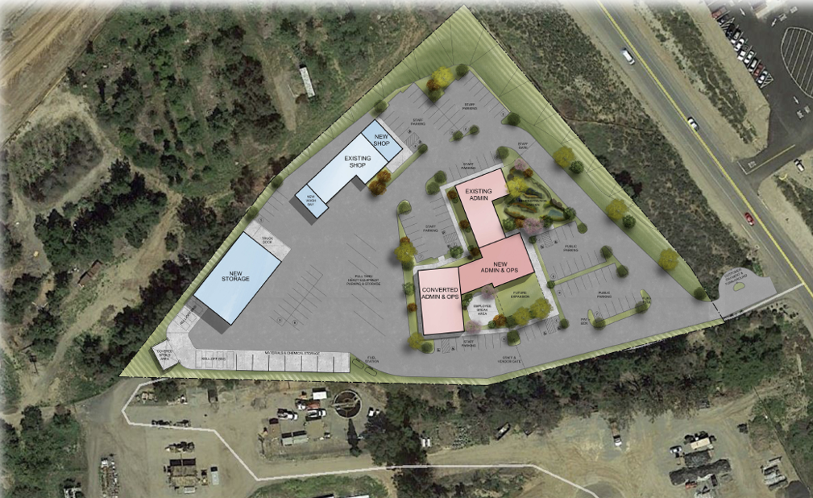
District Headquarters (300008)
Scope of Work: Repair and replace necessary facilities for on-going operations and explore options for long-term District facilities plan with the recently re-established Ad-Hoc committee.
Project Rationale: The project will fund roof and HVAC upgrades in the Admin Building in FY24/25 to maintain adequate facilities in the near-term and explore feasibility of a long-term facilities solution of either re-development of the existing site and relocation of District facilities or extending the useful life of existing facilities through significant upgrades. Facilities support day-to-day administration and operations of the District.
 | Planned Expenditures
Project | Year 1 (FY 24/25) | Year 2 (FY 25/26) | Year 3 (FY 26/27) | Year 4 (FY 27/28) | Year 5 (FY 28/29) | Total
300008 | $600,000 | $500,000 | $1,000,000* | $4,000,000* | $0 | $ 6,100,000
*Assumes a significant investment will occur starting in FY26/27 to either fund major activities associated with re-development of the site (EIR and entitlements) or existing facilities rehabilitation.

Slide 22
Sewer Projects
FY 24/25

Slide 23
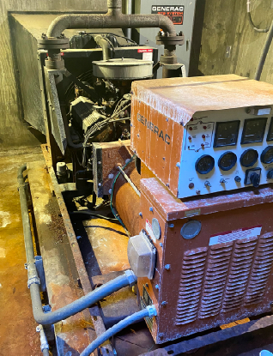
Rancho Monserate, Rancho Viejo, and HQ B-Plant Emergency Generators (530023)
Scope of Work: This project proposes to in-kind replacements of the obsolete emergency generators at Rancho Monserate, Rancho Viejos, and HQ B-Plant lift stations.
Project Rationale: The project will provide a backup power source for critical sewer infrastructure. Existing equipment hhas exceeded its useful life.
 | Planned Expenditures
Project | Year 1 (FY 24/25) | Year 2 (FY 25/26) | Year 3 (FY 26/27) | Year 4 (FY 27/28) | Year 5 (FY 28/29) | Total
530023 | $525,000* |  |  |  |  | $525,000
*Grant funding dependent

Slide 24
Pipeline Replacement Projects
Years 2-10

Slide 25
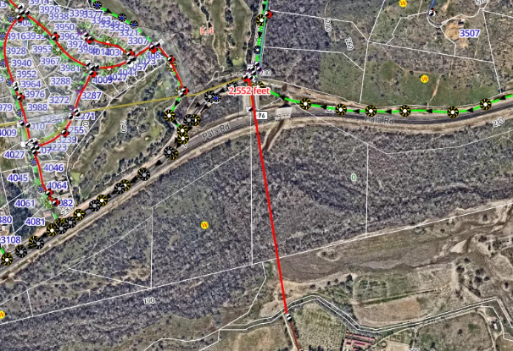
Gird to West Lilac Pipeline Rehabilitation (600085)
Scope of Work: Pipeline is currently abandoned in place with end caps at the North and South. To avoid environmental impacts and permitting issues, Cure-in-Place (CIPP) technologies will be utilized.
Project Rationale: With this waterline out of service more customers are affected by shutdowns as well as it limits operational flexibility to move water throughout the system.
 | Planned Expenditures
Project | Year 1 (FY 24/25) | Year 2 (FY 25/26) | Year 3 (FY 26/27) | Year 4 (FY 27/28) | Year 5 (FY 28/29) | Total
600085 |  | $125,000 | $1,235,000 |  |  | $1,360,000

Slide 26
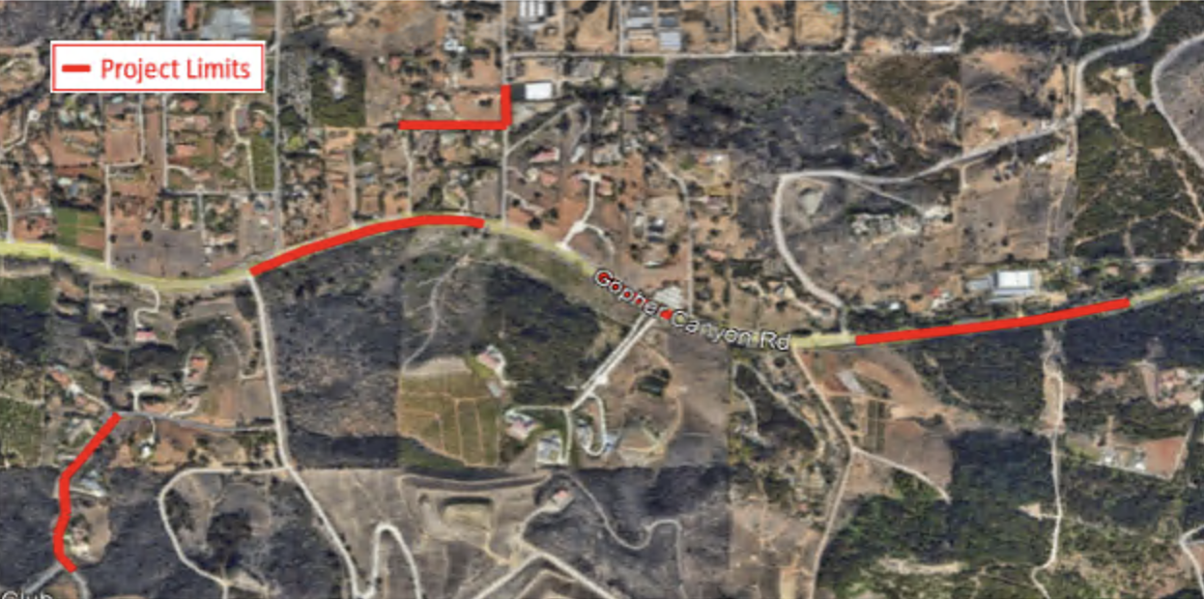
Gopher Canyon Water Pipeline Improvements (600045)
Scope of Work: Install multiple pipe segments within Gopher Canyon Road, Margale Lane, and Integrity Ct.
Project Rationale: The pipeline is past its useful life. Within this alignment there are several dead ends as well as sections of pipeline crossing private property. The proposed project would create a looped system.
 | Planned Expenditures
Project | Year 1 (FY 24/25) | Year 2 (FY 25/26) | Year 3 (FY 26/27) | Year 4 (FY 27/28) | Year 5 (FY 28/29) | Total
600045 |  |  | $138,000 | $2,760,000 |  | $2,898,000

Slide 27
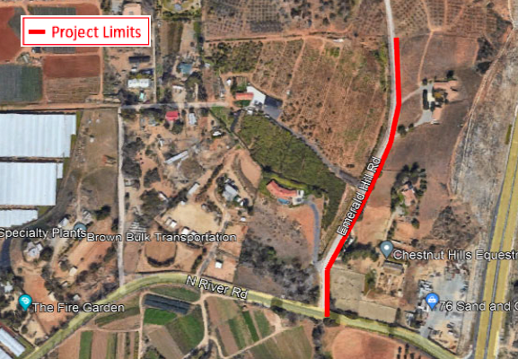
Roy Line Extension (600075)
Scope of Work: Replace 1,056 feet of 6-inch pipe on Emerald Hills Road near North River Road as identified in the Condition Assessment as High Risk.
Project Rationale: The project will prevent future costs associated with leaks or main breaks and reduce service interruptions.
 | Planned Expenditures
Project | Year 1 (FY 24/25) | Year 2 (FY 25/26) | Year 3 (FY 26/27) | Year 4 (FY 27/28) | Year 5 (FY 28/29) | Total
600075 |  |  | $150,000 | $2,000,000 |  | $2,150,000

Slide 28
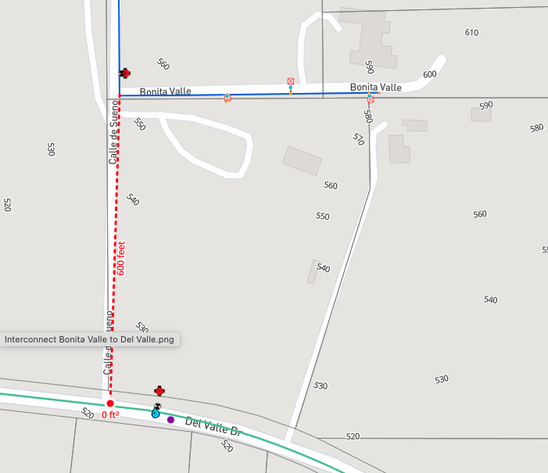
FPUD Bonita Valle to RMWD Del Valle (Morro Tank)
Scope of Work: Install 600 LF of C900 to connect FPUD and RMWD potable water systems.
Project Rationale: The project will assist in transporting critical water supply to Morro Tank. Once fully disconnected from the SDCWA this project will be reassessed.
 | Planned Expenditures
Project | Year 1 (FY 24/25) | Year 2 (FY 25/26) | Year 3 (FY 26/27) | Year 4 (FY 27/28) | Year 5 (FY 28/29) | Total
TBD |  |  | $170,000 |  |  | $170,000

Slide 29
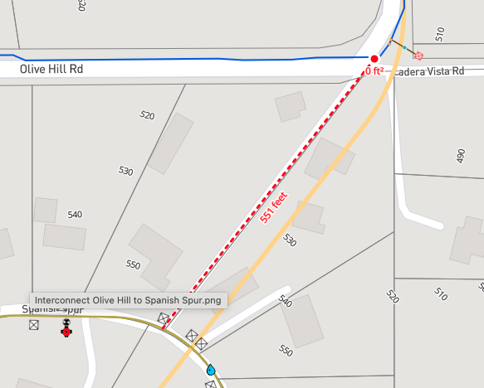
FPUD Olive Hill to RMWD Spanish Spur (Morro Reservoir)
Scope of Work: Install 550 LF of C900 to connect FPUD and RMWD potable water systems.
Project Rationale: The project will assist in transporting critical water supply to Morro Reservoir. Once fully disconnected from the SDCWA this project will be reassessed.
 | Planned Expenditures
Project | Year 1 (FY 24/25) | Year 2 (FY 25/26) | Year 3 (FY 26/27) | Year 4 (FY 27/28) | Year 5 (FY 28/29) | Total
TBD |  |  | $155,000 |  |  | $155,000

Slide 30
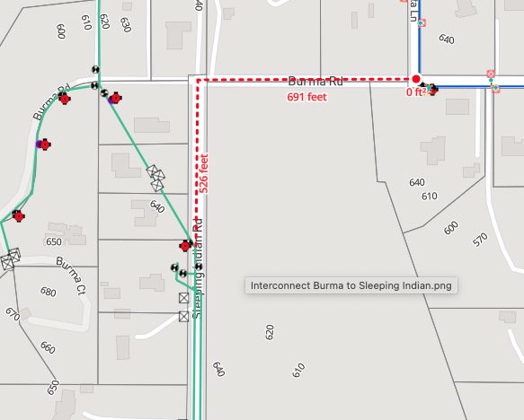
FPUD Burma Rd. to RMWD Sleeping Indian (Morro Tank)
Scope of Work: Install 1,217 LF of C900 to connect FPUD and RMWD potable water systems.
Project Rationale: The project will assist in transporting critical water supply to Morro Tank. Once fully disconnected from the SDCWA this project will be reassessed.
 | Planned Expenditures
Project | Year 1 (FY 24/25) | Year 2 (FY 25/26) | Year 3 (FY 26/27) | Year 4 (FY 27/28) | Year 5 (FY 28/29) | Total
TBD |  |  | $345,000 |  |  | $345,000

Slide 31
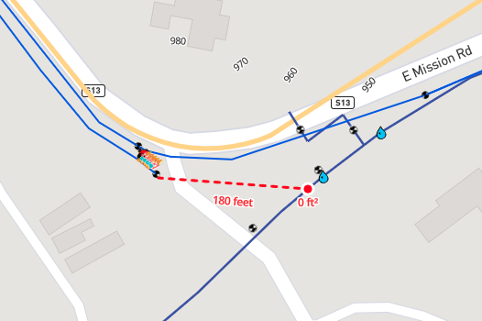
FPUD Sanchez Zone to RMWD Northside Zone (Rainbow Hills Reservoir)
Scope of Work: Install 180 LF of C900 to connect FPUD and RMWD potable water systems.
Project Rationale: The project will assist in critical water supply to Rainbow Hills Reservoir. Once fully disconnected from the SDCWA this project will be reassessed.
 | Planned Expenditures
Project | Year 1 (FY 24/25) | Year 2 (FY 25/26) | Year 3 (FY 26/27) | Year 4 (FY 27/28) | Year 5 (FY 28/29) | Total
TBD |  |  | $60,000 |  |  | $60,000

Slide 32
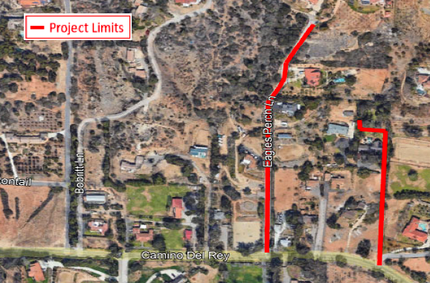
Eagle's Perch Water Pipeline Improvements (600043)
Scope of Work: Replace and relocate water pipelines in difficult-to-access easements to a new alignment within a roadway and private driveway.
Project Rationale: The pipeline has exceeded its useful life. Within this alignment there are several dead ends as well as sections of pipeline crossing private property. The proposed project would also remove a District asset from private property.
 | Planned Expenditures
Project | Year 1 (FY 24/25) | Year 2 (FY 25/26) | Year 3 (FY 26/27) | Year 4 (FY 27/28) | Year 5 (FY 28/29) | Total
600043 |  |  |  | $96,000 | $1,920,000 | $2,016,000

Slide 33
Rice Canyon Main Replacement (600061)
Scope of Work: Replace 2,149 feet of 8-inch pipe on Rice Canyon Road, north of the Rice Canyon tank.
Project Rationale: This pipeline has exceeded its useful life and has had seven (7) main breaks. Any main breaks in this area cause catastrophic damage to the road resulting in full lane closures for repairs.
 | Planned Expenditures
Project | Year 1 (FY 24/25) | Year 2 (FY 25/26) | Year 3 (FY 26/27) | Year 4 (FY 27/28) | Year 5 (FY 28/29) | Total
600061 |  |  |  | $1,500,000 |  | $1,500,000

Slide 34
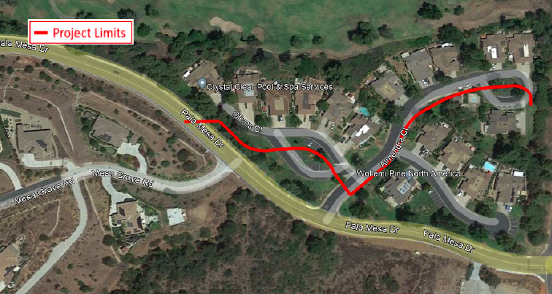
Pala Mesa Fairways Community (600067)
Scope of Work: Replace 1,500 feet of 8-inch pipe identified by the Condition Assessment as High Risk.
Project Rationale: This pipeline has exceeded its useful life and has experienced 14 mainline leaks.
 | Planned Expenditures
Project | Year 1 (FY 24/25) | Year 2 (FY 25/26) | Year 3 (FY 26/27) | Year 4 (FY 27/28) | Year 5 (FY 28/29) | Total
600067 |  |  |  | $71,250 | $2,500,000 | $2,571,250

Slide 35
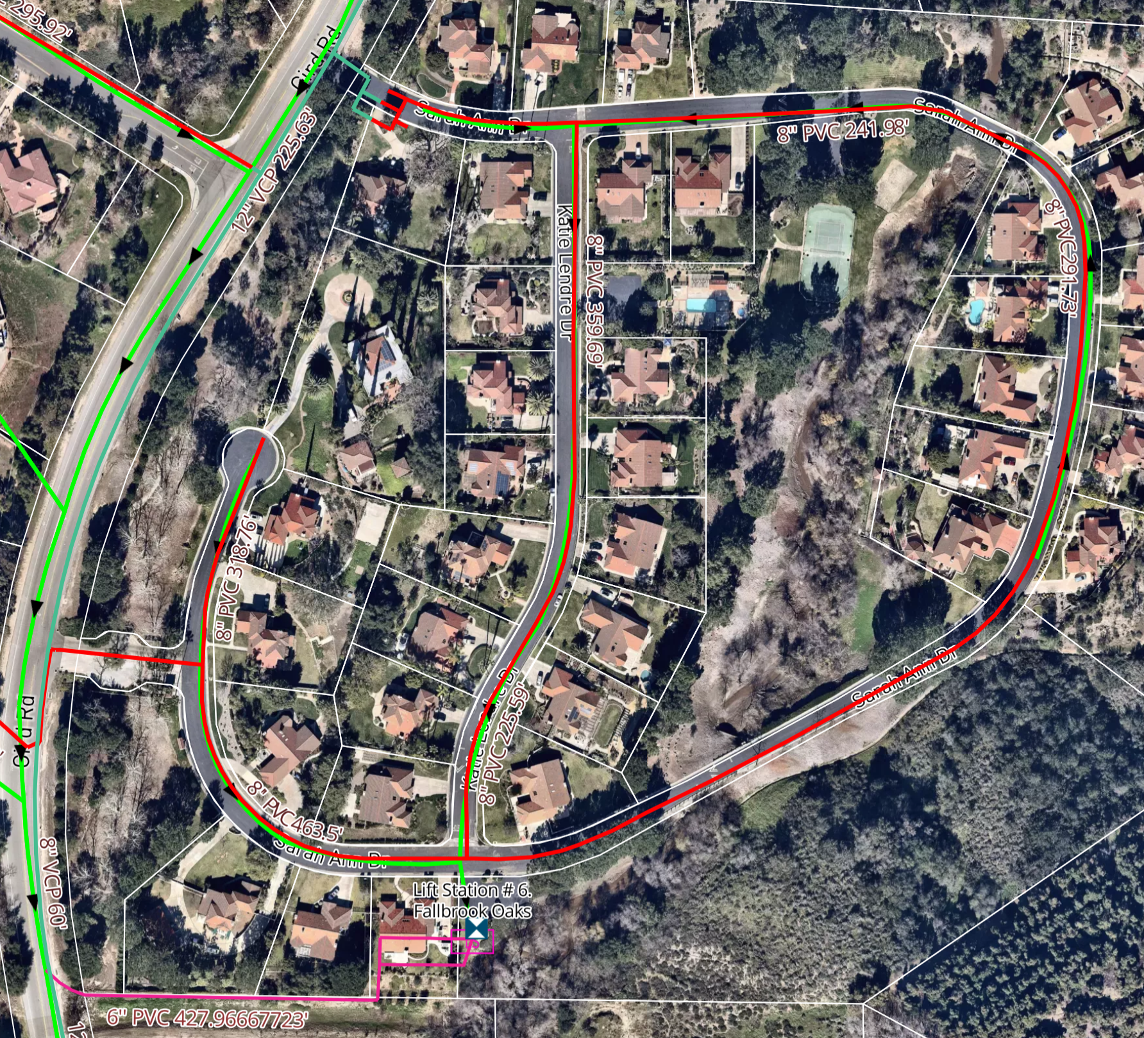
Sarah Ann Entire Community and Fallbrook Oaks Force Main, and Manhole Replacement (600068 and 530018)
Scope of Work: Replace pumps, suction piping, manholes, electrical, motor controls, and 800 feet of 6-inch force main at Fallbrook Oaks Lift Station. Additionally, the 8-inch water line will be replaced within Sarah Ann community.
Project Rationale: The existing lift station is obsolete. The existing force main alignment runs adjacent to channel. The existing pipeline for the entire community has experienced 26 mainline leaks.
 | Planned Expenditures
Project | Year 5 (FY 28/29) | Year 6 (FY 29/30) | Year 7 (FY 30/31) | Year 8 (FY 31/32) | Year 9 (FY 32/33) | Total
600068 | $200,000 | $4,000,000 |  |  |  | $4,200,000
530018 |  | $1,650,000 |  |  |  | $1,650,000

Slide 36
Thibido Water Main Replacement (600066)
Scope of Work: Replace 940 feet of 6-inch pipe identified in the Condition Assessment as High Risk.
Project Rationale: The project will prevent future costs associated with leaks or main breaks and reduce service interruptions. Ingress/egress does not accommodate vehicles or heavy equipment.
 | Planned Expenditures
Project | Year 6 (FY 29/30) | Year 7 (FY 30/31) | Year 8 (FY 31/32) | Year 9 (FY 32/33) | Year 10 (FY 33/34) | Total
600066 | $700,000 |  |  |  |  | $700,000

Slide 37
North Feeder and Rainbow Hills Water Line Replacements (600051)
Scope of Work: Replace 3,788 feet of 30-inch and 27-inch pipelines that are severely corroded using CIPP technologies. In addition, the project would add three (3) new isolation valves.
Project Rationale: The pipeline is at the end of its useful life. The pipeline runs under the highway making access for any repairs or maintenance difficult.
 | Planned Expenditures
Project | Year 6 (FY 29/30) | Year 7 (FY 30/31) | Year 8 (FY 31/32) | Year 9 (FY 32/33) | Year 10 (FY 33/34) | Total
600051 |  | $150,000 | $1,850,000 |  |  | $2,400,000

Slide 38
Water Pump Stations/Electrical Upgrades
Years 2-10

Slide 39
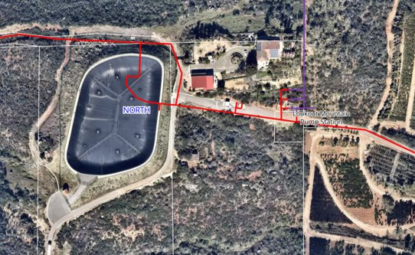
Lookout Mountain Pump Station Electrical Upgrades and New Emergency Generator (600050)
Scope of Work: Enclosed facility with upgraded pumps, motor control, electrical components, transfer switch, and a new emergency generator.
Project Rationale: The project will ensure reliability of critical water infrastructure during emergencies. Existing equipment is obsolete.
 | Planned Expenditures
Project | Year 1 (FY 24/25) | Year 2 (FY 25/26) | Year 3 (FY 26/27) | Year 4 (FY 27/28) | Year 5 (FY 28/29) | Total
600050 |  | $500,000 | $3,000,000 |  |  | $3,500,000

Slide 40
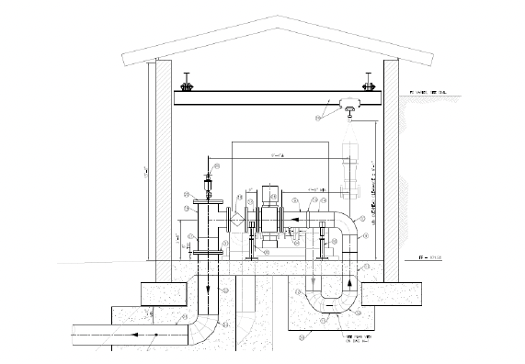
Weese WTP Permanent Emergency Interconnect Pump Station (600008)
Scope of Work: Install a pump station to pull water from Oceanside's Weese WTP into the District's southern zone.
Project Rationale: Required operational flexibility to move water without SDCWA connections within the southern zone.
 | Planned Expenditures
Project | Year 1 (FY 24/25) | Year 2 (FY 25/26) | Year 3 (FY 26/27) | Year 4 (FY 27/28) | Year 5 (FY 28/29) | Total
600008 |  |  |  |  | $1,725,000 | $1,725,000

Slide 41
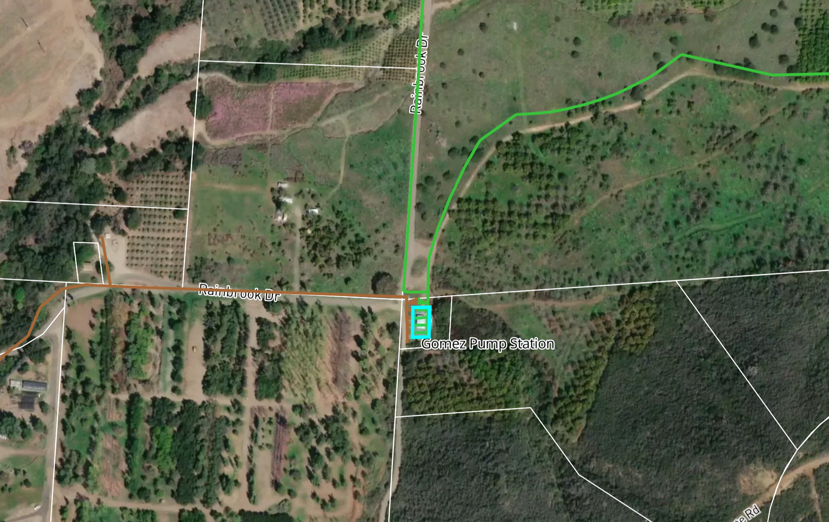
Gomez Pump Station Electrical Upgrades
Scope of Work: Upgrade motor controls, breakers, relays, and wiring to replace obsolete system.
Project Rationale: Existing equipment is obsolete.
 | Planned Expenditures
Project | Year 1 (FY 24/25) | Year 2 (FY 25/26) | Year 3 (FY 26/27) | Year 4 (FY 27/28) | Year 5 (FY 28/29) | Total
TBD |  |  | $100,000 | $1,000,000 |  | $1,100,000

Slide 42
Vallecitos Pump Station Replacement (600040)
Scope of Work: Replace the existing pump station, which was constructed in 1978.
Project Rationale: Existing equipment is reaching the end of its useful life and requires replacement.
 | Planned Expenditures
Project | Year 6 (FY29/30) | Year7 (FY 30/31) | Year 8 (FY 31/32) | Year 9 (FY 32/33) | Year 10 (FY 33/34) | Total
600040 | $500,000 | $1,400,000 |  |  |  | $1,900,000

Slide 43
Morro Pump Station Rehabilitation (600084)
Scope of Work: Retrofit the existing pump station facility, replace pumps and motor controls.
Project Rationale: Station is near the end of its useful life and provides operational flexibility to move the water in the Southern zone.
 | Planned Expenditures
Project | Year 6 (FY 29/30) | Year 7 (FY 30/31) | Year 8 (FY 31/32) | Year 9 (FY 32/33) | Year 10 (FY 33/34) | Total
600084 | $300,000 | $1,225,000 |  |  |  | $1,525,000

Slide 44
Detachment Requirements
Years 2-5

Slide 45
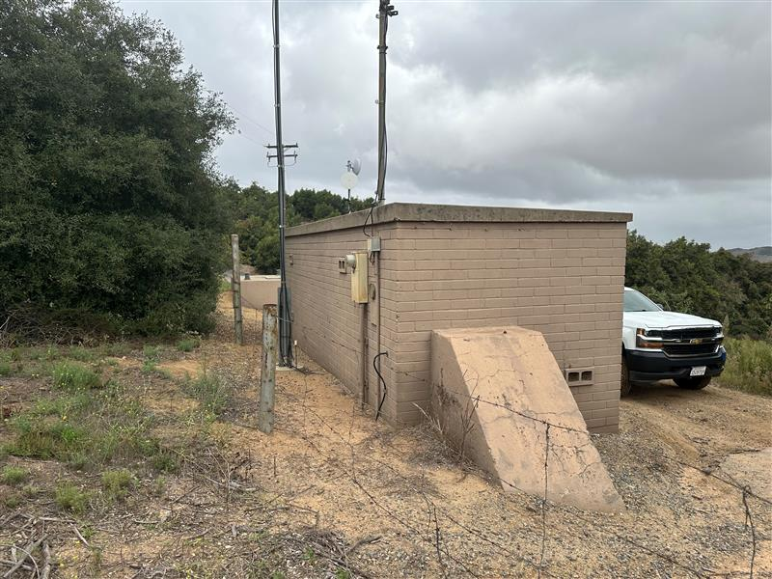
SDCWA Connections 3, 6, 7, and 11 Interim Decommissioning
Scope of Work: Interim decommissioning at SDCWA connections 3, 6, 7, 11, and 12.
Project Rationale: Requirement of detachment from SDCWA.
 | Planned Expenditures
Project | Year 1 (FY 24/25) | Year 2 (FY 25/26) | Year 3 (FY 26/27) | Year 4 (FY 27/28) | Year 5 (FY 28/29) | Total
TBD |  | $350,000 |  |  |  | $350,000

Slide 46
SDCWA Connections 3, 6, 7, 11, and 12 Permanent Decommissioning
Scope of Work: Permanent decommissioning of SDCWA connections 3, 6, 7, 11, and 12.
Project Rationale: Requirement of detachment from SDCWA.
 | Planned Expenditures
Project | Year 1 (FY 24/25) | Year 2 (FY 25/26) | Year 3 (FY 26/27) | Year 4 (FY 27/28) | Year 5 (FY 28/29) | Total
TBD |  |  |  | $1,650,000 |  | $1,650,000

Slide 47
Sewer Lift Stations/Electrical Upgrades
Years 2-10

Slide 48
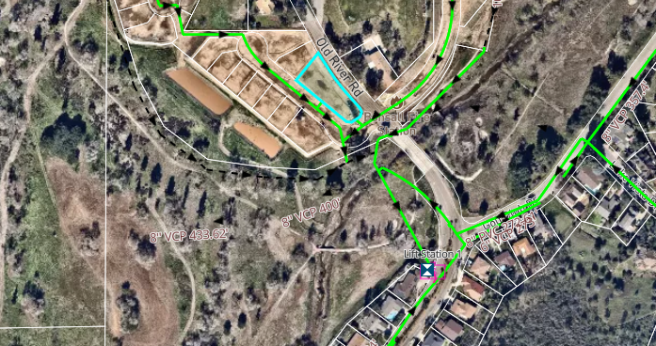
School House Lift Station
Scope of Work: This project proposes construction of a new lift station to help address current and projected build-out flows.
Project Rationale: The project is intended to offset higher demand at Lift Station-1 which has limited capacity. The proposed Lift Station would be needed to additional development. If needed, the project would be funded with future capacity fees.
 | Planned Expenditures
Project | Year 1 (FY 24/25) | Year 2 (FY 25/26) | Year 3 (FY 26/27) | Year 4 (FY 27/28) | Year 5 (FY 28/29) | Total
TBD |  |  |  | $500,000 | $10,000,000 | $10,500,000

Slide 49
Sewer Pipeline/CIPP
Years 2-10

Slide 50
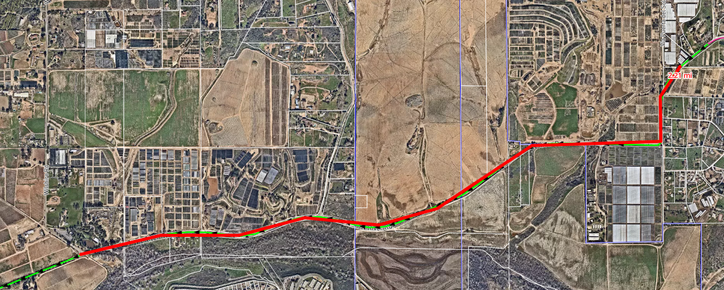
North River Road Sewer Capacity Expansion
Scope of Work: This project proposes to upsize a 15-inch sewer pipeline to a 21-inch sewer pipeline along North River Road from Via Puerta del Sol to Wilshire Road.
Project Rationale: The project is intended to address capacity of an undersized system.
 | Planned Expenditures
Project | Year 1 (FY 24/25) | Year 2 (FY 25/26) | Year 3 (FY 26/27) | Year 4 (FY 27/28) | Year 5 (FY 28/29) | Total
TBD |  | $50,000 | $500,000 | $9,000,000 |  | $9,550,000

Slide 51
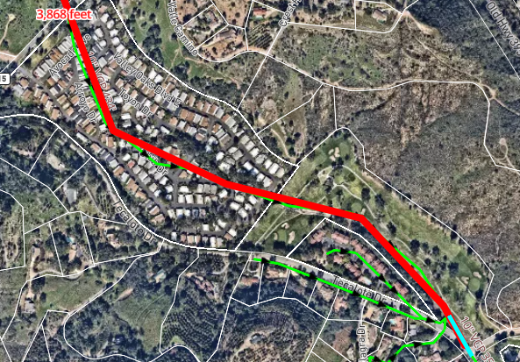
CIPP 2,000 LF of 8-inch VCP near Pala Mesa/Palomar (530019)
Scope of Work: This project proposes to install 2,000 to 4,000 linear feet CIPP lining on an existing 8-inch vitrified clay pipe (VCP) and to raise or relocate manholes throughout the golf course.
Project Rationale: The project will extend the useful life of the facility and reduce ongoing maintenance costs. Inflow and infiltrations (I&I) will be reduced.
 | Planned Expenditures
Project | Year 1 (FY 24/25) | Year 2 (FY 25/26) | Year 3 (FY 26/27) | Year 4 (FY 27/28) | Year 5 (FY 28/29) | Total
530019 |  |  |  | $100,000 | $1,000,000 | $1,100,000

Slide 52
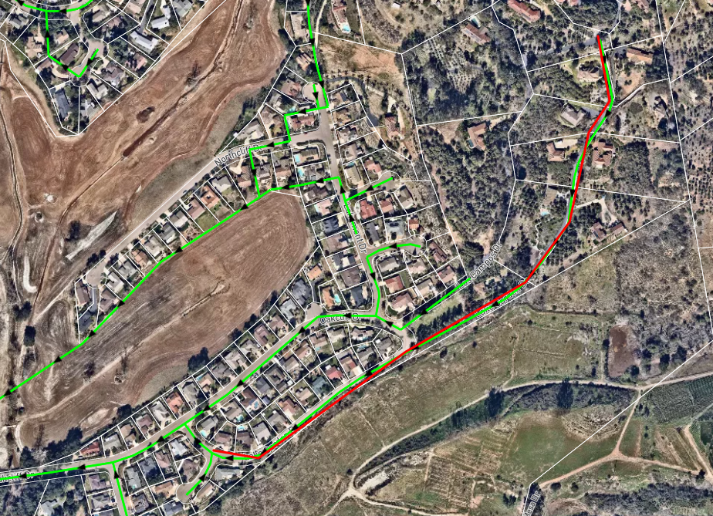
Lake Garden CIPP Lining
Scope of Work: This project proposes to install about ~2,800 linear feet of CIPP lining and to line manholes.
Project Rationale: The project will extend the useful life of the facility and reduce ongoing maintenance costs. I&I will be reduced.
 | Planned Expenditures
Project | Year 1 (FY 24/25) | Year 2 (FY 25/26) | Year 3 (FY 26/27) | Year 4 (FY 27/28) | Year 5 (FY 28/29) | Total
TBD |  |  |  | $100,000 | $1,000,000 | $1,100,000

Slide 53
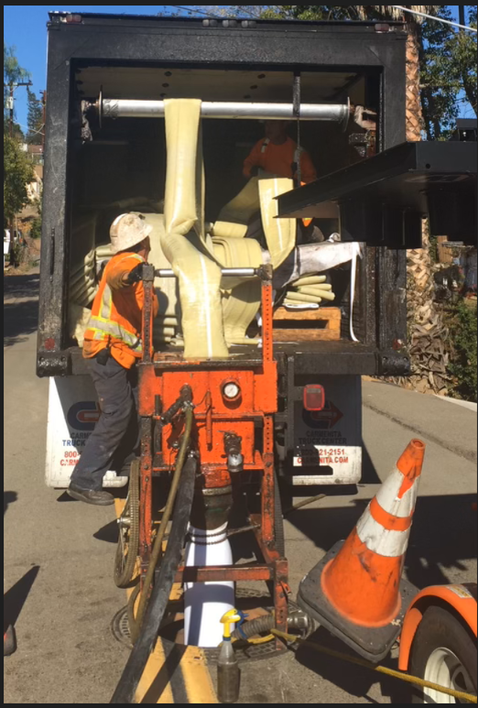
CIPP Lining
Scope of Work: This project proposes to install CIPP lining district-wide.
Project Rationale: The project will extend the useful life of facilities and reduce ongoing maintenance costs. I&I will be reduced.
 | Planned Expenditures
Project | Year 6 (FY 29/30) | Year 7 (FY 30/31) | Year 8 (FY 31/32) | Year 9 (FY 32/33) | Year 10 (FY 33/34) | Total
TBD | $1,000,000 |  |  |  |  | $1,000,000

Slide 54
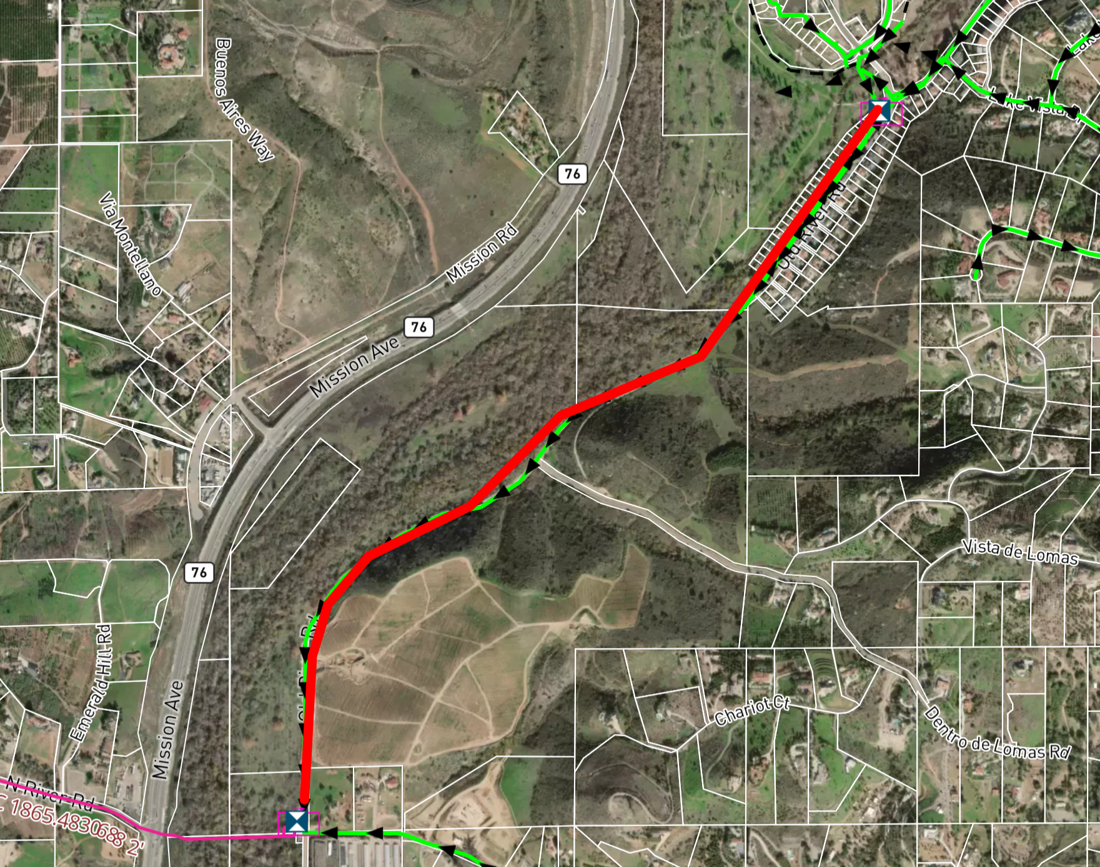
Old River Road between LS-1 and LS-2
Scope of Work: This project proposes to convert a gravity main to a force main and upsize to a 21-inch pipe between LS-1 and LS-2 on Old River Road.
Project Rationale: The project is intended to address capacity of an undersized system.
 | Planned Expenditures
Project | Year 6 (FY 29/30) | Year 7 (FY 30/31) | Year 8 (FY 31/32) | Year 9 (FY 32/33) | Year 10 (FY 33/34) | Total
TBD | $3,000,000 |  |  |  |  | $3,000,000

Slide 55
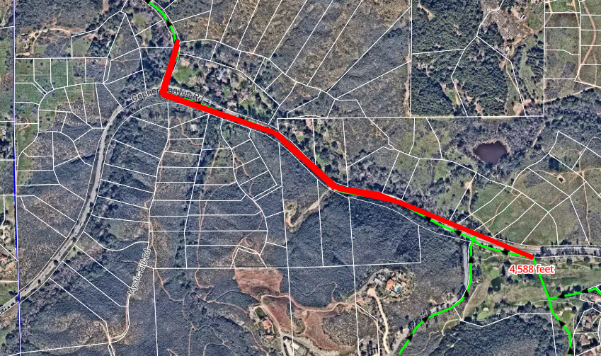
Gopher Canyon CIPP
Scope of Work: This project proposes to install CIPP lining along a segment of sewer alignment on Gopher Canyon Road includes lining manholes and replacing frames and covers.
Project Rationale: The project will extend the useful life of the facility and reduce ongoing maintenance costs. I&I will be reduced.
 | Planned Expenditures
Project | Year 6 (FY 29/30) | Year 7 (FY 30/31) | Year 8 (FY 31/32) | Year 9 (FY 32/33) | Year 10 (FY 33/34) | Total
TBD |  | $2,000,000 |  |  |  | $2,000,000

Slide 56
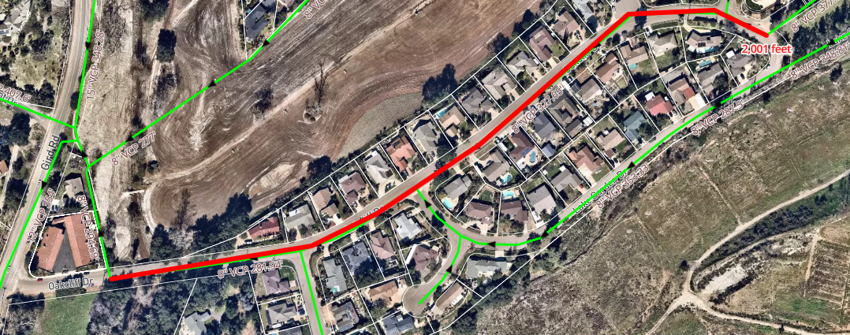
Oakcliff CIPP
Scope of Work: This project proposes CIPP lining of approximately 2,000 linear feet of sewer main along Oakcliff drive.
Project Rationale: The project will extend the useful life of the facility and reduce ongoing maintenance costs. I&I will be reduced.
 | Planned Expenditures
Project | Year 6 (FY 29/30) | Year 7 (FY 30/31) | Year 8 (FY 31/32) | Year 9 (FY 32/33) | Year 10 (FY 33/34) | Total
TBD |  |  | $100,000 | $650,000 |  | $750,000

Slide 57
Tank Maintenance and Other Projects
Years 2-10

Slide 58
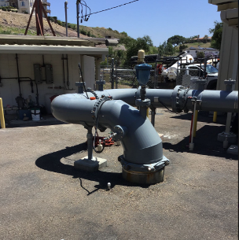
Morro Chemical Tanks
Scope of Work: Install two (2) new ammonia and chlorine storage chemical tanks at the Morro Reservoir.
Project Rationale: The project will establish an adequate supply of chemical storage to treat varying water chemistry as-needed.
 | Planned Expenditures
Project | Year 1 (FY 24/25) | Year 2 (FY 25/26) | Year 3 (FY 26/27) | Year 4 (FY 27/28) | Year 5 (FY 28/29) | Total
TBD |  |  | $150,000 | $1,500,000 |  | $1,650,000

Slide 59
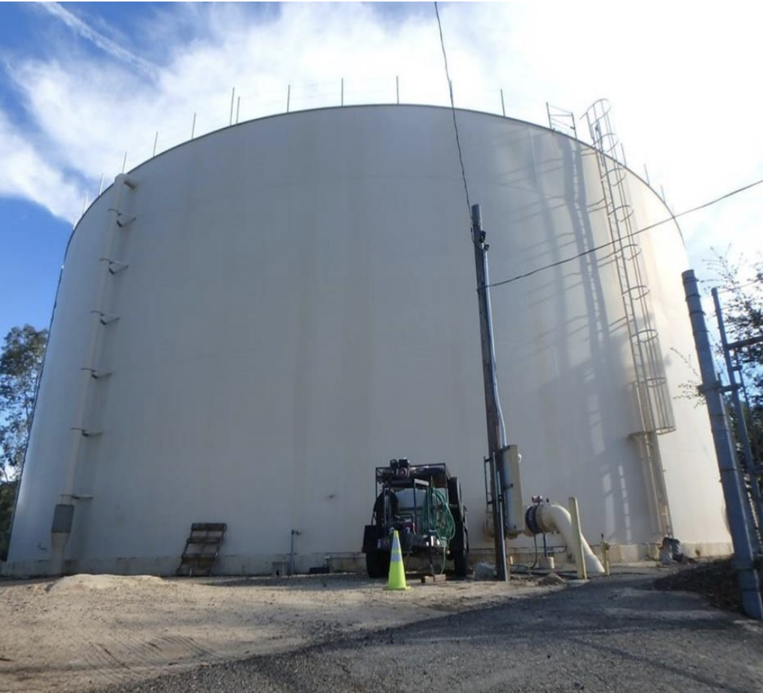
Rainbow Heights Tank Interior/Exterior Coating (4M Gallons)
Scope of Work: Restore interior and exterior coating at the Rainbow Heights Tank.
Project Rationale: The project will extend the useful life of the tank.
 | Planned Expenditures
Project | Year 1 (FY 24/25) | Year 2 (FY 25/26) | Year 3 (FY 26/27) | Year 4 (FY 27/28) | Year 5 (FY 28/29) | Total
TBD |  |  | $1,000,000 |  |  | $1,000,000

Slide 60
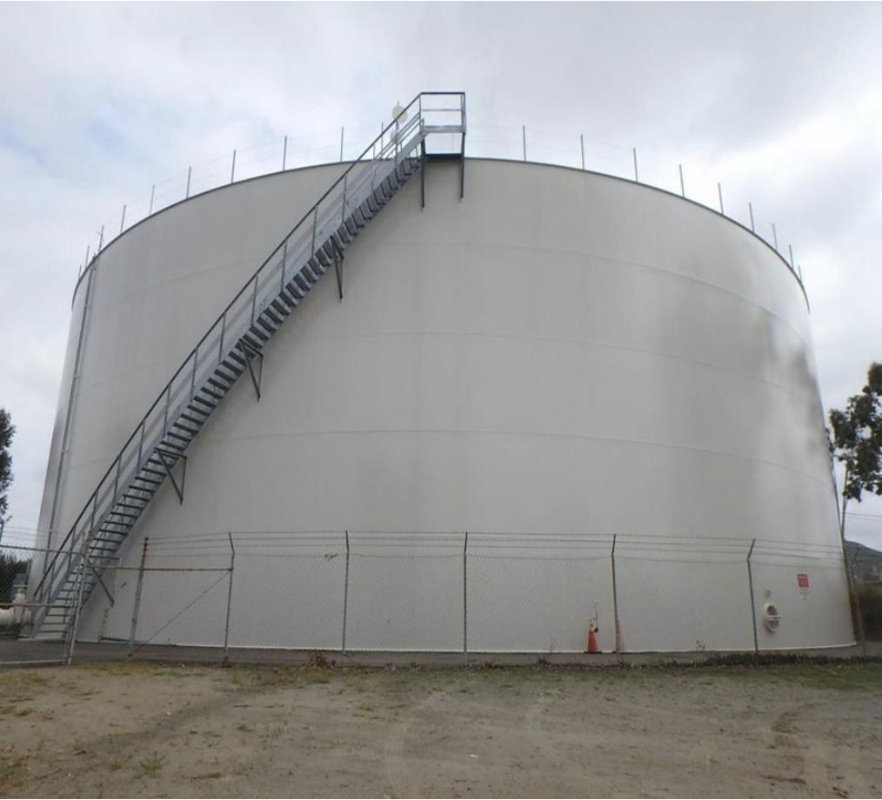
Gopher Canyon Tank Interior/Exterior Coating (4M Gallons)
Scope of Work: Restore interior and exterior coatings at the Gopher Canyon Tank.
Project Rationale: The project will extend the useful life of the tank.
 | Planned Expenditures
Project | Year 1 (FY 24/25) | Year 2 (FY 25/26) | Year 3 (FY 26/27) | Year 4 (FY 27/28) | Year 5 (FY 28/29) | Total
TBD |  |  |  | $1,050,000 |  | $1,050,000

Slide 61
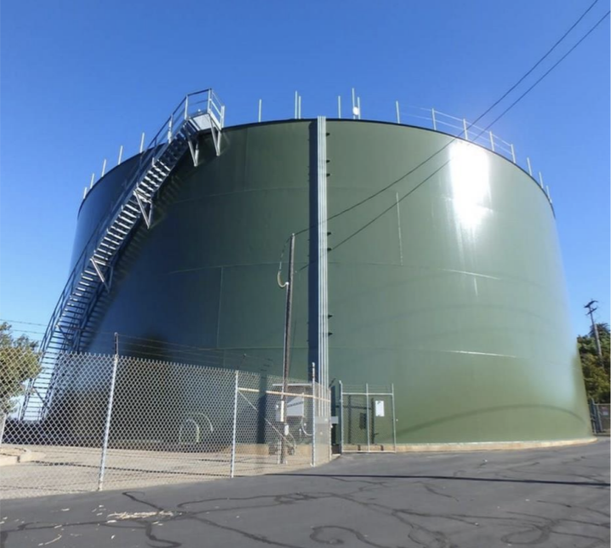
Turner Tank Interior/Exterior Coating (4M Gallons)
Scope of Work: Restore interior and exterior coatings at the Turner Tank.
Project Rationale: The project will extend the useful life of the tank.
 | Planned Expenditures
Project | Year 1 (FY 24/25) | Year 2 (FY 25/26) | Year 3 (FY 26/27) | Year 4 (FY 27/28) | Year 5 (FY 28/29) | Total
TBD |  |  |  |  | $1,102,500 | $1,102,500

Slide 62
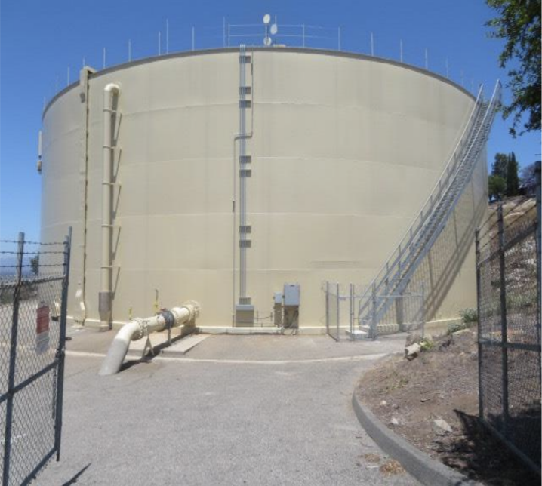
Hutton Tank Interior/Exterior Coating (4M Gallons)
Scope of Work: Restore interior and exterior coatings at the Hutton Tank.
Project Rationale: The project will extend the useful life of the tank.
 | Planned Expenditures
Project | Year 6 (FY 29/30) | Year 7 (FY 30/31) | Year 8 (FY 31/32) | Year 9 (FY 32/33) | Year 10 (FY 33/34) | Total
TBD | $1,157,652 |  |  |  |  | $1,157,652

Slide 63
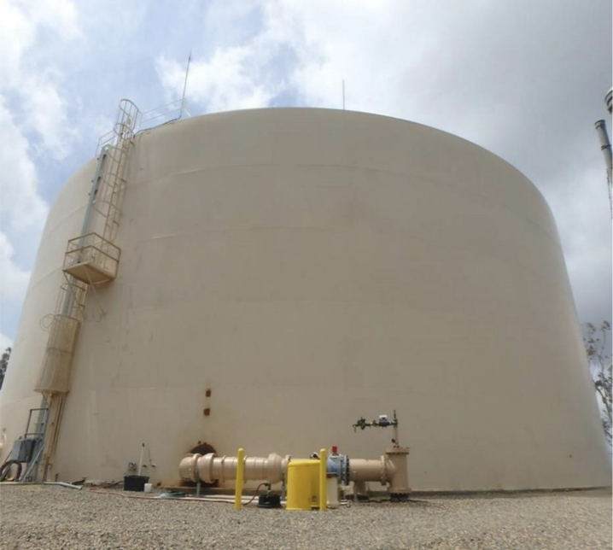
Rice Canyon Tank Interior/Exterior Coating (4M Gallons)
Scope of Work: Restore interior and exterior coatings at the Rice Canyon Tank.
Project Rationale: The project will extend the useful life of the tank.
 | Planned Expenditures
Project | Year 6 (FY 29/30) | Year 7 (FY 30/31) | Year 8 (FY 31/32) | Year 9 (FY 32/33) | Year 10 (FY 33/34) | Total
TBD |  | $1,215,506 |  |  |  | $1,215,506

Slide 64
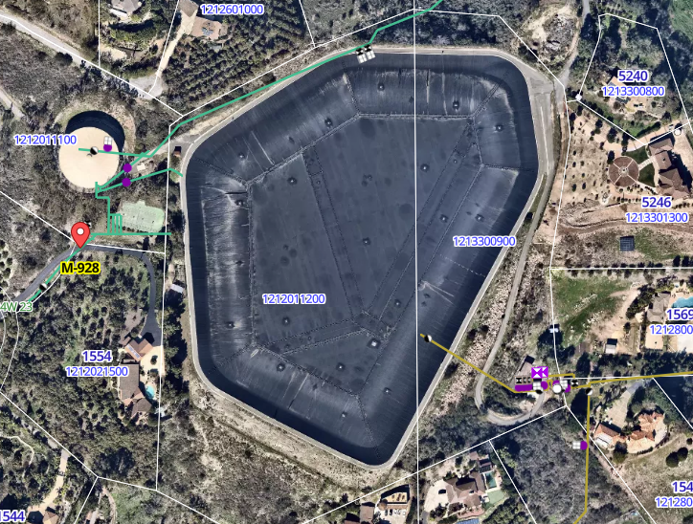
Replace Liners and Floating Covers at Morro, Rainbow Hills, and North Reservoirs
Scope of Work: Replace liners and floating covers at Morro Reservoir, Rainbow Hills Reservoir, and North Reservoir.
Project Rationale: Potable water reservoirs are required by the state to be covered. The existing covers and lining are approaching the end of their useful life.
 | Planned Expenditures
Project | Year 6 (FY 29/30) | Year 7 (FY 30/31) | Year 8 (FY 31/32) | Year 9 (FY 32/33) | Year 10 (FY 33/34) | Total
TBD |  |  | $14,000,000 |  |  | $14,000,000

Slide 65
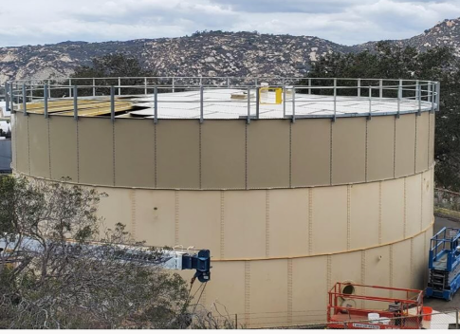
Vallecitos Tank Interior/Exterior Coating (500k Gallons)
Scope of Work: Restore interior and exterior coating at the Vallecitos Tank.
Project Rationale: The project will extend the useful life of the tank.
 | Planned Expenditures
Project | Year 6 (FY 29/30) | Year 7 (FY 30/31) | Year 8 (FY 31/32) | Year 9 (FY 32/33) | Year 10 (FY 33/34) | Total
TBD |  |  |  |  | $1,407,100 | $1,407,100

Slide 66
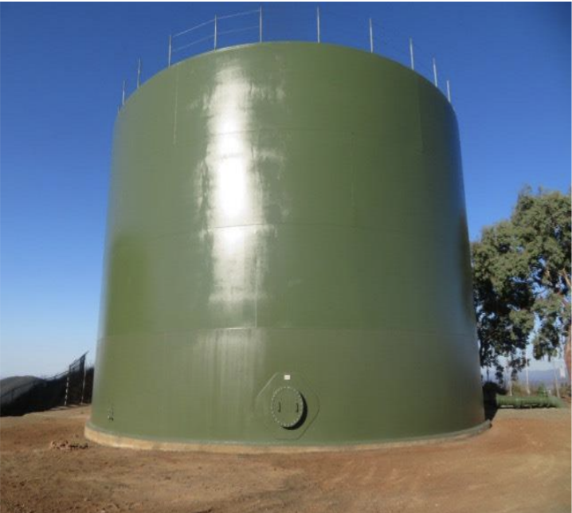
Upper Lookout Tank Interior/Exterior Coating (500k Gallons)
Scope of Work: Restore interior and exterior coatings at the Upper Lookout Tank.
Project Rationale: The project will extend the useful life of the tank.
 | Planned Expenditures
Project | Year 6 (FY 29/30) | Year 7 (FY 30/31) | Year 8 (FY 31/32) | Year 9 (FY 32/33) | Year 10 (FY 33/34) | Total
TBD |  |  |  |  | $200,000 | $200,000

Slide 67
Questions?

