Slide 1
Tank Asset Management Program
Engineering & Operations – Committee
August 6, 2024

Slide 2
Existing Tank Maintenance Contract
Originally initiated in 2003, 12 Steel Tanks
  Amended to include Pala Mesa Concrete Tank
  Amended to include construction of safety & electrical improvements
Auto-renewal in December
Cost of $708k/year for tank maintenance only
  Allows for 5% annual escalation
Specific to tank inspection, washdown, and coating renewals
Additional authorized work (safety/electrical) via amendments w/~$710k remaining balance

Slide 3
Welded Steel Tank Maintenance
Detailed inspection/washdown every 3-4 years ($10k-20k)
Exterior re-coatings typically 10-12 years ($100k-$300k)
Interior re-coatings typically 10-15 years ($400k-$800k)

Slide 4
Current Contract Performance
Tank Inspections/Washdowns – Met District needs, somewhat sporadic scheduling in recent years
Exterior Coatings – Met District Needs, most tanks exteriors appear in good shape.
Interior Coatings – Extended deferrals on this work. Trending towards a 17 year average for interior re-coat in contrast with the expected 10 to 11 year cycle.

Slide 5
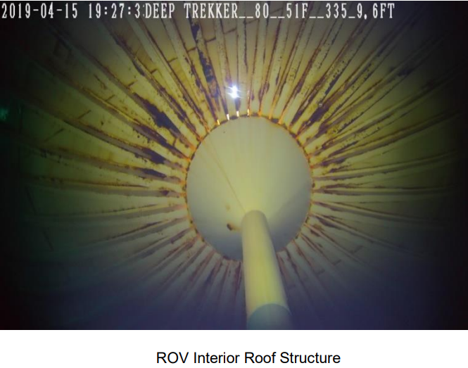
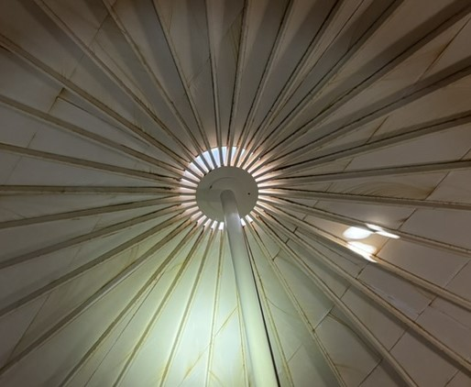
Interior Condition – Turner & Rice Tanks

Slide 6
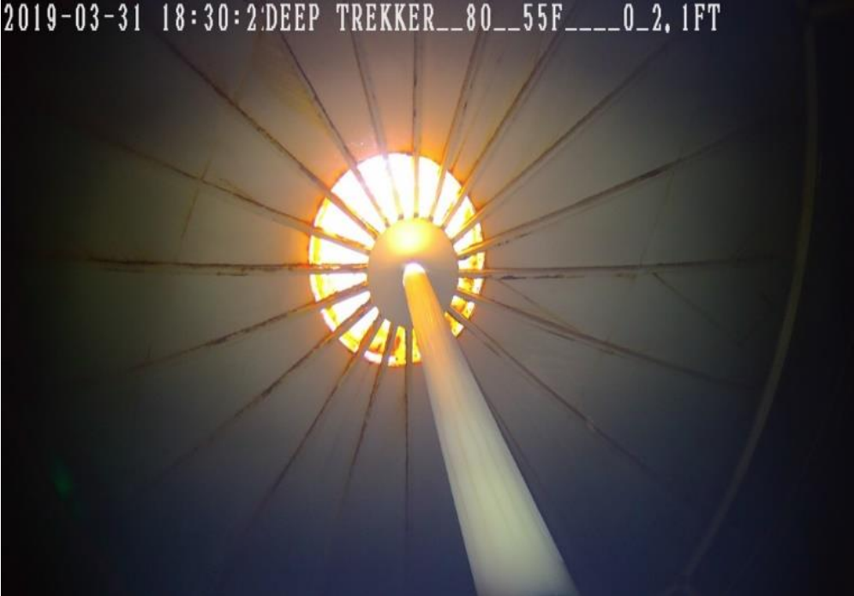
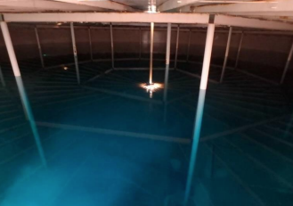
Interior Condition – Rainbow Heights

Slide 7
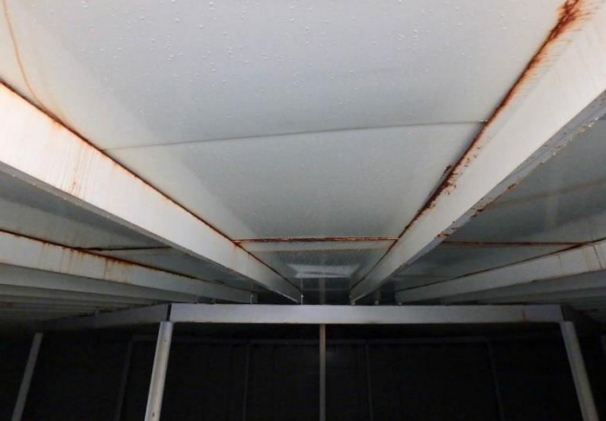
Interior Condition – Morro

Slide 8
Proposal
Cancel the Tank Maintenance Contract and take over the maintenance and rehabilitation program
  Operations – Tank Washouts/Inspections (ROV/Dive)
  Engineering – Rehabilitation
  Requires final payout of amendment construction items @ $786,561
Benefits
  ~$3.2M over the next 4 years remains with the District to re-invest in infrastructure rehab
  Estimated savings of ~$4.0M over a full tank rehab cycle (15-year) with a more active interior coating management schedule

Slide 9
Questions

