Slide 1
CropSWAP
Program Update

Slide 2
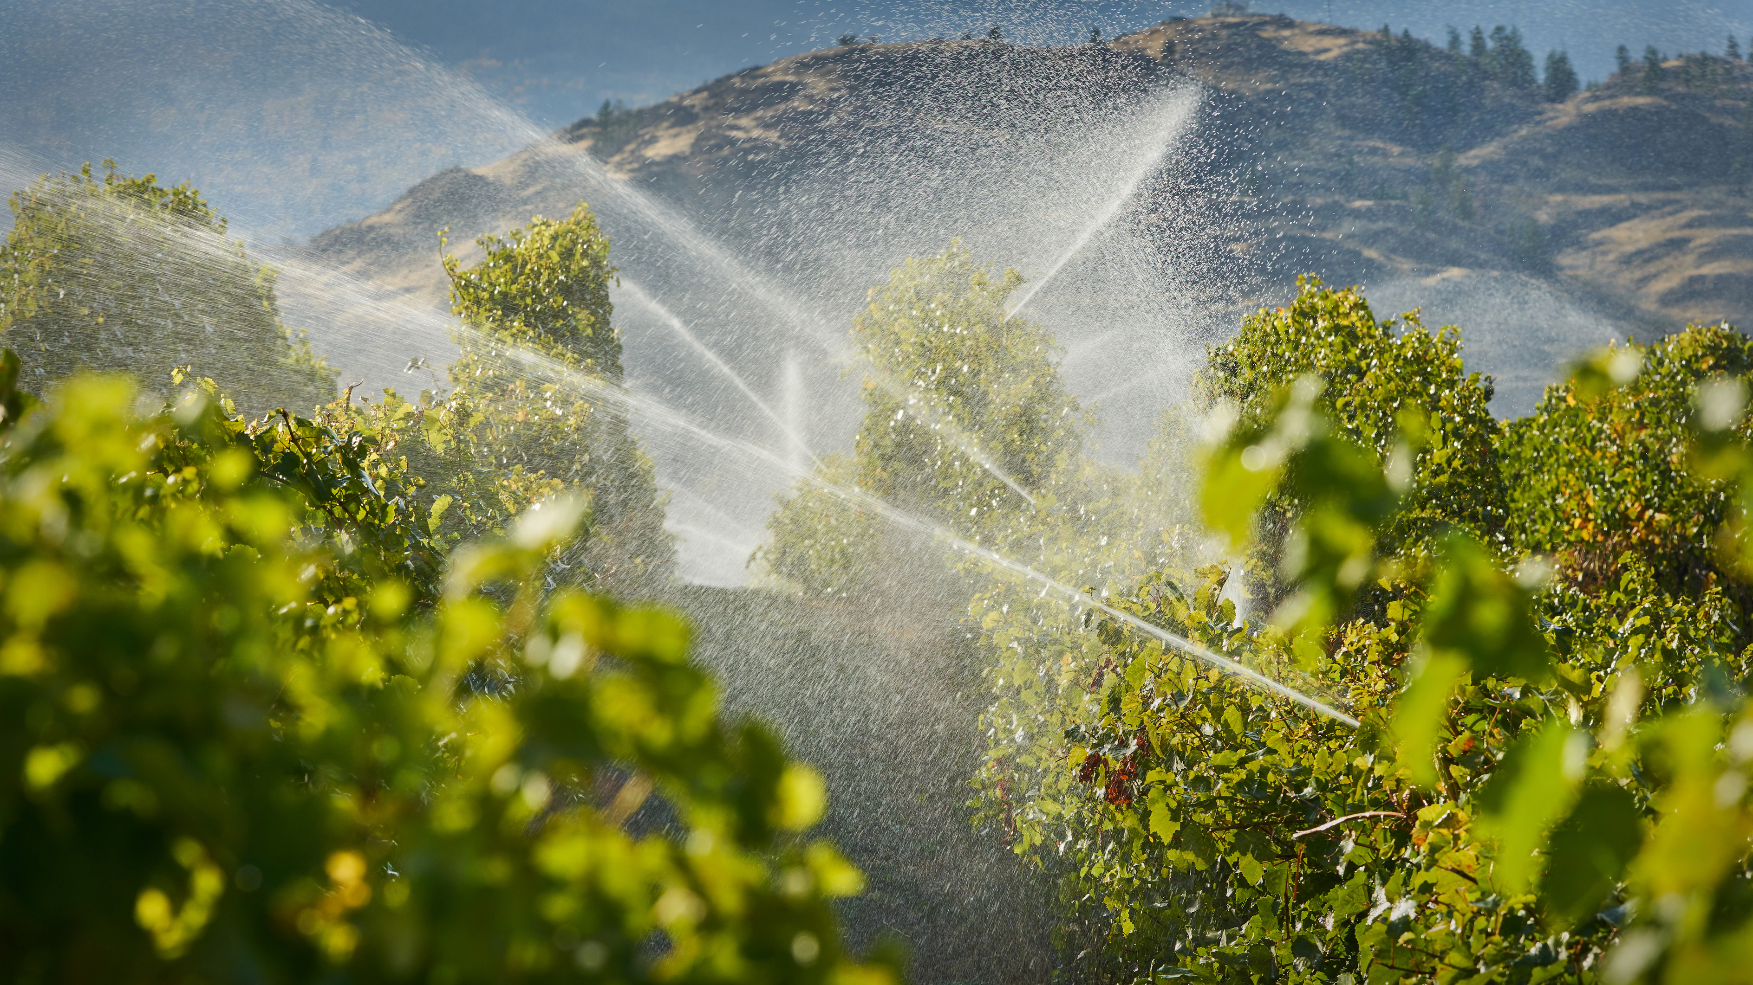



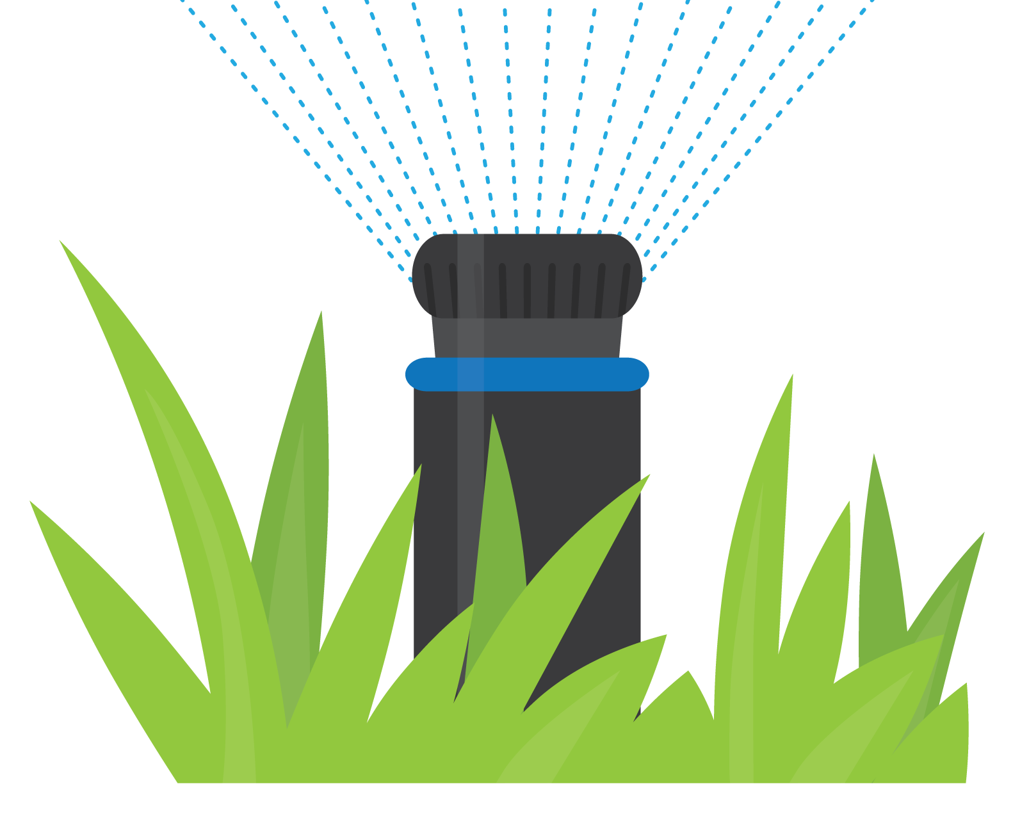

CropSWAP Program
Funded through a $5M grant through California Dept. of Water Resources (DWR)
Program launched April 29, 2024
Regional Program
(6 Agencies: SW Riverside and North San Diego County)
Three distinct incentive project types:
Crop Conversion/ Enhancement, Irrigation Efficiency, & Other BMP’s
60 individual project applications submitted by
Rainbow Water agricultural customers
Notes:
Regional CropSWAP Program continues to bring online applications from Rainbow Water customers.
Rainbow Water has reported 60 admissions to date
National Farmer’s Day October 12: Rancho recommends promoting the mulching rebate and best management practices.

Slide 3
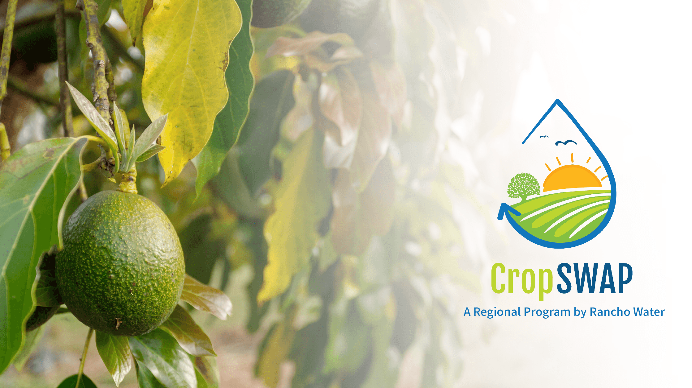




Program Metrics
60
Project Submissions to Date
45
Projects Approved
14
Pre-Inspection
8
Submissions July-Sept
$597,550
In Reserved Grant Funding for Approved Projects
Notes:
Regional CropSWAP Program continues to bring online applications from Rainbow Water customers.
Rainbow Water has reported 4 submissions for the month of July, for a total of 54 submissions to date.
Status on the 54 projects to date: 33 up from 20 approved last month, 13 in pre-inspection for review with Rancho Water’s project administrators.
July newsletter featured information on CropSWAP, however, heat advisories have slowed applications due to growers not wanting to plant during summer months. Rancho anticipates program applications will begin to increase as the weather cools in October.
Over by 209K over the 200K grant funding, now in group regional funding

Slide 4
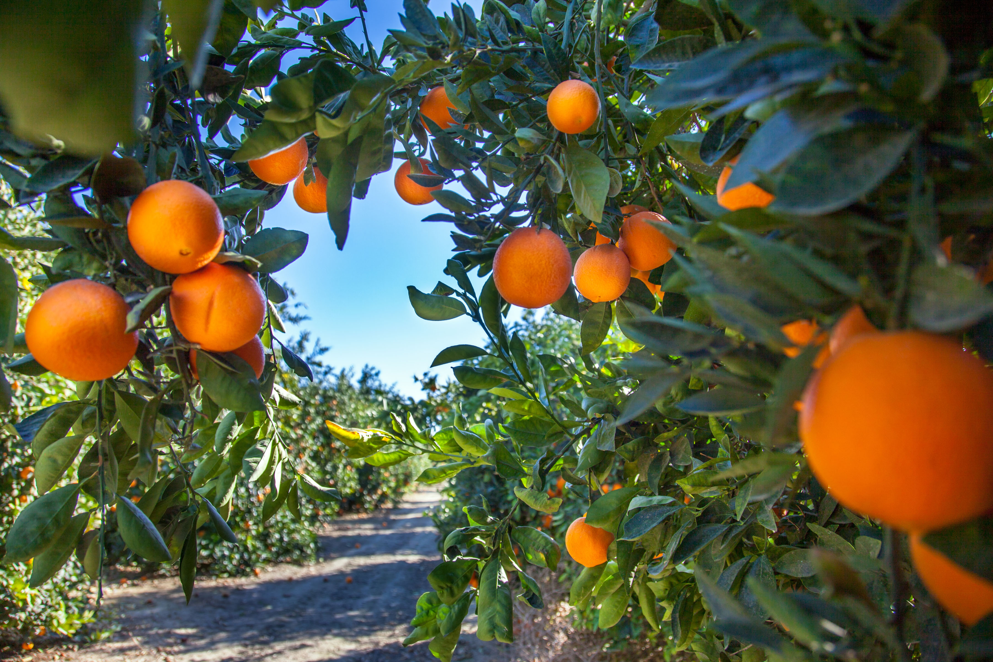

Total Applications by Project Type
11
Crop Conversion
8
Avocado Rejuvenation
6
Soil Moisture Sensors
4
Mulching
4
Scheduling Automation
3
Uniformity Improvements
1
Nutrient Management
1
Cover Crops
22
Avocado Rootstock
Notes:
The top two rebate types: 18 avocado rootstock and 10 Crop Conversion.
Crop Conversions approved are between $15K to $45K
Avocado Rootstock rebates approved range between $9K and 45K
Average property size is 1-5 acres
45% of submission are repeat customer submission for multiple projects

Slide 5
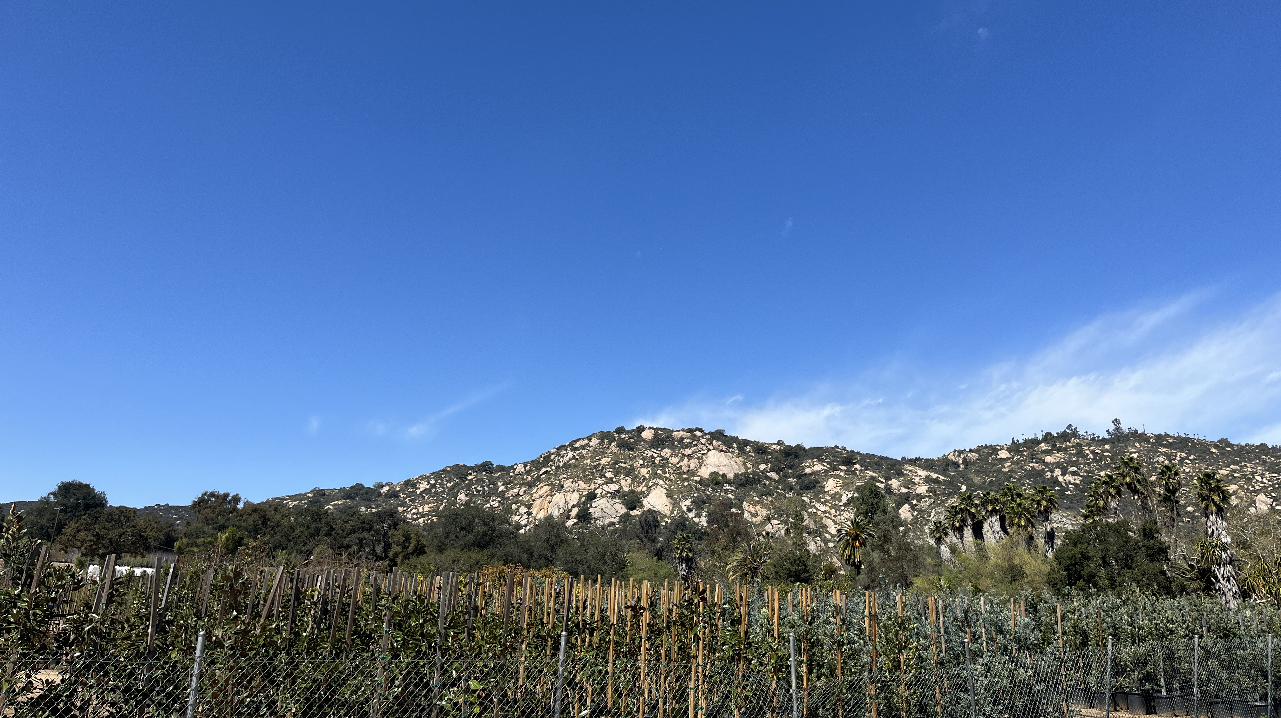

Average Project
1-5 Acres
Average Property Size
Average Rebate
$15-45K Crop Conversion
$9-45K Avocado Rootstock
45% of Applications
Customers with Multiple Rebate Types
Notes:
The top two rebate types: 18 avocado rootstock and 10 Crop Conversion.
Crop Conversions approved are between $15K to $45K
Avocado Rootstock rebates approved range between $9K and 45K
Average property size is 1-5 acres
45% of submission are repeat customer submission for multiple projects

