Slide 1
Budget and Finance Committee
Review of Fixed Costs and Charges
10/09/2024

Slide 2
Rainbow – Especially High Water Sales Risk

Slide 3
The Need for Higher Fixed Cost Recovery
Water Sales have dropped over 11,000 AF since FY14 (53% decrease)
FY24 Sales were 3,525 AF (26%) under Adopted Budget (13,500 AF)
Every 1,000 AF drop in budgeted water sales = $1.2M decrease in cash reserves (12%)
Board approved Rates & Rate Study in June 2023 to raise fixed charges due to Sales Volatility

Slide 4
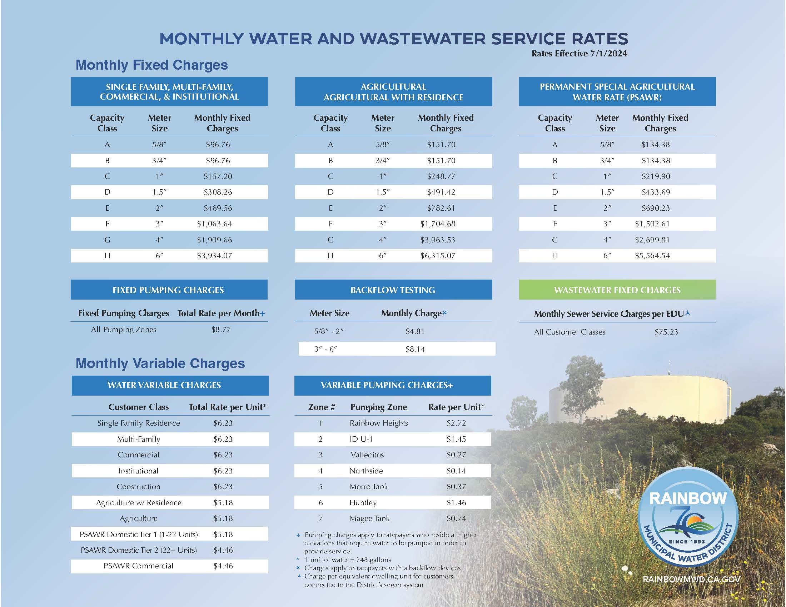
Ag vs Other Rates
2023 Rate Study intentionally raised the fixed cost recovery for AG vs Other due to Ag sales Volatility
Monthly Fixed Charge (1.0” M)
  SFR - $157.20
  AG - $248.77
Commodity Charge – per HCF
  SFR - $6.23
  AG - $5.18

Slide 5
Fixed Costs – Before and After Detachment
*Represents full year costs at CY 2024 Imported Water Rates (MWD vs SDCWA) and inclusion of $10M US Bank Debt

Slide 6
Variable Costs – Before and After Detachment
*Represents full year costs including $500,000 for operating 3 new pump stations

Slide 7
Fixed Cost Recovery
*Based on average of Fy25-Fy29 Water CIP

Slide 8
Questions?

