Slide 1
Communications & Customer Service
COMMITTEE MEETING
August 20, 2024

Slide 2
Agenda
Approval of Minutes
General Manager Comments
Committee Member Comments

Slide 3
CropSWAP
Program
Regional Program Update

Slide 4
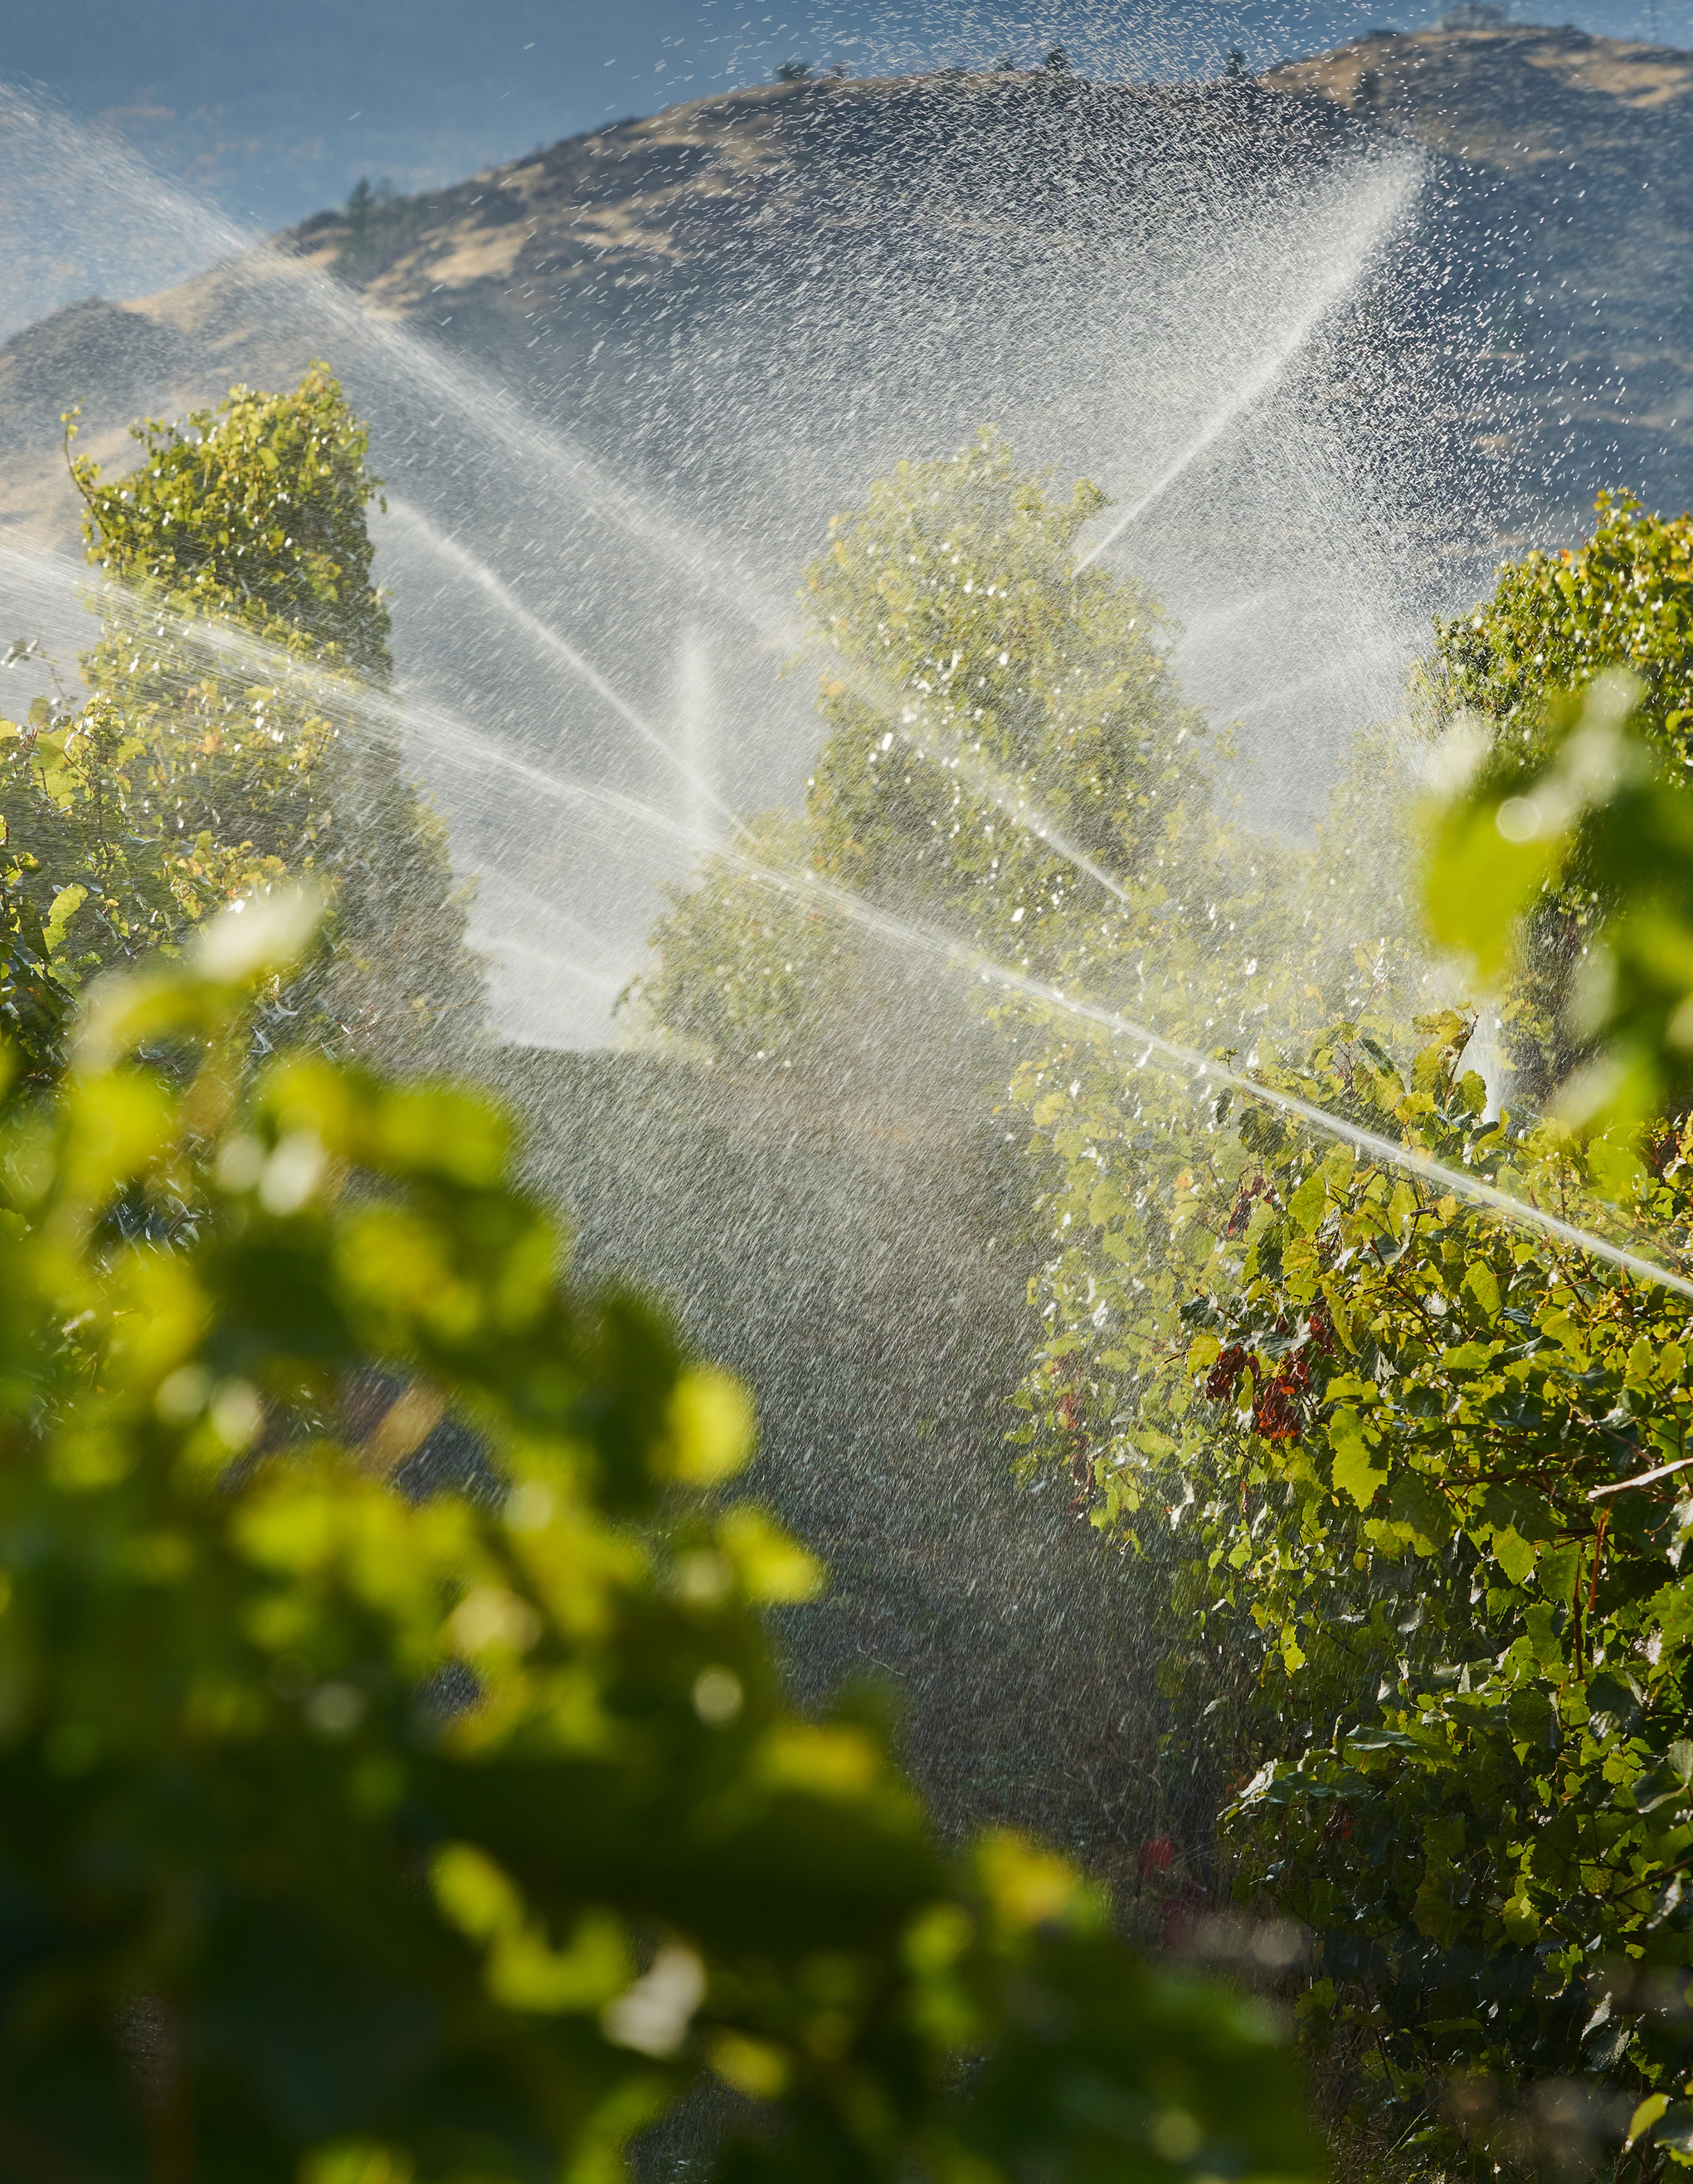
CropSWAP Program
  Rainbow Water leads with participation in Regional CropSWAP program
  54 Applications submitted to date
  Marketing efforts will continue in Sept with promotion of mulch rebate and best management practices to coincide with:
      October 12 – National Farmer’s Day
      Slideshow overview of the program to be included on website
Notes:
Regional CropSWAP Program continues to bring online applications from Rainbow Water customers.
Rainbow Water has reported 4 submissions for the month of July, for a total of 54
National Farmer’s Day October 12: Rancho recommends promoting the mulching rebate and best management practices.

Slide 5





Program Metrics
54
Project Submissions to Date
33
Projects Approved
13
Pre-Inspection
6
Submissions July-August
$409,450
In Reserved Grant Funding for Approved Projects
Notes:
Regional CropSWAP Program continues to bring online applications from Rainbow Water customers.
Rainbow Water has reported 4 submissions for the month of July, for a total of 54 submissions to date.
Status on the 54 projects to date: 33 up from 20 approved last month, 13 in pre-inspection for review with Rancho Water’s project administrators.
July newsletter featured information on CropSWAP, however, heat advisories have slowed applications due to growers not wanting to plant during summer months. Rancho anticipates program applications will begin to increase as the weather cools in October.
Over by 209K over the 200K grant funding, now in group regional funding

Slide 6
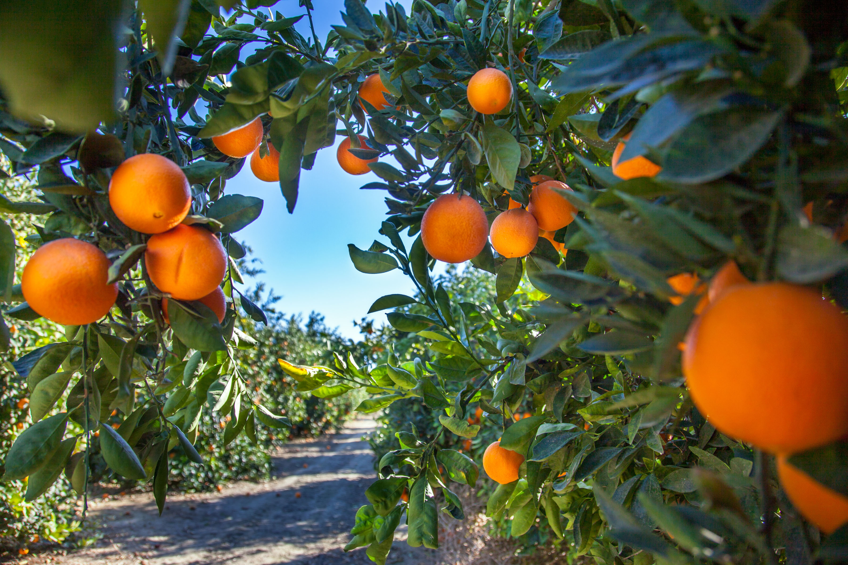

Total Applications by Project Type
10
Crop Conversion
6
Avocado Rejuvenation
5
Soil Moisture Sensors
4
Mulching
3
Uniformity Improvements
3
Scheduling Automation
1
Nutrient Management
1
Cover Crops
18
Avocado Rootstock
Notes:
The top two rebate types: 18 avocado rootstock and 10 Crop Conversion.
Crop Conversions approved are between $15K to $45K
Avocado Rootstock rebates approved range between $9K and 45K
Average property size is 1-5 acres
45% of submission are repeat customer submission for multiple projects

Slide 7
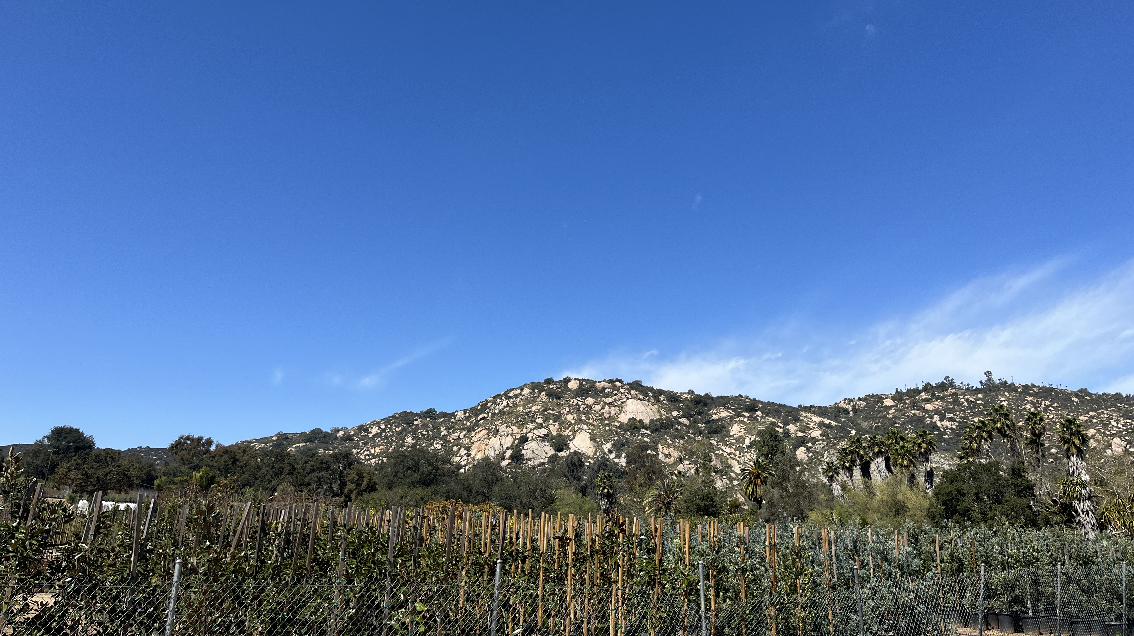

Average Project
1-5 Acres
Average Property Size
Average Rebate
$15-45K Crop Conversion
$9-45K Avocado Rootstock
45% of Applications
Customers with Multiple Rebate Types
Notes:
The top two rebate types: 18 avocado rootstock and 10 Crop Conversion.
Crop Conversions approved are between $15K to $45K
Avocado Rootstock rebates approved range between $9K and 45K
Average property size is 1-5 acres
45% of submission are repeat customer submission for multiple projects

Slide 8
Customer Service
Call Metrics

Slide 9
Average Hold Time: May – July 2024

Slide 10
Average Hold Time: 2023 vs 2024

Slide 11
Average Talk Time: May – July 2024

Slide 12
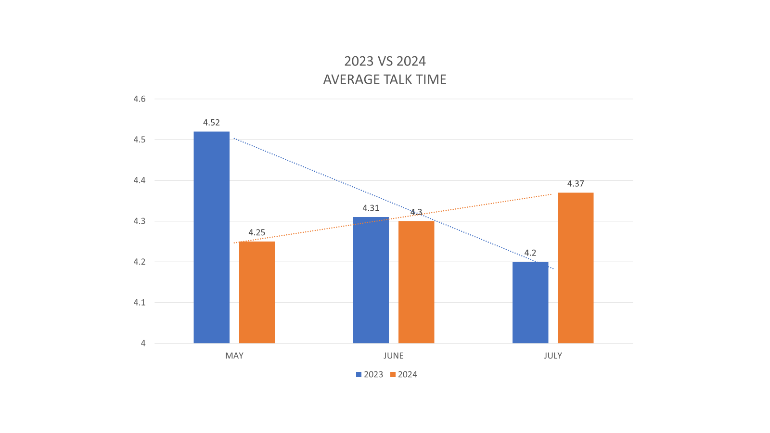
Average Talk Time: 2023 vs 2024

Slide 13
Monthly Calls: May – July 2024

Slide 14
Monthly Calls: 2023 vs 2024

Slide 15
Community
Events Update

Slide 16
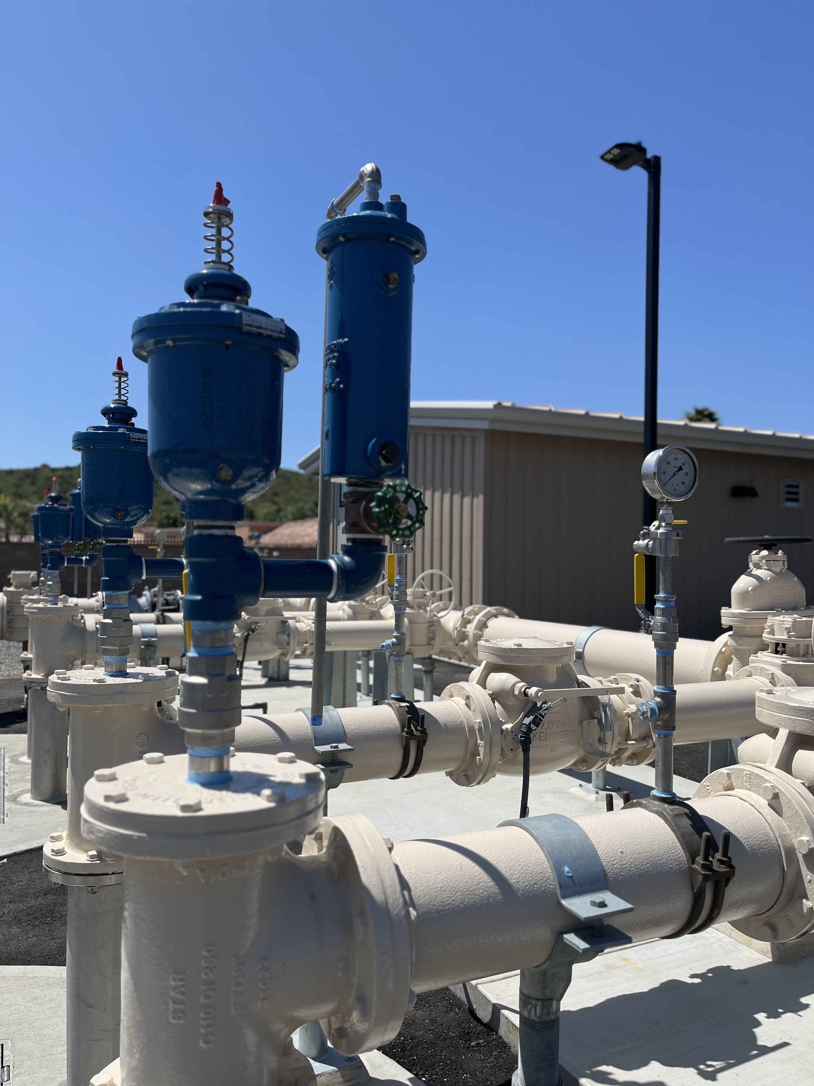
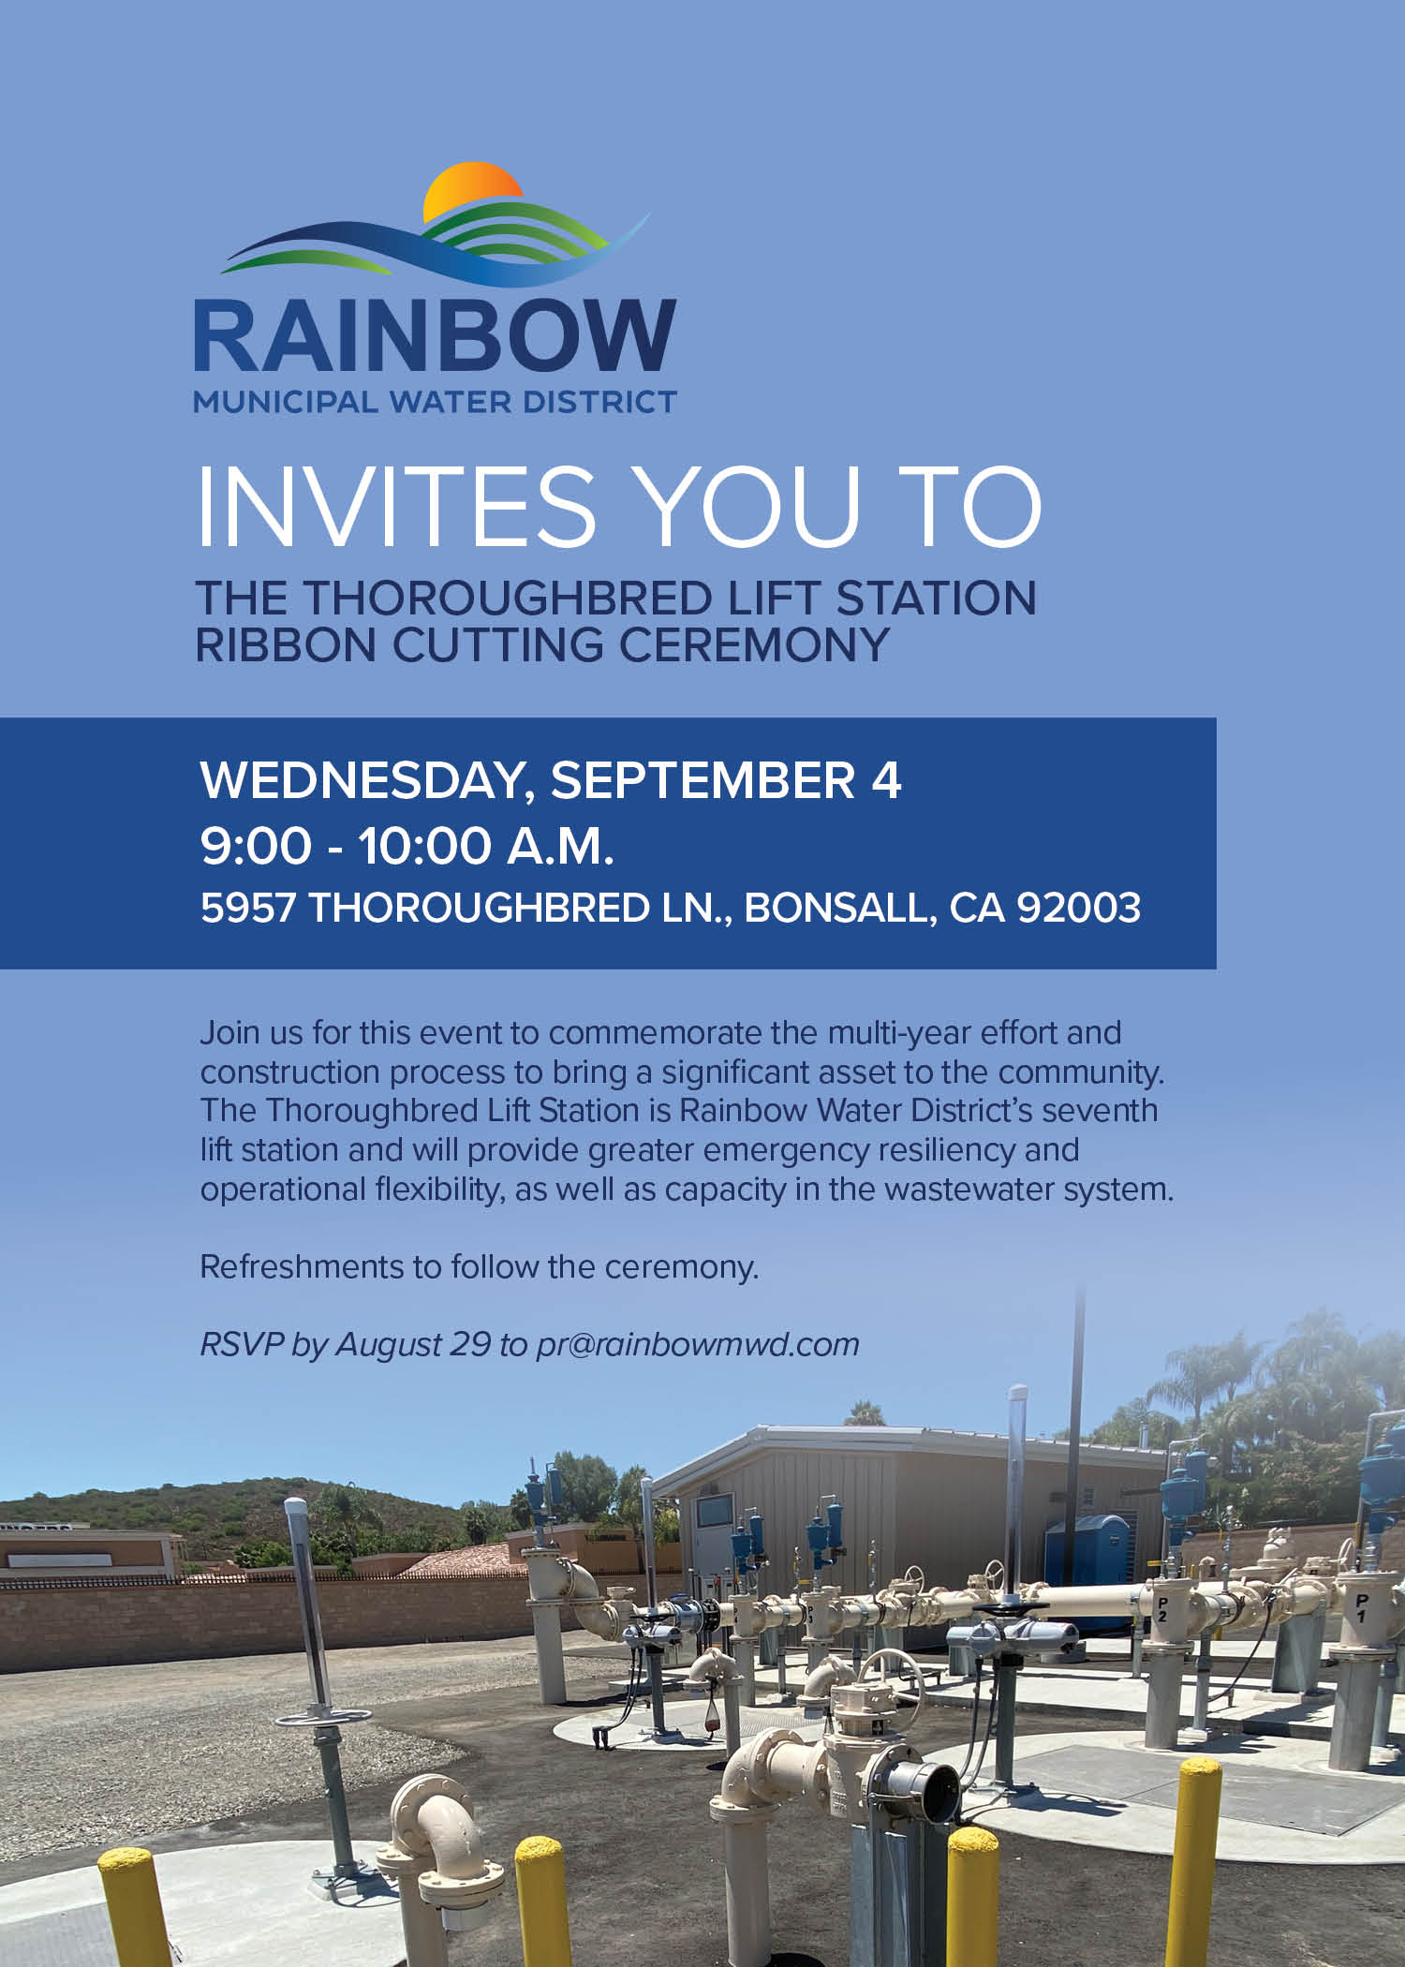
Thoroughbred Lift Station
Lift Station in Operation
  Opened July 2024
  Eighth Lift Station for the District
Ribbon Cutting Event
Wednesday, September 4
  9:00 – 10:00 a.m.
  Ribbon cutting, photo opportunity, light refreshments
  Invitation to project partners, school district, neighboring agencies, local representatives, media, staff, Board and Committee members

Slide 17
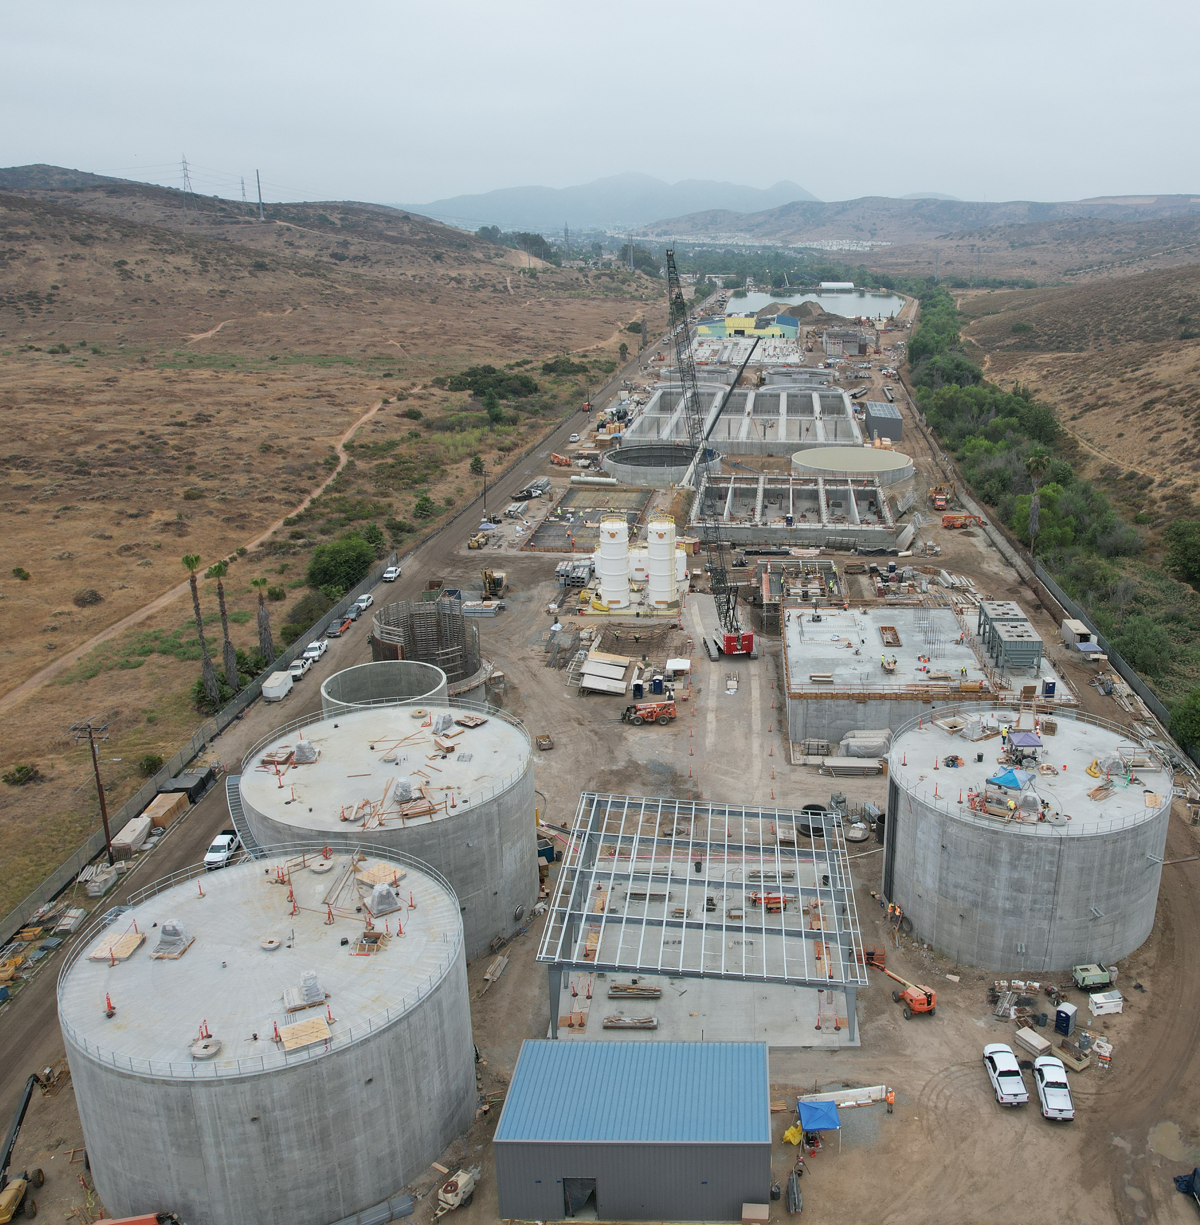
Padre Dam Field Trip
Thursday, September 5
  East County Advanced Water Purification Program
  Tour the facility north of Santee Lakes
  The water recycling facility is in construction phase and will treat
  16 million gallons of
  water per day
Notes:
Water recycling facility treating16 million gallons of water per day (MGD).
Advanced water purification facility treating 11.5 MGD.
Supplies 30 percent of a local water source that is reliable and uninterruptable during periods of drought.
As of late July 2024, roughly 42,000 cubic yards of concrete has allowed portions of the advanced water purification, water recycling and solids handling facilities to take shape.

Slide 18
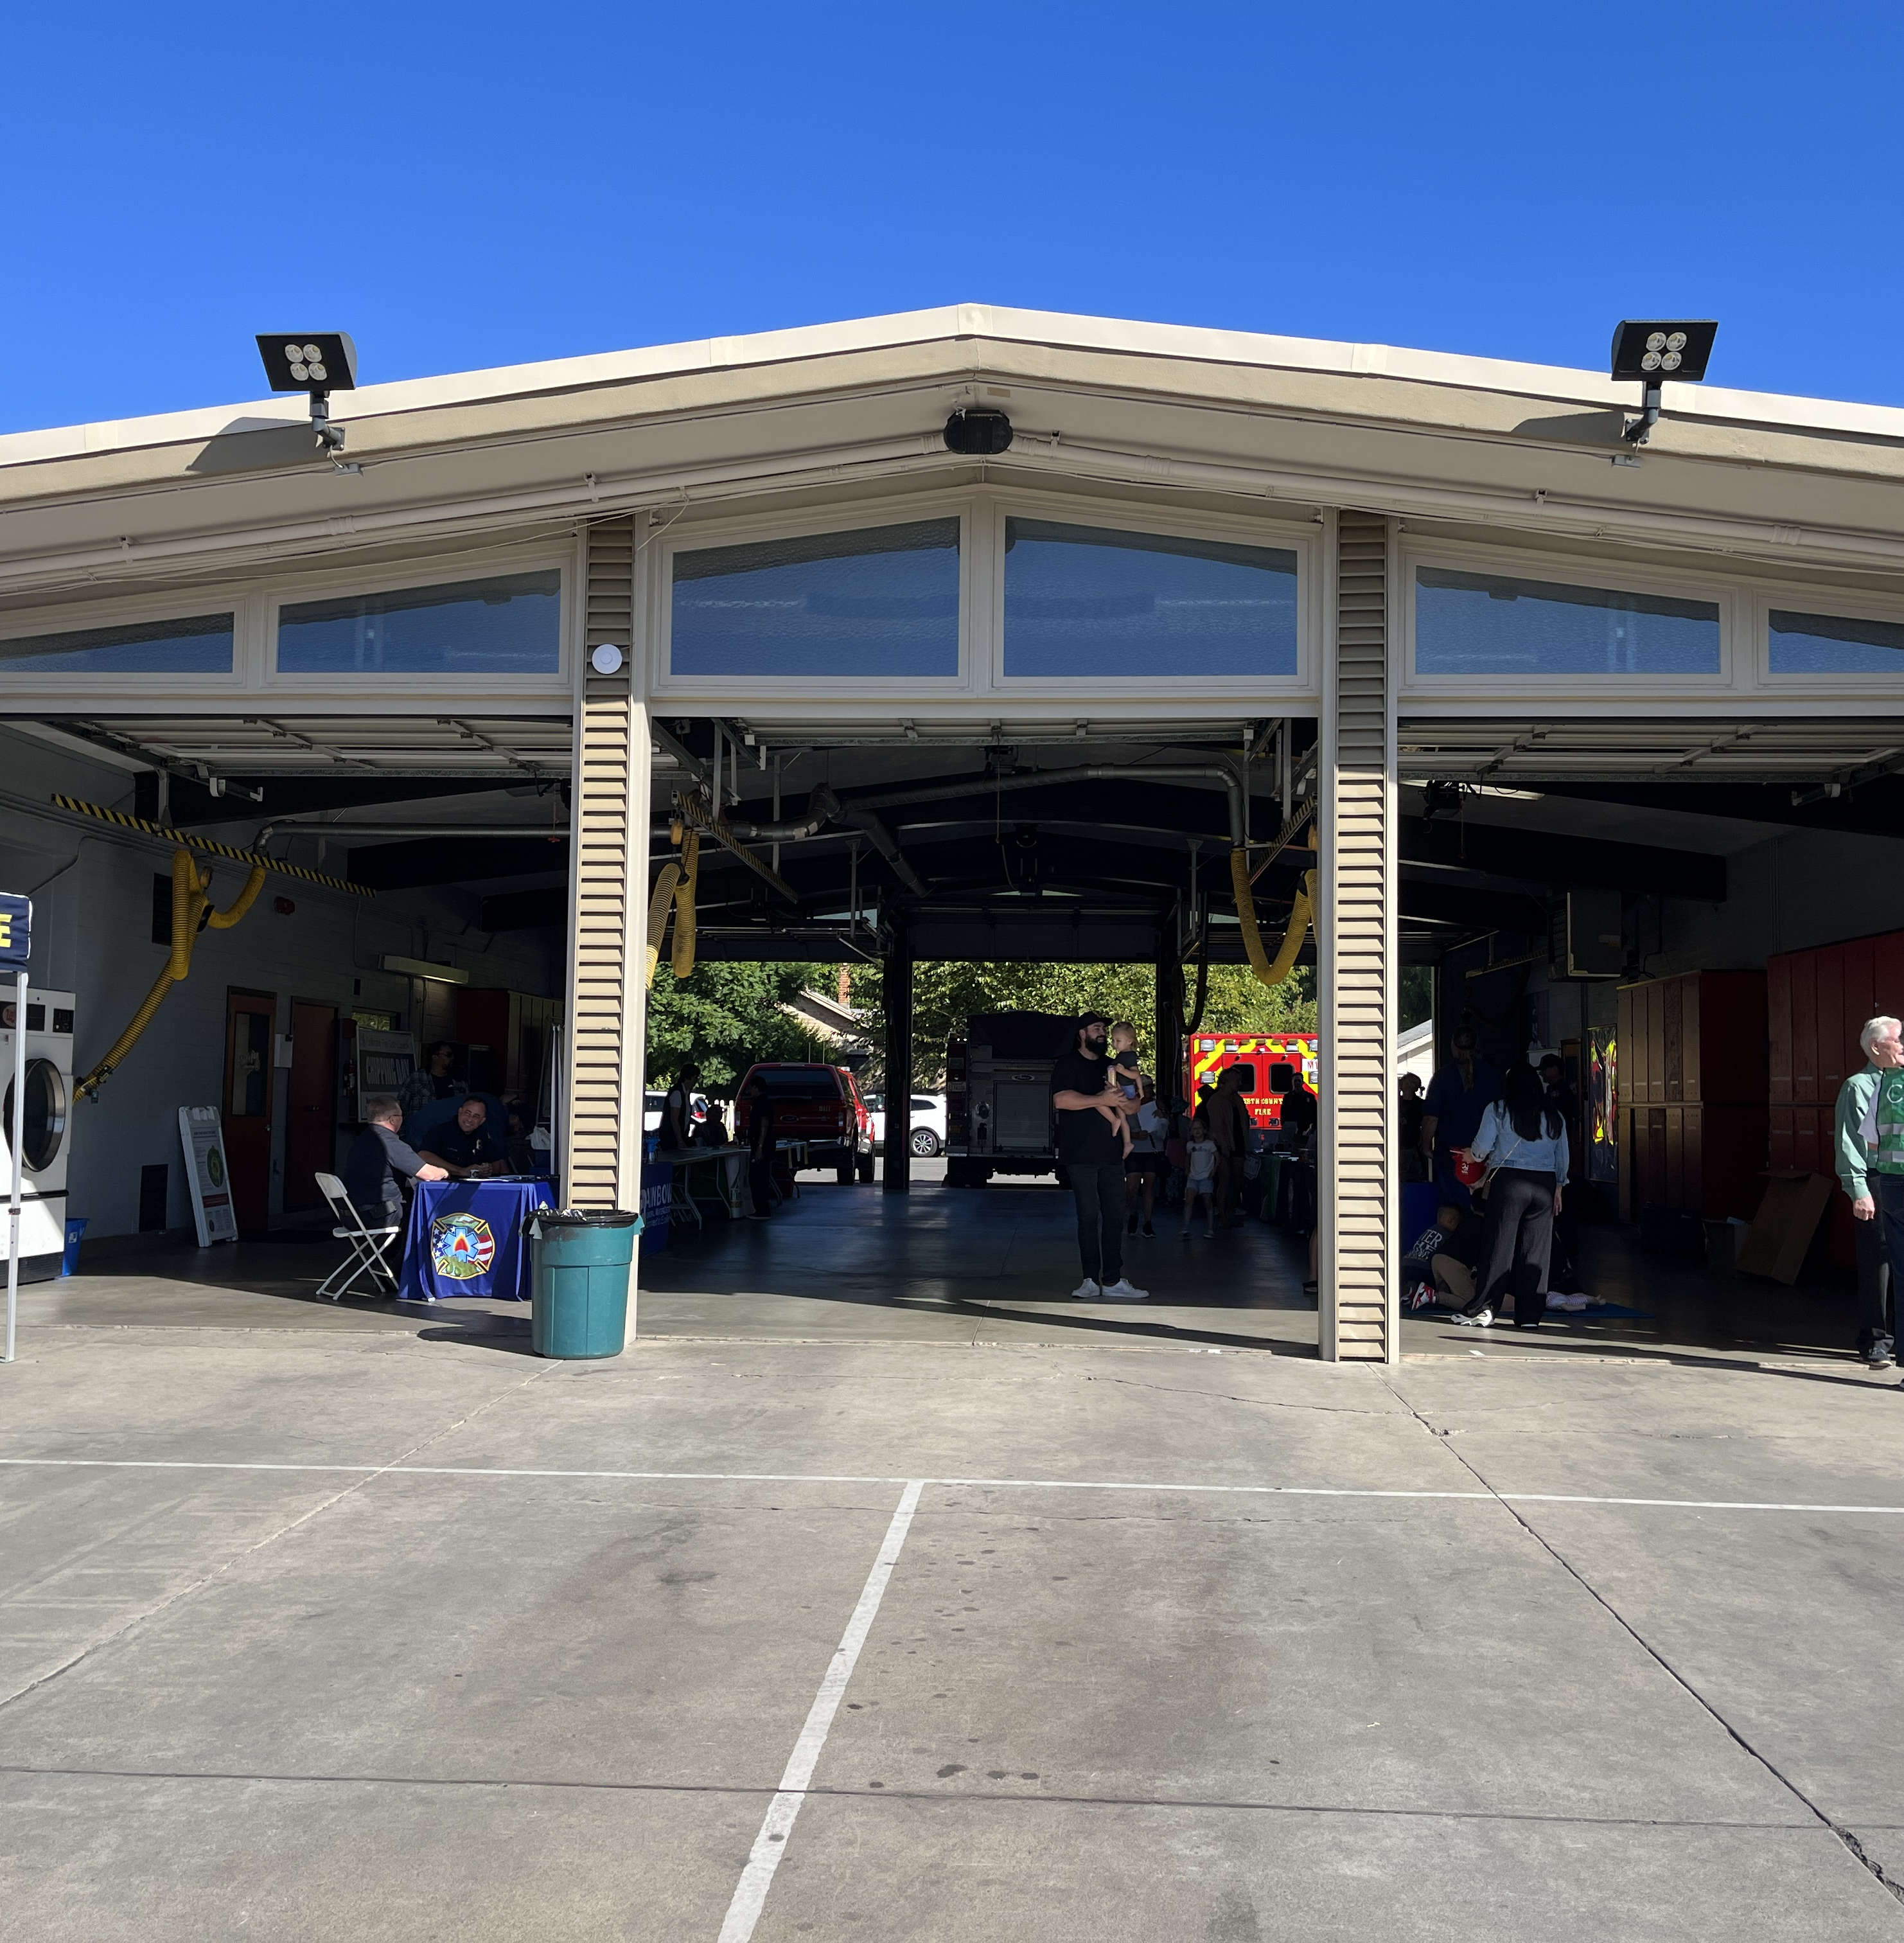
North County Fire Open House
October 2024
  Free community event at Fire Station 1 in Fallbrook
  More information to be release in September
  Plan to reserve a table to handout promotional items, collateral & answer questions
Notes:
Planning in progress, sign up sheet to be sent late August 2024
Booth will feature a table with promotional items remaining from Avocado Festival
Geared towards families and kids to explore public agencies, hands on demonstrations from fire, CHP, Sheriffs, helicopter, fire hose demo

Slide 19
Newsletter
Content Planning

Slide 20

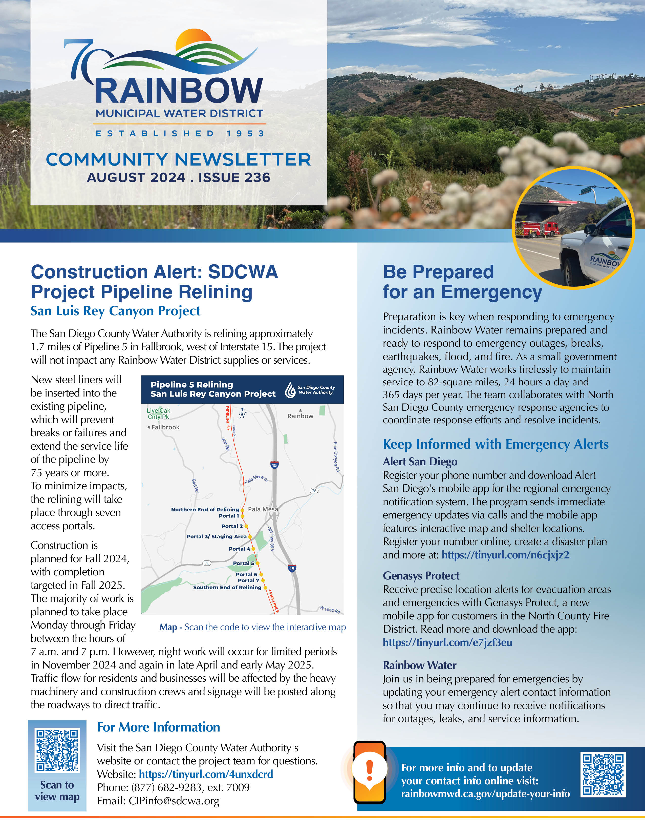
Newsletter Review
August
Construction Alert: SDCWA Project Pipeline Relining
  Overview of San Luis Rey Canyon Project, info on who to contact for more info, map and project timeline
Be Prepared for an Emergency
  Emergency Alert programs
  Reminder to Update Emergency Contact Info with link to webpage
2024 Poster Contest Winners
  Announcement with photo and artwork
Water Efficiency Workshop
  Free landscape class to earn water efficiency landscape dual certification

Slide 21
Newsletter Planning
September
  National Preparedness Month
    How to be prepared for disasters or emergencies at home/businesses
      Tips from the EPA: Assess Needs,
      Make a Plan, Engage Your Network
    Highlight: Watch Duty app
    Reminder to Update Emergency Contact Info with link to RMWD website
  Construction update
    Thoroughbred LS opening, progress update on Pump Stations for Division 1
  Fire Station 1 Open House
    Visit our booth and meet the team
  Share Your Experience
    Take the customer service survey
October
  National Farmers Day
    Look back at the history of Rainbow, farming community, and role farmers played in the formation of the District
    Programs available to growers: CropSWAP best management practices
  Fall Planting
    Make the most of your landscape with native plants, feature photos and plant types
    Turf & Tree Replacement Program from Metropolitan Water
  Water Footprint Calculator
    Free online tool to get an inside look at the amount of water used for residential and “virtual water” usage
  Share Your Experience
    Take the customer service survey
Notes:
Make sure you and your family have a plan for when disaster strikes
- Sign up for weather emergency alerts
Prepare an emergency kit
Make a communications plan that fits the needs of your family, household or business
Construction update: West Lilac, Rancho Amigos and Dentro De Lomas The three pump stations will deliver water to the Hutton, Turner, and Gopher Tank Zones in the District’s southern region by transporting water supply from the District’s northern connections.
Water Footprint: It's the tap water and the “virtual water” used to produce your food, electricity, gas and home goods.
Future Ideas: Value of Water
Explain how price of water pays for components of infrastructure, maintenance, and more to deliver safe reliable water
Infographic with length water travels across CA

Slide 22
Public
Communications
& Related Media Stories

Slide 23
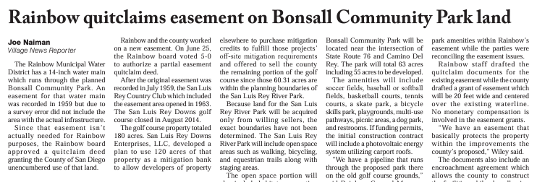
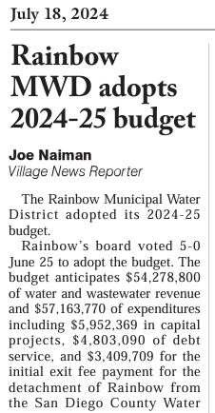
Village News
July 18
Rainbow MWD adopts
2024-25 Budget
July 18
Rainbow quitclams easement won Bonsall Community Park land

Slide 24
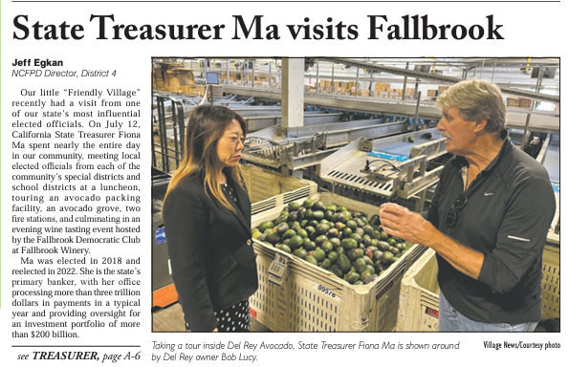
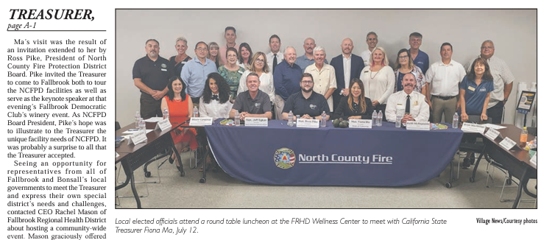
Village News
July 18
State Treasurer Ma
visits Fallbrook

Slide 25
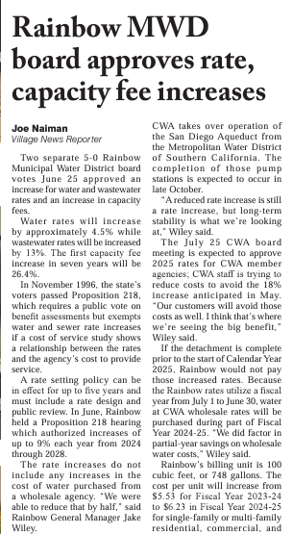

Village News
July 18
Rainbow MWD board approves rate, capacity fee increases
July 25
Rainbow Water announces winners of the 2024 Student Poster Contest

Slide 26
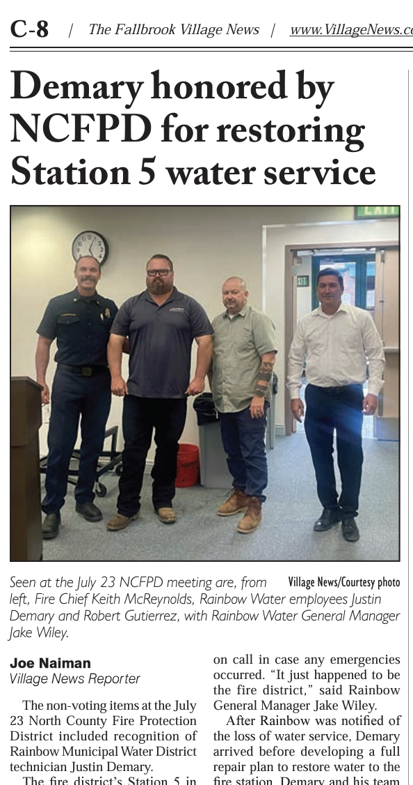
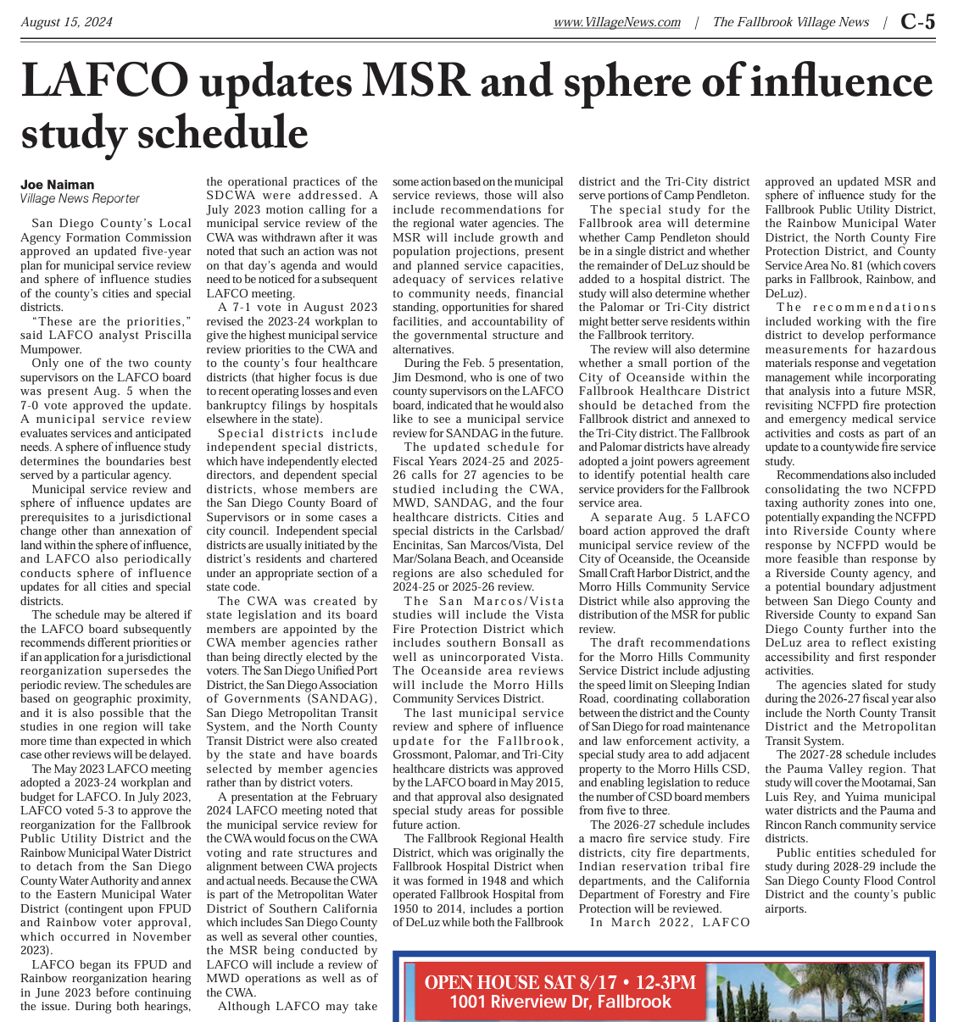
Village News
August 8
Demary honored by NCFPD for restoring Station 5 water service
August 15
LAFCO updates MSR and sphere influence study schedule
Notes:
Our very own, Justin Demary, was honored for his efforts to respond to an emergency at the end of June. Chief Ketih McReynolds recognized Demary and Rainbow Water at the July meeting of the North County Fire Protection District.
The fire district’s Station 5 in Bonsall was without water on the morning of Saturday, June 22, after the water main which provides service to the fire station
was struck by a vehicle. The valve was destroyed and water service to the station was fully interrupted. Demary responded, prepared a repair plan, and had
water restored to the fire station within three hours.
The May 2023 LAFCO meeting adopted a 2023-24 workplan and budget for LAFCO. In July 2023, LAFCO voted 5-3 to approve the reorganization for the Fallbrook Public Utility District and the Rainbow Municipal Water District to detach from the San Diego County Water Authority and annex to the Eastern Municipal Water District (contingent upon FPUD and Rainbow voter approval, which occurred in November 2023).

Slide 27
Agenda Items for the Next Meeting
Tuesday, October 15

