Slide 1
FY24 Mid-Year Preview

Slide 2
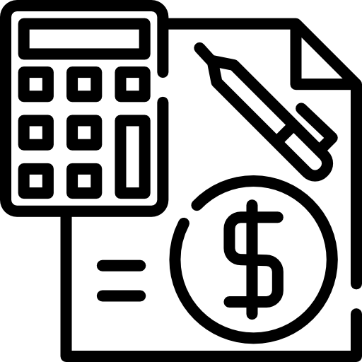
Operating Budget
Key Changes
Sales: 12,700 AF -> 10,500 AF
Operating Revenue: $(1,597,152)
Purchased Water: $(2,889,113)
Operating Expenses: $(323,953)
Notes:
Revenue decrease is due to decreased quantity of sales.
RMWD O&M increase is due to updated Meter Counts and District Fixed Rate
Purchased Water decrease due to decreased sales and fixed fees decrease due to SDCWA Fees not final at time of budget (we over budgeted)

Slide 3
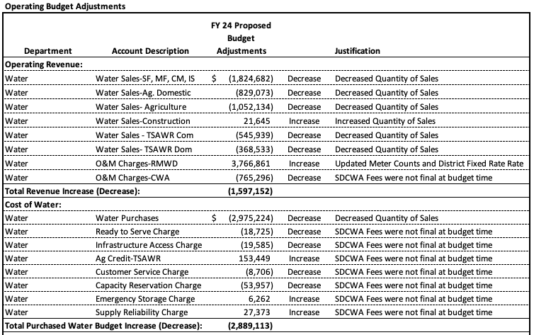
Operating Budget

Slide 4
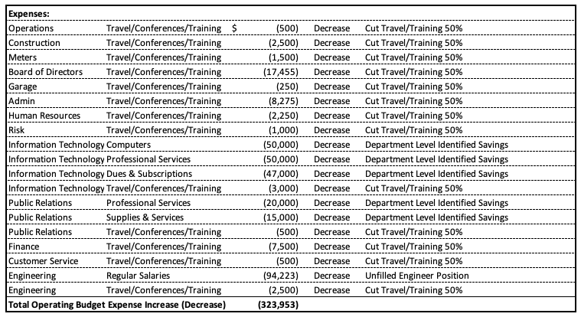
Operating Budget

Slide 5
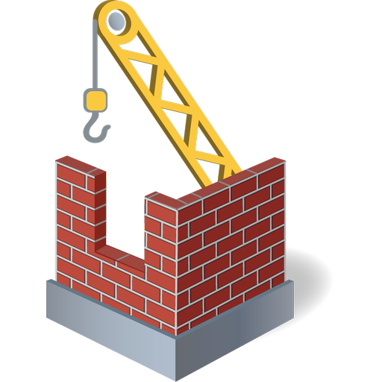
Capital Budget
Key Changes
Water Capital Increase: $741,281
Wholesale Water Efficiency: $3,577,891
Wastewater: $3,680,787
Notes:
Wholesale Water Efficiency Project increase due to the construction contract coming in much higher than the engineer’s estimate. Also, a majority of the EFI invoices for the pump stations were paid this FY ($6.34M out of $6.76M).

Slide 6
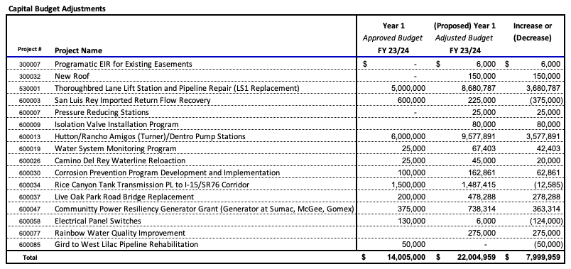
Capital Budget

Slide 7
Summary
Water
Operating Water:
  Decrease in Revenue $(1,597,152)
  Decrease in Expenses $(3,213,066)
  Net: $(1,615,914)
Water Capital:
  Increase in Expenses by $4,319,172
Overall Water Net:
  $2,703,258
Wastewater
Wastewater Capital:
  Increase in Expenses by $3,680,787

Slide 8
Questions?

