Slide 1

PROPOSED ADJUSTMENTS OF WATER AND WASTEWATER RATES
Hearing for June 27, 2023
Open Rate Hearing April 25, 2023

Slide 2
COST OF SERVICE RATE STUDY NEEDED
The District hired an independent third-party, IB Consulting, to conduct a rate study for RMWD. Study focused on full cost of service recovery for water and wastewater services through rates.
A new rate study was needed due to…
Inflation resurgence and supply chain challenges significantly adding to the cost of capital projects
Necessary investments in aging pipes, pumps, treatment facilities and other infrastructure
Operating and energy cost escalations
Commitment to Transparency: RMWD’s full Cost of Service Study will be available on the District’s website www.rainbowmwd.com

Slide 3
KEY ASSUMPTIONS
Water Sales – 12,700 AF
Account Growth – 0%
  Recommend 0% growth during this uncertain climate
Developer Fees – $0
  If developer fees are received, rate increases will be lower, assuming no other changes

Slide 4
KEY ASSUMPTIONS
Cost Escalations
  Salaries – 6%; Benefits – 3%
  Capital Construction
    FY 2024 & 2025 – 7.2%
    FY 2026 and beyond - 3.93% (based on 5-Yr average ENR Construction Cost Index)
  General
    FY 2024 & 2025 – 7.71%
    FY 2026 and beyond – 4.03% (based on 5-Yr average CPI – SD)
  Energy – 5%
  Pass-Through
    SDCWA Purchased Water – Accounts for about 58% of total operating costs (entirely outside of the District’s control)
    Wastewater Treatment Costs (Oceanside) 6% – Account for about 35% of total operating costs (entirely outside of the District’s control)

Slide 5
KEY ASSUMPTIONS
Rates are re-evaluated with each budget cycle.
  Revenue requirements (rates) are reviewed annually and approved with the budget process based on the prior year actual financial results and the projected sales and expenses for the upcoming year.
  Rates will be set to increase up to the approved rate each year.
Notes:
Emphasize this is worst case scenario with rates as it assumes we receive $0 in Developer fees for 5 years…

Slide 6
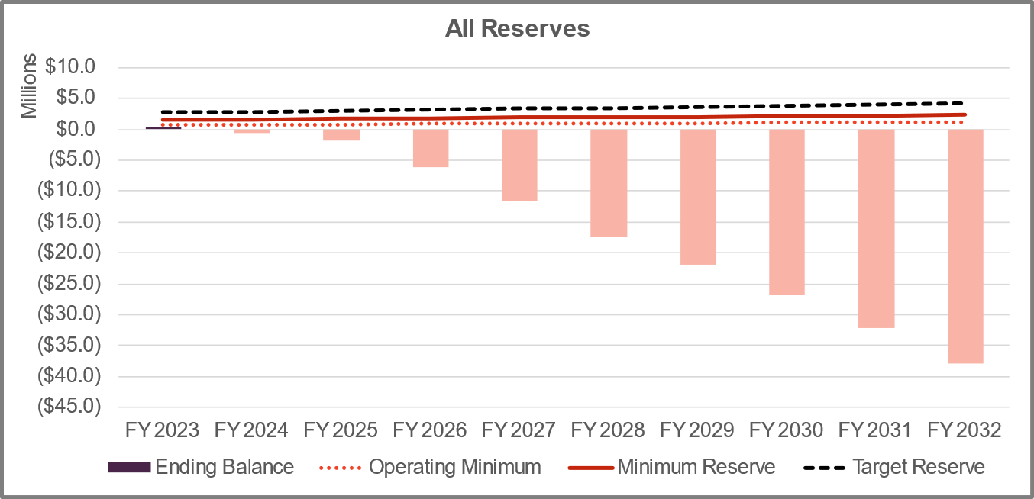
Current Wastewater Financial Position
Current Rates
Operating costs are currently outpacing revenues each year
FY 2023 ~ ($765K)
Current rates do not include funding for capital projects

Slide 7
Wastewater Capital Projects:
LS1 has extended into FY 24 with an additional budget request of $2.5M
Forecasted spend in current year has been reduced by $2.5M and will be allocated to FY 24
This is a net budget increase of $2.5M for LS1

Slide 8
Wastewater Projection:
Proposing Debt Financing of $5M to replenish reserves while new rates catch up
Citro CFD funds are expected in April 2024
Additional Debt Financing is planned if Developer Fees remain stagnant
Notes:
Walk through each column here, explaining each row and how it feeds into the next year….Board asked about the rates available. I told them that I didn’t have a rate yet.

Slide 9
Wastewater Options
Revenue Increases & Rates
Revenue Adjustments
Single-Family $/EDU
Objective | FY 2024 | FY 2025 | FY 2026 | FY 2027 | FY 2028
Deferred CIP | 40% | 7.5% | 7.5% | 7.5% | 7.5%
Planned CIP (Debt Financed) | 35% | 13% | 13% | 13% | 13%
Objective | Existing | FY 2024 | FY 2025 | FY 2026 | FY 2027 | FY 2028
Deferred CIP | $55.07 | $69.04 | $74.22 | $79.79 | $85.78 | $92.22
Planned CIP (Debt Financed) | $55.07 | $66.57 | $75.23 | $85.01 | $96.07 | $108.56
Staff is recommending Option 2
If developer fees are received, rate increases will be lower, assuming no other changes.
Notes:
Additional EDU’s gained here (call out) (FY 2023 to-date)

Slide 10
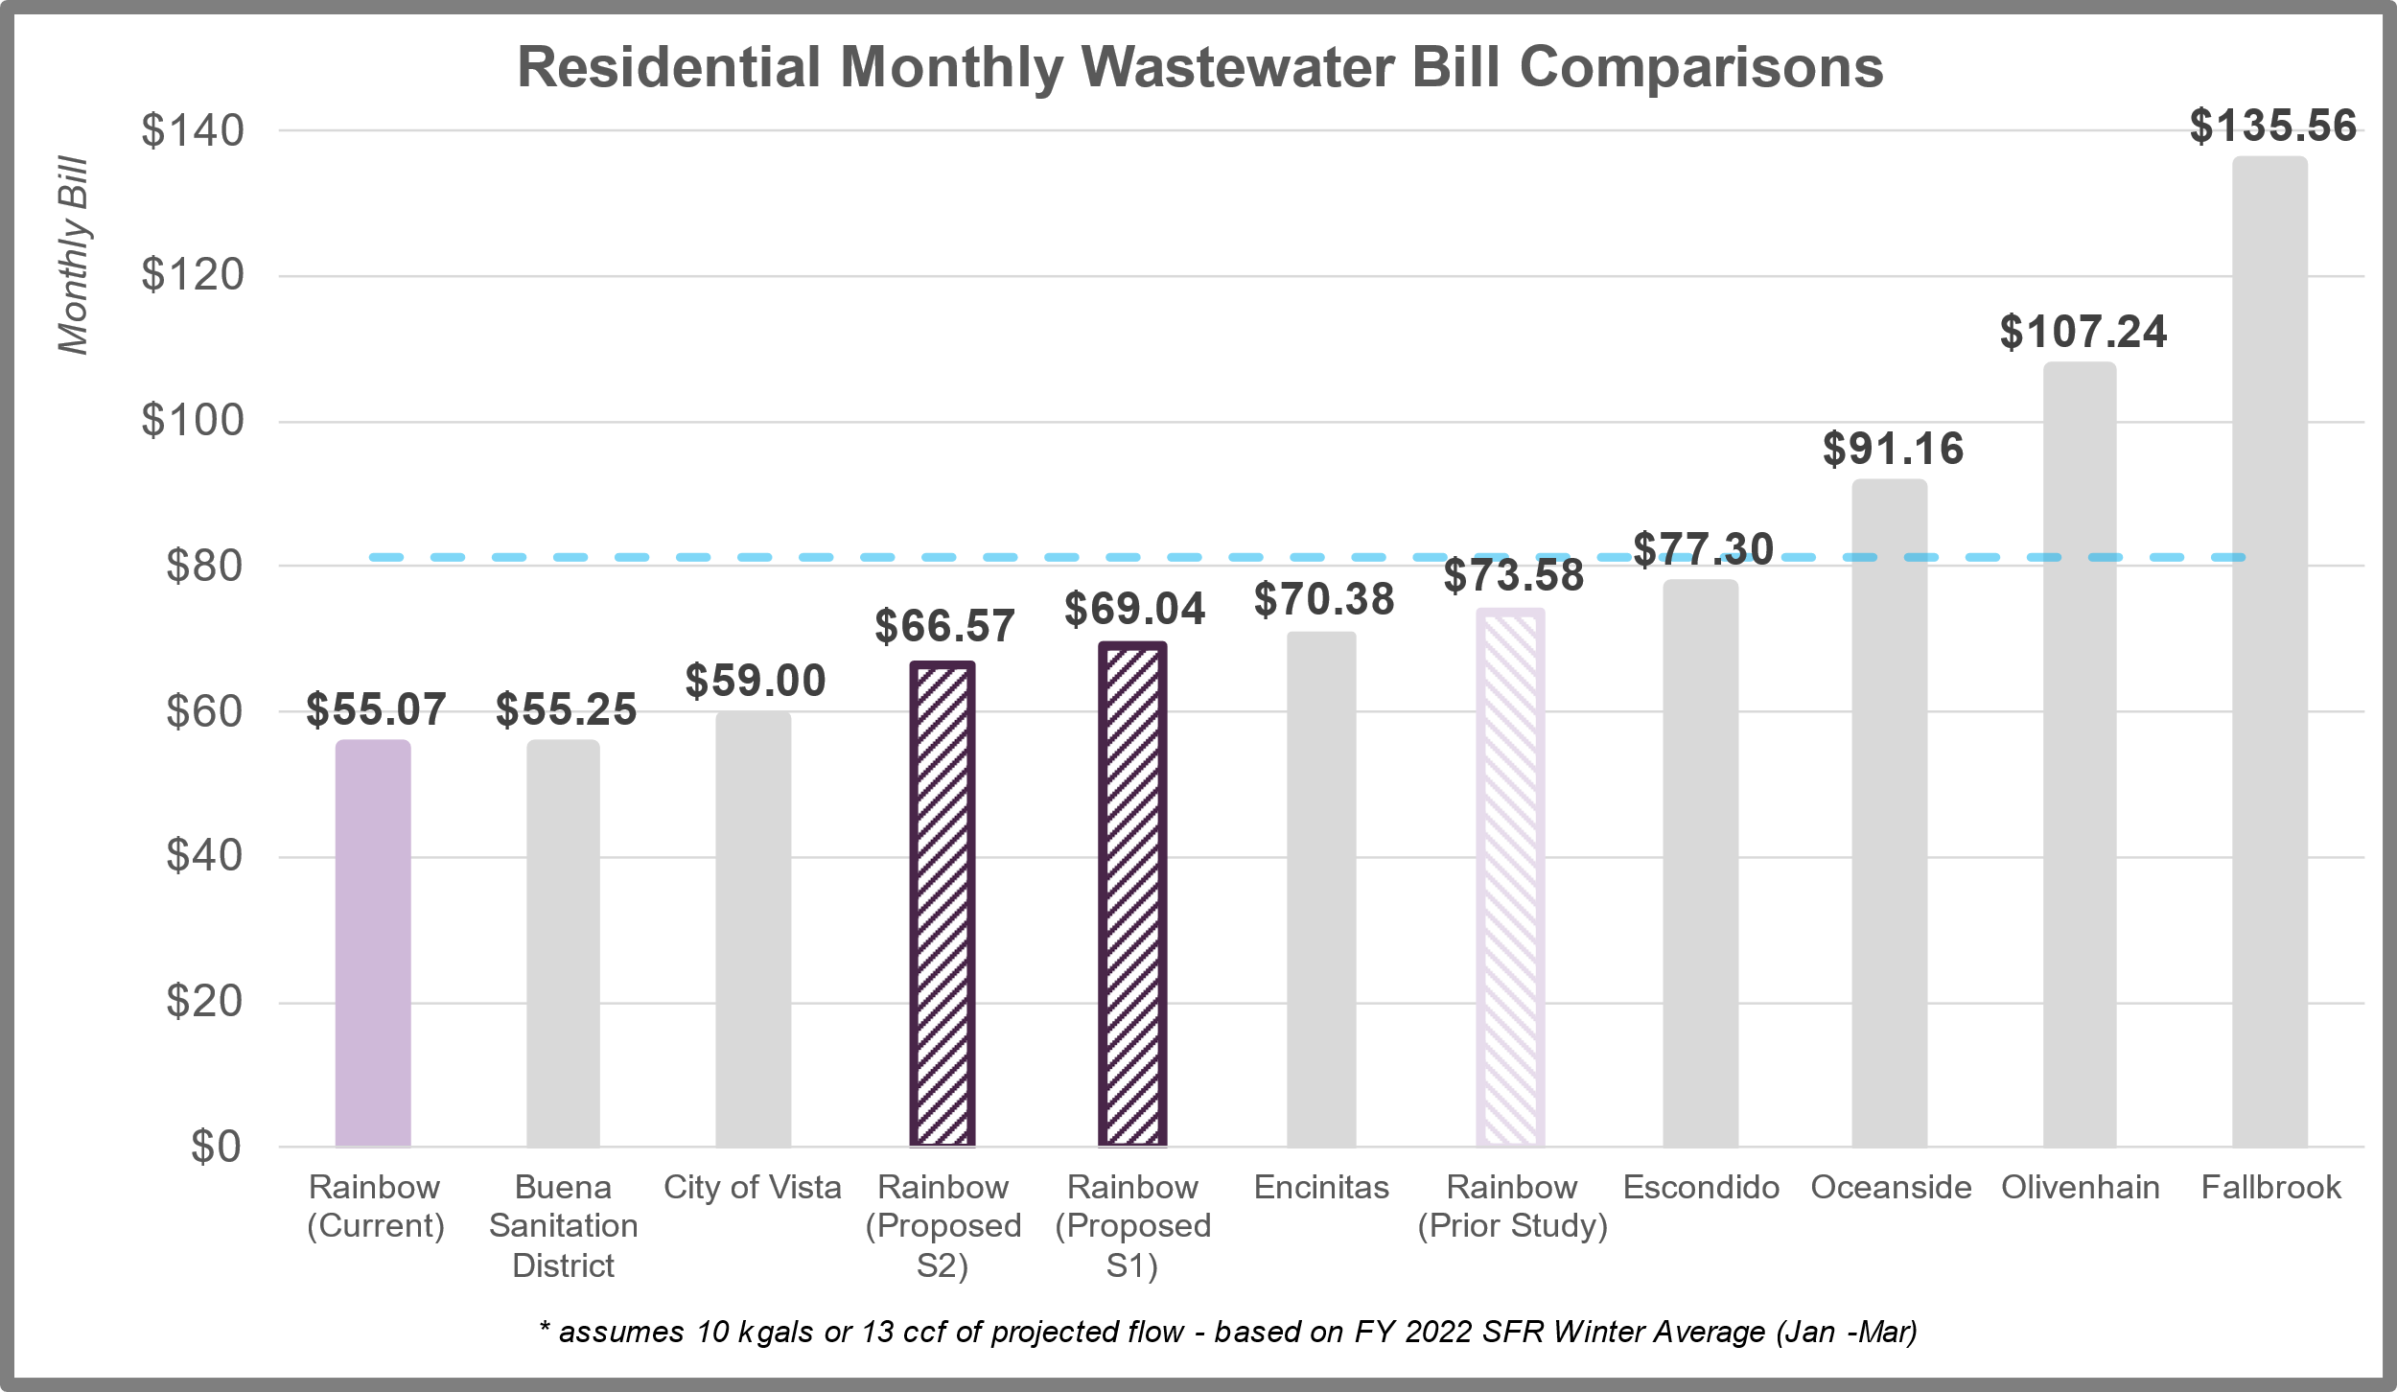
Regional Rate Comparison
Wastewater Monthly Bill

Slide 11
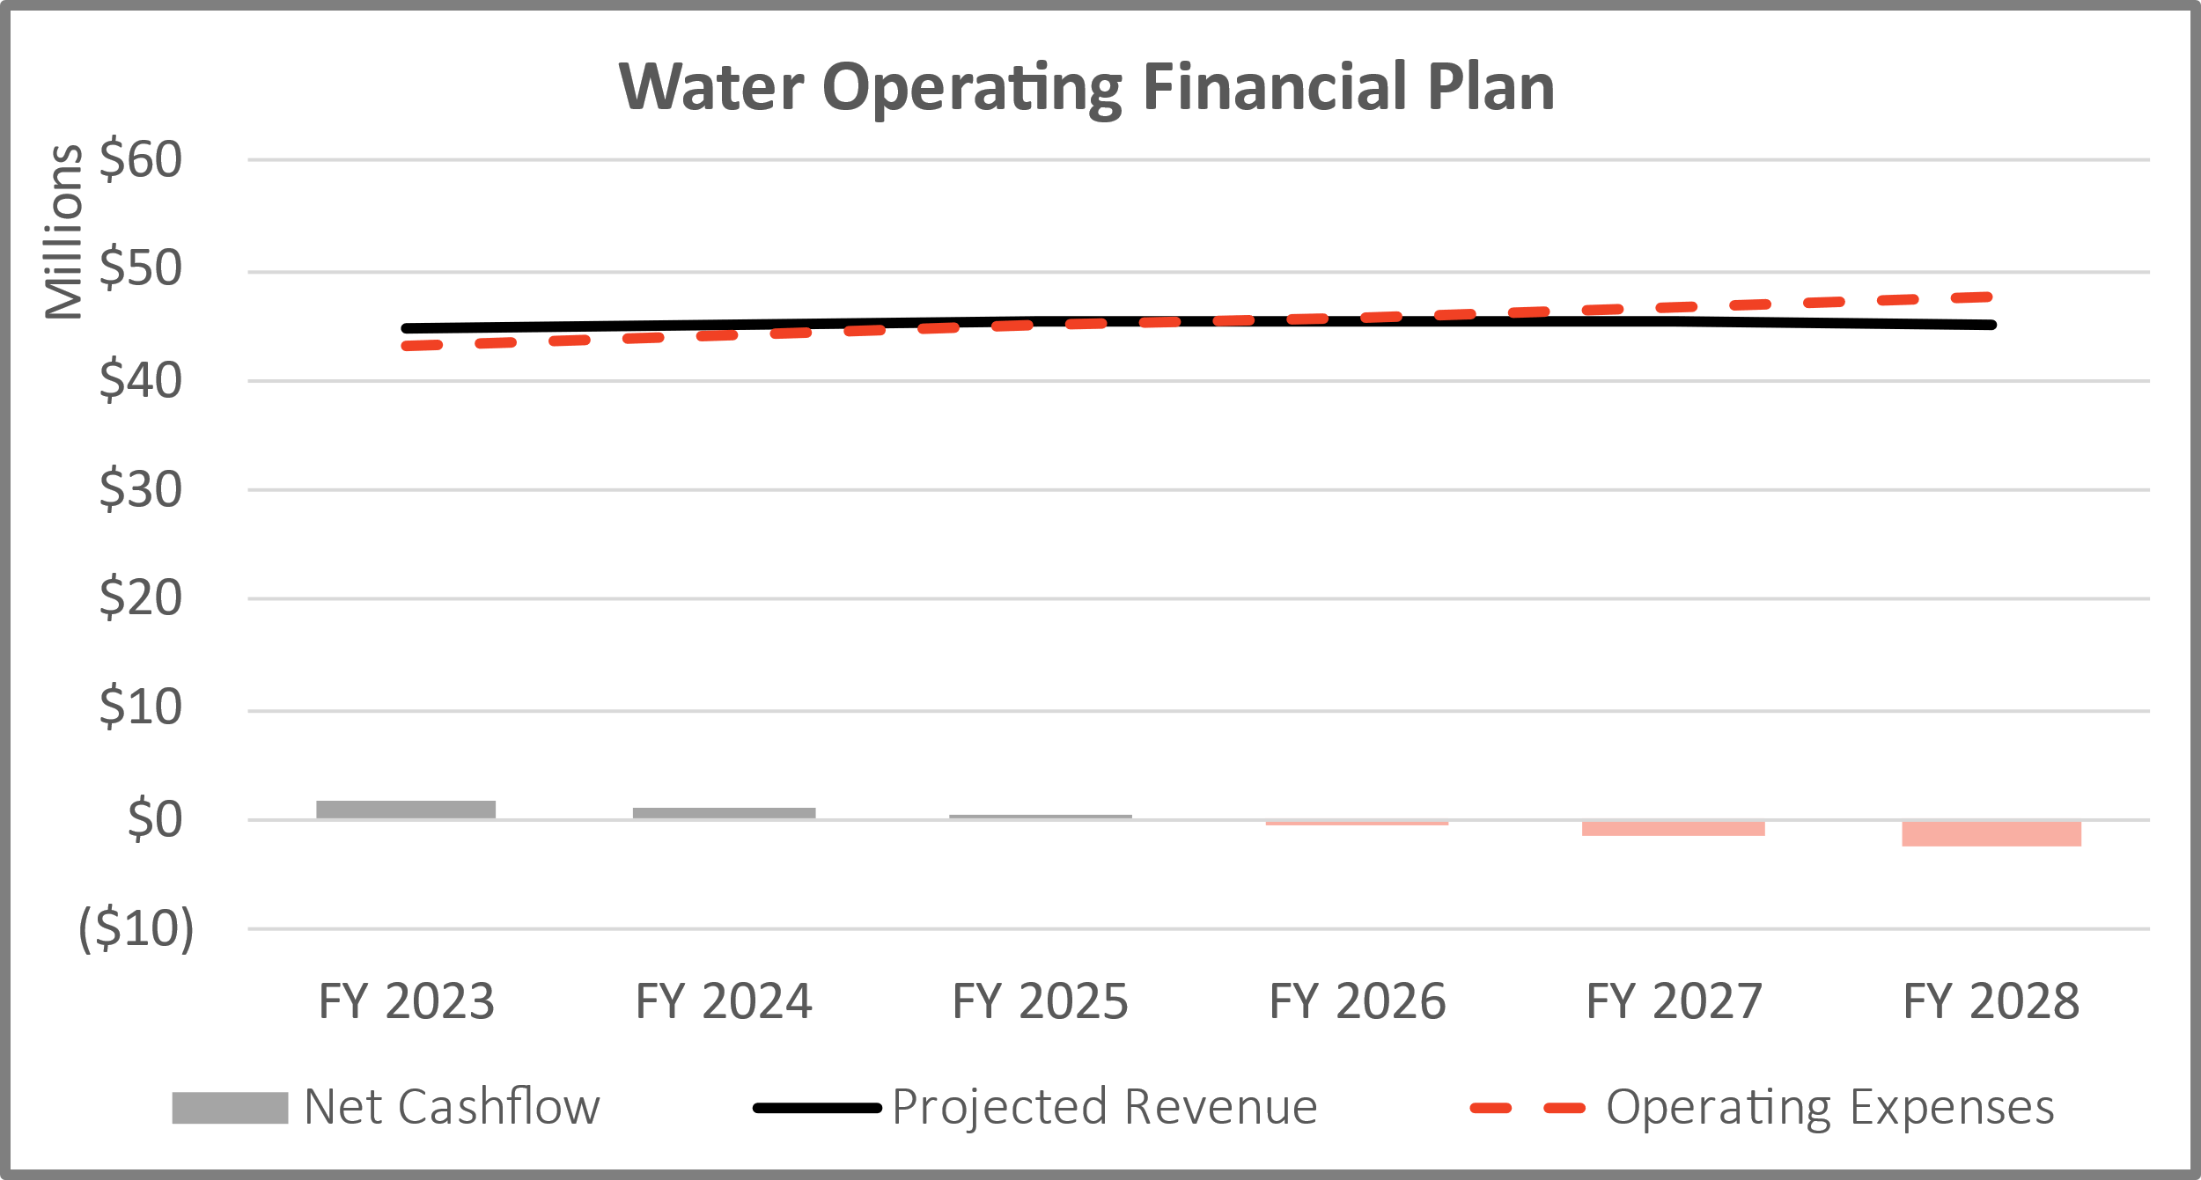
Current Water Financial Position
Current Rates-Cash Flow
Positive Net Cash flow through
FY 2025

Slide 12
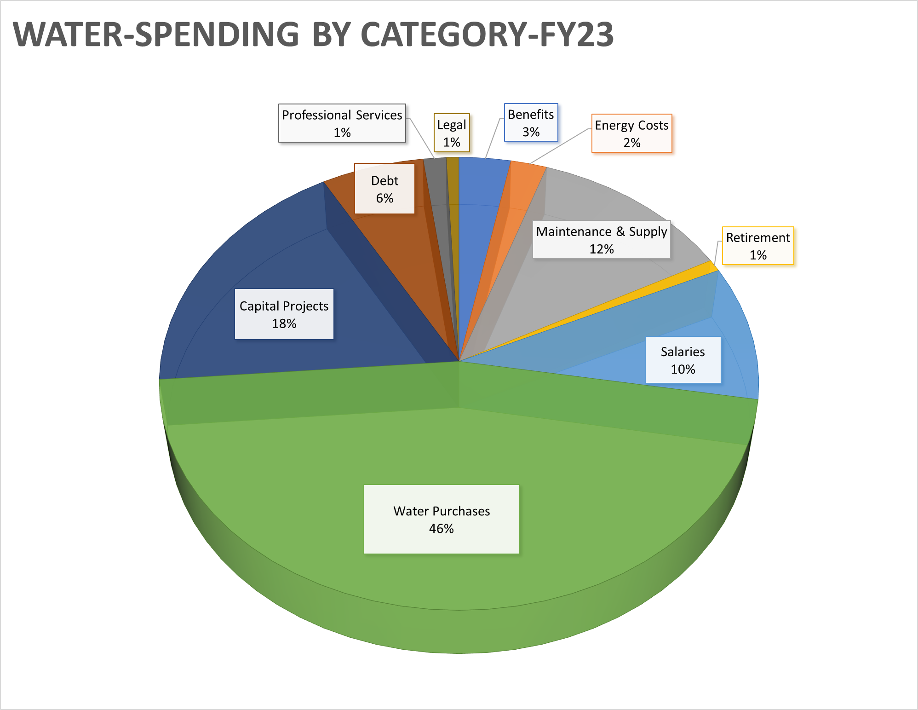

Slide 13
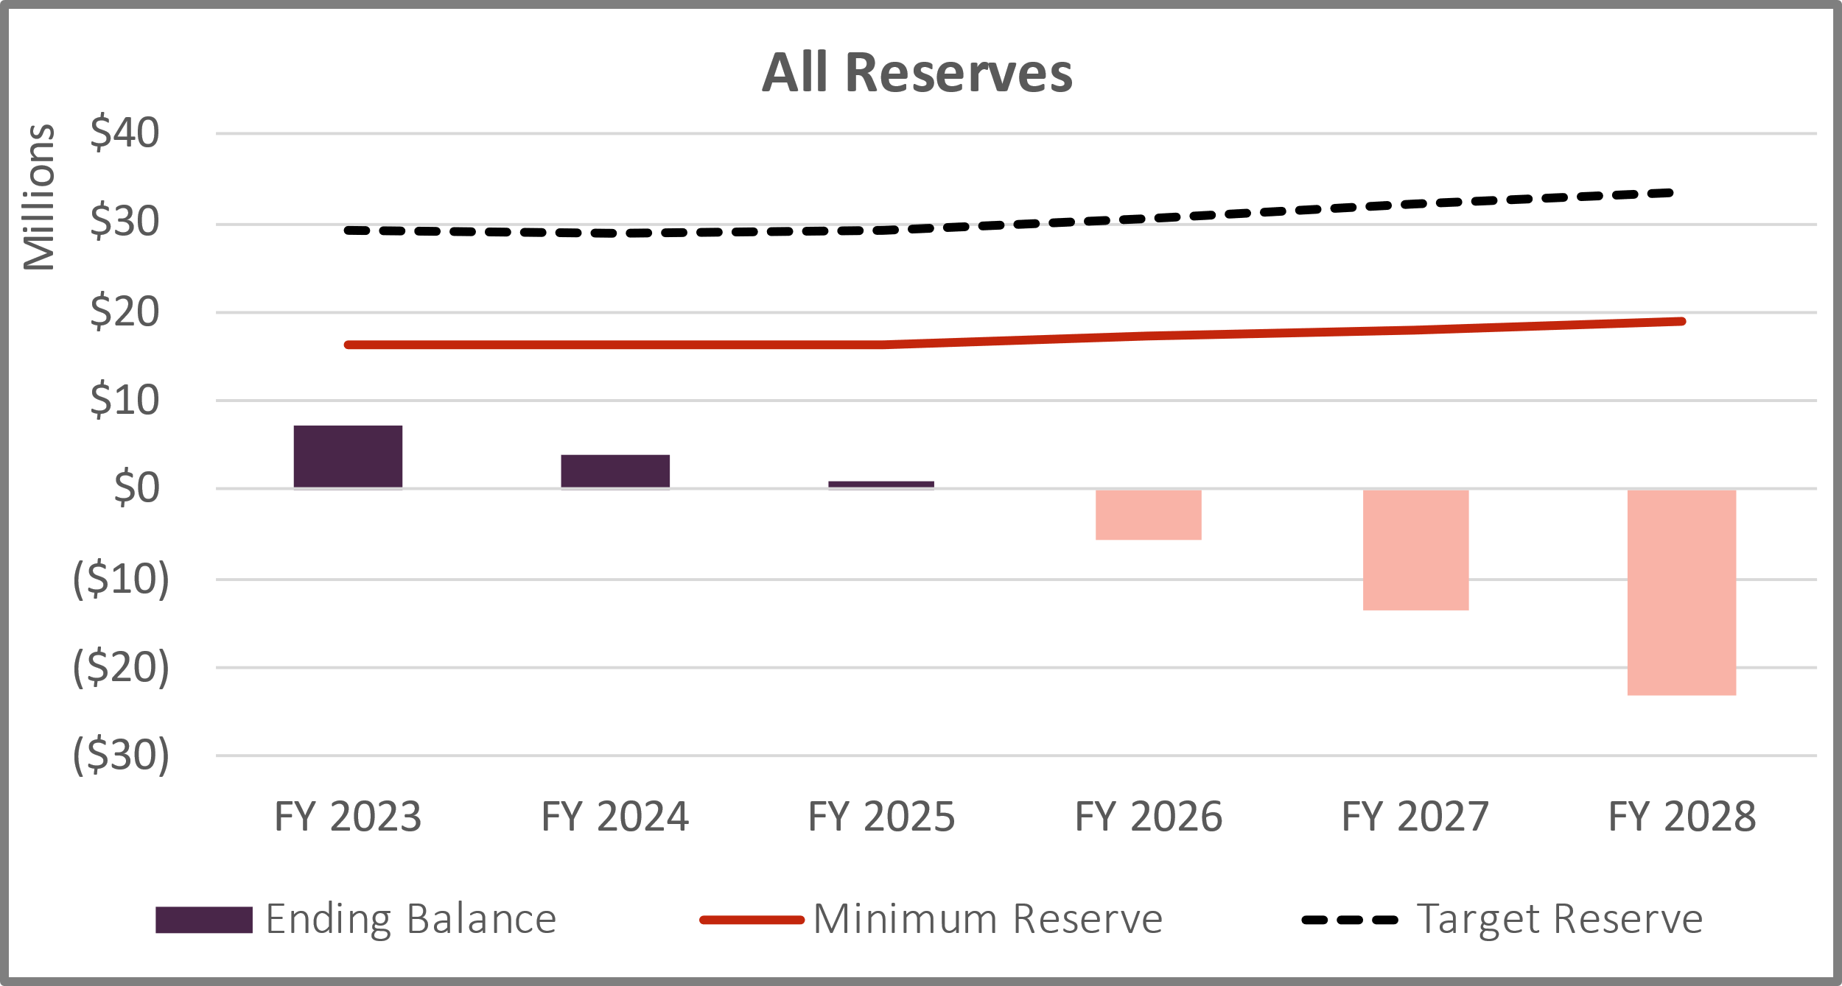
Current Water Financial Position
Current Rates-Reserve Balances
Current Rates do not provide enough funding for capital projects
Includes Wholesale Efficiency Projects, $9.7M funded through loan

Slide 14
Current Financial Position
Water Reserves
Water Reserves | Minimum | Ideal Target
Operating | 60 days of O&M | 90 days of O&M
Water Capital | 1 Year of 5-Year Average CIP | 2 Years of 5-Year Average CIP
Rate Stabilization | 5% of Rate Revenues | 10% of Rate Revenues
New Water Resource | No Minimum | No Target
Liability Self-Insurance | $100k (Fixed Amount) | $100k (Fixed Amount)
FY 2024 Requirement ($) | $17.2M | $30.8M
Notes:
Best practices would be to be at the Ideal Target in case of inflation spike, emergency, and unknown events happening simutaniously

Slide 15
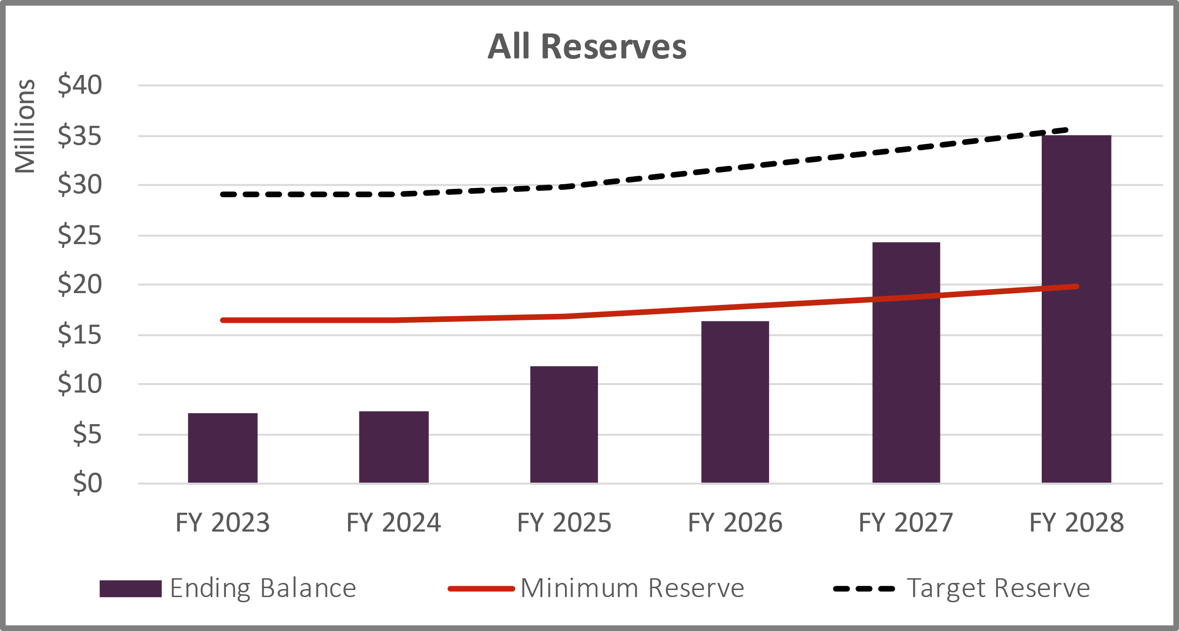
Water Financial Position
Proposed Water Financial Plan
FY2024-FY2028 Revenue adjustments of 8-9% each year
  Net positive cash flow each year
  Sufficiently fund capital needs
  Re-establishes healthy reserves

Slide 16
Water Capital Projects:
Rice Canyon Transmission Line has extended into FY 24 with an additional budget request of $1.5M

Slide 17
Water Projection:
Notes:
Walk through each column here, explaining each row and how it feeds into the next year….

Slide 18
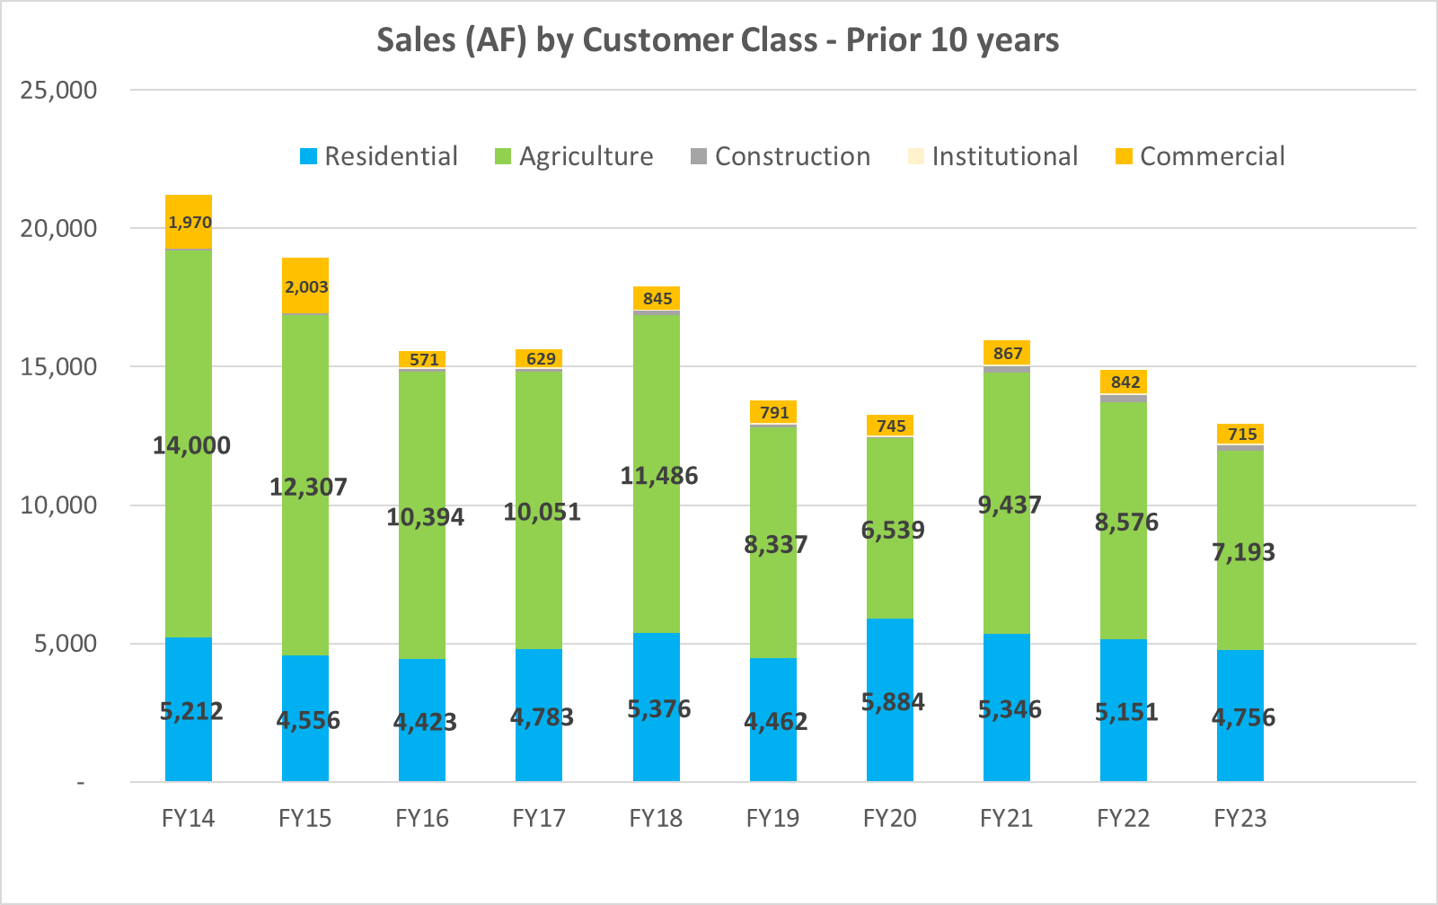
Notes:
Board loved this slide, add to prop 218 notice

Slide 19
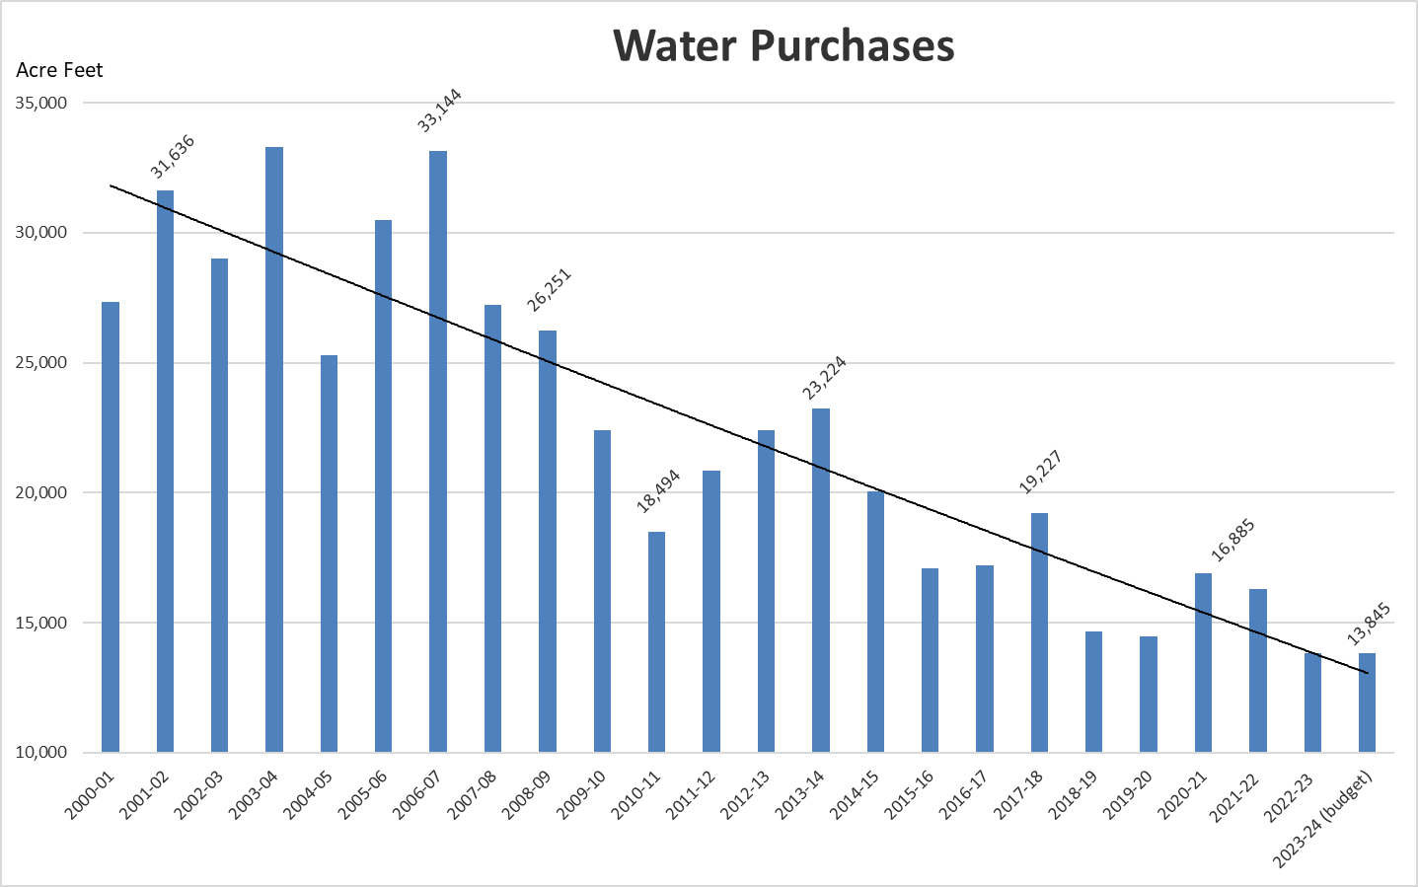
Greatly impacted by weather and changes in usage
  ~63-67% of water usage is generated by 24% of customers (Agriculture)

Slide 20
WATER RATE DESIGN CATEGORIES
Considerations
A significant portion of the District’s costs are fixed.
  It is difficult to recover all fixed costs on a fixed charge
  Study will recalibrate the revenue recovery between fixed and variable
  Fixed cost recovery is trending upwards to 40% or more at other districts
Decreasing demands will increase fixed cost recovery
  The more the district delays increasing fixed cost recovery, the sooner it will happen naturally

Slide 21
RATE STUDY RESULT
Comprehensive Cost of Services study determined:
Current Rates would provide inadequate revenues to operate, maintain, and replace system assets to meet current and long-term needs of the RMWD.
Revenue requirement increases of 8% over the 5-year study period are needed to meet the District’s future financial obligations to ensure safe and reliable water supplies are available 24 hours a day – 365 days per year

Slide 22
Options 1-5: Revenue Adjustment Projections

Slide 23
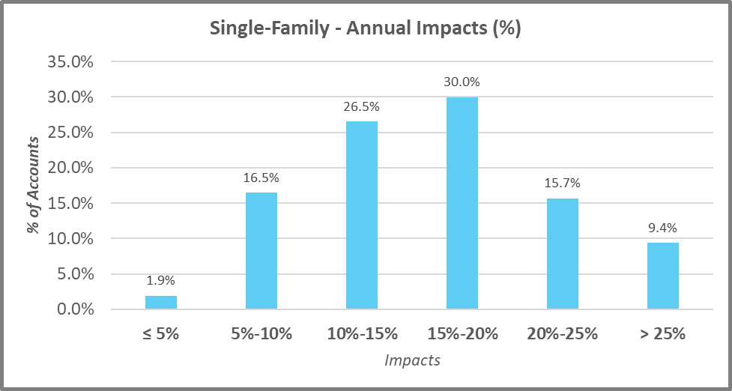
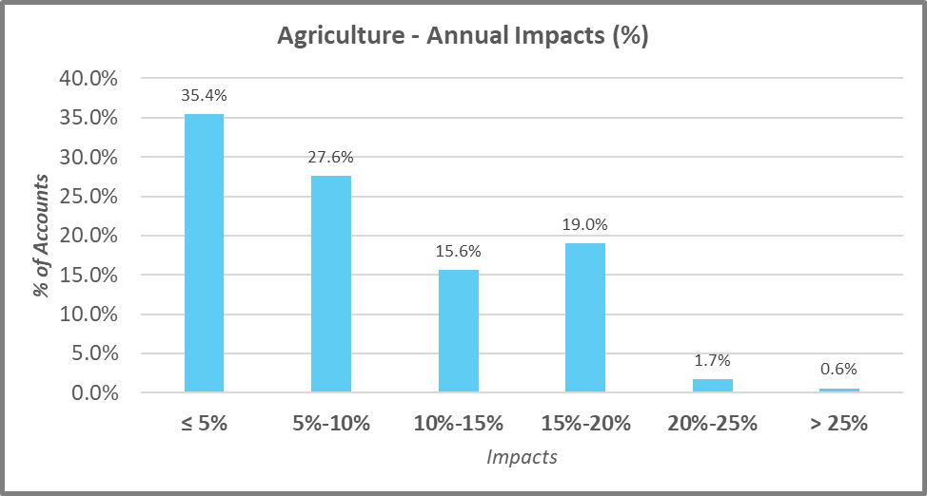
Scenario 1:
Fixed Cost Recovery = 42.2%;
9% Revenue Adjustments
Sales 12,738 AF
Advantages:
More stable revenue recovery
Less impactful on Agriculture
Delays risk of Scenario 4 and 5
Disadvantages:
More impactful on Residential
Notes:
Average customer bill would go up $20 per month for a ¾” meter.

Slide 24
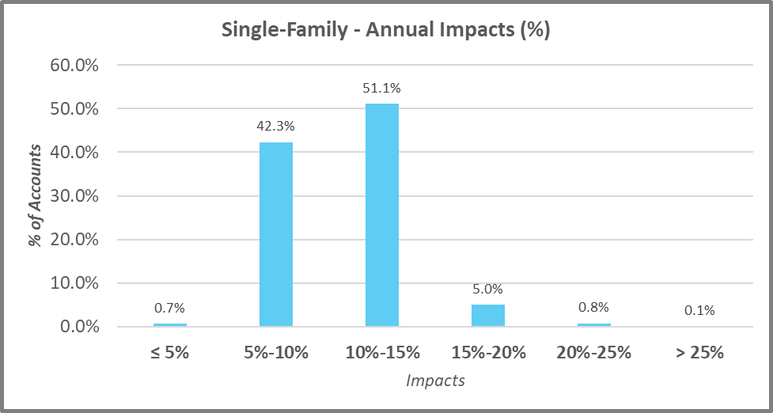
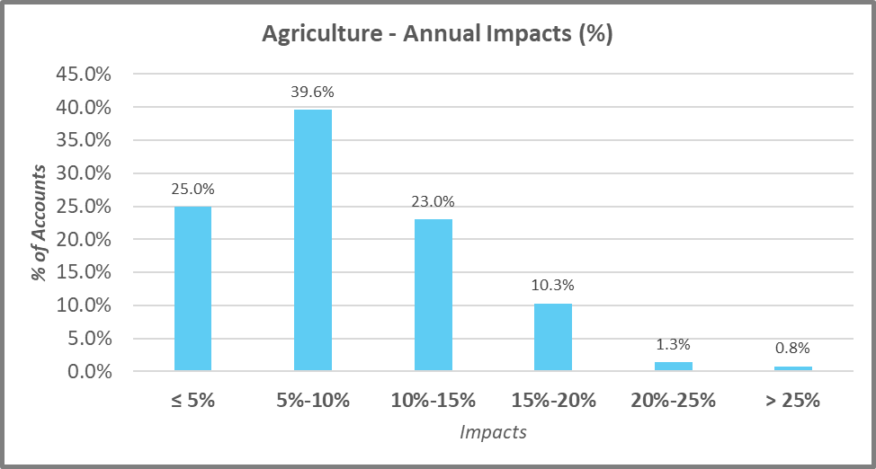
Scenario 2:
Fixed Cost Recovery = 39.9%
8% Revenue Adjustments
Sales 12,738 AF
Advantages:
More stable revenue recovery
Less impactful on Agriculture
Delays risk of Scenario 4 and 5
Disadvantages:
More impactful on Residential
Notes:
Average customer bill would go up $18 per month for a ¾” meter.

Slide 25
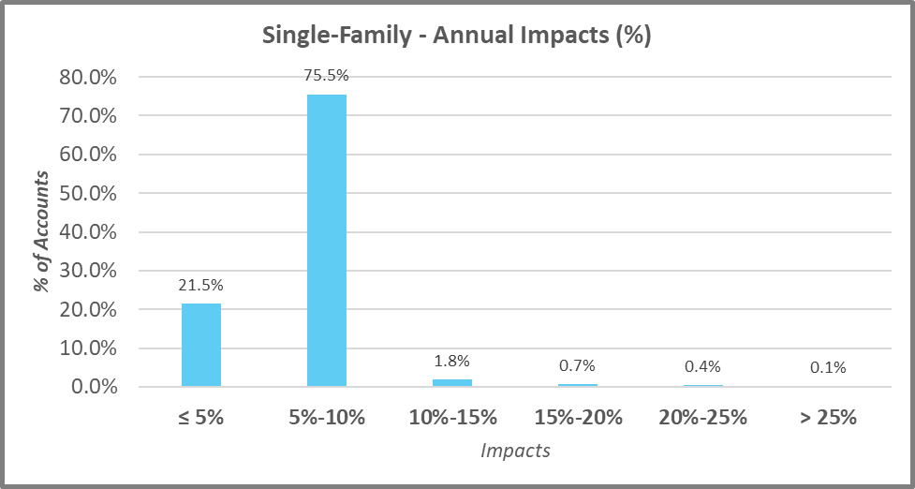
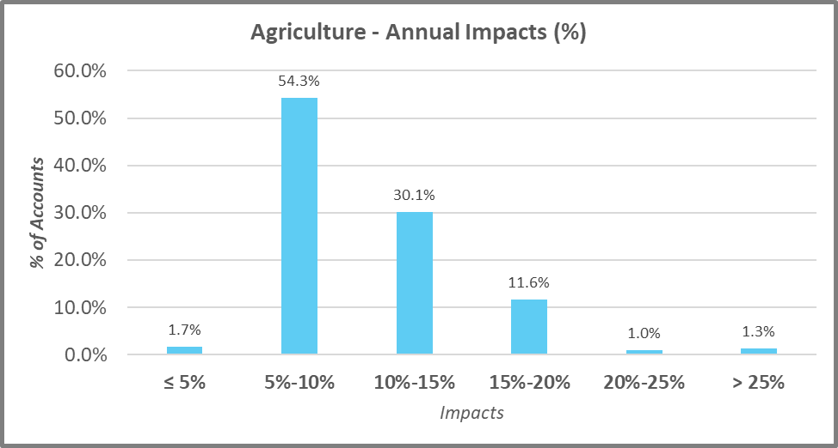
Scenario 3:
Fixed Cost Recovery = 37.7%
8% Revenue Adjustments
Sales 12,738 AF
Advantages:
~Less stable revenue recovery than Scenario 1 & 2
~Less impactful on Residential
Disadvantages:
~More impactful on Agriculture
Notes:
Average customer bill would go up $16 per month for a ¾” meter.

Slide 26
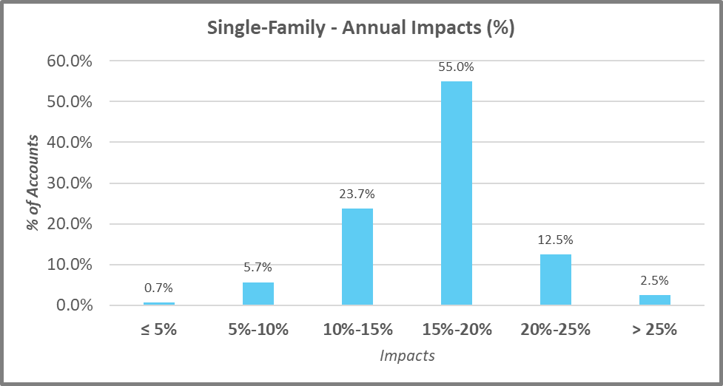
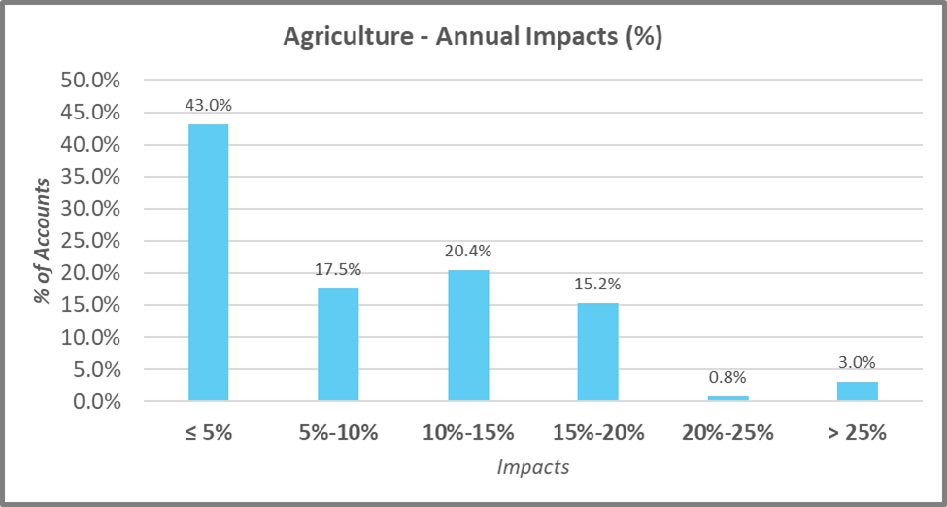
Scenario 4:
Fixed Cost Recovery = 41.6% 12% Revenue Adjustments Sales 8,000 AF
This scenario models the impact of agriculture sales dropping by 50%:
Advantages:
~none
Disadvantages:
~Impactful on Residential

Slide 27
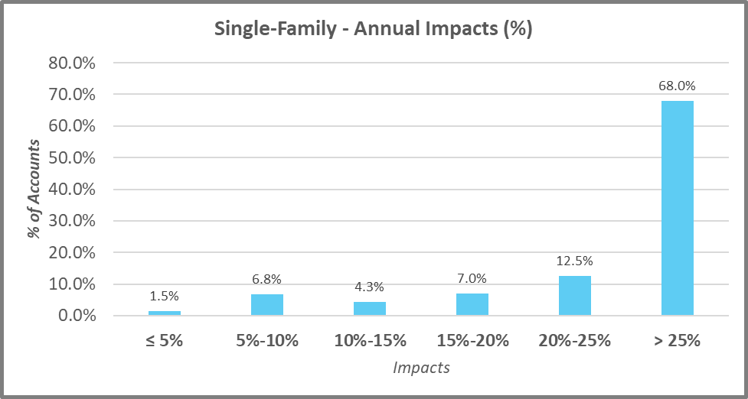
Scenario 5:
Fixed Cost Recovery = 42.5%
16% Revenue Adjustments
Sales 5,000 AF
This scenario models the impact of no Agriculture sales
Advantages:
~none
Disadvantages:
~Impactful on Residential

Slide 28
Options 1-5: Revenue Adjustment Projections
  Staff recommends Scenario 2
  Advantages:
  More stable revenue recovery
  Less impactful on Agriculture
  Delays risk of Scenario 4 and 5 which would have a significant impact on residential in the long run
  Disadvantages:
  More impactful on Residential in the short term

Slide 29
BENEFITS OF RATE INCREASE
Continue to provide a safe, and reliable water supply 24/7
Provide continuous 24/7 – 365 wastewater collection services
Eliminate operating deficit and build up reserves
Leverage technology to benefit our customers
Replacement of aging infrastructure to reduce breaks and emergency shutdowns

Slide 30
Staff recommends the following:
Open the Rate Hearing for June 27, 2023
Wastewater: Option 2 for Proposition 218 Rate Notices
Water: Option 2 for Proposition 218 Rate Notices
Rate notices need to be sent out no later than May 13, 2023, to all property owners within the district for a June 25, 2023, rate hearing.

Slide 31
Questions

