Slide 1
Groundwater Review

Slide 2
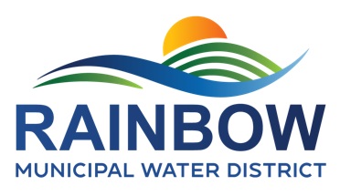
Groundwater
Well Info Request
Water Rights
2003 – Latest known correspondence w/CA SWRCB regarding “native” water rights application by Rainbow. Failed application in late 1970’s/early 1980’s
  Direct diversion of 7.2 cfs, 3,000 AF annually
  Requires extensive study concluding that water is available, environmental impacts are fully mitigated, all challenges resolved
2016 (West Yost) – Rainbow completed a comprehensive study on the capture of return flows, that is, water imported to the area by Rainbow that returns to the groundwater basin.
  Septic, Ag runoff, etc.
  Well established rights by water importing agencies
2023 (Hoch) – Rainbow update return flow analysis in a feasibility study that is currently undergoing USBR review
  2.5 MGD capacity

Slide 3
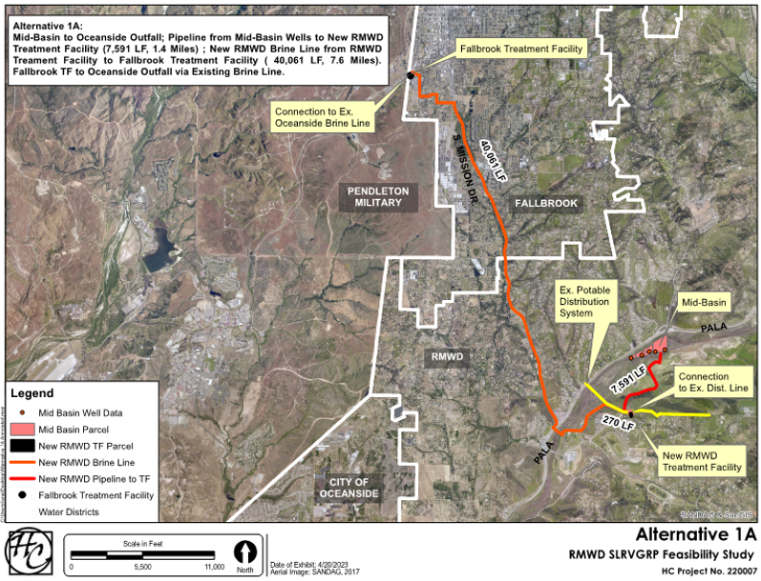
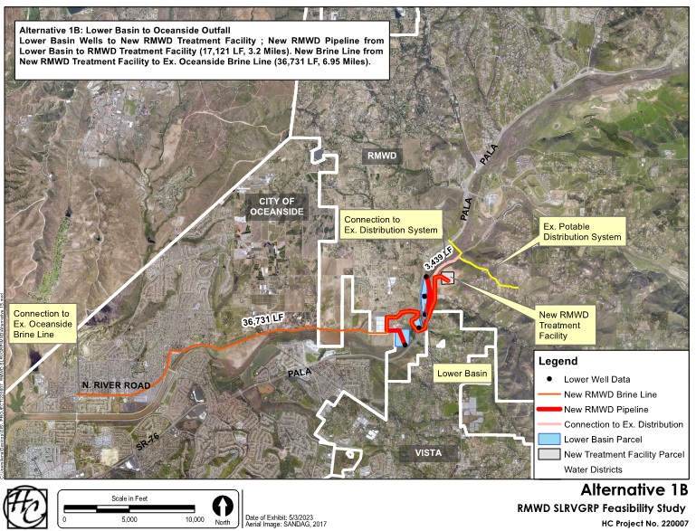
Alternative1 (1A and 1B) – RMWD Project
- $78-$86M Capital Costs
- $3,300/AF

Slide 4
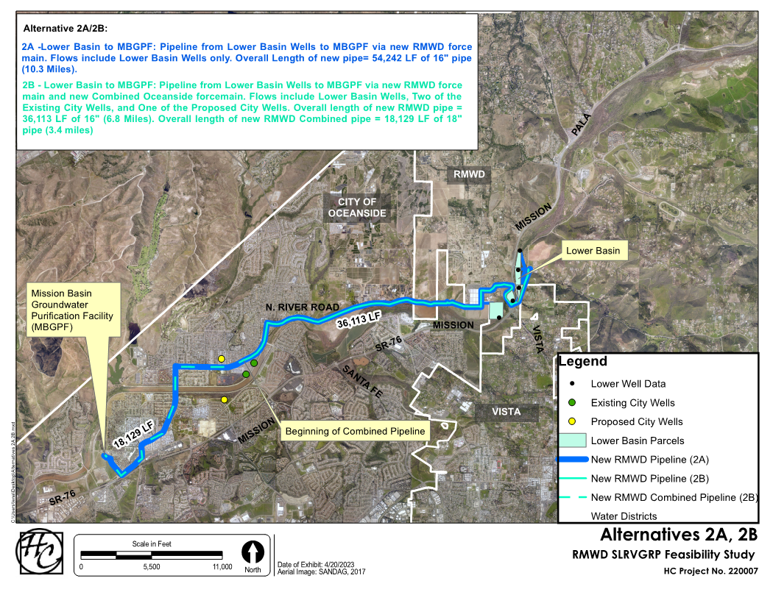
Alternative 2 (1A and 1B) – RMWD/O’side Project
- $70-$78M Capital Costs
- $2,100/AF

Slide 5
Sept 2024 Board Meeting direction to not advance major activities at this time.
Draft Final Feasibility Study complete
USBR preliminary review of Feasibility Study
  Updated w/financials from wholesaler switch
  Comments expected in the next few months
  Address comments and formally submit
Approval of Feasibility Study places the Project in a favorable position for Federal Funding
  Phased funding for planning, design, construction efforts
  USBR Title XVI (25%), WaterSmart (50%), etc.
Current Activities

Slide 6
Discussion

