Slide 1
District Headquarters Project
RMWD Board of Directors Meeting
January 23, 2024

Slide 2
Background
Land
  District Headquarters was built in 1975
  District owns 32.24 acres
  12-14 acres are developable
Environmental/Land Use Constraints
Critical Habitat for Federal and State protected species
FEMA and County of San Diego floodplain
Wetlands
Fuel Modification Zone
Limited Building Zone
Land Use Zoning
VMT/County Mandated Improvements
Notes:
District HQ was constructed in 1975 and has undergone several remodels and expansions of existing structures.
The District owns 32 acres, but only a portion of the acre is developable.
The portion of the District owned land that is able to be developed has a few environmental constraints including wetland, floodplain and critical habitats for protected species.
The land is also already zoned for fuel services, limited building and land use.

Slide 3
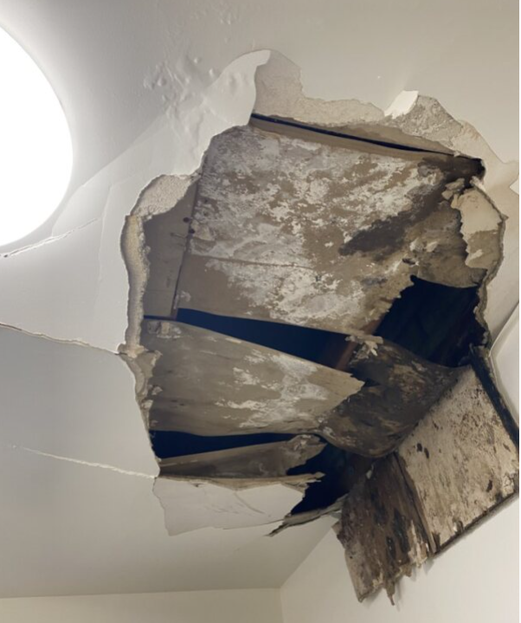
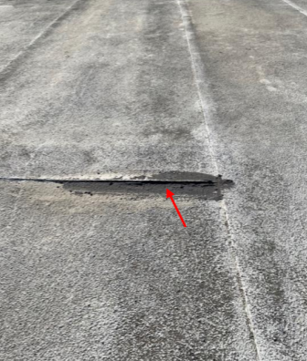
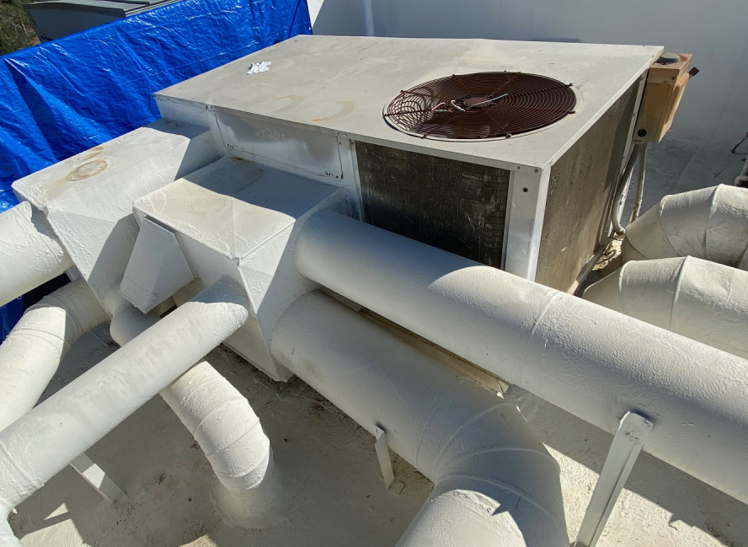
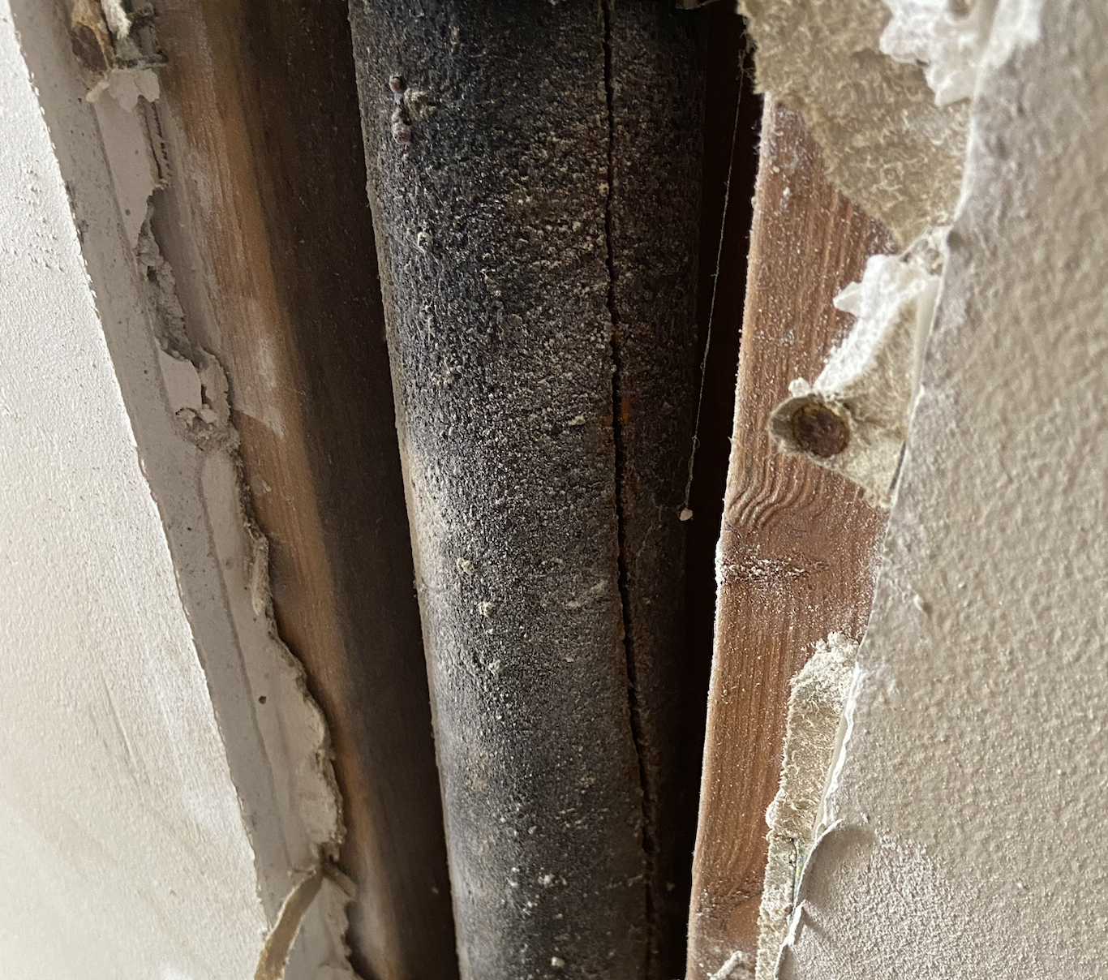
Building Maintenance
Maintenance/Repair Costs
  2019- 2024: $438,475.38
Major Repairs
  Sewer and Vent Pipe Repairs at Building 1
  HVAC at Building 1, Building 3, and Temporary Trailers
  General Repairs with Handy Man
  Ongoing Roof Repairs
  Flood repairs in Building 2
  Ongoing Gate Maintenance
  Trailer Rentals
Notes:
Since 2019, the District has paid approximately $400,000 to repair and maintain the existing structures.
Major repairs include HVAC repairs and upgrades, roof repairs, upgrades to the security gates, and flood repairs.
Costs for regularly scheduled maintenance on the slide gates, general repairs by the handy man on an as needed basis, and trailer rentals will continue to increase as the current infrastructure ages.

Slide 4
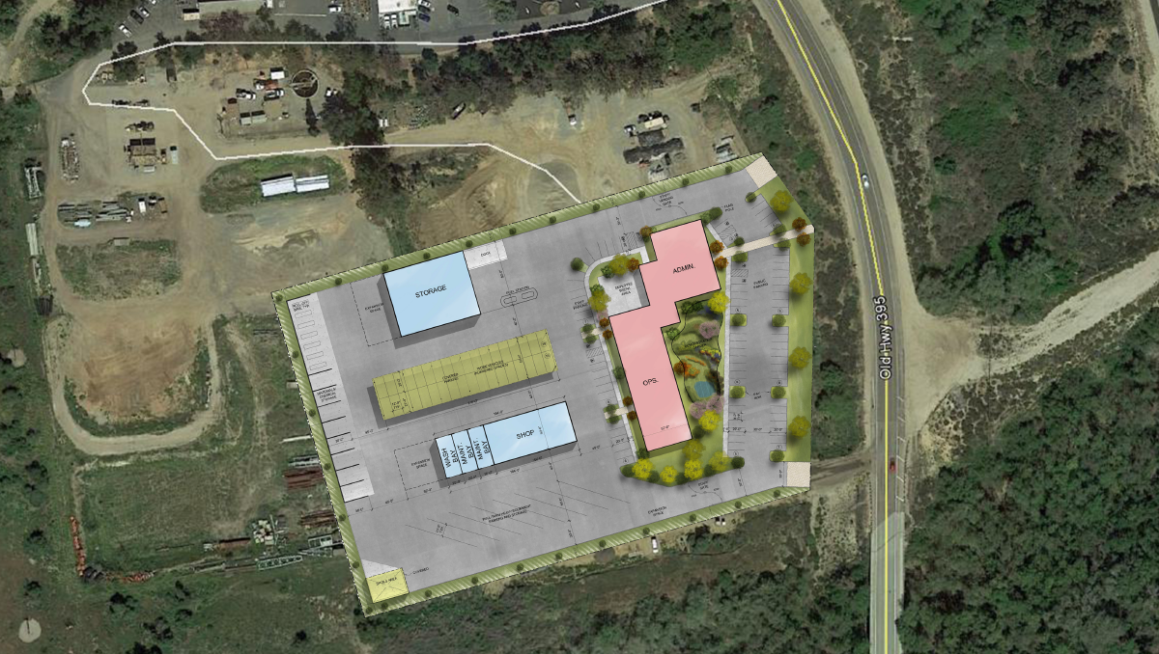
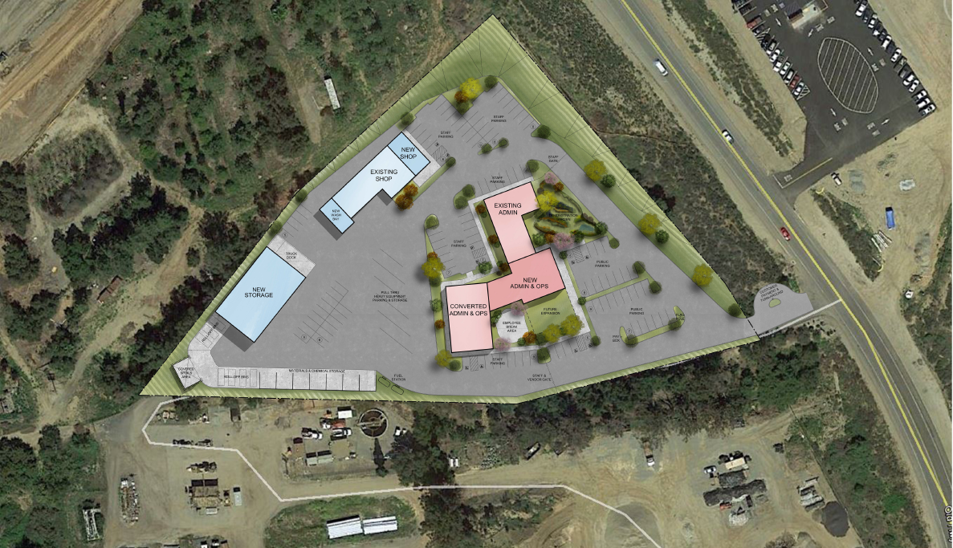
2016 Concept Study Report by HB&A Architects
Option 1 – New Facility in Lower Yard
Estimated cost: $15,900,000 (2016 monies)
Option 2 – Remodeled Facility
Estimated cost: $7,200,000 (2016 monies)
Notes:
In 2016 HB&A Architects performed a Concept Study Report. The purpose of this study was to compare building options for a new and remodeled operations and administrative facility on District property. Main goal of study was to determine the smallest-sized facility possible to continue normal District operations.
Option 1 consisted of building an entirely new facility on 5.78 acres, which would cost $15,900,000.
Option #2 consisted of remodeling the existing facility on 4.3 acres, which would cost $7,200,000.
4. It is worth noting that the 2016 effort did not include a scope of work for a market analysis or detailed land use analysis, which is why the District decided to move forward with additional studies.

Slide 5
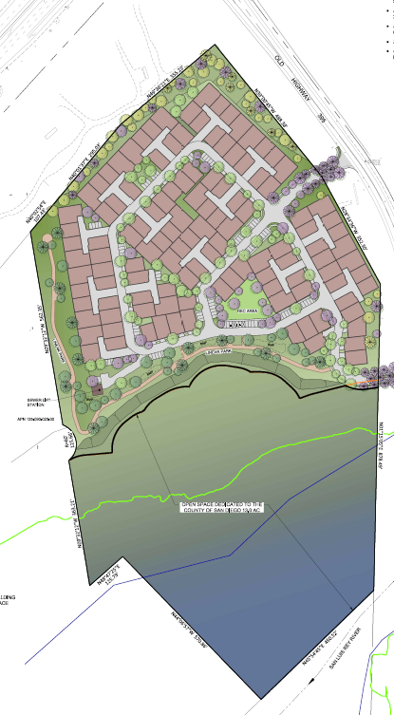
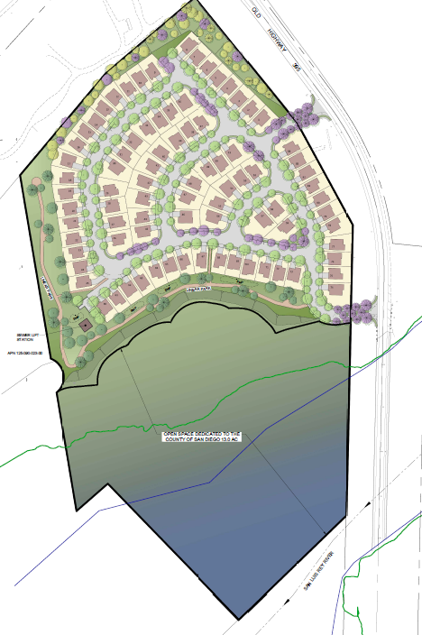
2020 -2021 Market Study by Reeb Development Lot Study by MasterCraft
Option 1 – Motorcourt (165 SFD)
Option 2 – Single Family Homes (107 SFD)
Notes:
1. In 2020, Reeb Development conducted a marketing study to assess the highest and best use for the District’s property. Reeb analyzed retail, office, industrial, hotel, multi-family, and single-family for sale options. They determined small lot single family detached homes at a density of +/- 12 dwelling units per acre to be the best use. This would mean that approximately 107– 165 dwelling units could be constructed on the District’s property and would allow for roads and common space areas.
2. From 2020 – 2021, Mastercraft prepared a conceptual lot study for the District to explore development options for the District property. Site layouts, floor plans and elevations were prepared for two options; Option 1: Motorcourt with 165 dwelling units and Option 2: 107 single-family homes. Mastercraft’s experience and knowledge in navigating the development process in San Diego County helped the District better understand all that would be required for redeveloping the District’s property. Mastercraft partnered with a team of Consultants to determine the District’s needs, maximum return on investment and existing conditions that would impact development.
3. These are example concept layouts for each development option and will be revised after we receive input from the County of San Diego on buffer sizes or setbacks and other requirements. We plan to adjust the development layout to whatever option most likely guarantees a general plan amendment.

Slide 6
District Headquarters Options
Option 1 – Relocate to Temporary Trailers and Build in Place
Option 2 – Entitle and Sell Land, Buy New Land, and Build New
Option 3 –
Remodel Existing Building
Notes:
Current Options:
1. Relocate District staff to temporary trailers in the lower yard and build in place
2. Sell the land and buy property elsewhere in the District then build a new building
3. Keep staff in the buildings and commence remodeling existing structures

Slide 7
Next Steps
Ad Hoc Committee
  Further Refinement of Options
  Schedule Development
  Update Cost Estimates
Notes:
An Ad Hoc committee is requested to explore options for remodeling or updating the District’s headquarters.

Slide 8
Questions?

